Slide 1

Embracing diversity through education Regional Conference , Tirana, 6-7 November 2013
Policy workshop:
How inclusive are the policies?
Moderator:
Raisa Venäläinen
raisa.venalainen@kolumbus.fi

Slide 2
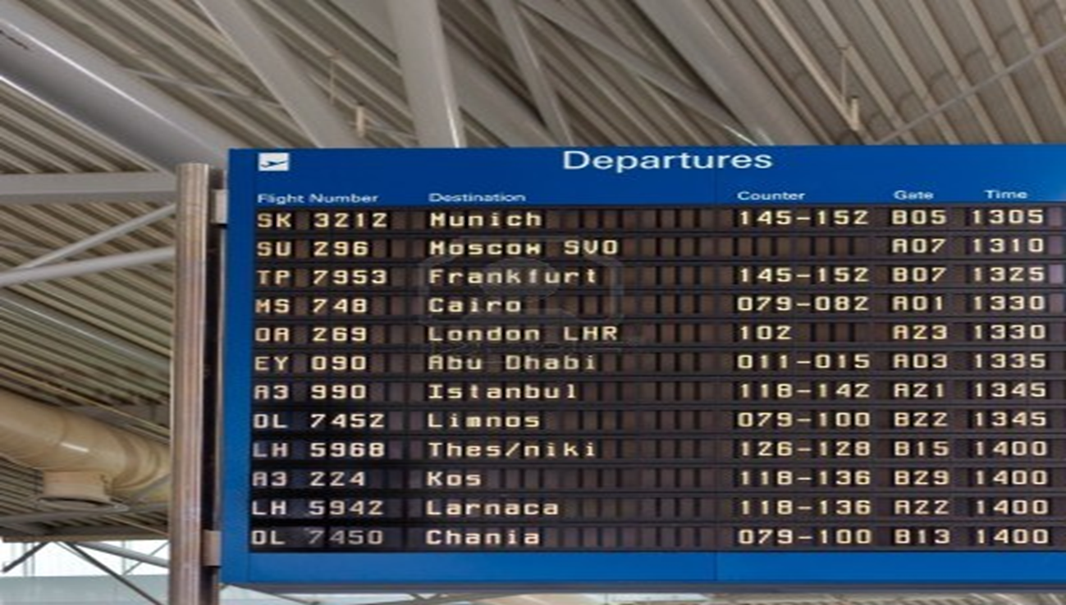
Vision is our Destination

Slide 3
Objectives for the Workshop
To describe existing policies: What policies exist?
What are the gaps and struggling points?
2) To design action steps that will take education systems in SEE towards the vision for inclusive education

Slide 4
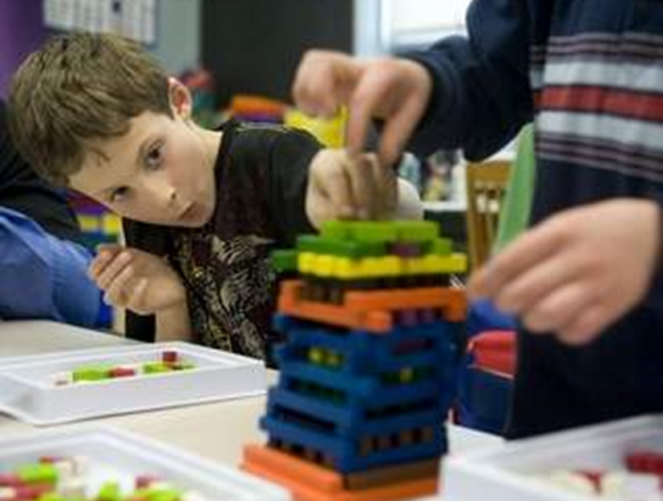
Three perspectives and entry points: What policies exist, where are the gaps and struggling points?
Entry point 1:
By theme: ACCESS, LEARNING, PROGRESSION
Entry point 2:
By education level: pre-school, primary, secondary, secondary/VET
Entry point 3:
By target group/ beneficiary (e.g. individuals, teachers, schools, municipalities, inspection etc.)

Slide 5
Examples
Access | Policies and measures promoting access and enrollment to schools, e.g Financial support, Transport, Support to registration for Roma etc.
Learning | Quality measures promoting learning and preventing drop-out, e.g. Meals, Adaptations (curricula and standards, instructison, assessment, school level adaptations) Support measures: Individualization and differentiation Pedagogical Assistants Extra curricular activities etc.
Promotion | Student guidance and counselling Support to transition Affirmative actions 10th grade Orientation and introductory courses

Slide 6
What policies exist? What are the gaps and struggling points?
 | ACCESS | LEARNING AND ATTRITION | PROGRESSION
Pre-school education
Primary education
Secondary ducation
VET
Other (if needed)

Slide 7
Procedure
Mixed groups
Select a raporteur in a group
Agree language and interpretation issues
Brief self introduction within a grop
… and then let’s start

Slide 8
Programme of today
MORNING SESSION What is the reality of inclusiveness and dicvrsity in education in South Eastern Europe?
9.30 | Orientation
10.00 | Group discussion on policies and policy gaps
11.00 | Coffee break
11.20 | Sharing of findings, additional contributions
12.30 | Lunch
AFTERNOON SESSION What are the steps that talk us from where we are to the desired results and vision?
13.45 | Plenary session at Balsha Room
14.15 – 15.30 | Development of Action Steps
15.30 | Coffee
16.00 | Conclusions – plenary session
17.00 | End of Conference

Slide 9
Action Steps

Slide 10
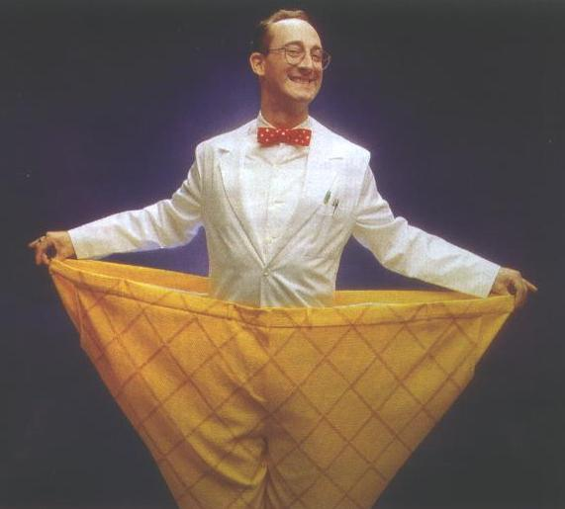
One size does not fit all
What concrete actions you can take home with you?

Slide 11
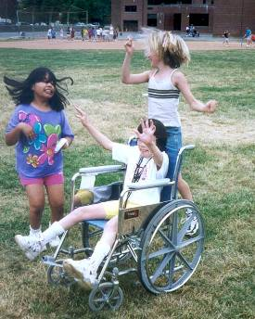
Thank you!

