Slide 1
MAPPING OF YOUTH RESEARCH STRUCTURES, KEY STAKEHOLDERS AND DATA COLLECTIONS IN EUROPE
IGNATOVITCH Alena
PETKOVIC Sladjana
Pool of European Youth Researchers (PEYR)

Slide 2
METHODOLOGY AND OBJECTIVES
Q1: WHAT STRUCTURES AND ACTORS PLAY A ROLE IN KNOWLEDGE-GATHERING, TRANSFER AND DISSEMINATION IN THE YOUTH? | Q2: WHAT TYPES OF RESOURCES AND DATA COLLECTIONS ARE AVAILABLE?
2.1. Departments in universities gathering knowledge on youth 2.2. Major public and semi-public bodies dealing with youth research 2.3. Private companies dealing with youth research | Data collections gathered by the state statistical offices and other public, semi-public and private actors which provide updated statistics on youth (3.1, 3.2) Data collections gathered by either semi-public or private actors which does NOT provide updated statistics on youth (3.3) Data collections supporting development of youth policy and youth work (3.4)
2.4. Statistical offices that collect statistics on youth 2.5. NGOs gathering knowledge on youth | 3.5. Regular youth reports (local, national) 3.6. National journals and reviews on youth research
2.6. National and transnational youth knowledge (research) networks supporting youth policy | IT knowledge dissemination tools (3.7); Priority areas/topics (3.8); Challenges in data collection/dissemination (3.9)

Slide 3
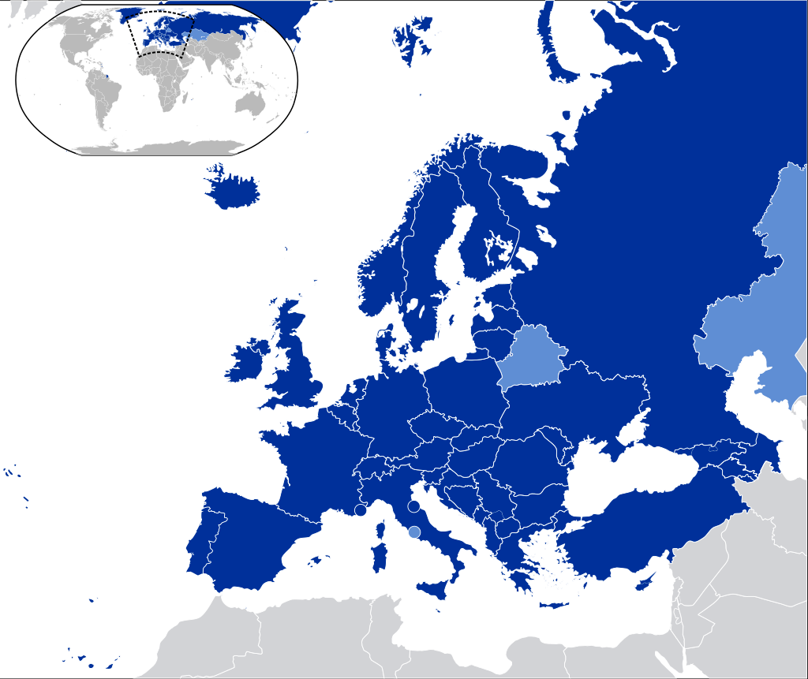
European Cultural Convention signatories
Mapping report relies on the data review of the 110 country sheets with focus on an evidence-based youth policy and youth work:
34 EACEA Youth Wiki reports;
10 Contributions of non-programme countries to EACEA Youth Wiki (Albania, Armenia, Belarus, Bosnia and Herzegovina, Georgia, Kosovo, Moldova (Republic of), Montenegro, Serbia, Ukraine);
the 42 EKCYP country sheets on youth policy;
the 24 EKCYP country sheets on youth work
the secondary was then followed up with an online qualitative questionnaire:
15 completed questionnaires were submitted from 12 countries (Belarus, Bulgaria, Croatia, Czech Republic, France, Germany, Poland, Portugal, Romania, Serbia, Sweden, United KIngdom)
https://www.coe.int/en/web/conventions/full-list/-/conventions/treaty/018

Slide 4
2. STRUCTURES AND ACTORS THAT PLAY A ROLE IN KNOWLEDGE-GATHERING, TRANSFER AND DISSEMINATION IN THE YOUTH - Key findings
2.1. Departments in universities gathering knowledge on youth
2.2. Major public and semi-public bodies dealing with youth research
2.3. Private companies dealing with youth research
2.4. Statistical offices that collect statistics on youth
2.5. NGOs gathering knowledge on youth
2.6. National and transnational youth knowledge (research) networks supporting youth policy

Slide 5
3. NATIONAL STATISTICS AND ACCESSIBLE DATA SOURCES ON YOUTH - Key findings
3.1 Data collections gathered by the state statistical offices which provide updated statistics on youth
3.2 Data collections gathered by semi-public and private actors which provide updated statistics on youth
3.3 Data collections gathered by either semi-public or private actors which does NOT provide updated statistics on youth
3.4 Data collections supporting development of youth policy and youth work
3.5. Regular youth reports (local, national)
3.6. National journals and reviews on youth research
3.7. IT information dissemination tools
3.8. Priority themes in the field of youth research
3.9. Challenges in collecting statistics and data on youth / youth policy / youth work

Slide 6
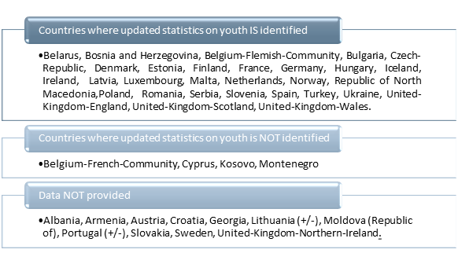
Figure 2: Data collections which provide updated statistics on youth per country

Slide 7
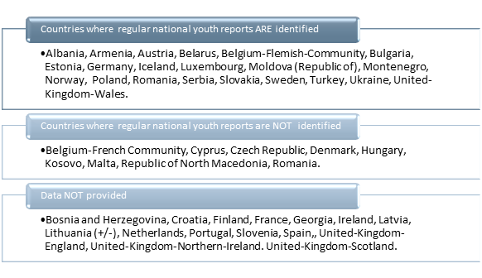
Figure 3: Regular youth reports per country

Slide 8
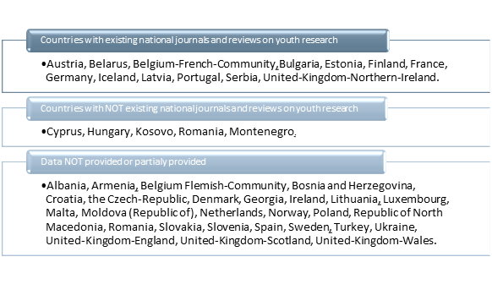
Figure 4: National journals and reviews on youth research

Slide 9
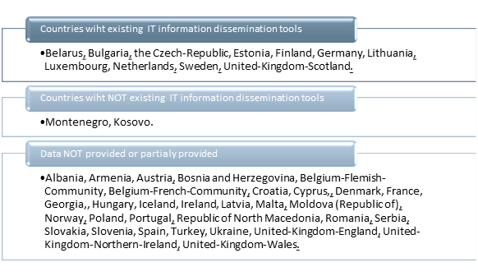
Figure 5: IT information dissemination tools

Slide 10
4.GOOD PRACTICE EXAMPLES RELATED TO FOSTERING A BETTER KNOWLEDGE ON YOUTH
Sweden: the Swedish Agency for Youth and Civil Society, A thematic in-depth study from that is called Fokus.
Portugal: The Permanent Youth Observatory is a research program conducted at Institute of Social Sciences, University of Lisbon, specialized in the field of youth in Portugal.
Norwegian Social Research (NOVA) at the Centre for Welfare and Labour Research at OsloMet (Oslo and Akershus University College of Applied Sciences) develops multidisciplinary research on youth in Norway.
Luxembourg. The research group “Youth Research: Context and Structures of Growing-up” at the University of Luxembourg is the main youth research group in Luxembourg.
Ireland: The Youth Participation Unit in the Department of Children and Youth Affairs (DCYA) and Hub na nÓg regularly conduct consultations with children and young people on issues that affect their lives.
Germany: To improve the access to the European Youth Wiki and its information, a new entry point was set up by creating a so-called Youth Wiki space at the national portal for experts in child and youth services (Fachkräfteportal der Kinder- und Jugendhilfe, FKP).
Annex 3: Relevant publications on youth across Europe

Slide 11
5. CONCLUSION
A variety of actors and structures are involved in enhancing a better knowledge on youth in Europe. Some structures (university departments, statistic offices, government funded or independent research institutes, and other public bodies responsible for youth research) exist in the majority of the countries addressed. Other structures (private companies and non-governmental organisations) vary in types, but their role in youth knowledge gathering still needs to be clarified or improved. Knowledge networks are rarely recognized and formally supported at the national level. Youth researchers and experts have gained significant visibility in certain countries.
Cross-sectoral cooperation and institutionalized dialogue between all the actors of the “youth triangle” needs to be further promoted and advocated.
A centralized, integrated and regularly updated statistical system on youth is needed.
Limited availability of knowledge and data sources and collections at the country level. IT knowledge dissemination tools - knowledge gaps identified!
The lack of system of continuous documentation or study on youth work.
Priority areas of youth research at the national level are still aligned with policy domains of the previous EU Youth Strategy 2010-2018.

Slide 12
Q&A
Thank you!

