Slide 1
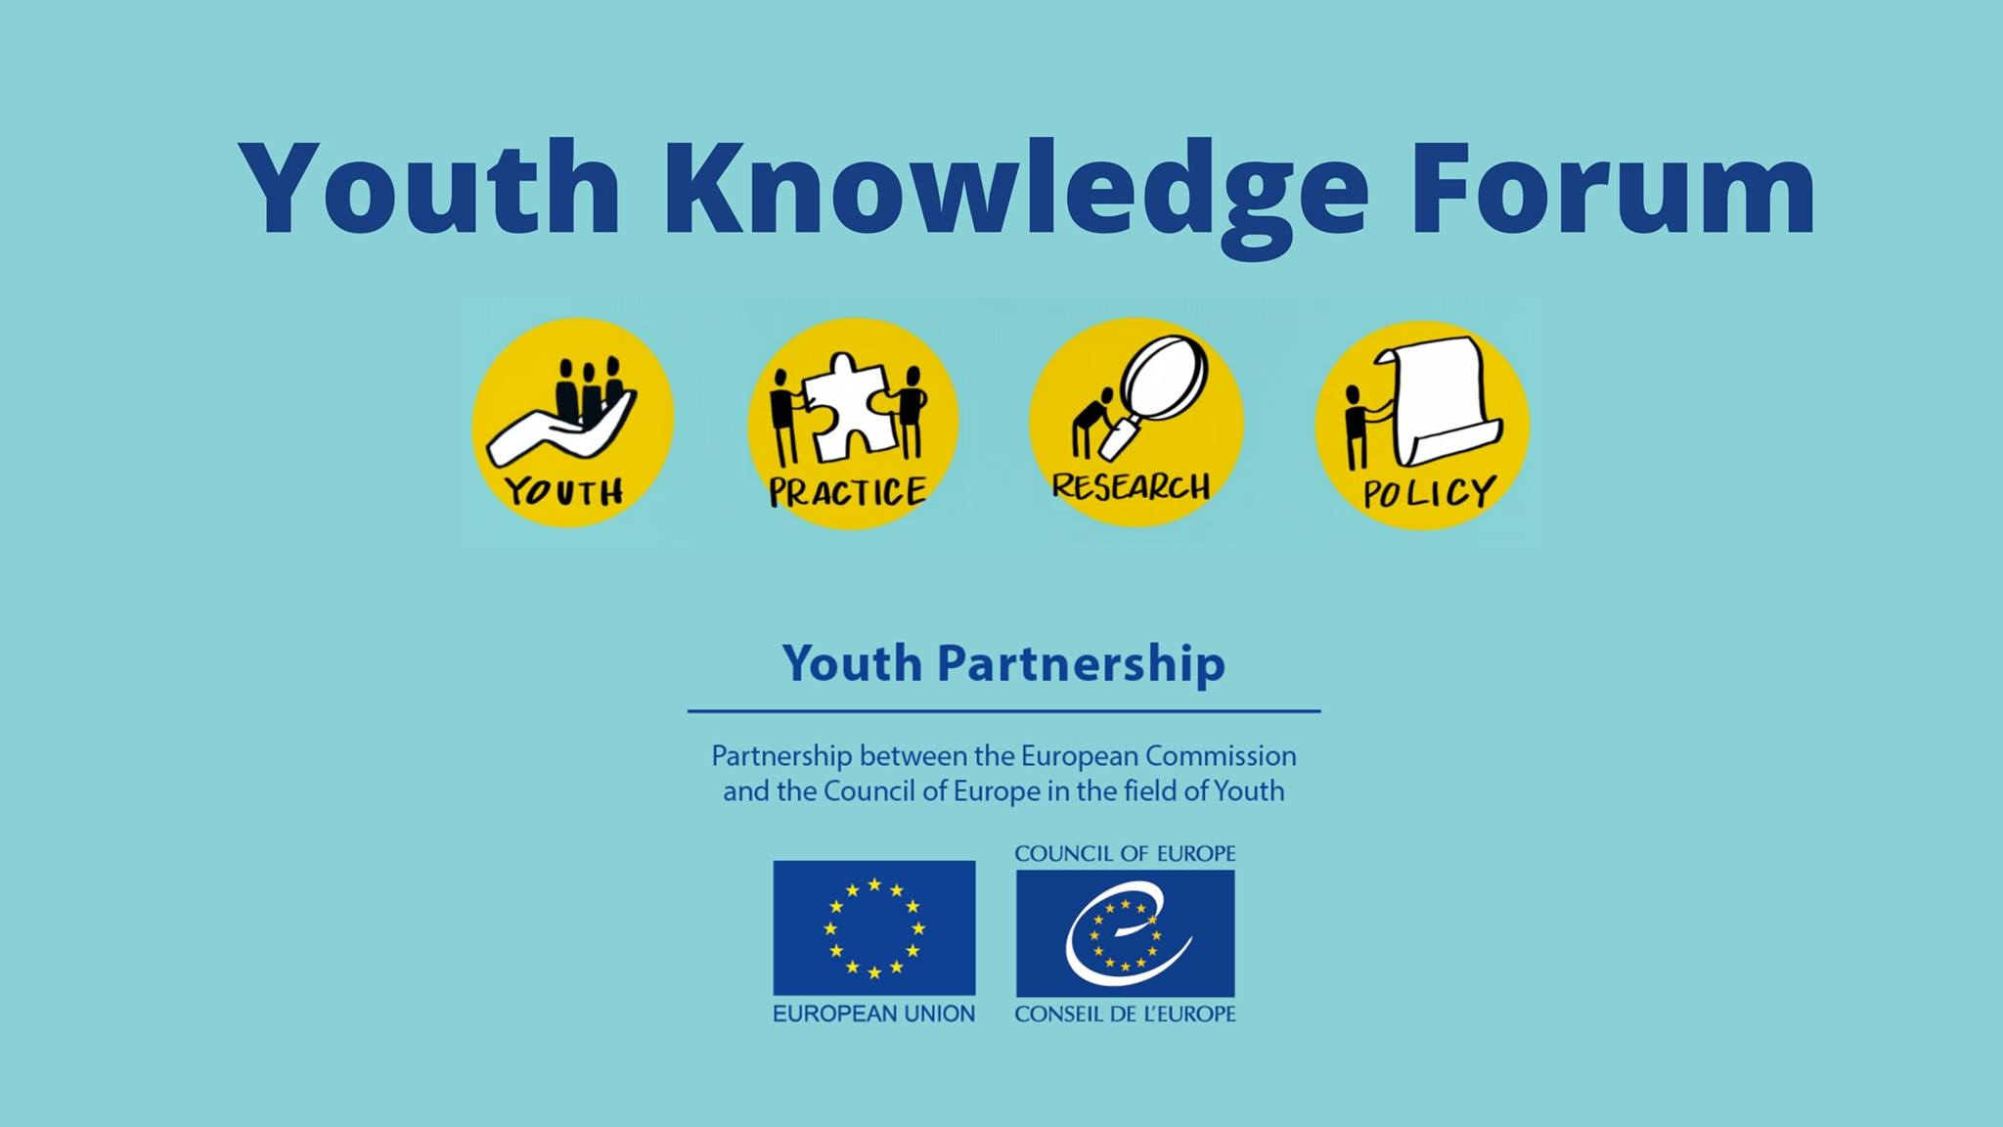

Slide 2
GUIDE
COMMUNICATING YOUTH
RESEARCH
IN 6 STEPS
Maria Paola de Salvo, EasyTelling Founder
Dan Moxon, Director People, Dialogue and Change and
Member of the Pool of European Youth Researchers

Slide 3
THE CHALLENGE

Slide 4
THE GOAL
HOW CAN WE IMPROVE THE EXCHANGE OF INFO?

Slide 5

THE GOAL
YOUTH
POLICY MAKERS
PRACTITIONERS
YOUNG PEOPLE
YOUTH RESEARCHERS
HOW?

Slide 6



THE REQUEST
and members of the Pool of European Youth Researchers

Slide 7
THE SOLUTION
YOUTH
POLICY MAKERS
PRACTITIONERS
YOUNG PEOPLE
YOUTH RESEARCHERS
A KNOWLEDGE TRANSLATION GUIDE

Slide 8
THE SOLUTION
COMMUNICATING YOUTH
RESEARCH
IN 6 STEPS

Slide 9
THE SOLUTION
PROPOSED STRUCTURE
(Working in Progress)

Slide 10
OVERVIEW
Intro: What KT is and why it is useful
Step 1: Identify your research results
Step 2: Establish what outcomes you want to achieve with them
Step 3: Identify your knowledge users
Step 4: Develop content and arguments (the messages)
Step 5: Reaching the audiences
Step 6: Follow up and evaluation

Slide 11

STEP 1
IDENTIFY YOUR RESEARCH RESULTS
Understanding differences between:
Scientific evidence
Results that can be translated
Direct social impacts of your project
Social impacts in the long term
And how to identify them in your study

Slide 12

STEP 2
ESTABLISH THE OUTCOMES YOU WANT TO ACHIEVE
What do you hope to generate with the disclosure of your results?
Examples:
Generate awareness
Share knowledge
Guide decision making
Support new laws
Facilitate change in practices and behaviors
Changing public policies

Slide 13

STEP 3
IDENTIFY YOUR KNOWLEDGE USERS
Which audiences do you need to share your results with for them to achieve the goals of step 2?
Most appropriate
TYPE OF INFORMATION and
TIMING OF COMMUNICATION
For:
Youth policy makers
Cross-sectorial policymakers
Practitioners
Young People

Slide 14

STEP 4
DEVELOP CONTENT AND ARGUMENTS
(the messages)
What actions should your audience take based on the results you present to them?
Sounding like music to your knowledge users
Form to identify the key messages and information to be shared
The four steps to frame the best messages
Hunting for jargon!
Examples of clear and accessible message in the youth field

Slide 15

STEP 5
REACHING THE AUDIENCE
(formats and strategy)
Which materials will you have to develop to disseminate your message and how to do that?
Goal
Format of communication products
Dissemination strategies and channels for each one of our four audiences:
Youth policy makers
Cross-sectorial policymakers
Practitioners
Young People

Slide 16

STEP 6
FOLLOW UP AND EVALUATION
Did my strategy reach the outcomes defined to each audience?
How to evaluate it
Indicators of:
  REACH
  UPTAKE
  USE
  CHANGE IN POLICIES,LAWS, CULTURES/BELIEFS
  INTEREST

Slide 17
QUESTIONS?
WHAT IS NEXT:
Discussion on the content guided by Dan
Based on your today’s inputs, we will finalize the guide and share with you all

