Slide 1
Production of knowledge
Mode 1 and Mode 2 (Gibbons et al., 1994; Fisher, 2013)
Mode 1 (hierarchical)
  Propositional knowledge planned to improve various academic disciplines, developed in universities/institutes.
Mode 2 (open and inclusive – horizontal)
  developed through partnership between a range of stakeholders in a variety of settings.
  Hybrid Forum - The expert group with various stakeholders (Décieux, 2020)
The relevance criterion

Slide 2
Knowledge (co)production
Models of relations between actors:
Atomised actions. Each of the actors act on his own. There are no collaborations.
Dyadic model (two possible options)
  linear model where researchers produce data and policy makers use it.
  relationship model where researchers and policy makers collaborate
Systems model. Researchers, policy makers and other stakeholders collaborate. (Best, Holmes, 2010)
Institutional systems model – Institutions/bodies that facilitate the process

Slide 3
Knowledge to Action – KTA (Best, Holmes, 2010)
linear model
  Dissemination criteria are met
  Strong institutional structure and resources
relationship model
  local context must be taken into account.
  There is a need of systems change to support practitioner change.
  Steady research agenda and platform
Systems model
  All stakeholders are active and involved in modeling research aims and solutions
  Willing to invest resources.
Institutional systems model
  Sustainability

Slide 4
Model Examples
Linear model: where researchers produce data and policy makers use it
Example: Youth Wiki
Relationship model: where researchers and policy makers collaborate
Example: Drafting of the Belarusian Youth Policy Strategy for 2020-2030
Systems model: Researchers, policy makers and other stakeholders collaborate
Example: EU Youth Dialogue

Slide 5
Institutional Systems Model Example
Hub na nÓg (Youth Hub) is a national centre of excellence and coordination on giving children and young people a voice in decision-making in Ireland
Set up by the Department of Children and Youth Affairs to support implementation of the National Strategy on Children and Young People’s Participation in Decision-Making (2015-2020)
Supports Government Departments, State agencies and NGOs to give children and young people a voice in decision-making, e.g. policy
Established a panel of youth researchers

Slide 6
Ireland 2016 Consultations
Policy Issue:
Getting the view of children and young people on how they would like to remember children who died in the 1916 Rising
Strategic Partners:
Department of the Arts, Culture and Heritage
Department of Children and Youth Affairs
Ireland 2016
Office of Public Works
Áras an Úachtarain (Residence of the President of Ireland)
Researchers from University College Cork
Methodological Approach:
Regional consultations with children (8 -12 years) and young people (13- 17 years)

Slide 7
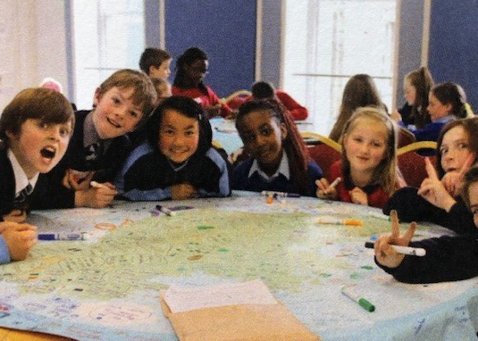
Ireland 2016 Consultations
Outcomes:
The report on what children and young people wanted for the future of Ireland was launched at a State Ceremonial event in the presence of the President and Government Ministers
The report was buried in a time capsule and a tree was planted in the President’s garden to commemorate the children who died in the 1916 Rising
The Department of Children and Youth Affairs and Dublin City Council funded a commemorative play garden, the top idea of children in the consultations
Children and young people are on the play garden Steering Committee

Slide 8
The involvement of children in appointing the Ombudsman for Children
Policy issue:
Ensure the appropriate involvement of children and young people in the appointment of the Ombudsman for Children
Strategic Partners:
Department of Children and Youth Affairs
Public Appointments Service
Office of the Ombudsman for Children (OCO)
Independent Researcher
Methodological Approach:
Consultations with 40 children and 40 young people on the ideal qualities for the post
Selection of a panel of 11 children and young people for the interview process

Slide 9
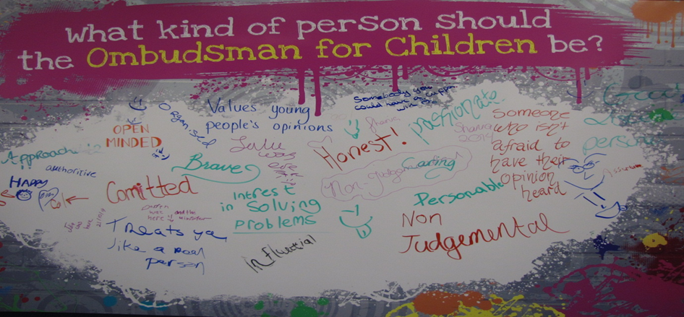
The involvement of children in appointing the Ombudsman for Children
Outcomes:
Children and young people were meaningfully involved in the interview process for the appointment of the Ombudsman for Children
The wall of ideas graphic from the consultation workshops hangs on the wall of the Ombudsman for Children Office

Slide 10
Thank you!

