Slide 1
Youth Policy Evaluation Review Some conceptual aspects
Marti Taru
Brussels, 7.11.2019

Slide 2
Evaluation
…a social and politizised practice nonetheless aspires to some positions of impartiality or fairness, so that evaluation can contribute meaningfully to the well-being of people in that specific context and beyond (p.4)
the systematic and objective assessment of an on-going or completed project, programme or policy, its design, implementation and results. The aim is to determine the relevance and fulfilment of objectives, development efficiency, effectiveness, impact and sustainability. An evaluation should provide information that is credible and useful, enabling the incorporation of lessons learned into the decision-making process of both recipients and donors. Evaluation also refers to the process of determining the worth or significance of an activity, policy or program, to an assessment, as systematic and objective as possible, of a planned, on-going, or completed development intervention (p.15)

Slide 3
Evaluation research paradigms
Positivist
social reality exists independent of evaluators opinions, actions.
(Evaluation) research goal is to uncover the relationships between independent variables – the intervention – and dependent variables – (intended) societal outcomes.
„black box“ models (e.g. instrumental variable method, difference-in-differences)
Experimental and quasi-experimental designs
Social mechanisms
Emphasize on uncovering how exactly the outcomes are brought about by the intervention
E.g. The YG in Italy brought about reduction in youth unemployment rate through a change in collaboration institutions, where different actors meet
Theory of change and programme theory
Constructivist
no objective social reality exists, instead there are subjective interpretations, understandings
No objective basis for planning and evaluation of goodness of interventions exists
Evaluation is based on collating different and differing viewpoints

Slide 4
Quality of evidence
The concept is useful in all paradigms as it describes each piece of evidence
Positivist paradigm: absolute criteria for considering a piece of research
Counterfactuals and (quasi)-experimental design
Constructivist paradigm: a feature describing a piece of research
Evidence gap map

Slide 5
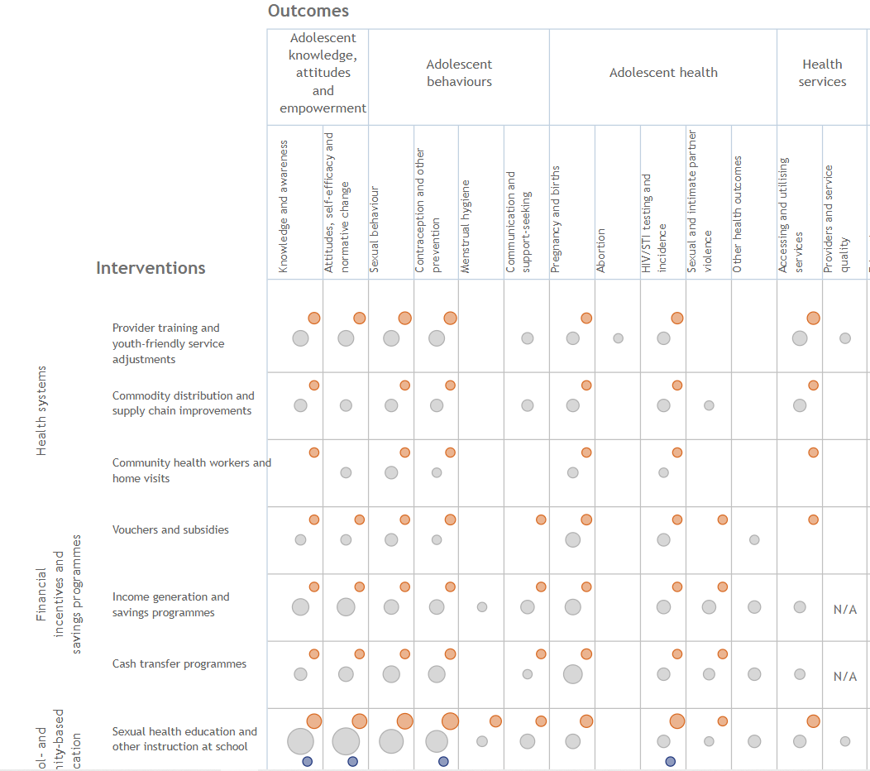
Quality of evidence
The concept is useful in all paradigms as it describes each piece of evidence
Positivist paradigm: absolute criteria for considering a piece of research
Counterfactuals and (quasi)-experimental design
Constructivist paradigm: a feature describing a piece of research
Evidence gap map

Slide 6
Types of evaluation; timing in policy cycle
Prospective / ex ante evaluation
The planned impacts of an intervention (reduce unemployment rate, increase civic activism, provide more non-formal learning opportunities, ....)
Regulatory Impact Analysis RIA
Formative evaluation / monitoring
How is it going? Can we improve implementation?
How many people have picked up a service
Counting, indicators and statistics
What are the challenges for implementing organisations
Organisation studies
Impact / summative / retrospective / ex post evaluation
What are the outcomes?
When; immediate ... long-term outcomes (for youth – in the adulthood?)
Intended and unintended outcomes (e.g. stigmatisation)
Costs and benefits of an intervention (costs born by society, benefits for a specific group)

Slide 7
Knowledge to action
At the level of public policy, youth field is part of public administration
Education, employment, health, prevention, participation, youth work, ...
Policy makers are „bombarded“ by a flows of information and requests from stakeholder groups
There are legal and institutional restrictions
Decision-makers’ ability to process information is bounded (bounded rationality)
Under stable conditions, changes in public policy are incremental; no single piece of information causes abrupt changes

Slide 8
Knowledge to action
Linear model: research / evidence has been produced by researchers, in a fairly independent manner, and needs be communicated to policy circles
Network/relationship model: researchers and policy-makers are connected on a permanent basis and there is more permanent collaboration, exchange of ideas and information between them
Researchers wanting to have impact on policy processes ought to act like representatives of any other stakeholder group
Build workings connections with policy-makerss
Familiarise themselves with policy processes
Look for opportunities to interfere and have potential inputs ready
User-friendly communication format are a must but not enough

Slide 9
Policy learning and transfer
transferring knowledge about policy interventions, administrative arrangements and institutions in one political setting (now or in the past) for developing policies, and related arrangements in another political settings – in another country, in different times, under different socio-economic conditions
Policy emulation model: learning from other countries and regions and adopting those practices that are backed by evidence gathered from high quality research
Online databases of interventions in certian sectors
Influence of large international organisations like EU, OECD, WB, UN
Storytelling model similar to the model above; the difference lies in what is considered as good evidence – less stringent criteria.
Exchange of best practices
Improvement science model: learning and borrowing from other sectors and/or scaling up a small initiative.

Slide 10
What do we mean by „evaluation“ in the youth sector?

