Slide 1

TEN YEARS OF BOOSTING
VIBRANT YOUTHFUL CITIES
Lana Pasic
Independent Research and Evaluation Consultant
Pool of European Youth Researchers (PEYR)

Slide 2
European Youth Capitals
2009 | Rotterdam, Netherlands
2010 | Torino, Italy
2011 | Antwerp, Belgium
2012 | Braga, Portugal
2013 | Maribor, Slovenia
2014 | Thessaloniki, Greece
2015 | Cluj-Napoca, Romania
2016 | Ganja, Azerbaijan
2017 | Varna, Bulgaria
2018 | Cascais, Portugal
2019 | Novi Sad, Serbia
2020 | Amiens, France

Slide 3
A decade of European Youth Capitals - evaluating the impact
Evaluation as means of analysing the impact of the initiative, shaping the knowledge on youth and learning for the future
Evidence-based assessment & comparative study
Desk review
Online survey
39 interviews in 10 Capitals
8 focus groups in 6 capitals with 49 participants

Slide 4
A decade of European Youth Capitals - evaluating the impact
Internal report - recommendations
External report – publication
Need for common indicators and reports
Setting goals and targets
Managing the expectations

Slide 5
Mapping the benefits
1. Encouraging youth participation | 5. Increasing opportunities for youth
2. Empowering youth and strengthening youth organisations | 6. Boosting the local economy
3. Fostering European identity | 7. Developing spaces for youth
4. Championing diversity and inclusion | 8. Impact outside of the city walls

Slide 6
1. Encouraging youth participation
Co-decision-making and participation structures
Young people as policy-makers: participatory policy development
“It is important to think long-term, not just to work during the year of the title, but to use the title to improve youth sector as a whole, advance youth participation and strengthen the networks created during the year” - Member of the youth organisation, Maribor (2013), Slovenia.
Innovation in decision-making: participatory budgeting for youth
Active citizenship: promoting youth volunteering
MORE THAN 10,000 VOLUNTEERS ENGAGED IN VARIOUS ACTIVITIES!

Slide 7
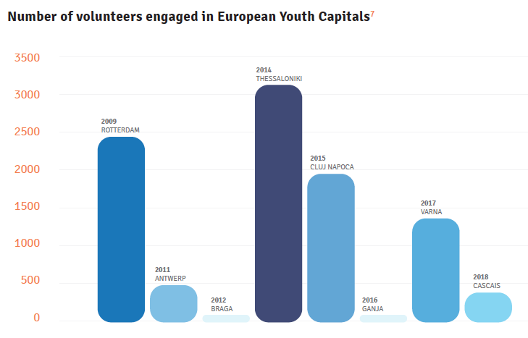

Slide 8
2. Empowering youth and strengthening youth organisations
Young people developing their skills and knowledge
Strengthening youth organisations: increased cooperation between youth organisations
Improving youth organisations’ capacity to apply for funding

Slide 9
3. Fostering European identity
“The EYC promoted the cooperation across Europe not only with other EYC cities but with most of the European countries via Erasmus + actions, the special promotion of Thessaloniki as a youth destination in the Balkan countries and the links with the young community people from the network of Thessaloniki’s sister cities”
- Member of the youth organisation, Thessaloniki (2014), Greece.

Slide 10
4. Championing diversity and inclusion
“We managed to bring new faces in the youth sector. Youth sector was represented by people who were in the youth sector for ten years, but the EYC was a change to support new organisations and bring new people into the sector”
- member of the organising team, Varna EYC 2017, Bulgaria.

Slide 11
5. Increasing opportunities
Increasing funding opportunities
More than 50,000,000 EUR have been invested in youth in different Capitals as a part of the initiative!
Increased number of youth-oriented activities
Since 2009, more than 8,000 events and activities have taken place across the European Youth Capitals!

Slide 12
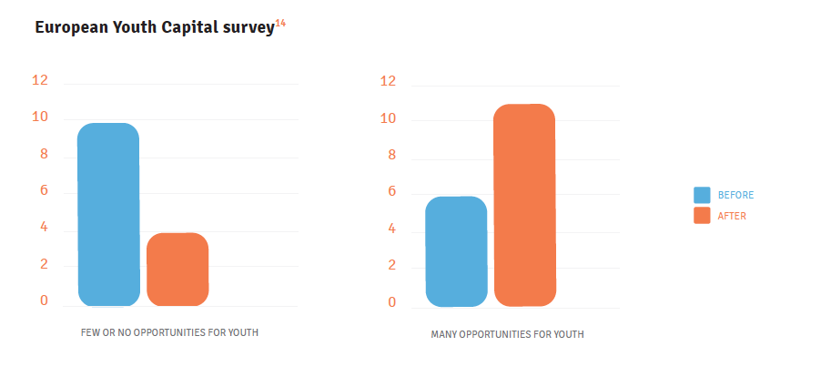
Perception of opportunities available for youth
before and after the EYC title

Slide 13
6. Boosting the local economy
In all the former Capitals, the investment of the municipality in the EYC initiative and in young people has proven to be beneficial and has brought revenues in various ways.
The title continues to bring economic benefits to the Capitals, as the cities remain to be seen as youth-friendly places, attracting large numbers of young people to visit them.

Slide 14
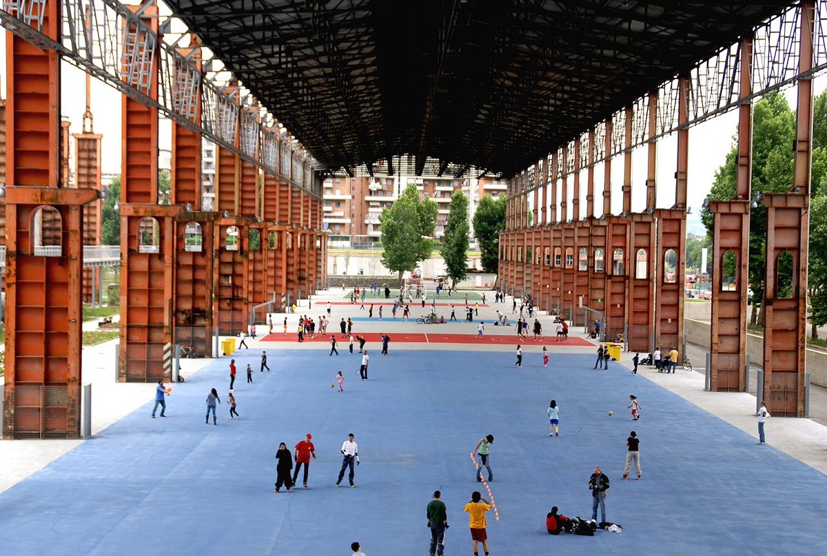
7. Developing spaces for youth

Slide 15
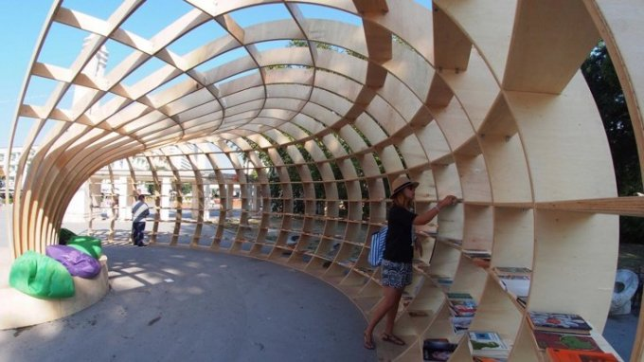

Slide 16
8. Outside of the city walls
Creating stronger links across the country
The Capitals have included surrounding municipalities in their activities, they brought important national events to the cities, and the national Youth Capital titles were awarded both in the awarded in the countries within and outside the cities holding the EYC title.
Building a European-wide network
Capitals are actively cooperating through various projects and exchanges with cities across Europe, as well as through the Network of European Youth Capitals, an informal body created in 2012 in Braga.

Slide 17
THE NEXT TEN YEARS OF THE EUROPEAN YOUTH CAPITAL TITLE…
EYC 2019 - NOVI SAD
OPENS 2019

