Slide 1
Social Inclusion, DigitaliSation and YouNg People
Research Study

Slide 2
Social Inclusion and Digitalisation?
In order to support the social inclusion, young people’s participation in social, economic and political life should be promoted, based on the equality of rights, equity and dignity.
What about young people with fewer opportunities/ young people at risk of exclusion? - Certain groups of young people face multidimensional barriers or disadvantages, encompassing political, social, cultural and economic dimensions.

Slide 3
Purpose and Objective
Purpose: to explore the intersection of these two themes by:
Examine Concepts & Understandings of social inclusion and exclusion
Look at the existing digital knowledge and opportunities, including the digital youth work.
Examine the existing legal frameworks in a comparative way
Objective of the study is also to explore the ways in which we can utilise the opportunities of new digital reality towards promoting social inclusion.

Slide 4
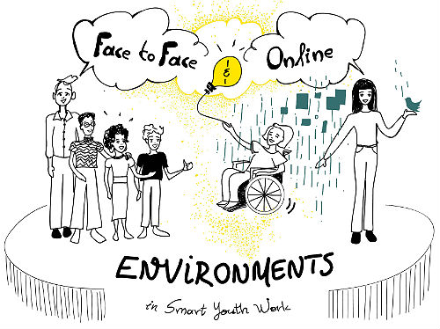
Concepts – Intersection?
Social Inclusion – and the ‘safety nets’ – digital inclusion – another safety net?
Digitalisation
a new landscape for inequalities?;
promotes or inhibits social inclusion?

Slide 5
Methodology
Overall question: : “What is the intersection between social inclusion and digitalisation?”
Objectives:
To offer a general review of the European youth policy focusing on social inclusion and digitalisation.
To present existing practices, based on a brief analysis of the cross-national examples
To develop a set of risks and opportunities.
Data collection:
1. Desk review & 2. Online questionnaire (23 countries)

Slide 7
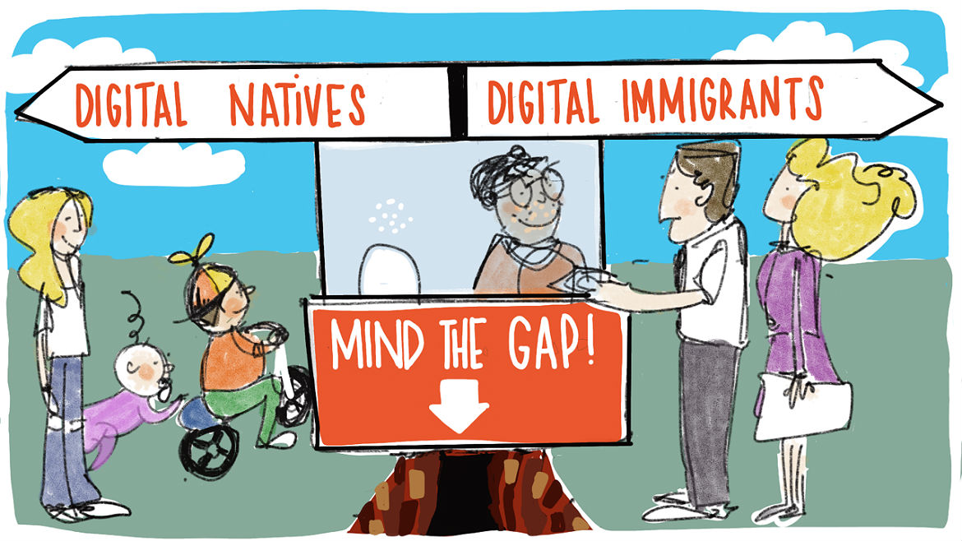
Digitalisation for ALL?!

Slide 8
Access to Internet vs. Use of Internet?
1% of young people have never accessed the Internet, while 95% use it daily and 89% prefer to use mobile devices as access points.
VIth cycle of Structured Dialogue: indicates that there are distinct differences in the way young people from minority backgrounds engage with online tools and sources of information, compared to those from majority backgrounds.
Young people from minority backgrounds found social media and general Internet searches more important for accessing truthful information than young people from non-minority backgrounds.

Slide 9
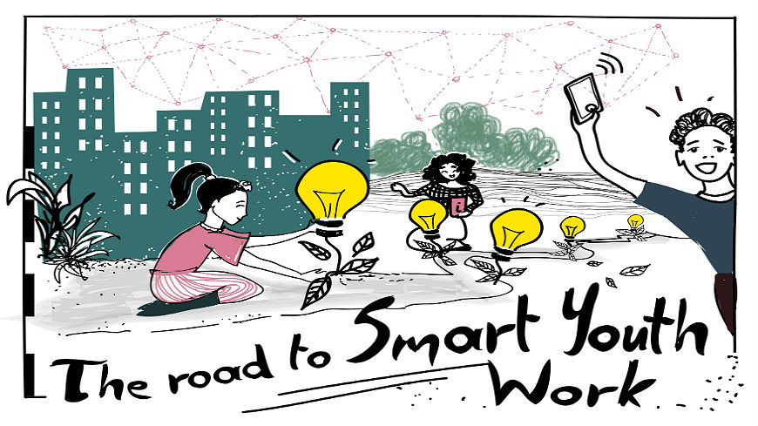
Digital & Smart Youth Work?
Conclusions on Digital Youth Work (Council of the European Union, 2019) – Digital youth work = Priority.
New/different approach in youth work? Different outcomes?

Slide 10
Relevant Policies
EU Policy: the digitisation agenda which, at times, refers to young people but not through a separate agenda for all its citizens & the youth policy agenda that is currently focused on promoting the digital tools.
Digital Agenda for Europe,Digital Single Market for Europe, Europe fit for the digital age - rather focus on infrastructure; ICT & Digital Skills
Council of Europe has extensively worked on ensuring a safer Internet for children and young people.
The Recommendation of the Council of Europe on the access of young people from disadvantaged neighbourhoods to social rights (2015) – including access to information and technology

Slide 11
National Policies
38 answers from 23 countries
State and non-state actors
Efforts taken by various governments:
1. to advance digital agenda and promote digital skills, particularly in formal education
2. to support infrastructure development
3. and ensure schools’ access to the Internet
4. as well as to develop public digital services.

Slide 12
Examples
Albania & Estonia - defined national policies and initiatives addressing digitalization and connections with young people’s skills, inclusion or online safety
Croatia and Germany –digitalisation mainly resides with the formal education system linking IT, STEM and digitalisation.
Greece, Estonia, Ireland, Malta and Serbia - recently adopted National Youth Strategies there are references to digitalisation and inclusion of young people, even if they are not shaped as separate pillars.

Slide 13
Other practices
online tools that allow for more transparent and faster approaches that could foster the social inclusion of young people - from the online platforms that monitor and support young people
A. the Estonian tool that monitors young people at risk of exclusion and provides early intervention measures)
B. participation platforms for young people and youth organisations (Greece)
C. overall monitoring related to the process of digitization (Austria).

Slide 14
?

Slide 15
Conclusions
The digital age does not have the same set of benefits for all young people;
We’re all far behind offering young people the equal participation opportunities;
Young people & all citizens as beneficiaries?
Thank you, Youth NGOS & Youth Networks for the results of your work! – Next level?
With and for young people!

