Slide 1
Mapping Educational and Career Paths of Youth Workers
Marta Mędlińska
and Tanya Basarab
EU-CoE youth partnership
February 2019

Slide 2
Project Aim and Context
Aim of the research project: to contribute to a better understanding and sharing of information about the education and training of youth workers across Europe and their ensuing employment/career paths – in support of the implementation of the Youth Work Recommendation CM/Rec (2017)4 and of the EU initiatives on promoting quality youth work development

Slide 3
Questionnaire
Target groups: EKCYP correspondents, relevant ministries, Advisory Council on Youth, European Youth Forum, Intercity Youth, other organisations delivering youth work.
Information collected between June-October 2017.
Questionnaire
Policy and Legislation – 5 questions
Regulation of youth work as a profession – 5 questions
Formal and accredited courses in youth work – 6 questions
Non-formal education and training for youth workers – 10 questions
Quality and Competences – 4 questions
Associations of youth workers - 3 questions
Employment of youth workers – 4 questions
Career paths and employment opportunities for youth workers – 5 questions
Anything to add?

Slide 4
Process
Completed questionnaires received from 41 countries.
Outstanding countries include: Denmark, Hungary, Spain, and Switzerland.
Annual meeting of European Knowledge Centre for Youth Policy – September 2017.
Benchmarking Exercise based on 10 countries – September 2017.
Report finalised with input of 2nd Expert Group meeting.
Final check with CDEJ and experts. First presentation of the report findings, ETS Conference in March 2018

Slide 5
Contents of the report: Part I
Introduction
Current European policy on promotion and development of youth work
Research questions and methodology
Data analysis
Policy and Legislation incl. Tables (Question 1)
Formal and non-formal education and training incl. Tables (Questions 3 and 4)
Quality and Competences incl. Tables (Question 5)
Associations and networking incl. Tables (Question 6)
Employment, career paths and professionalisation incl. Tables (Questions 7, 8 and 2)
Main findings, emerging issues and challenges
References
The opinions expressed in this work, commissioned by the European Union–Council of Europe youth partnership, are the responsibility of the authors and do not necessarily reflect the official policy of either of the partner institutions, their member states or the organisations co-operating with them.

Slide 6
Appendices and further results
Appendices to the report: https://pjp-eu.coe.int/en/web/youth-partnership/related-publication
Table 1: National structures responsible for creating a framework for youth policy and its implementation (information collected between May-November 2017)
Table 2: National/regional legislation on youth work
Table 3: Other forms of national recognition for youth work
Table 4: Degree and postgraduate-level courses in youth work and related fields
Table 5: Vocational and further education and training courses in youth work and related fields
Table 6: Non-formal education and training: provision, funding and accreditation
Table 7: Non-formal education and training: methods, themes and competences
Table 8: Quality and competences
Table 9: Competency framework in different countries
Table 10: Most common competences and skills for youth workers in 10 countries
Table 11: Associations and networking of youth workers
Table 12: Regulation of youth work as a profession
Table 13 Youth work and employment
Table 14: Career paths and employment opportunities for youth workers
Table 15: Nomenclature on youth worker and other professions delivering youth work

Slide 7
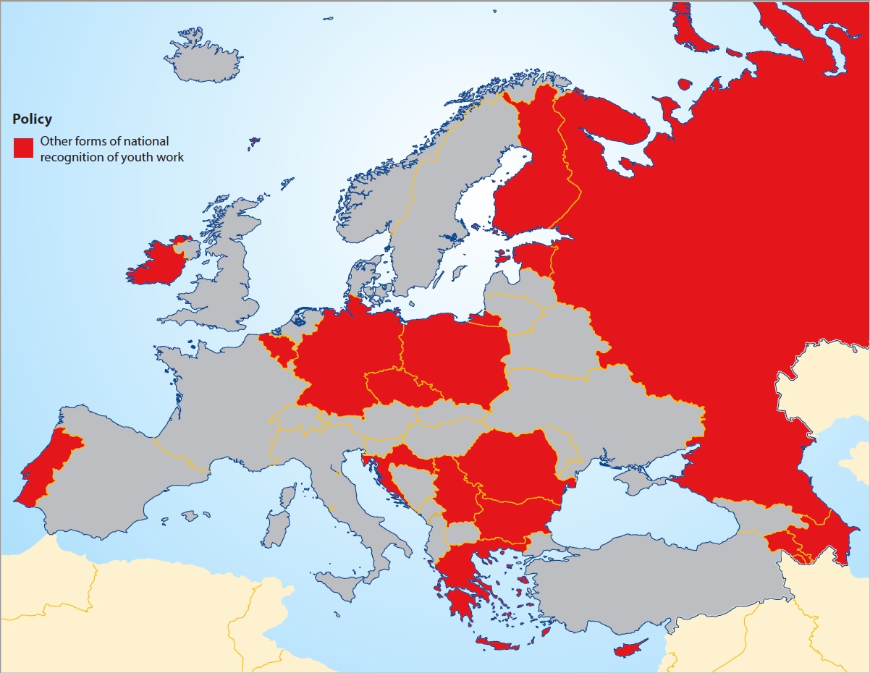
Main Findings
Policy and Legislation
41 countries have some form of structure or framework in place, either at national or regional level, for youth policy and its implementation.
34 countries have some form of legislative or strategic policy provision for youth, at either national or regional level.
Policy initiatives and developments in youth work were under way during the data collection phase in 21 countries.

Slide 8
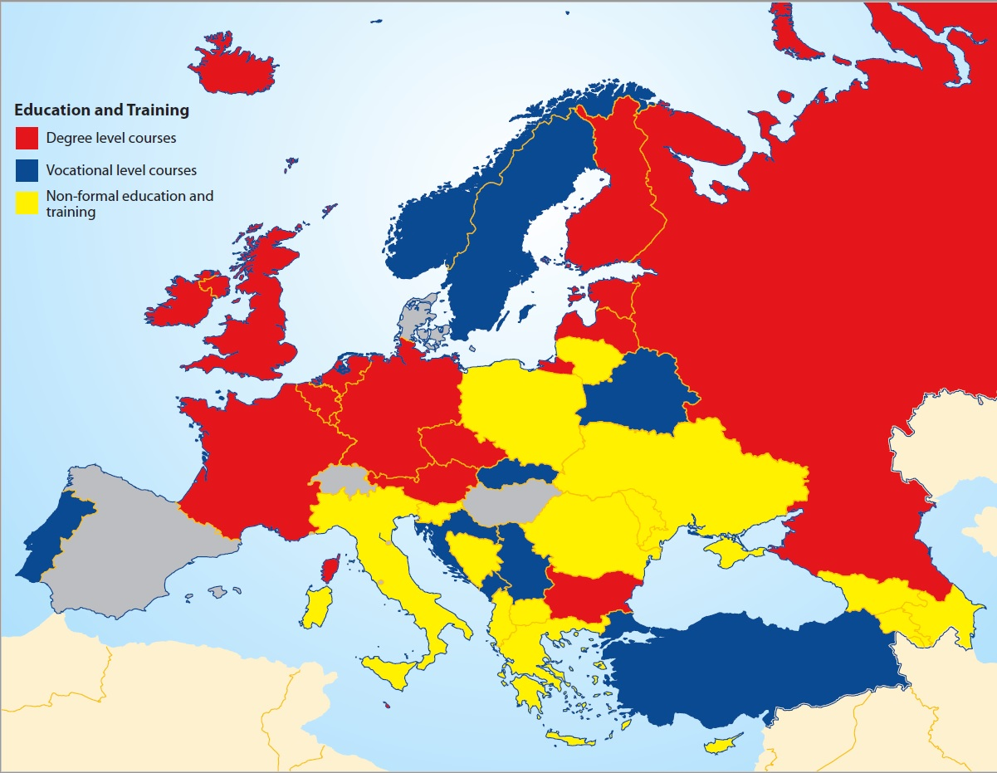
Main Findings
Formal and non-formal education and training
17 countries have degree level courses in youth work or related fields.
17 countries provide vocational or further education and training.
The blurring of the lines between youth work and other related fields is a complicating factor as it also tends to blur education/training and career paths.
39 countries surveyed provide some level of non-formal education and training for youth workers.
Main providers of non-formal education and training: the state, the voluntary sector, and European support programmes.
In almost half of the countries surveyed, the voluntary youth sector plays a defining role and most of these countries are in either Eastern or Southern Europe.
A Centre/North/West and South/East divide in Europe as regards the provision of both formal and non-formal education and training is also evident from the survey.

Slide 9
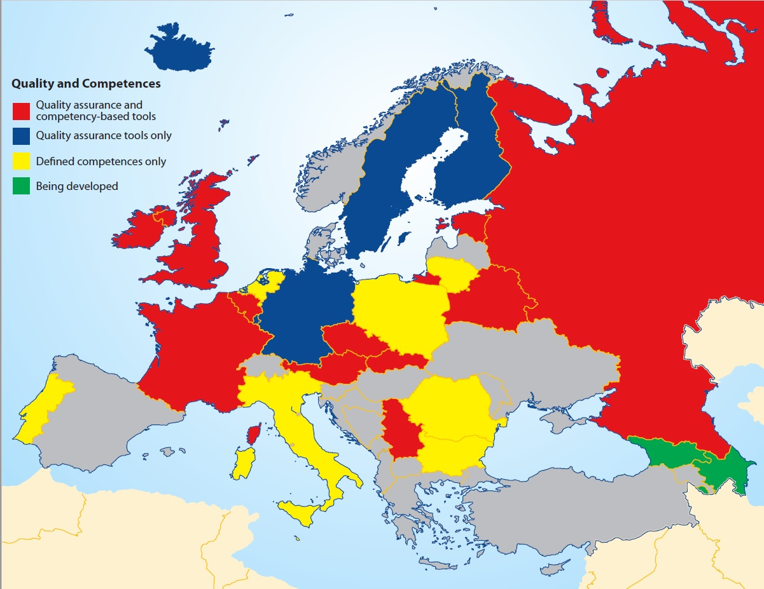
Main Findings
Quality and Competences
18 countries have some form of quality assurance framework or system in place and 20 are developing such systems.
In 13 countries they are at national level and the remainder are at either local or organisational level. 2 countries are developing frameworks.
The approaches to developing and implementing quality assurance frameworks, systems or standards varies widely across the countries surveyed and include:
Certification of courses for youth workers
Evaluation of youth workers
Evaluation of the youth organisations
National standards
Funding requirements
20 countries also have national competency-based frameworks or competency descriptors for youth workers.

Slide 10
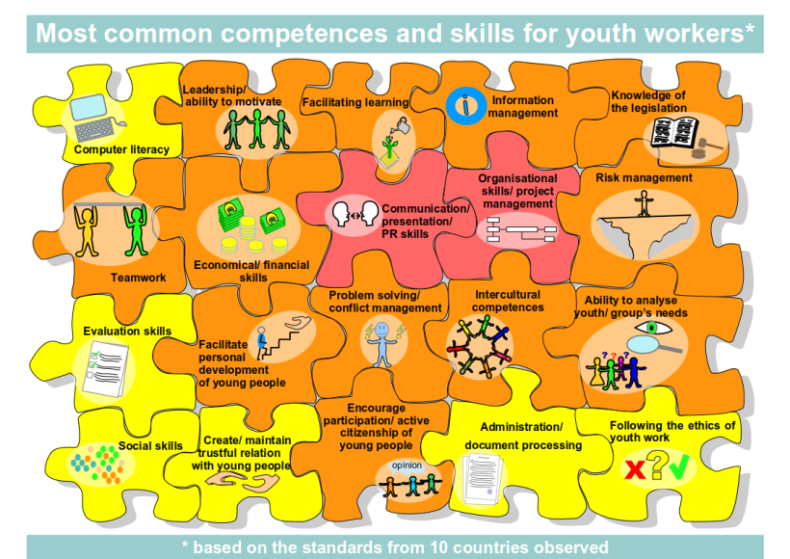
Main Findings

Slide 11
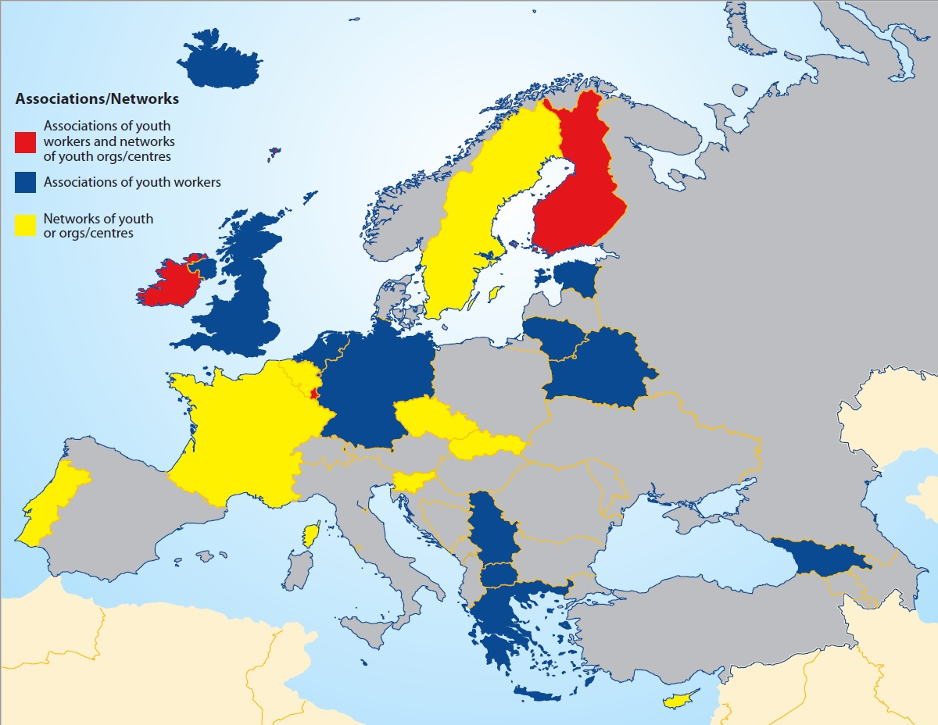
Main Findings
Associations and networking
15 countries have associations of youth workers (training for youth workers; promote professional competence; the profile of youth workers and their professional status).
In 11 countries other organisations undertake the role of youth workers’ associations including umbrella organisations of youth centres, trade or professional unions, and networks of municipalities.

Slide 12
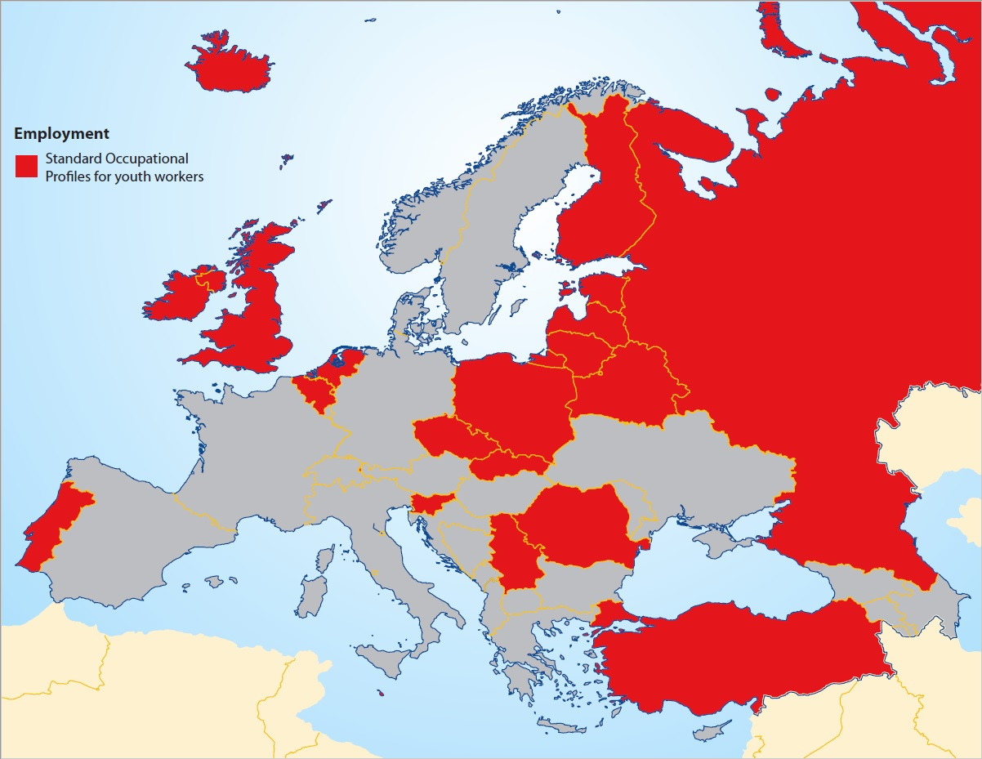
Main Findings
Employment, career paths and professionalisation
13 countries provided data on the number of youth workers employed by the state, public sector or NGOs.
11 countries also provided data on the numbers of youth workers in NGOs/voluntary organisations.
22 countries have occupational standards.
10 comprehensibly monitor the numbers of professionally registered youth workers.

Slide 13
Main Findings
Most frequently cited employment:
youth centres,
advice and counselling,
Young people’s health services,
NGOs,
leisure and after and out-of-school voluntary activities.
Overlap between youth work and social work
Challenges with occupational profiles not recognised in labour law – need to look at quality of work offers, protection and benefits, long-term perspectives and parity of status as a profession.

Slide 14
Information and data
Issues arising from responses to the questionnaire
Many information and data gaps in responses to the questionnaire.
Some respondents had to decide what to focus on when responding (ex: national vs. local; state perspective quite visible).
Time and capacity to collect information and data.
Understanding of question (ex: problematic interpretation of competencies).
Size, scale and diversity of provision.
Regions and municipalities.
Voluntary youth sector and NGOs.
Youth workers perception.

Slide 15
Some challenges!
Embedding youth work in and ensuring that it is an integral part of all youth related policies/strategies and implementation.
Strengthening and expanding formal education and vocational training for youth workers, particularly in those member states where it is under-developed or absent.
Further developing and strengthening over-arching structures for non-formal education and training that ensure an appropriate level of provision, funding and accreditation and that align methods, themes and competences.
Reaching a European wide consensus on who "youth workers" are, what education/training "qualifies" them to be youth workers and what employment and career paths are available to them, regardless of the nomenclature, status or role of “youth workers” in individual member states.
Affording additional supports to the voluntary youth sector and NGOs in those member states where they play the leading role in promoting youth work and the youth work profession.

Slide 16
Some challenges!
Promoting and supporting innovative and experimental approaches in developing and implementing quality assurance and competency-based frameworks and systems.
Exploring the role that associations and networks of youth workers might play in supporting the development of youth work and the youth worker profession.
Promoting the formal recognition of youth work as a profession and parity of status with related professions.
Further developing and strengthening the data, knowledge and research base of youth work particularly with regard to the voluntary youth sector and NGOs, quality and competences, associations and networking, and employment and career options and opportunities.

Slide 17
Practice Architectures for Youth Worker Education in Europe – Part II

Slide 18
Theoretical framework – what supports youth workers’ learning
Sayings/cultural-discoursive dimension: how youth work is recognised, formulated, talked about and debated
Professional vocabulary, professional recognition and theories of how good practice is organised.
Doings/structural-occupational dimension: how youth work education is supported and how youth work can be a sustainable career
Physical and economic realities. Design of youth work places, wages of youth workers, economic status of youth work organisations, sustainable career paths.
Relatings/social-political dimension: how youth work is recognised, supported and organised so that it can relate to young people, general public and other professional cultures
Social relationships and power, resources, relations to other professions and groups.

Slide 19
Kemmis’ visualisation of his theory

Slide 20
Group 1. Strong practice architectures
Belarus
Belgium (French)
Estonia
Finland
France
Germany
Ireland
Luxembourg
Slovakia
UK (England)
UK (Wales)
Legislative definitions
2. Competency description and/or
3. Quality assurance
o
strong Associations of youth workers
1. Vocational education on youth work
2. Tertiary education for youth work
3. Public support for non-formal learning
4. Identifiable and sustainable career paths
Formal learning,

Slide 21
Group 2. Strong practice architectures, room for development
Austria
Belgium (Flemish)
Belgium (German)
Czech Republic
Iceland
Liechtenstein
Malta
Portugal
Russian Federation
Serbia
Sweden
The Netherlands
Usually legislative definitions
2. Competency description and/or
3. Quality assurance work education
Associations of youth workers
1. Usually vocational education on youth work and/or
2. Tertiary education for youth work
3. Usually public support for non-formal learning
4. Usually identifiable and sustainable career paths
ng, economic Formal learning,

Slide 22
Group 3. Practice architectures where some parts have been developed
Armenia
Bulgaria
Latvia
Lithuania
Norway
Slovenia
“The former Yugoslav Republic of Macedonia”
Turkey
1. Usually legislative definitions
2. In some cases competency description and/or
3. Quality assurance
In some cases
associations of youth workers
1. Usually vocational education on youth work and/or
2. Tertiary education for youth work
3. In some cases support for non-formal learning
4. Usually no identifiable and sustainable career paths
ng, economic Formal learning,

Slide 23
Group 4. Practice architectures in need of development
Albania
Azerbaijan
Bosnia and Herzegovina
Croatia
Cyprus
Georgia
Greece
Italy
Moldova (Republic of)
Montenegro
Poland
Romania
Ukraine
Usually legislative definitions
In some cases
associations of youth workers
1. In some cases tertiary education for youth work
2. In some cases public support for non-formal learning

Slide 24
Track 1 pursued in 2018
Getting the perspective of youth work organisers, educators and managers
Views of educators and youth work managers on the competences of youth workers by Dunja Potočnik
What do you see? A look at youth work through the prism of sociology of occupations by Marti Taru
Ethical standards in youth work and how they support education and career pathways of youth workers by Sladjana Petkovic and Ondřej Bárta

Slide 25
Track 2 pursued in 2018
Getting the perspective of youth work workers
Youth workers in Europe. Associations, networks and support by James O’Donovan
Early career perspectives on the educational pathways of youth workers by Tomi Kiilakoski
Youth workers learning in non-formal contexts by Dunja Potočnik

Slide 26
@eucoeyouth marta.medlinska@partnership-eu.coe.int tanya.basarab@partnership-eu.coe.int https://pjp-eu.coe.int/en/web/youth-partnership/related-publication

