Slide 1
Three perspectives on youth workers’ education and work: policy-makers, youth workers and organisers of youth workers
Expert group on youth work professions, education and training, job support of youth workers meeting in Brussels, 9-10.April 2019
Marti Taru

Slide 2
Aims at deeper understanding of learning pathways of youth workers: contexts, components and aspects, outcomes, reasons and motivations

Slide 3
Contexts, within which learning occurs
Youth work is a highly diverse field of practice in terms of methods, goals, target groups, countries and type of engagement (paid, volunteering-based)
Youth work differs from neighbouring occupations and fields of practice
  Youht work ethics as the differentiating feature (ideally: voluntray; young person centered; on their terms)
Paid youth work is part of public policy
  financed from public budget, not from market interactions
  Development of youth policy, which foresees youth work a certain role to support realising policy goals
  Development of youth work quality guidelines, competence frameworks, professional standards
  Professional organisations?

Slide 4
Components and aspects of learning
(paid?) youth workers’ level of formal education is high
Many have acquired a degree in a neighbouring field
  Youth work degree education available only in few countries
Formal education experiences are appreciated by youth workers
Availability of degree programs is a signal to other social actors telling that this is a serious occupation which possesses its own distinct values, specialised knowledge and skills that are transferred within formal education system
Some job transition support systems are in place, but need for more and systematic support systems as they are efficient
Lack of institutionalised forms of knowledge production, exchange, communication like specialised research centers, journals, conferences etc

Slide 5
Components and aspects of learning
Youth workers are eager to learn and engage in NFL based trainings outside formal education system
Many youth workers have engaged in a high number of trainings over years
Lack of clear quality criteria, competence frameworks, strategic development plans, cooperation within field, weakness of professional organisations are discouraging factors
Lack of recognitions of NFL learning is another factor which hinders youth worker NFL learning; it is rooted in youth work recognitions in general
Lack of organisational support

Slide 6
Reasons and motivations for learning
Providing value to society is one of the core motivations to engage in youth work
  Support to young people in risk of social exclusion, resulting from influence of different vulnerability factors and lack of resilience factors
  Support to young people’s development, support to transition from childhood dependencies to independence (employment, but not only)
    Paid youth work / volunteering based youth work
    Entrance into youth work – transition to youth work from other occupations (and also from youth work to other occupations)
Wish to be engaged with young people
Personal positive experiences with youth work, youth workers who act as role models
  Entrance into youth work: participation in youth work → engagement on voluntary basis → youth work or related studies → paid youth work

Slide 7
Outcomes of learning
A number of youth work competence systems exist and are used, which describe skills, knowledge, values, motivations necessary for quality youth work
Lack of youth work qualification systems, which would describe learning outcomes
  Youth studies programs mainly emphasize knowledge aspects

Slide 8
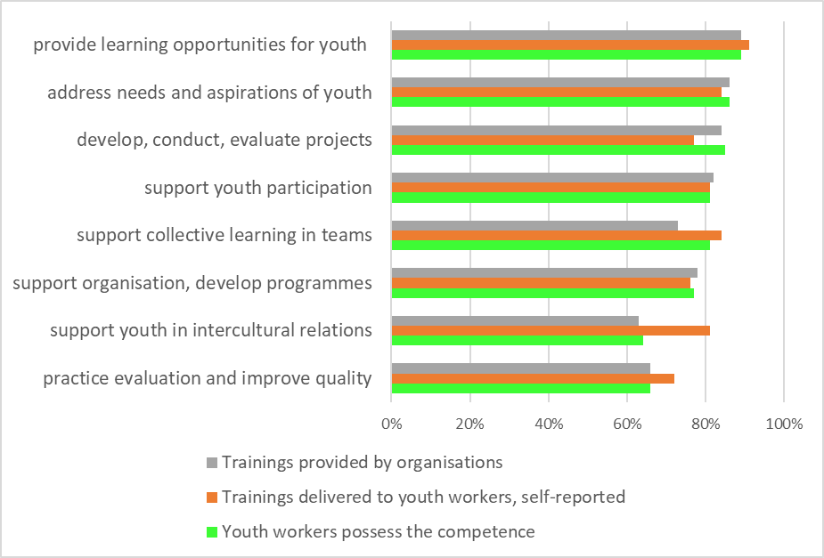
Outcomes of learning

Slide 9
Primacy of public sector / policy
Applying the concept of practice architecture on youth work shows that youth work education and NFL opportunities as well as its usefulness co-varies with other aspects describing the overall status of youth work within a country
  National/Regional Legislation
  Quality assurance
  Competency Framework
  An association for youth workers / youth work communities
Other chapters leave an impression that youth workers as learners and youth work educators act within policy environment but do not significantly alter it in short run
Public sector follows its own logic
  Rise of cross-ministerialism, cross-sectoralism, cross-level interactions → cross-sectoral youth policy and professional networks; youth work as a component of this
  Europeanisation and influence of European institutions via soft law, financing, peer-learning
  European long-term large-scale goals and trends: prosperity and international competitiveness, European social model, social investment state, aging societies

Slide 10
Thank you for your attention ☺

