Slide 1
Between insecurity and hope: reflections on youth work with young refugees
Tanya Basarab & Maria Pisani
4 December 2018
Strasbourg

Slide 2
Ongoing human rights crisis affecting refugees
Impetus for a number of EU-CoE youth partnership actions geared towards exploring the situation of young refugees in Europe
Role of youth work and youth policy in integration and inclusion?
What is being done in the youth field? the challenges, the strengths, ways forward?
Critical engagement, advancing a dialogue between policy, research and practice, both in the youth field and in co-operation with other fields.

Slide 3
Diversity of practices across a range of settings
Drawing on a contextualized knowledge base (dialogue between theory and practice), and a range of methodologies, skills and tools to respond to the needs and aspirations of young refugees.
Key youth work characteristics (CoE, 2015) informing analysis and practice throughout the book:
emphasis on value-driven youth work that is self-reflective and critical
focus on young people’s expressed needs and aspirations
voluntary participation,
focus on the personal, social and ethical development of young people
focus on relational practice, emphasizing dialogue with young people and the broader communities

Slide 4
What is particular about youth work with young refugees and migrants?
What knowledge base, sources and skills are youth workers drawing on and developing in order to address new learning needs?

Slide 5
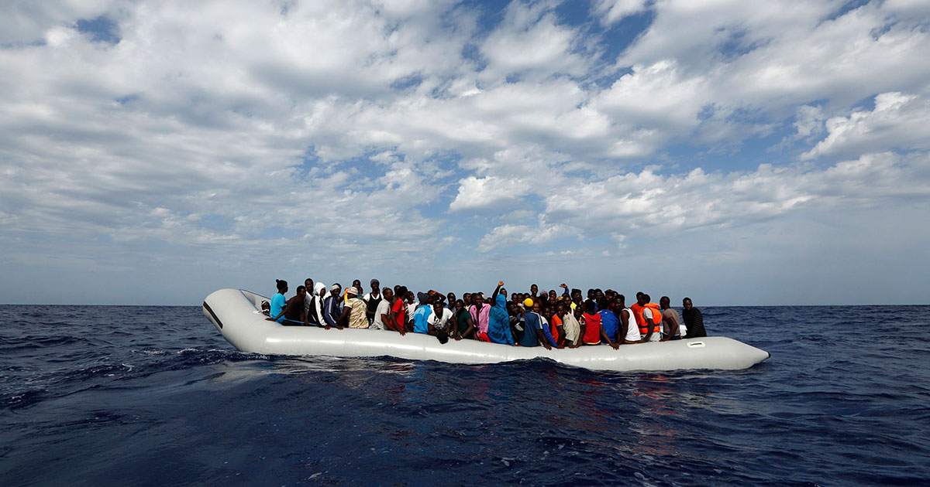

Slide 6
Between violence and hope – youth work navigating insecurity and uncertainty
Smugglers, deportation, refugee camps, legal status, illegal, detention, irregular, borders
The subjective life-world of young refugees, the backdrop against which they try to make sense of their world, their journeys and their future
YW need to understand the legal terrain, administrative obstacles

Slide 7
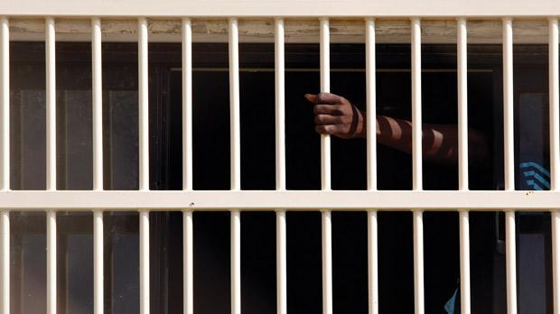

Slide 8
Najid who we met in Melilla, north Africa in August 2015 was sent back to Spain after losing an asylum appeal. The Dublin convention obliges refugees to stay in the country where they present themselves and once processed they can’t present as a refugee elsewhere. However, given the fragile nature of the economy in Spain, most people we have met leave straight away for France, Belgium and Germany. Many actually tried to go back to Germany even having been sent back to Spain. However, when Najid returned to Spain, he found no work and had no support so took an arduous trip back to Syria via north Africa. Before Christmas 2016, Najid was killed by the Syrian army. The only photo we have of him from Melilla is him celebrating freedom on the beach. [Field notes] (Briggs & Cordero)

Slide 9
Violence and multiple insecurities, war, persecution, loss of family and home, SGBV, institutional violence, racism and hate crime, deportation and human rights violations
Waitinghood: a draw-out process marked by insecurity and precarity
Beyond binaries: vulnerability, agency and resilience
Recognize the role and limitations of youth work
Trauma-informed youth work practice
Understand and navigating complex legal terrain
Transitions: access to rights associated with adulthood
Defining youth participation in this context

Slide 10
“How can you say that a person is a victim when they have been through so much? I am a survivor, I am not a victim…You are the one who is making me a victim…you put this label on me” (interview participant, female youth refugee, in Gateley and Refugee Youth)

Slide 11
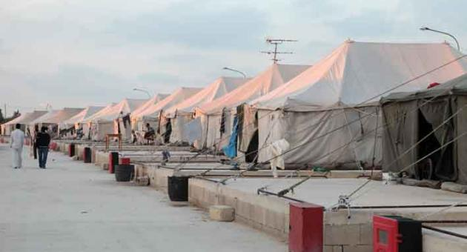

Slide 12
Youth work, cross-sectoral partnerships and relationships
new alliances, cross-sectoral cooperation and working relationships with other service providers and professionals
tap in to diverse perspectives, resources and expertise
develop service provision, practice and youth policies
Youth work in emergency contexts – way forward?

Slide 13
`My home will close. They will transfer me and my friends to different homes. I will lose my friends, my home and since I will be moved very far, also my job.´ (Abbas, 17 years of age from Afghanistan, in Eicken)

Slide 14
Ongoing disruption and new contexts
Isolation, othering and racism, barriers to accessing rights
Language and cultural barriers
Social capital: bonding and bridging
Cross-sectoral cooperation throughout all chapters
Relationships matter: trust, friendships, support networks, communities
Communities, education, employment, media…

Slide 15
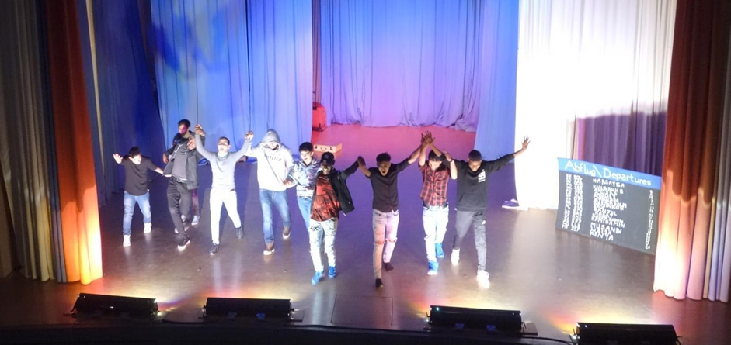

Slide 16
YW respond through informal and nonformal learning
Language, play,
friendships and relationships
theatre and the arts, sports, leasure-time activities
Dialogue, participatory methodologies, horizontal approaches

Slide 17
“One young person who came to our Youth Club couldn’t speak English and I couldn’t speak their language, but they sat next to me, and we communicated through grunts, signs and drawings. Each session she came back and sat next to me and we engaged with each other and formed a relationship, despite it being several weeks before we could communicate through words” (in Williams)

Slide 18
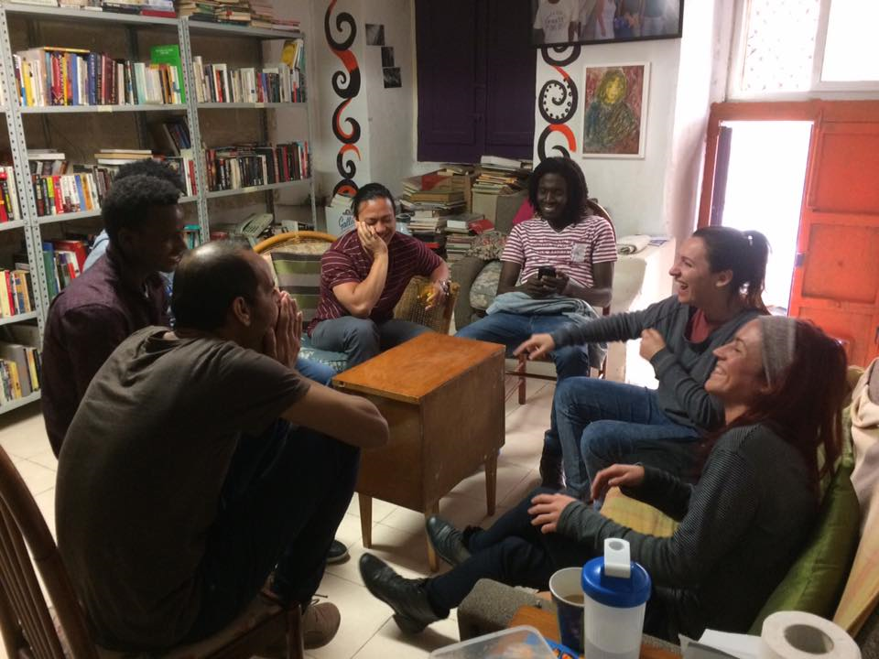

Slide 19
Political contributions of youth work and policy – embracing and shaping a more dynamic and diffuse new world order
The arrival of the ‘Other’ is forcing us all to reflect on the complexities, risks, disruptions and possibilities of the ‘post’ world we call home.
The nation state and the comfortable familiar challenged by growing global, regional and local economic inequality, climate change, political unrest and transnational conflicts and disasters.
New opportunities and the excitement of unknown and yet unimagined possibilities.
Youth work is embracing the unknown, and this in itself is a strength.

Slide 20
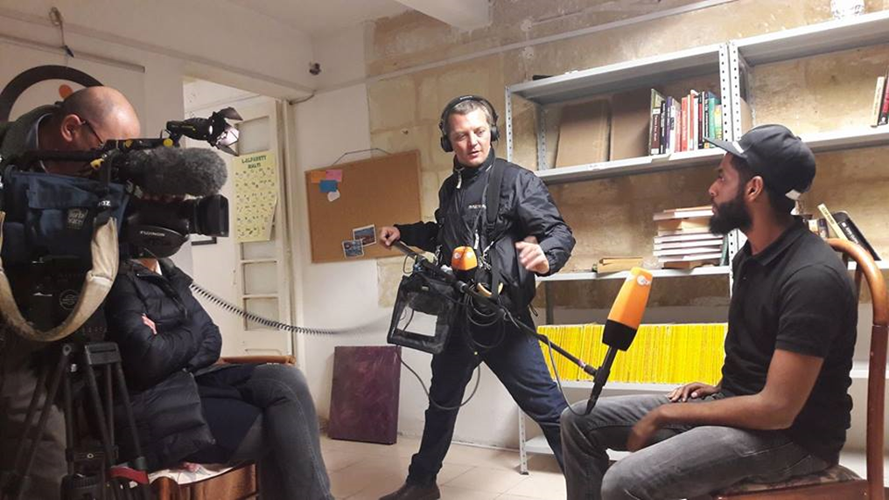

Slide 21
“Joining Spark 15 has given me the opportunity to make new friends from the different nationalities and cultures with whom I have common challenges with and meeting regularly to discuss ways to tackle and improve on our challenges. This has helped me getting to know members and develop a strong bond and being inspired to take on advocating for equality” (Bakary Kanteh, member Spark 15 in Galea & Kanteh)

Slide 22
What does YW stand for?
Respect for each and every individual
Participation and inter and intra-cultural dialogue
Young refugees are young people first and foremost
Inter and intra-sectionality
A space for building political agency

Slide 23
A transformative practice that moves beyond youth workers as providers of recreation to engaging with the structural inequalities that shape young people’s lives
Recognizing the inalienable human rights of every young person, not just as an ethical stance, but also as a legal obligation of the State
Supporting inclusion and participation through critical engagement, dialogue and participation, knowledge and action
Advocating with, and sometimes on behalf of young refugees and migrants

Slide 24
Thank you

