Slide 1
Finnish Youth Research Network
Knowledge building for youth work development: how can knowledge support the development of youth work?
Ljubljana 14/11
Tomi Kiilakoski

Slide 2
Mapping the Educational Paths of Youth Workers Study: how the data was grouped
Sayings = Legislation, Competency framework, Quality Assurance
Doings = Vocational Education, Higher (Tertiary) Education, National support for Non-Formal Learning, Sustainable and Identifiable Career Paths
Relatings = Associations of Youth Work

Slide 3

Group 1. Strong practice architectures
Legislative definitions
2. Competency description and/or
3. Quality assurance
o
strong Associations of youth workers
Belarus
Belgium (French)
Estonia
Finland
France
Germany
Ireland
Luxembourg
Slovakia
UK (England)
UK (Wales)
1. Vocational education on youth work
2. Tertiary education for youth work
3. Public support for non-formal learning
4. Identifiable and sustainable career paths
Formal learning,

Slide 4
Group 2. Strong practice architectures, room for development on certain level
Usually legislative definitions
2. Competency description and/or
3. Quality assurance work education
Associations of youth workers
Austria
Belgium (Flemish)
Belgium (German)
Czech Republic
Iceland
Liechtenstein
Malta
Portugal
Russian Federation
Serbia
Sweden
The Netherlands
1. Usually vocational education on youth work and/or
2. Tertiary education for youth work
3. Usually public support for non-formal learning
4. Usually identifiable and sustainable career paths
ng, economic Formal learning,

Slide 5
Group 3. Practice architectures where some parts have been developed
1. Usually legislative definitions
2. In some cases competency description and/or
3. Quality assurance
Armenia
Bulgaria
Latvia
Lithuania
Norway
Slovenia
The Former Yugoslav Republic of Macedonia
Turkey
In some cases
associations of youth workers
1. Usually vocational education on youth work and/or
2. Tertiary education for youth work
3. In some cases support for non-formal learning
4. Usually no identifiable and sustainable career paths
ng, economic Formal learning,

Slide 6
Group 4. Practice architectures in the need of development
Usually legislative definitions
Albania
Azerbaijan
Bosnia and Herzegovina
Croatia
Cyprus
Georgia
Greece
Italy
Moldova
Montenegro
Poland
Romania
Ukraine
In some cases
associations of youth workers
1. In some cases tertiary education for youth work
2. In some cases public support for non-formal learning

Slide 7
The comparative perspective on youth work practice architectures
Sayings/cultural-discoursive dimension: how youth work is recognised, formulated, talked about and debated.
Doings/structural-occupational dimension: how youth work education is supported and how youth work can be a sustainable career.
Relatings/social-political dimension: how youth work is recognised, supported and organised so that it can relate to young people, general public and other professional cultures.
(As formulated by Howard Williamson in his commentary)

Slide 8
A youth worker perspective
“It has always been difficult for me to justify youth work to the politicians and others.”
“When somebody says, ‘Oh, you are a youth worker, what exactly do you do?”, I have never been able to answer.”

Slide 9
Research perspectives
“The challenge has always been persuading others that youth work is anything more than ‘ping pong and pool’” (Williamson, 2012: 41-42.)
“To determine what we are and what we are not”. This “requires articulating our philosophy and principles for work with young people as well as naming the proven research-based methods and techniques that make sense in light of our goals”. (Walker, 2016: 14.)

Slide 10
Youth knowledge books on youth work knowledge in SEE
“Apart from general impressions and overviews, evidence on the existing processes and initiatives that could provide data for evaluation and monitoring is missing in all of the countries discussed.” (Draško, 2016: 137.)
” There is no empirical research on youth work practice, nor academic texts on youth work conceptualisation applied to the Croatian context. … Most information on youth work in Croatia could only be acquired from reports developed by various youth organisations, while at the same time those who work with young people (youth workers) suffer from a lack of competence in the area” (Kovačić & Ćulum, 2018: 149.)
  Transition vs. Tradition (Petkovic in this seminar)

Slide 11
Knowledge about youth work
Knowledge of the professional vocabulary, ethos, methodology and cultures of the youth workers themselves
The impact of youth work: well-being, peer relations and career paths of the young
The opinions, experiences, cultures and needs of the young people themselves inside and outside youth work
The place and role of youth work in the general youth policy or multi-professional net-works

Slide 12
1. Youth worker perspective
The outside perspective: Sometimes other people do not know what youth work community is about and why it does what it does. Spelling this out is needed to convince others about the value of youth work.
The inside perspective: We need tools to analyse youth work and develop it.
Example 1. Quality and Self-Assessment Model in Finland

Slide 13
Assessment model in Finland developede to evaluate youth clubs —why? (according to Sirpa Räikkönen)
Youth work requires a qualitative assessment tool
- > quantitative indicators are important, but other tools are needed as well
We need evidence so youth work is needed in the future too
Assessment is needed as the foundation to develop the work
Youth workers find the criteria an easy way to understand what types of components good work is made up of - > in every city and whole Finland
With the criteria and levels, a shared meaning and understanding is created for high-quality activities

Slide 14
Example of the criteria

Slide 15
Example of the criteria

Slide 16
2. The impact of youth work
Measuring the impact of youth work has been a controversial issue in the research of youth work. Opinions range from explicating youth work as ’a clear business idea’ to denying the possibility of measuring the outcomes because of the open-endedness and process-based nature of youth work.
Quantitative measures aim at developing indicators, qualitative measures aim at analysing the narratives and experiences of the young people.
Example 2. Developing indicators
Example 3. Transformative evaluation: looking as stories of change

Slide 17
Finding the right indicators (Improving Youth Work: 33)

Slide 18
Morciano & Cardigno : The impact of youth work in Italy (in Ord & al. 2018)

Slide 19
Morciano & Cardigno : The impact of youth work in Italy (in Ord & al. 2018)

Slide 20
3. Opinions, needs, cultures of the young
Youth work is done for young people and with young people. Without the knowledge on young people doing quality youth work is difficult. This creates a bridge between youth work and youth research.
Creating a knowledge base for examining the lives of the young people is important for youth policy. However, this should be done in a systematic, continuous and long-term manner. This way one can trace trends and evaluate if youth policy is succesful.

Slide 21
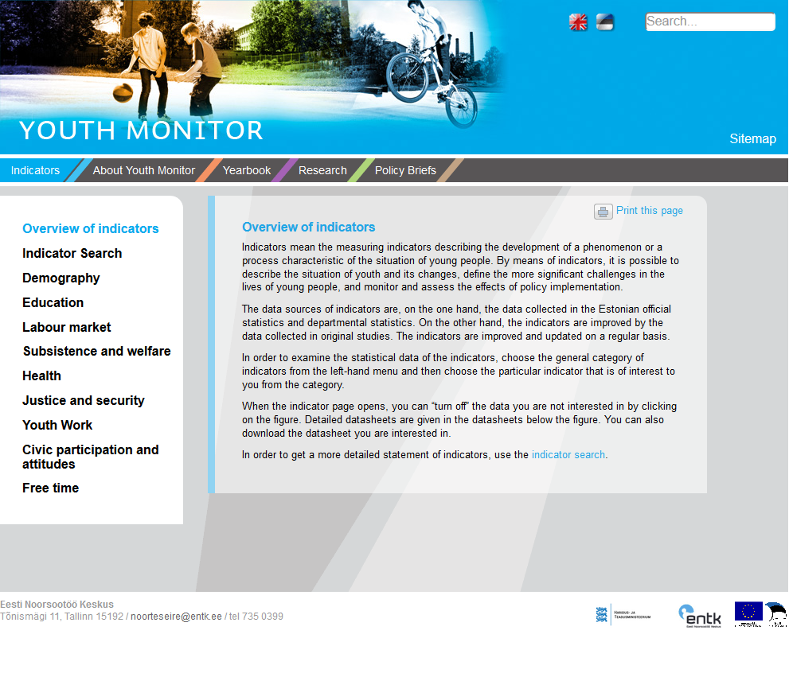
Indicators in Estonia

Slide 22
Finnish Youth Barometer

Slide 23
References
Draško (2017) Theories and concepts of youth work in South-East Europe. In Schildt, Connolly, Labadie, Vanhee & Williamson (eds.) Thinking seriously about youth work. Youth Knowledge #20. https://pjp-eu.coe.int/documents/1017981/1667851/Thinking+seriously+about+YW.pdf/6b620a71-f7be-cf80-7da9-17408a3960ba
Kovačić & Ćulum (2018) A new kid on the block: youth work meets youth policy in Croatia. In Williamson, Basarab & Coussee (eds.) History of Youth Work vol. 6. https://pjp-eu.coe.int/documents/1017981/1667851/History-of-Youth-Work-6.pdf/d4b829a2-3e82-8ff4-9e5b-ea61e5eb5f4f
Nöjd & Siurala (2015) Youth Work Quality Assessment. http://www.nuorisokanuuna.fi/sites/default/files/filedepot/youth_work_quality_assessment_verkkoversio.pdf
Ord & al (2018) The Impact of Youth Work. https://www.humak.fi/wp-content/uploads/2018/09/The-Impact-Of-Youth-Work.pdf
Quality Youth Work. European Commission. http://ec.europa.eu/assets/eac/youth/library/reports/quality-youth-work_en.pdf
Youth Monitor. Estonia. http://www.noorteseire.ee/en/about-youth-monitor/structure-of-youth-monitoring

