Slide 1
Youth work history in Europe workshops – a response
Walter Lorenz
Charles University Prague
(Free University of Bozen)

Slide 2

Blankenberge 2008

Slide 3

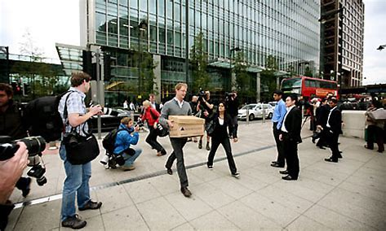
2008 Wall Street

Slide 4
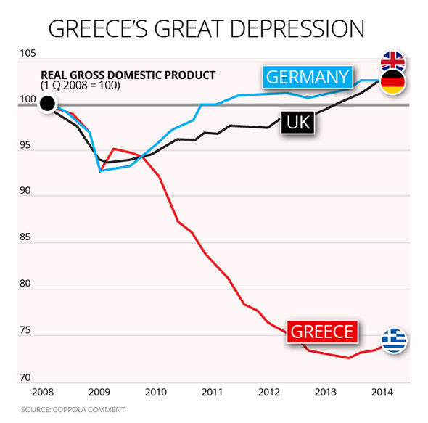
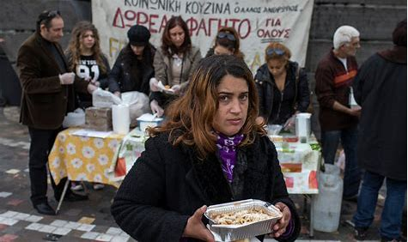

Slide 5


Slide 6
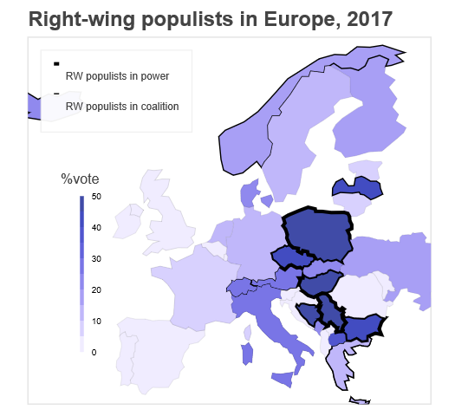

Slide 7
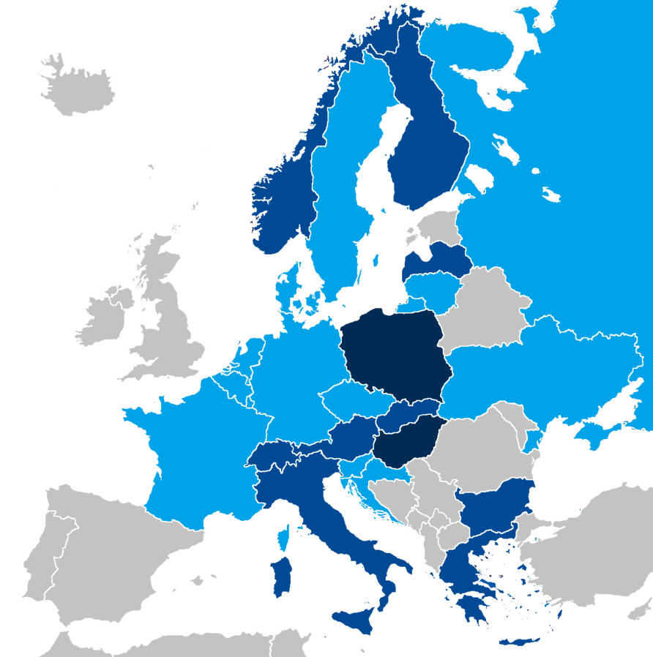
European national parliaments with representatives from right-wing populist parties in December 2017
﻿

Slide 8
The importance of regarding youth work as historically and culturally contingent
.’Taking an historical perspective which is being gradually eliminated from training programmes, becomes therefore something of an oppositional act’.
Tony Jeffs (in volume 2, p.22),
Hence the overall conclusion of the project is that youth work must be understood as a relational activity both in the sense that it is essentially about fostering relationships among young people and between them and society

Slide 9
Fundamental polarisation
Youth work in its various recognisable formats represents the nature of the relationship between young individuals and society as either an expression of agency on the part of young people and their leaders or as structural imposition shaped by various political, ideological, cultural and economic interests.

Slide 10
Fundamental polarisation
Youth work in its various recognisable formats represents the nature of the relationship between young individuals and society as either an expression of agency on the part of young people and their leaders or as structural imposition shaped by various political, ideological, cultural and economic interests.
Forum type approaches Youth giving (democratic) impulses for the renewal of society

Slide 11
Fundamental polarisation
Youth work in its various recognisable formats represents the nature of the relationship between young individuals and society as either an expression of agency on the part of young people and their leaders or as structural imposition shaped by various political, ideological, cultural and economic interests.
Forum type approaches Youth giving (democratic) impulses for the renewal of society | Transit zone approach Youth as having to learn how to adapt properly to the norms of society

Slide 12
Value of a historical perspective on youth work
Youth and youth work as contested field over value orientation of society overall
Youth work is, directly or indirectly, part of the “social question” of modern societies, the search for best forms of social integration (“welfare regimes”)
Public funding for youth activities is contentious – furthering autonomous activities or targeting specific (behavioural) outcomes?

Slide 13
Origins of youth work – addressing needs:
Need for education (supplementary to schooling): personal skills, craft skills, hygiene,
Need for protection and welfare: clubs as ‘safe havens’, social bonds, compensatory activities which youth could otherwise not afford
Need for leisure activities and opportunities: sports clubs with or without competition, ‘breathing space’, being together, Ferienkolonien
Need for citizenship education: imparting civic ideals, building nations
Need for political engagement: autonomous or organised movements, student movement, political opposition or conformity

Slide 14
Forms of youth work characterised by diversity
‘Is youth work a social service delivery mechanism, an allied educational system, a community recreation programme, a problem prevention scheme, a client service system of case management, an intervention unit to pull out when something goes wrong, or a service on the side of young people?’ Joyce Walker
Independent and then affiliated to / incorporated into state services: Scouts, YMCA / YWCA
Official responses to ‘moral panics’ (youth riots, disaffected youth)

Slide 15
Theoretical underpinning
Social group work (Gisela Konopka)
Community education
animation socioculturelle,
Social pedagogy
Positive youth development (PYD)
Overall: distinction from both school pedagogy and social work

Slide 16
Social policy frameworks
Close relationship to “welfare regimes”
  Liberal / residual: state as last resort; freedom and autonomy
  Social-democratic: good public services; equality
  Bismarckian / conservative: civil society duties; identity and community
Recent changes in welfare consensus:
  Reduction of public expenditure, contracting out, commercialisation
  Accountability and efficiency
  Activation and responsibilisation

Slide 17
Post-modern culture, hyper-capitalism and youth work
‘This stable, pluralised coexistence of styles leads to a cultural mainstream formation built of very different but coexisting minorities. Although what is now a postmodern formation of plural minority cultures would previously have embodied emancipatory potential in the context of Fordist industrial systems, it seems no longer able to fulfil this potential within the current contexts of globalised hyper-capitalism. In the end, postmodern capitalism needs exactly the flexible, dynamic and youthful ego-tacticians that, like the members of the minority youth cultures, can flexibly reinvent themselves according to the rapid demands of change in a global culture of competition.’
(Spatscheck, 2011: 146)

Slide 18
Trends in youth work in the last decade (EC 2014)

Slide 19
Is the distinction “forum” – “transit zone” still useful?
Youth as a ‘precious resource’ (in view of drastic changes in age structures) requires explicit public attention, support and resourcing, - but political impositions are unacceptable
Can youth work still provide a “safe haven” where youth practise “being together” – or does it need to engage with the urgent issues of the future explicitly and pedagogically?
How to ‘steer’ youth work in the age of drastic shifts in ‘seats of governing’ – commercial pressure, power of social networks, Mafia-type clans fostering protection and self-interest

Slide 20
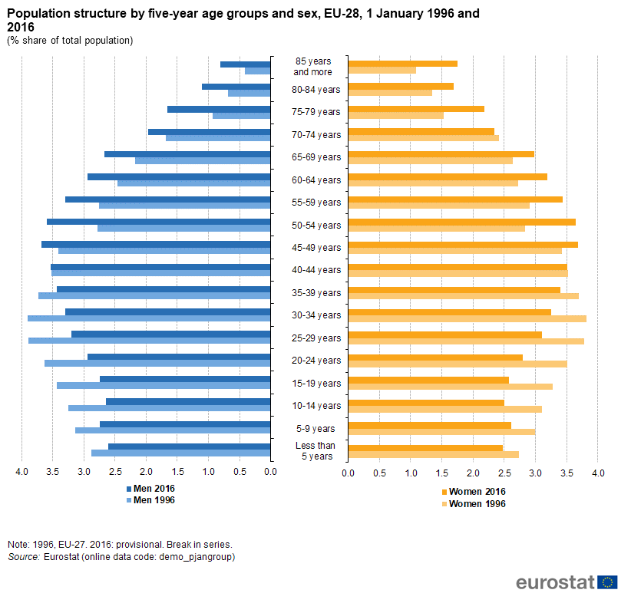

Slide 21
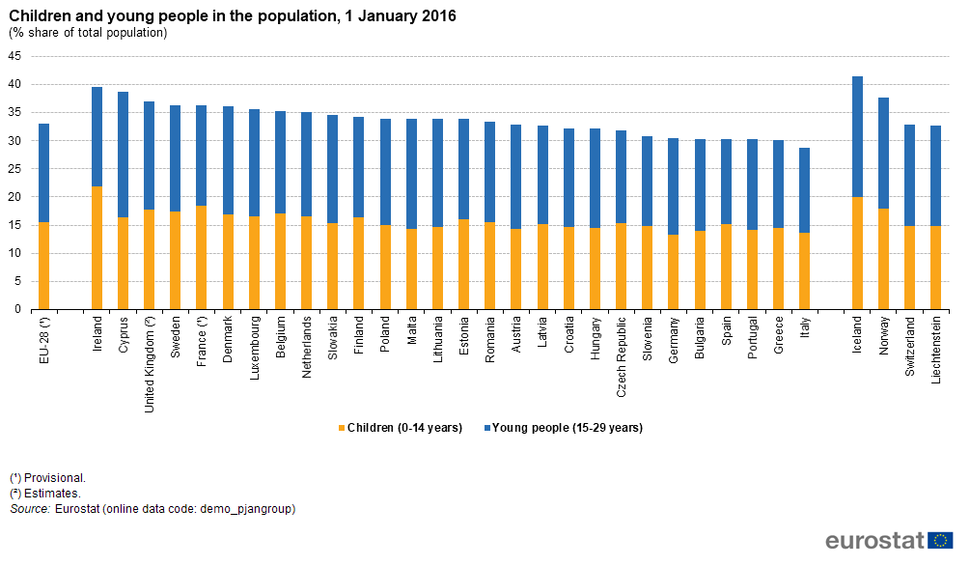

Slide 22
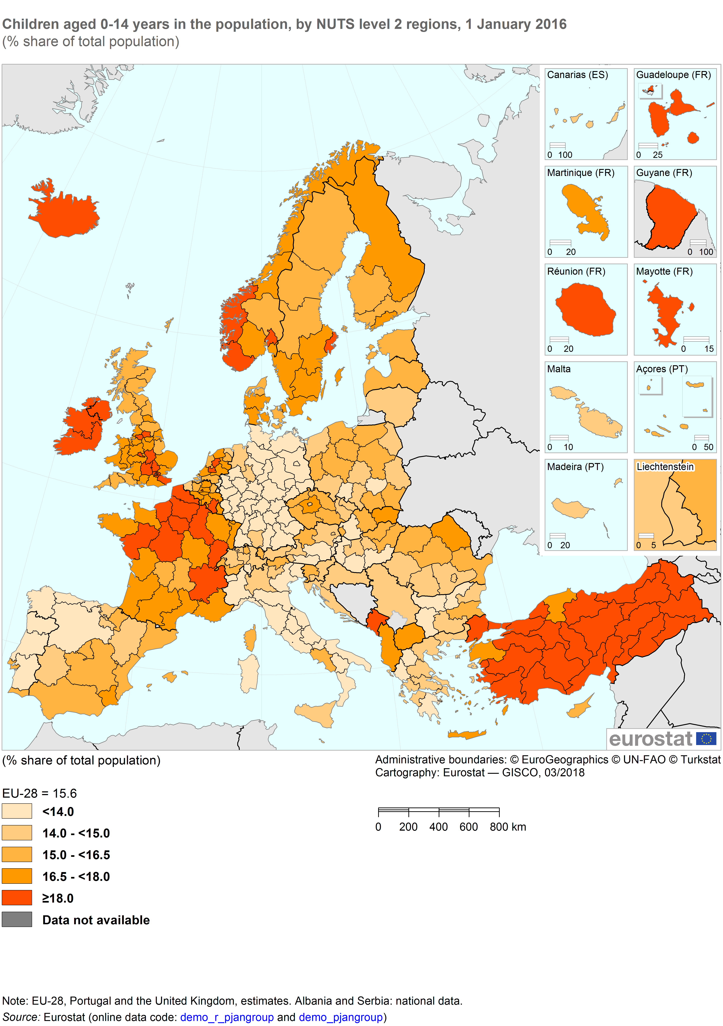

Slide 23
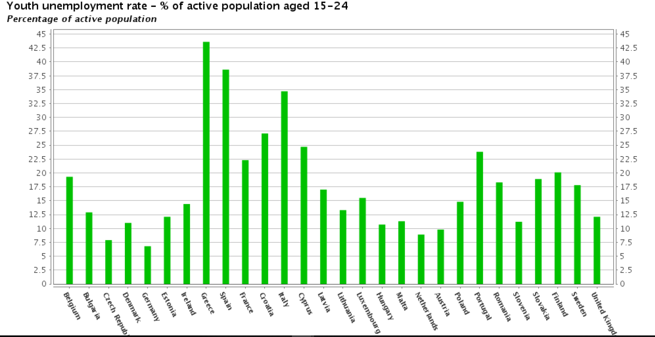

Slide 25
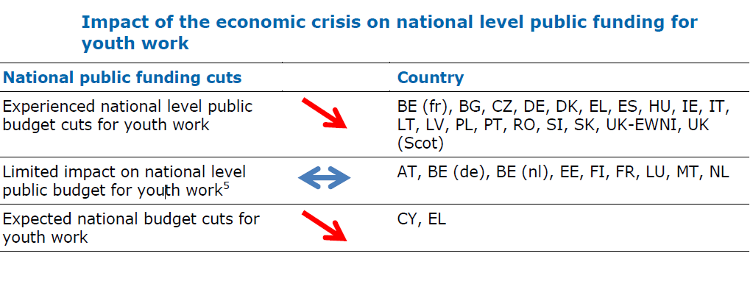

Slide 26
Impact of economic crisis on youth work
The majority of EU countries have experienced cuts to public funds to youth work due to the economic crisis (at national and municipality level);
There is a growing use and reliance on EU level support and financing for the youth work sector as other sources of funding at national level are reduced;
The priorities for public funding of youth work have changed. There is greater emphasis on youth work targeted at giving young people better opportunities on the labour market and in education

Slide 27
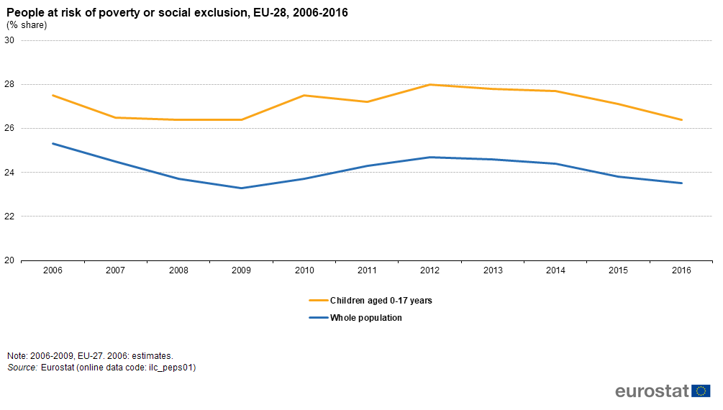

Slide 28
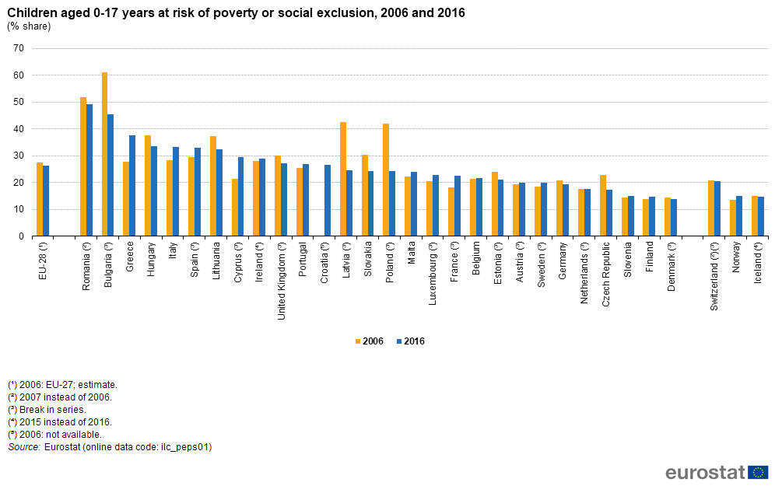

Slide 29
Dominant themes concerning youth
(youthpolicy.org)
Youth Employability, Livelihoods, and Entrepreneurship - in many regions of the world, a significant portion of young people is and remains unemployed for long periods, even when they have higher education qualifications. Research consistently shows that young people are more likely to be unemployed than their elders, especially in times of economic uncertainty or crisis. Much of the support is directed at individual young people “with a good idea,” who need funds to “make it happen,” especially in countries where the formal labor market excludes young people or where they are likely to be able to get only poorly paid jobs, or temporary contracts. This is also often the kind of employment which is first to be cut in times of crisis, putting young people at even greater risk of unemployment

Slide 30
Youth Development, Focusing Heavily on Formal Education - the great emphasis placed on formal education in terms of financial investments has not necessarily produced great results in development. This may be because of the insularity of such programs, focusing as they do only on formal education to the exclusion of non-formal education and other aspects such as the match (or, better put, mismatch) between education and the labor market; such dearth of results might also be attributed to a lack of awareness about the need to reform and improve training processes for teachers and other education professionals, etc

Slide 31
Youth and Participation - Youth participation (or, more narrowly, civic/political engagement) is a traditional focus of attention of both grant-making and operational programs. But, it has a tendency of fading in importance in the face of newer or more urgent issues that funders feel need to be addressed. Youth participation periodically resurfaces when young people are very visible in democratic change or when they are not visible enough in political milestones—national elections or European elections, for example.
European institutional funders often have it as a permanent priority. In other regions, such activity tends to be regarded with some suspicion—by governments especially. Hence, intergovernmental structures in some regions tend to avoid the issue and focus their attention on “nonpolitical” priorities, for example, development. If youth engagement is considered a priority, then the “nonpolitical” type of participation is favored—involvement in leisure-time activities, meaningful pursuits outside of school, actions that develop the competence of young people, other social and cultural activities.

Slide 32
Further topics for exploration
the gender dimension of youth work since the role of women in the economy has undergone strong variations in the historical perspective covered by these volumes.
youth work to address and make a contribution to the position of young migrants and refugees. The contributions hardly make reference to this group of young people although their ambivalent treatment by social services is symbolic of the dilemmas that accompanied the development of youth services and youth policies historically.
the role of social pedagogy as a conceptual and methodological medium

