Slide 1
EUROPEAN YOUTH FORUM

Slide 2
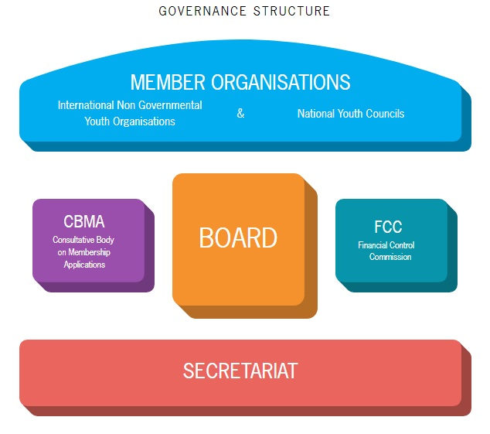
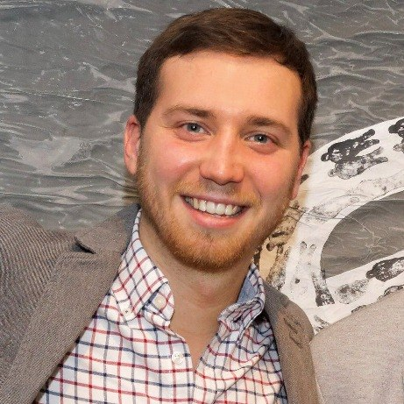
Platform of youth organisations in Europe
Over 50 million young people
Entirely run by young people
Notes:
2

Slide 3
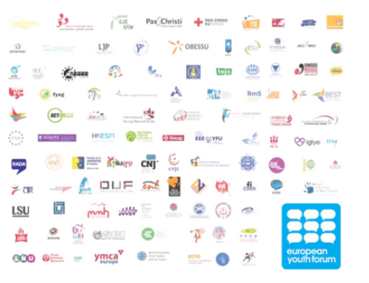
Made up of 104 National Youth Councils and International Non-Governmental Youth Organisations, which are federations of youth organisations.
Notes:
3

Slide 4
Vision
To be the voice of young people in Europe, where young people are equal citizens and are encouraged and supported to achieve their fullest potential as global citizens.

Slide 5
What does it do?
Represents the common interests of young people all over Europe and fights for their rights

Slide 6
Advocacy
Youth Rights
Strong Youth Organisations
Youth Participation
Social & Economic Inclusion
Sustainable Development

Slide 7
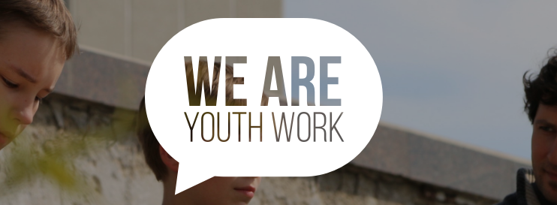
Promoting Youth Work
Notes:
7
Secretariat – experts in different areas eg youth policy, volunteering, education, employment…

Slide 8
History
Established in 1996
Independently established by youth organisations
Notes:
8

Slide 9
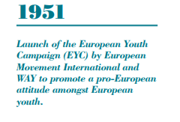
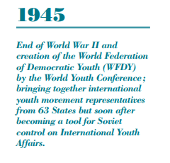
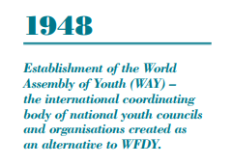
Notes:
9

Slide 10
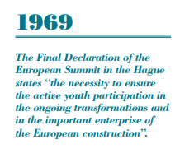
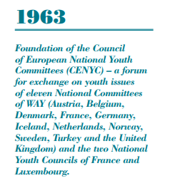
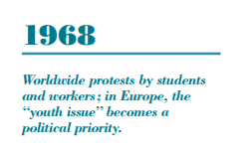
Notes:
10

Slide 11
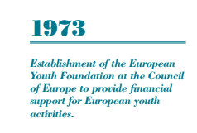
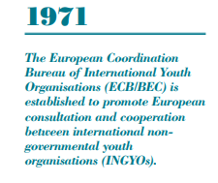
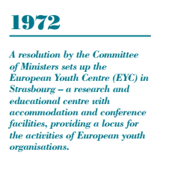
Notes:
11

Slide 12
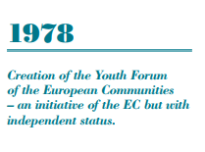
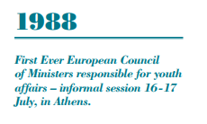
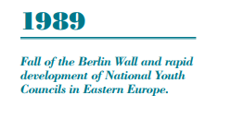
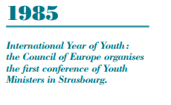
Notes:
12

Slide 13
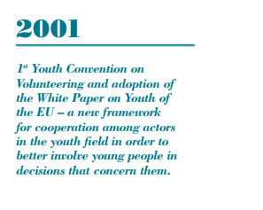
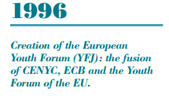
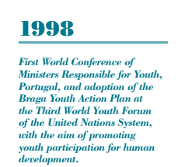
Notes:
13

Slide 14
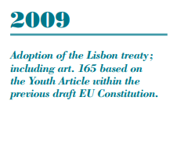
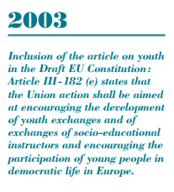
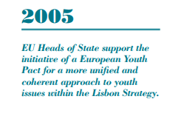
Notes:
14

Slide 15
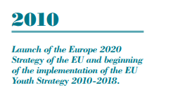
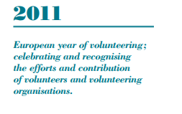
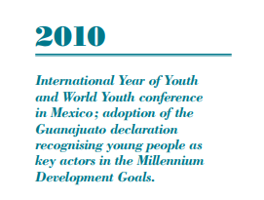
Notes:
15

Slide 16
THANK YOU!

