Slide 1
THE DUKE OF EDINBURGH’S INTERNATIONAL AWARD
EQUIPPING YOUNG PEOPLE FOR LIFE AND WORK
03-10-2018
Notes:
Introduction
-I work in the research team (what we do)
-I’m also a Gold Award Holder – can share some of my experience with you today
Going to talk through:
The history and structure of the award
The field of youth work & our contribution
Our organisation: The Foundation: how and where it is delivered, the critical moments in our history.
The impact of the award.

Slide 2
The Duke of Edinburgh’s International Award…
is a framework for young people that encourages learning and self-development outside the classroom.
Notes:
In short….
The Duke of Edinburgh’s International Award (the Award) is one set framework of learning for young people that
encourages learning and self-development outside the classroom (or what we all call ‘non-formal education’).

Slide 3
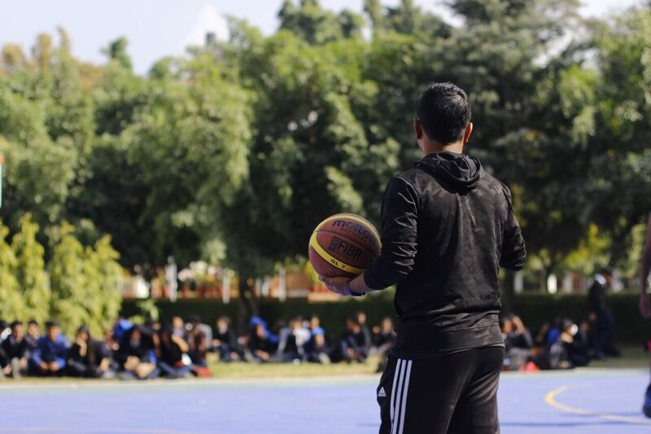
THE HISTORY OF THE AWARD

Slide 4
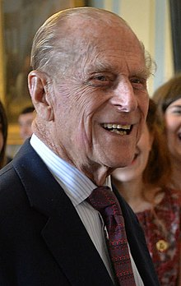
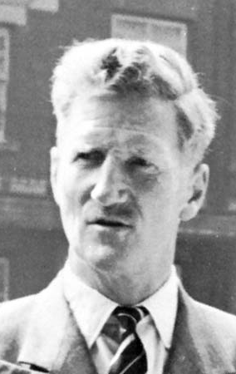
The History of the Award
The Founders of the Award
Kurt Hahn
Duke Of Edinburgh
Lord Hunt
Notes:
The Award was founded in 1956 by Kurt Hahn - a German educationalist
He approached Prince Philip, The Duke of Edinburgh, who found a similar passion the programme and used his contacts to set up and grow the Award.
Along with Lord Hunt, who was leader of the first successful ascent of Mount Everest, and first Secretary of the Award, establishing it as a charitable trust and leading its development in the initial years
They got together in response to growing concern in the UK about the development of boys, due to the gap between leaving school at 15 and entering National Service at 18.
Reaction so good from participating young people and their schools… it became available to girls, and in other countries soon afterwards, and today the Award is present in over 130 countries and territories, with over 1.3 million participants taking part in 2017.

Slide 5
The History of the Award
Kurt Hahn’s Philosophy
Kurt Hahn hypothesized six declines of modern youth:
Decline of Fitness
Decline of Initiative and Enterprise
Decline of Memory and Imagination
Decline of Skill and Care
Decline of Self-discipline
Decline of Compassion
Notes:
Structure of the Award based on Kahn’s educational theory. I will share some aspects of this.
To give this some more context, his theories were developed during an interesting time in history- he left Germany during the risk of Adolf Hitler before WW2, and was looking for a way to create a stable community and believed in the good of young people and wanted to harness their power.
He founded many schools in the UK such as Gourdonstoun – Prince Philips school.

Slide 6
The History of the Award
Kurt Hahn’s Philosophy
He further developed a program of ‘experiential therapy’ (Erlebnistherapie) as an antidote to these declines:
Fitness training, to train the discipline and determination of the mind through the body
Expeditions, to engage in long, challenging endurance tasks
Project work, involving crafts and manual skills
Service, for example surf lifesaving or first aid
Notes:
For example – this service, to give young people a positive purpose for life
Having them taking on responsibility (by running their own projects and expeditions) to show them the consequences of their actions.
(all part of his work to create a harmonious society)
-> basis for other programmes too – IB, Roundsquare.

Slide 7
The History of the Award
Kurt Hahn’s Philosophy
These became the sections of the Award Framework:
Fitness training -> Physical Recreation
Expeditions -> Adventurous Journey
Project work -> Skills
Service -> Voluntary Service
Gold Residential Project is added
Notes:
These sections became the sections of the Award – talk through my experiences.
Gold Residential Project – ME! Doing the Award, going to Spain etc.
Framework was finalised in 1980 after a couple of changes in age ranges and requirements.
Following cultural shifts – girls and boys doing same activities – smart targets came in so it’s achievable for all.
For example – adolescence length grew, and the award increased in age range in response to this.

Slide 8
The Award Framework
Notes:
The final structure:
For 14 – 24 year olds
3 levels, can do all or one.
Voluntary and participant led – choosing own activities, sense of achievement.
Individual but with team aspects
Non-competitive
Commitment to activities over time. – research shows that after participants participate in these activities regularly for the duration of the Award, the majority plan to, or actually continue pursuing these activities, forming healthy habits for life.
48% before the Award volunteering regularly – 84% intend to continue afterwards.
Internationally recognised certification of learning outside the classroom.
Maintains its relevance over time: Activities chosen by young person – so works in any age (over 60 years, from learning latin to coding) and works in any context because of it’s flexible nature – we have schools, young centres, prisons / young offenders institutions, other youth orgs such as the scouts and the red cross, running the Award.

Slide 9
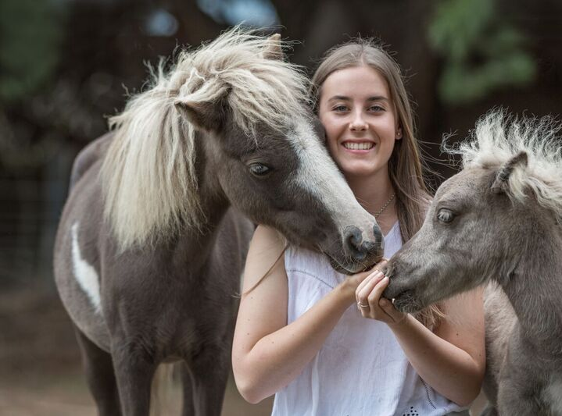
‘THERE IS MORE IN YOU THAN YOU THINK’
Kurt Hahn.
Notes:
The Award is a non-formal education framework, which aims to equip young people with skills for life
The structure looks complicated at first, but it’s all about encouraging young people to learn and develop outside of the classroom –to show them ‘there is more in you than you think’.

Slide 10
Supporting Adults in the Award
Last year 180,000 adults supported the delivery of the Award.
An emphasis is placed not only on developing young people, but on supporting and developing the adults who support Award participants.
Hahn’s seven laws of Salem:
‘have children meet with triumph and defeat’
‘give the children the opportunity of self-effacement in the common cause’
Notes:
Through the Award Journey – young peoples supported by a trained ‘Award Leader’ (depending on context – youth worker, teacher, prison officer, scout leader and so on).
We are working to ensure the Award experience is a high quality and positive experience for Award Leaders too, managing and delivering the Award also brings them beneficial outcomes and impacts their lives. Our learning and development team are committed to supporting them through various learning opportunities, and as you’ll see later – many digital tools…
-Stats: out of around 800 responses – 94% indicate they are involved because they are interested in the development of young people. We have a passionate network.
-93% felt they benefitted from being involved, and 98% felt they would recommend others to volunteer. But we still have a lot to work on – administration and ORB tasks etc. When asked why they felt they benefit – building new relationships with the young people, in different environments.
Kahn’s theories remain relevant in our teachings:
Today, the adults that support and assess participants’ Adventurous Journeys, are taught to let the participants lead and make their own mistakes, to learn lessons about working as a team to get through hardship during their journeys. Adventurous Journey Supervisors watch Award groups from afar, ensuring the young peoples’ safety but allowing them true responsibility and challenge. Award Leaders support and mentor participants through their Award Journey but allow them to take responsibility for their own participation and achievements.

Slide 11
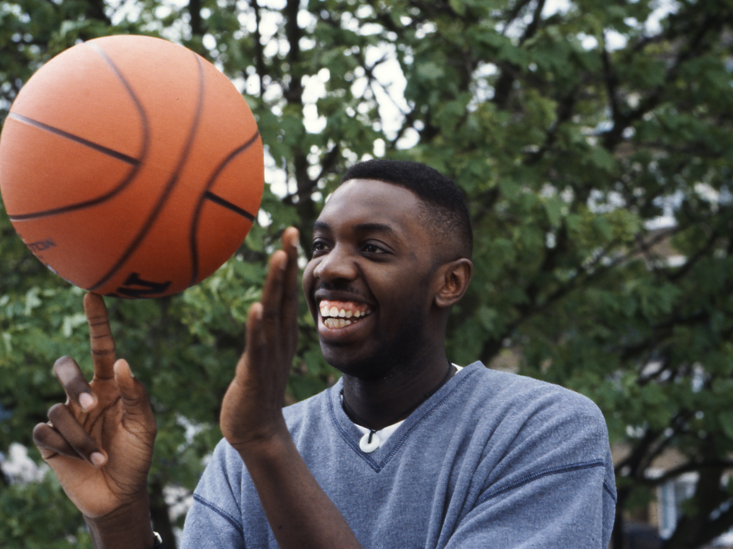
THE FIELD OF YOUTH WORK
Notes:
Now, discussing how the Award fits into the youth work field.

Slide 12
The Field of Youth Work
“Youth work, as it is largely understood at European level, is based on values and is about the promotion of human rights, diversity, social cohesion, peace and democracy […] what youth workers have and indeed should have in common is the fact that they all work directly with and for young people in non-formal education settings and with a defined intention”
Schild, Vanhee and Williamson (2017)
Notes:
Open, complex and interconnected field.
Its practice varies country to country, even youth worker to youth worker.
No internationally used definition and understanding of what youth work is but a good definition has been provided here’ – We see connections between the Awards outcomes and impact measures and what you see here – with values based learning for peace and democracy and so on.
Youth work may be a fluid, informal process within an open-access youth setting, in which youth workers try to foster a connection with the young person, then work together on set activities or objectives. On the other hand, youth work can be set programmes and projects that young people opt into.
Whilst the Award can be delivered in an open-access setting, it requires persistent engagement over a long period of time so is most often delivered in settings where there is guaranteed contact with the young people.
Framework for anyone working with young people to use, in any setting. BUT – NEEDS REGULAR CONTACT AND PARTICIPATION BY YP.
Merging boundaries: Although youth work happens in non-formal settings:
Can be delivered by teachers in schools – but it’s extra curricular and voluntary and is of course taught in other ways. It’s not completely detached from formal education in some delivery contexts.
What we bring: The Award exists among other amazing youth programmes, and, this is what we bring to the youth work field:
it provides is a tried and tested framework (for anyone working with young people to use)
allows achievement to be recognised in a way that is consistent worldwide,
so giving young people internationally recognised accreditation of their experiences.
Grown year on year for 60 years.
Fits with with other youth organisations
Award run in partnership with other youth organisation such as here in Slovenia, the Slovenian Catholic Girl Guides and Boy Scouts Association have a partnership agreement with the Award.
*Big Six collaboration. (YMCA, YWCA, Scouts, Guides, Red Cross and Red Crescent) – working together to influence policies, ensure involvement of youth in decision making share knowledge and activity).

Slide 13
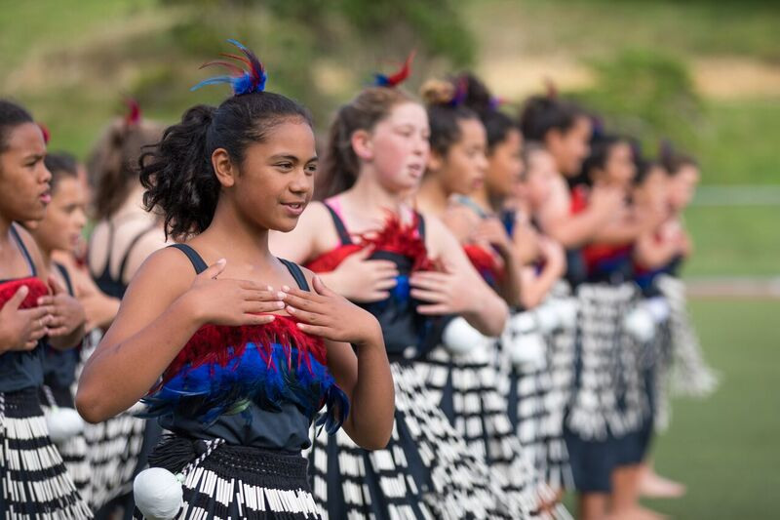
SLIDE DIVIDER
SUBJECT
THE FOUNDATION
How and where do we deliver the Award?
Notes:
Quick history of our organisation.

Slide 14
ORGANISATIONAL STRUCTURE
The Foundation
Licensed National Award Operators – 69
Licensed Independent Award Centres ~400
Emerging Leaders
Notes:
(The Foundation), supports the Award’s global delivery and growth through a social franchising system.
We were set up in 1988 due to the need to make the award consistent worldwide, and to scale it up.
We are an organisation with a programme designed by adults and run by adults ‘for’ young people, but we have processes by which they can feedback to us and be included in the delivery of the Award and in the future development of the Award. For example, our emerging leaders are nominated Award Holders who come to our association meetings to represent the views of young people.
Working through a network of licensed Award Operators,
We support national organisations in delivering the Award in their countries – provide operational guidelines and training
ensure consistency and quality in delivery globally – licence reviews, satisfaction surveys and so on
Supporting licensed operators’ strategies to grow the Award…
…and to reach more ‘at risk and marginalised’ young people.
**We work to increase global awareness of the value of non-formal education***

Slide 15
THE AWARD AROUND THE WORLD
Operating in over
130
countries & territories
Notes:
The basic principles and the framework of the Award have remained the same as when the idea was first conceived, but the modes of delivery continue to evolve and adapt to ensure quality and consistency in delivery, and to suit the demands of different cultural contexts around the world and the varying needs of young people.
Structure and requirements are the same, but it’s flexible enough to be tailored to it’s context and to each young person. (Schools, universities, workplaces, prisons, youth centres).
In Oz – bushwalking, but in … cultural examples
Another thing we’re proud of: Gender split –very equal numbers, 40% male, 40% female and 20% did not disclose their gender.

Slide 16
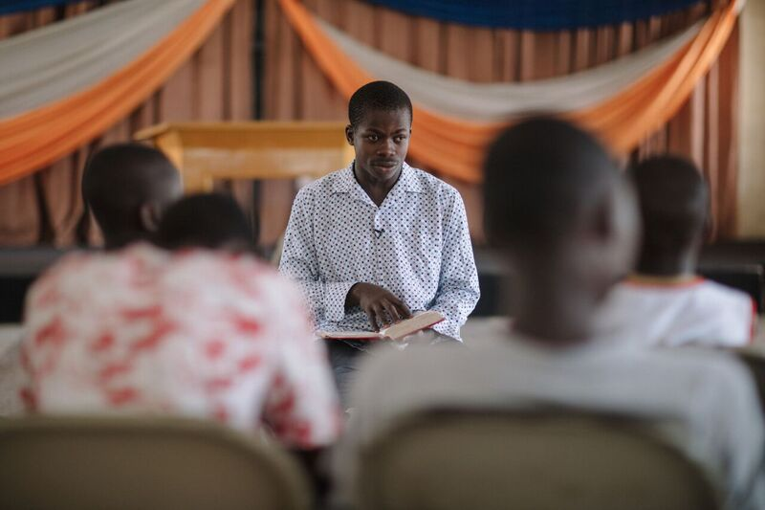
CRITICAL MOMENTS

Slide 17
CRITICAL MOMENTS IN OUR HISTORY
A timeline of events
1956
Launch of the Award in the UK
1958
-Girls Award launched -First schools outside the UK launch
1962
First directive on overseas policy and practice issued
1974
First overseas staff appointed
1988
The Duke of Edinburgh’s Award International Association is established.
2012
Launch of new global brand and digital tools
2016
60th Anniversary of the Award
Notes:
We have a long history, but for the purposes of giving some insight into our research progression and strategy, I will focus on the change process we went through in 2012.

Slide 18
CRITICAL MOMENTS IN OUR HISTORY
Social Franchising
Diagram of business replication options. (Adapted by De-Wint, 2012, from McNeill Ritchie et al. 2011)
Notes:
After the Award began to expand globally, very organically..
However, there were challenges and risks involved in this expansion.
The Award’s entry into a country was somewhat uncoordinated, sporadic and at times unsustainable.
Growth was driven by expansion into new territories – not maximising the potential in existing territories.
Delivery relied on staff and volunteers’ willingness to support the Award,
No global brand or consistency in delivery standards.
quality assurance was not a consistent process,
The challenge for us was scaling up this big –without losing quality and local practice and knowledge – we didn’t want to centralise everything – so the social franchising system was perfect.
In 2012 – started the major change process to move from loose partnership to social franchising.
Franchises:
central support,
uniform quality standards
a common philosophy (purpose it to deliveyr & grow the Award, rather than profit)
Now we all work towards common aligned strategy – for example at risk and marginalised recently.
Now we can ensure that where we enter a county – we find the right organisation that has the capacity to deliver to high standard and grow the Award (licensing becomes the blueprint underpinning operations). Rather than entering a country without the right structured organisation and so on.

Slide 19
CRITICAL MOMENTS IN OUR HISTORY
Digital Innovations
Development and release of the Online Record Book in 2012
The Online Learning Hub for adults in the Award in 2011
More recently, trialling Virtual Award Centres
Notes:
Part of the change process of social franchising involved bringing in digital tools to support our global network of operators.
Online Record Book: Developed in response to growth worldwide, reflects general increase in use of technology, laptops and smartphones
Enables Award Leaders to easily monitor participants’ progress and keep them engaged
Encourages good record keeping of young people – can reflect on their progress at the end of Award
Easy portability of Award from AL to AL, or from P to another country
Enables award units to track their quality, growth and performance and at the NAO level too
Challenges:
Flexible Award programme, non-flexible nature of technology
Translations
Changing processes at an international level
Developed in consultation with stakeholders
OLH – similar
To support training and support for ALs online, rather than all learning being completed in face to face training course (expensive)
Encourages networking and sharing best practice as a community involved in the Award
VACs – reaching remote places and so on.
All about / responses to:
Scaling up while maintaining international standards,
Ensuring we can support for adults & YP.
Centralise information and stats

Slide 20
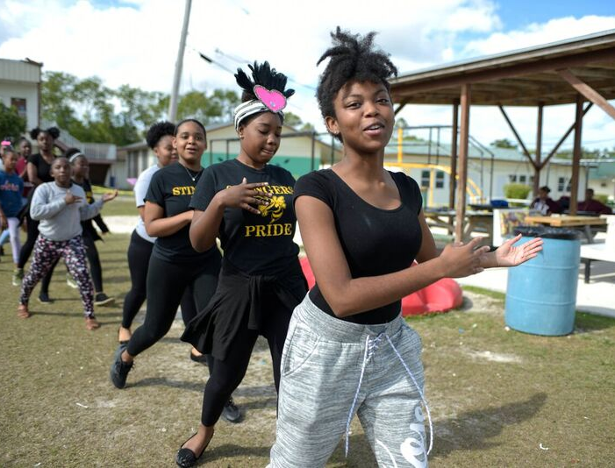
THE IMPACT OF THE AWARD
Notes:
Going to talk a bit more about the exciting stuff – why we do what we do. We have a research team now, since January last year, so we’re only just beginning to discover the true impact of the Award – and we have some really exciting research going on.

Slide 21
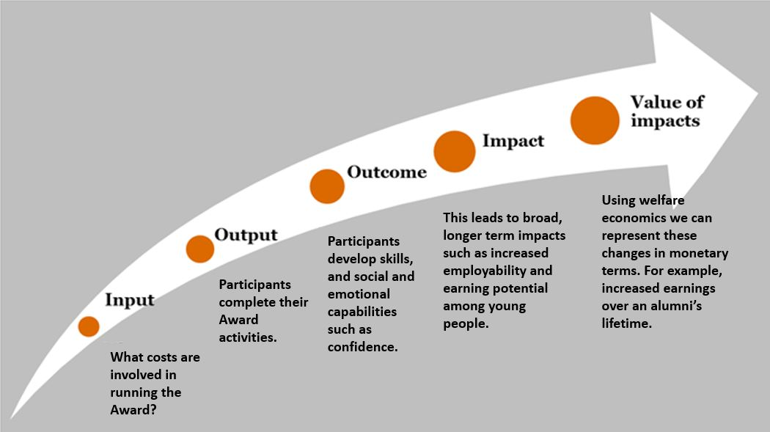
OUR THEORY OF CHANGE
Notes:
Recently, we’ve been working with PwC to calculate our social value. – Which is the final piece in this diagram – quantifying the impact we’re having and representing it in monetary terms.
As part of this work, we’ve been able to draw together our research learnings to communicate our theory of change.
I want to quickly run you through our outcomes and impacts here, and some of the research we’re doing on those.

Slide 22
OUTCOMES FOR YOUNG PEOPLE
Confidence
Managing feelings
Resilience and determination
Relationships and leadership
Creativity and adaptability
Planning and problem solving
Civic competence
Intercultural competence
Personal and social well-being
Communication
Notes:
As I’m sure you all know, there is wide evidence that taking part in organised activities during after-school hours, ->
makes essential contributions to individuals’ abilities to thrive in adolescence and adulthood
is positively associated with educational, civic, and occupational success in young adulthood
These are the particular outcomes we’ve identified for the Award, similar to other youth programmes and to the young foundations outcomes framework and others. Including civic competence and intercultural competence is often quite unique.
We are conducting wide scale, quantitative research on these outcomes currently –which I’d be happy to talk about later if anyone’s interested.

Slide 23
THE IMPACT OF THE AWARD
Reduced offending
Improved mental health and emotional wellbeing
Increased engagement with charitable and community causes
Improved environmental impact
Increased social cohesion
Improved physical health and fitness
Improved employability and earning potential
Notes:
Of course, when young people experience these positive outcomes, long term changes in society can be seen… our research has shown a link between the outcome measures and these impact measures. (stakeholder consultation, wider reading and so on…. More recently, working with PwC on social value to quantify these impacts).
These impact areas align well with the values of human rights, diversity, social cohesion, peace and democracy that are mentioned in Schild, Vanhee and Williamson’s definition of youth work, as previously cited (2017). Search for social cohesion, inclusion and diversity and so on.

Slide 24
THE SUSTAINABLE DEVELOPMENT GOALS
The Award’s outcomes and impact are in line with the SDGs.
We find connections between the Award and the following 9 SDG’s:
SDG3: Good Health and Well-being
SDG4: Quality Education
SDG5: Gender Equality
SDG8: Decent Work and Economic Growth
SDG13, 14 & 15: Climate Change, Water and Land
SDG16: Peace, Justice and Strong Institutions
SDG17: Partnerships for the Goals
Notes:
-as slide says.
How does all of our work link to a bigger picture.
I wont go into depth on this but have a paper I can send to anyone who wants to know how we’ve aligned ourselves to the SDGs.

Slide 25
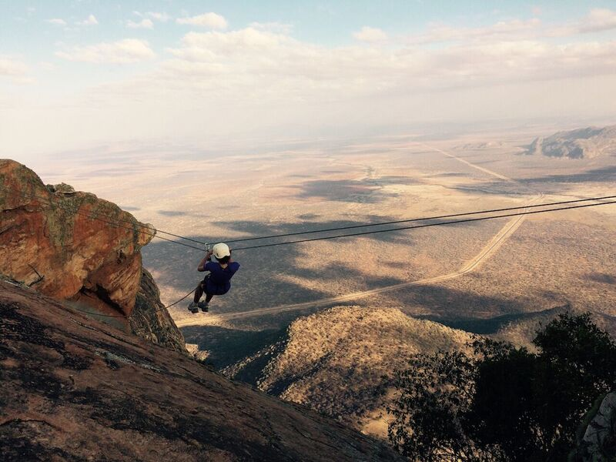
LOOKING TO THE FUTURE

Slide 26
LOOKING TO THE FUTURE
Our long term ambition is that every eligible young person will have the opportunity to participate in the Award.
Notes:
Our long term ambition is that every eligible young person will have the opportunity to participate in the Award.
We want more young people to experience these outcomes – quality formal education and quality non-formal education – learning experiences outside of the classroom.
This requires us to take a pro-active approach, to put in place greater capacity and break down the barriers to entry, both perceived and in reality.

Slide 27
LOOKING TO THE FUTURE
Our long term ambition is that every eligible young person will have the opportunity to participate in the Award.
Our vision is to reach more young people from diverse backgrounds and equip them to succeed in life.
Notes:
Our vision is to reach more young people from diverse backgrounds and equip them to succeed in life.
(If time – we are doing lots of work in this area including giving grants to organisations where they can grow the Award)
Numbers -11% now
By 2023 – aim to increase to 20%

Slide 28
THANK YOU
Amy Pearce
Research Officer, The Duke of Edinburgh’s International Award Foundation
03.10.18
Notes:
I hope that’s given you a good overview of what we do, how and why.
Any questions?

