Slide 2

‘…to stand beside the bourgeois alpine clubs and by asking low membership fees, give the opportunity to working-people to practice mountaineering …’
Foundation of the Naturefriends’ movement

Slide 3
‘…We want to pull the working-class-people out of the places of alcohol, gambling and playing card. We want to get them out of their small houses, the smoke of the factories and the pubs, to lead them into the wonderful nature, to let them discover beauty and happiness…’
Foundation of the Naturefriends’ movement

Slide 4
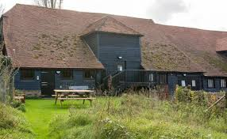
‘Berg Frei!’ v.s. ‘Berg Heil!’
Foundation of the Naturefriends’ movement

Slide 5
Regional Groups and Naturefriends Houses at the end of 1935
 | Regional Groups | Houses / Cottages
Switzerland | 132 | 74
Czech Socialist Republic | 108 | 28
Netherlands | 60 | 10
Belgium (Wallonia) | 6 | 1
Belgium (Flanders) | 25 | 2
Hungary | 10 | 9
Yugoslavia | 12 | 1
Poland (Warsaw) | ? | -
Poland (Bielsko) | 2 | 1
France | 22 | 10
USA | 17 | 10
Sources: ZA des TVdN: Annual financial statement 1938, p. 4, protocol of the 13th general assembly of the TVdN from the 7th to the 9th of August 1936 in Brno, p. 14

Slide 6
Membership Figures 1937 (without child-members)
Switzerland | 12,181
Czech Socialist Republic | 5,435
Netherlands | 11,356
Belgium (Wallonia) | 869
Belgium (Flanders) | 3,955
Hungary | 1,750
Poland (Warsaw) | 470
Poland (Bielsko) | 134
France | 1,950
USA | 1,773
IN TOTAL | 39,873

Slide 7

Adults – focus on work and management of the Naturefriends houses
1970s and Beyond:
A Difficult Road toward Independent Youth Work
Youth – focus on cultural and political work

Slide 8
March 1974
1970s and Beyond:
A Difficult Road toward Independent Youth Work
Jochen Zimmer,
the first International Youth Secretary of the NFI
Werner Schneider - the President of NFI
Hans Welti - the Secretary General of NFI

Slide 9
Disputes
1970s and Beyond:
A Difficult Road toward Independent Youth Work
over the independence of the NFJI
over the acknowledgement of ‘democratic socialism’

Slide 10
Stuttgart, Germany, July 1975
1970s and Beyond:
A Difficult Road toward Independent Youth Work
The first official Presidium of NFJI
Wim Bergans, Walter Gscheider, and Rudi Bergmann

Slide 11
NFJI becomes independent part of the NFI
1970s and Beyond:
A Difficult Road toward Independent Youth Work
NFI takes over financing guarantee, but has the ability to revise the NFJI finances
NFJI seat is supposed to be the same as NFI seat,
but temporarily is Stuttgart

Slide 12
1976
1970s and Beyond:
A Difficult Road toward Independent Youth Work
Supporting regional cooperation, especially in the Nordic area
Improving informational structures
Cooperation within the European youth politics

Slide 13
1977
1970s and Beyond:
A Difficult Road toward Independent Youth Work
NFJI reaches consultative status category C at the UNESCO
NFJI is a member of the Geneva Informal Meeting of the UN
IUSY - International Union of Socialist Youth
IFM-SEI - International Falcon Movement - Socialist Educational International
NFJI office moves to Strasbourg

Slide 14
1980
1970s and Beyond:
A Difficult Road toward Independent Youth Work
Seminar in EYC Strasbourg – no leaders at the spot
Official language switched to English
NFJI - IYNF
Geert Ates and Astrid van Herpen

Slide 15
1989 - 1992
1970s and Beyond:
A Difficult Road toward Independent Youth Work
IYNF opens to Central and Eastern Europe
Banners ‘East meets West’ carried on the streets of Gödöllö (Hungary) during an international camp
Russian young Naturefriends emerged on the basis of Nature Protection Group
IYNF Secretariat moves to Brussels-Schaarbeek

Slide 16

Presidium in charge, struggles to find an SG
IYNF in the New Millenium
December 2002 – office moved to Prague
Hana Sedláčková - President
Monika Novosadova - Secretary General
Establishing two regular events:
Networking Conference - April/May
Planning Weekend - September/October

Slide 17
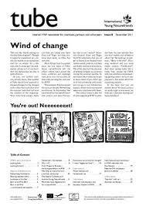
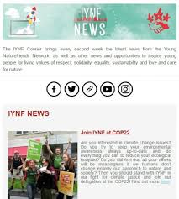
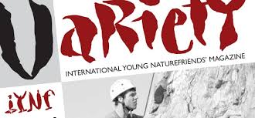
Developing new efficient ways of communication
IYNF in the New Millenium

Slide 18
Developing long-term Campaigns and Initiatives
IYNF in the New Millenium
GOTCHA Campaign (2003)
Attractive Youth Work
Gotcha gets local
Gotcha Training for Trainers
Designing Attractive Youth Organisations
IYNF Handbook – For volunteers to make things happen

Slide 19
2004
IYNF camps: international camps, summer camps, outdoor camps and work camps
IYNF in the New Millenium
Outdoor education:
International Symposium on Outdoor Sports Education,
International Mountaineering and Climbing Conference
International Mountain and Outdoor Sports Conference

Slide 20
Meet the Freak (2005)
IYNF in the New Millennium
discovering the world through dance, theatre,
painting, music and media,
peer-learning experience was one of the guiding principles.
All Means All
All on board
All Inclusive

Slide 21
In touch (2006)
IYNF in the New Millennium
to make the world of international youth work more accessible for the local groups.

Slide 22
Xperience (2009)
IYNF in the New Millennium
Long term training course on experiential education for international trainers

Slide 23

2010
IYNF in the last decade
The topic of the year was introduced
and the focus was given to green campaigning.
Get green campaigning
It aimed to reconsider our own approaches and work towards being a greener organization
and to be a good example for the others

Slide 24
2011 – Year of Volunteering
IYNF in the last decade
2012 – Year of Sustainability
2013 – Year of action for change
2014 – Year of Urban Outdoors
2015 - 40 years of connecting and inspiring
2016 – Year of e-participation
Border-free solidarity

Slide 25

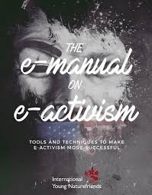
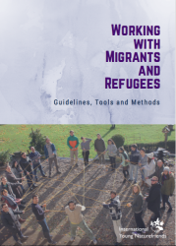
IYNF in the last decade
IYNF (on-line) Publications and Manuals

Slide 26


IYNF in the last decade
IYNF on-line Platforms

Slide 27
IYNF at glance
IYNF is an international network to
connect and inspire Young Naturefriends
for living values of respect, solidarity, equality, sustainability and love and care for nature

Slide 28
IYNF at glance
stands for values of solidarity, justice, democracy, peace and internationalism
stands for values of love and care for nature, direct environmental experience, sustainability and environmental education
stands for youth participation, personal development, non-formal and experiential education

Slide 29
IYNF at glance
a network of groups and organisations cooperating together. The core role of IYNF is to facilitate this cooperation by creating links, organising meetings, providing direct support and promoting nature-friendly activities all over Europe
a training and exchange organisation organising value-driven youth exchanges and capacity building activities for the benefit of its members
a value-based organisation representing its members at the European level. By our delegations, publications and promotion activities, we carry our values to European political stakeholders

Slide 30
Questions and comments are welcome
petre@iynf.org

Slide 31
Questions and comments are welcome
petre@iynf.org

