Slide 1


History of AIESEC:
70 years of Developing Youth Leadership for Peace
Tanja Dibou, AIESEC alumni
Tallinn University, youth work lecturer
tanja.dibou@tlu.ee

Slide 2
What is AIESEC?
an acronym for French name „Association Internationale des Étudiants en Sciences Économiques et Commerciales“ ( in English: International Association of Students in Economics and Commercial Sciences).
Non-governmental not-for-profit organisation in consultative status with the United Nations Economic and Social Council (ECOSOC), affiliated with the United Nations Department of Public Information(UN DPI), member of International Coordination Meeting of Youth Organisations (ICMYO), and is recognized by UNESCO.
Youth -led organization-the world's largest student organization, run by current students and recent graduates at the age of 18-30 of institutions of higher education
Youth leadership movement with the aim to explore and develop leadership among young people
„Global network of people that simply believe that youth leadership is not an option, but our responsibility.“ ( AIESEC)
AIESEC offers the opportunity to young people to develop their leadership and cross-cultural potential by experiencing global internships, volunteering programs and AIESEC campus programs.
Notes:
Video https://www.youtube.com/watch?time_continue=30&v=IDJQOJCFPng

Slide 3

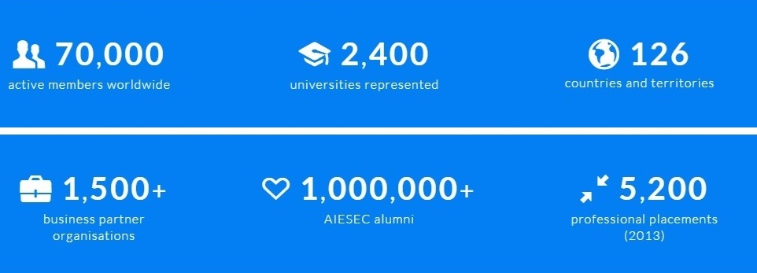
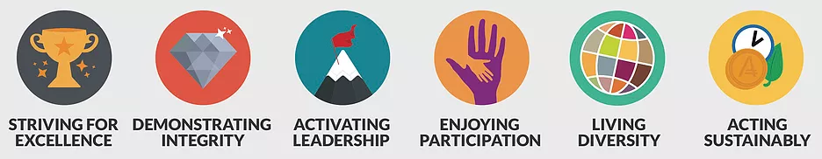
AIESEC's Vision
AIESEC in Numbers
AIESEC´s Values
Notes:
Our values provide a way for AIESEC to encourage common behaviour across our global network.
Activating Leadership
We lead by example and inspire leadership through our activities. We take full responsibility for developing the youth leadership potential of our members.
Demonstrating Integrity
We are consistent and transparent in our decisions and actions. We fulfil our commitments and conduct ourselves in a way that is true to our ideals.
Living Diversity
We seek to learn from the different ways of life and opinions represented in our multicultural environment. We respect and actively encourage the contribution of every individual.
Enjoying Participation
We create a dynamic environment created by active and enthusiastic participation of individuals. We enjoy being involved in AIESEC.
Striving for Excellence
We aim to deliver the highest quality performance in everything we do. Through creativity and innovation we seek to continuously improve.
Acting Sustainably
We act in a way that is sustainable for our organisation and society. Our decisions take into account the needs of future generations.

Slide 4
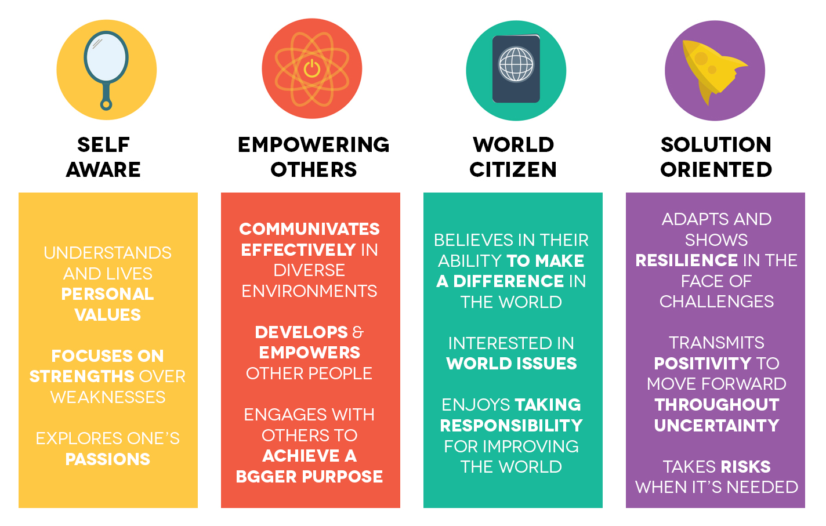
AIESEC´s methodology of developing youth leadership
Develop youth leaders with the following qualities:
Notes:
In AIESEC, we believe that youth are the key to shaping a better future. Through each and every experience we provide, we strive to develop youth leaders with the following qualities.
Ability to Empower Others: Communicates clearly, engages in meaningful conversations, and creates spaces that empower others to take action.
Solution Oriented: Flexible, ready to take risks, and actively finds solutions to challenges.
World Citizen: Aware of global events and enjoys taking an active role in contributing towards making it a better place for everyone.
Self Aware: Understands personal strengths, lives by his/her values and constantly explores passions.
Can you imagine the world when we engage and develop every young person to obtain these qualities? We want to see a brighter future for all. This is why we do what we do.

Slide 5

HOW AIESEC works with young people?
Notes:
YouthSpeak Forum powered by AIESEC is a forum run by youth for
youth. It is a forum where inspira1on and collabora1on convert into
ac#on. Both young and senior leaders are brought together to form a
diverse cross-­‐sector and mul1-­‐genera1onal space for inspiring
conversa)ons around pressing global, na)onal and local issues. It is an
a"rac%ve and engaging approach to making AIESEC relevant to any
young person and a way to get involved with no barriers and low
commitment.
How do we spark interest through this product?
The agenda for the forum creates a environment for intellectual
s"mula"on and inspira"on for any a0endee. It triggers thought
towards important issues and encourages the a2endee to par3cipate
in the conversa-ons and collaborate with other a2endees to create
ac#onable outcomes.
What is Local Volunteer ?
Local Volunteer is an EwA product which gives a “sneak peak” into
what a Global Volunteer experience looks like. It allows locals to
volunteer on a project or in an NGO addressing one of the SDGs for
6-­‐8 weeks, alongside Global Volunteer par8cipants. The aim is to
empower young people to develop LDM characteris8cs by
volunteering together with the par0cipants of Global Volunteer
product.
How do we spark interest through this product?
We provide an opportunity for young people to begin developing the
global mindset by volunteering to address the SDGs alongside
par$cipant of Global Volunteer product and to acquire leadership and
so# skills while crea.ng direct posi.ve impact in their local
communi'es.

Slide 6

History: the start of AIESEC
1948- AIESEC was established after World War II in Europe by students from 7 countries: Belgium, Denmark, Finland, France, Netherlands, Norway and Sweden. Students determined that cross-cultural understanding was essential to avoid war conflicts and contribute to tolerance between people.
March 1949- First International Congress of AIESEC in Stockholm
In the first year of AIESEC's existence, 89 students were exchanged among 7 countries.
Main activities:
Internships and study tours
Mission:
Improve international understanding
Notes:
1948- It was founded in 1948, when a group of young students wanted to do something mindful to join the ties among countries after the World War II. They were: Jean Choplin (France), Bengt Sjøstrand (Sweden), and Dr. Albert Kaltenthaler (Germany). They thought that by doing cultural exchanges among their nations they could foster tolerance, and they firmly believed that tolerance was the key to peace.
And it is “peace” the motto surrounding AIESEC operations, as its vision expresses it: “peace and the fulfilment of humankind’s potential.
AIESEC wants to open
people’s mind and make them understand the different cultures, religions and other aspects that
differentiate humans to avoid conflicts. The aim is also to develop individuals who have the
knowledge, skills and determination to develop a world with more respect of others.

Slide 7
History 1950-1990: expansion of AIESEC
1955- more than 1000 internships
1957- USA joins AIESEC
1958- South Africa joins AIESEC as first African country and Venezuela as first in South America
1961- establishment permanent secretariat in Geneva
1963- AIESEC extends to Asia with inclusion of Japan and Korea
1965- Australia joins AIESEC. AIESEC now in all inhabited contenents
Czechoslowakia joins AIESEC as the first country behind the „ Iron curtain“
1989- The highest number of internships ever recorded (7029)
1992- AIESEC was involved in almost every UN conference as one of youth sector representative.
Main activities:
Internships and study tours
Social based projects
Mission:
Improve international understanding and cooperation of countries and communities

Slide 8
History: Today
2015-AIESEC’s youth leaders from 126 countries in collaboration with the Office of the Secretary-General’s Envoy on Youth gathered at the United Nations Headquarters to promote and drive youth participation in implementing the Sustainable Development Goals (SDGs)
July 2015- AIESEC was recognized for the 9th time on the WorldBlu list of "Most Freedom Centred Workplaces„
-LOOKING FOR NEW PRACTICAL WAYS OF BUILDING BETTER WORLD
-EDUCATING FUTURE RESPONSIBLE LEADERS

Slide 9
AIESEC and Youth Work: main links
Run by young people, for young people
Methods are based on non-formal learning through youth voluntering and internships ( learning by doing)
Directed to youth development and youth active participation in society
AIESEC´s experience is toward development of key competences among young people
Preparedness for job / smooth transition from education to job market, employability skills ( as responce to the recent priority of EU youth policy and majority of national youth policies´ agendas)
Raising awareness about young leaders and positive general image of young people in society ( „youth as resourse and partner“)
Youth Speak survey-taking into account youth opinions, youth needs

Slide 10
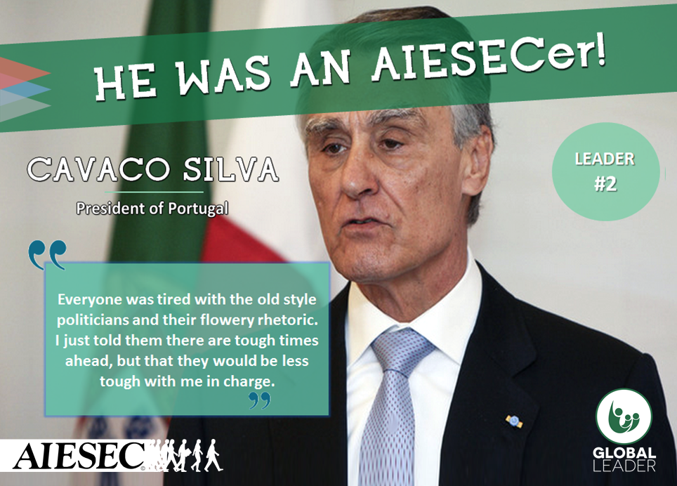
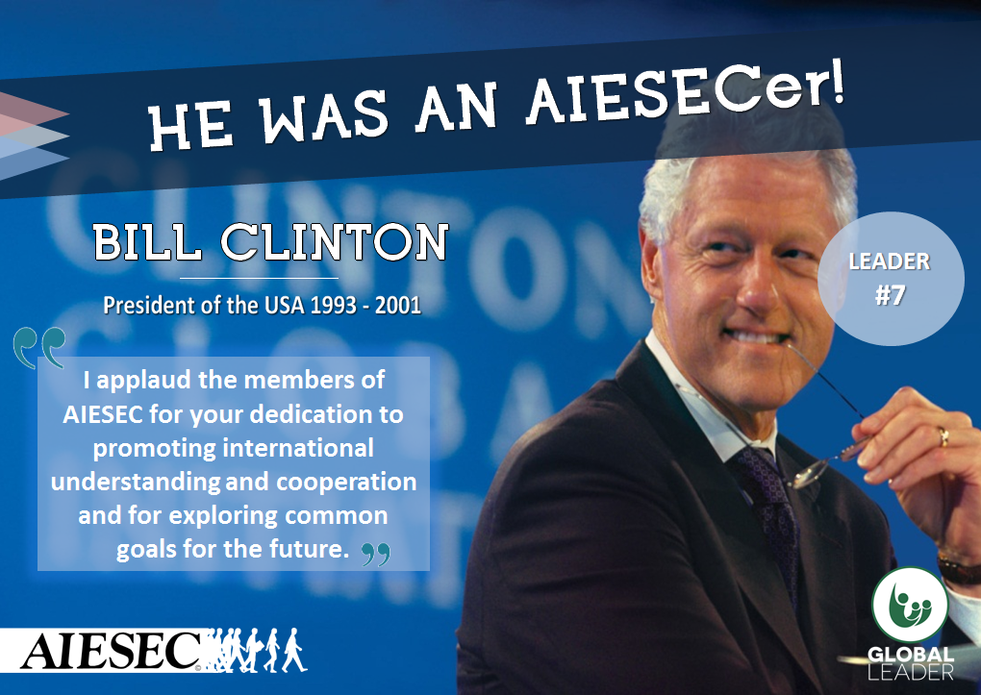
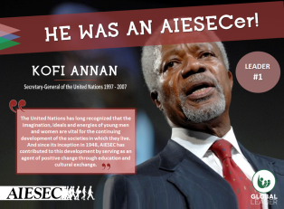
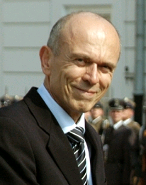
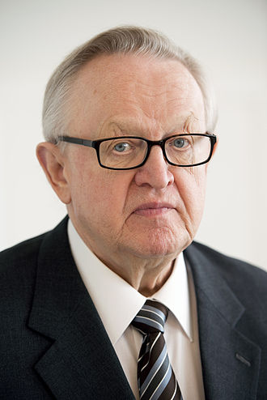
Impact of AIESEC
impacted society through AIESEC 1,000, 000 alumni. AIESEC alumni represent business, NGO and world leaders
Kofi Annan, secretary-general of Aníbal Cavaco Silva, President of Portugal (2006-2016) Bill Clinton, President of USA(1993-2001)
the United Nations (1997-2007)
Janez Drnovšek, President of Slovenia (2002-2007) Martti Ahtisaari, President of Finland (1994-2000), a Nobel Peace Prize laureate

Slide 11
Development of 8 EU key competences
(research in Estonia 2016 among AIESEC alumni)
Sense of initiative and entrepreneurship | Cultural awareness and expression | Social and civic competences | Learning to learn | Communication in foreign languages | Digital competence | Mathematical competence and basic competences in science and technology | Communication in the mother tongue | Total impact on competences

Slide 12
Thank you for attention!

