Slide 1
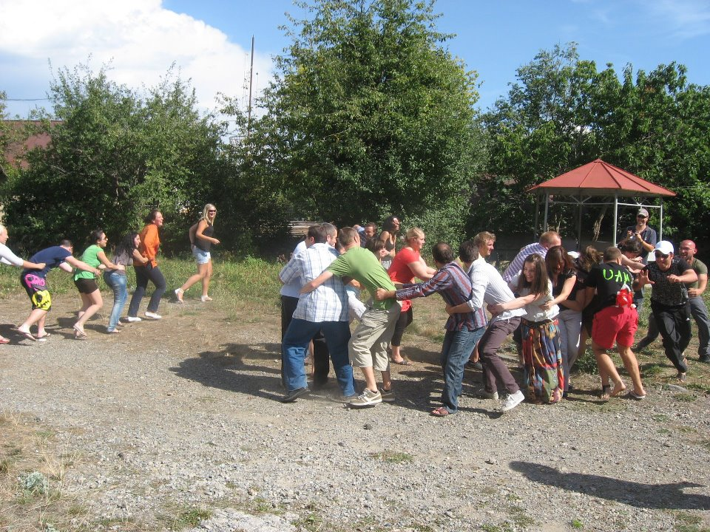

Slide 2
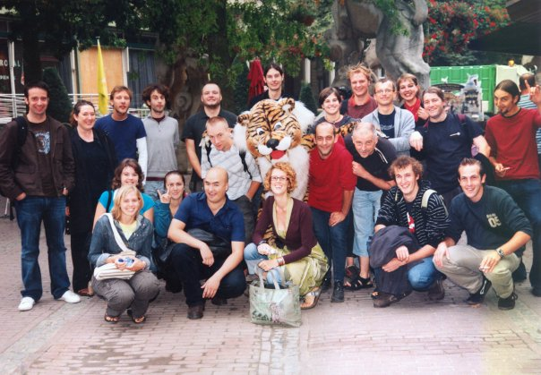
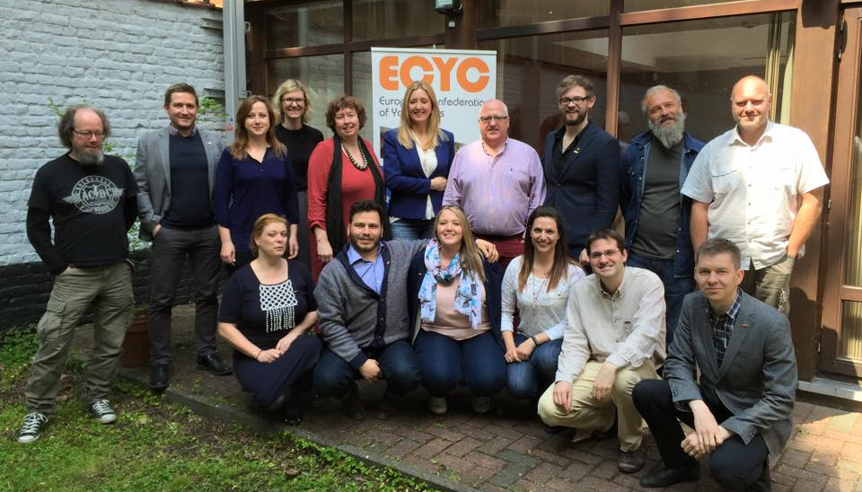
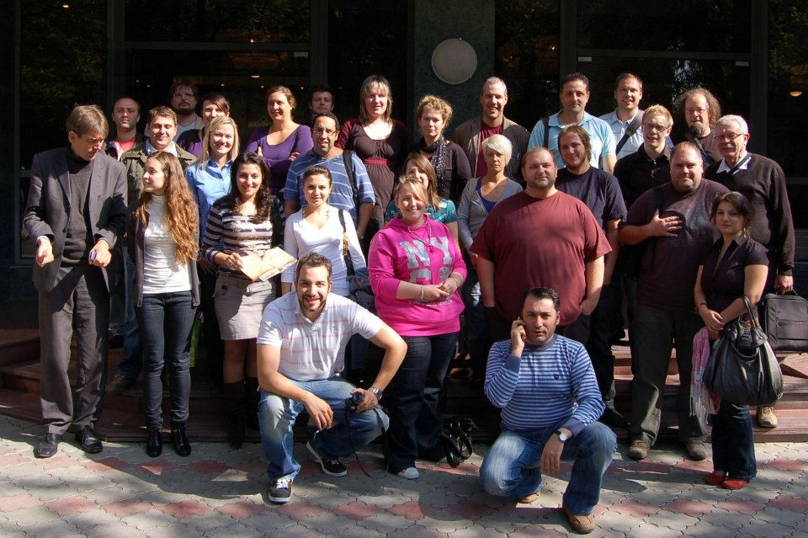
42 years old!

Slide 3
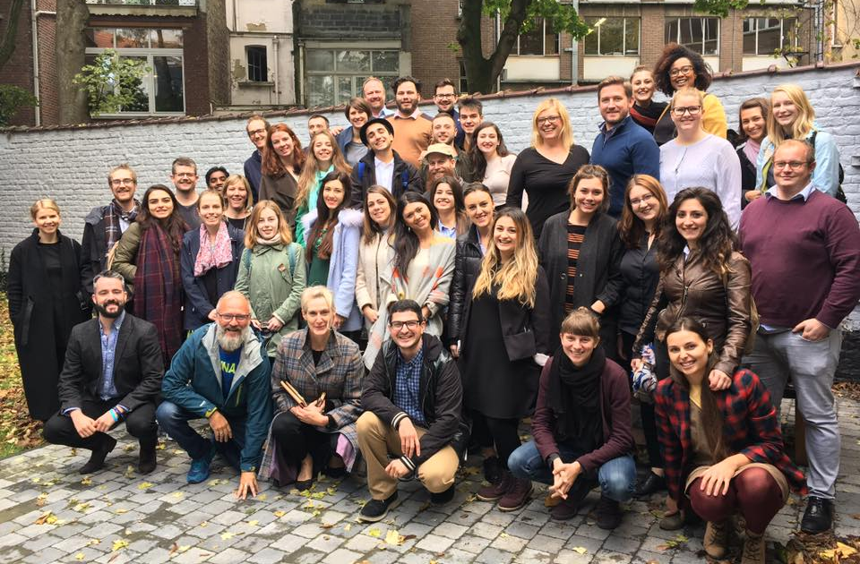
What is ?
A European, non-profit, non-governmental organisation
ECYC’s vision is to empower young people through open youth work and non-formal learning in order to promote democratic and civil society and to encourage young people to be actively involved in their communities.
We reach 1.2 million young people in Europe every year!

Slide 4
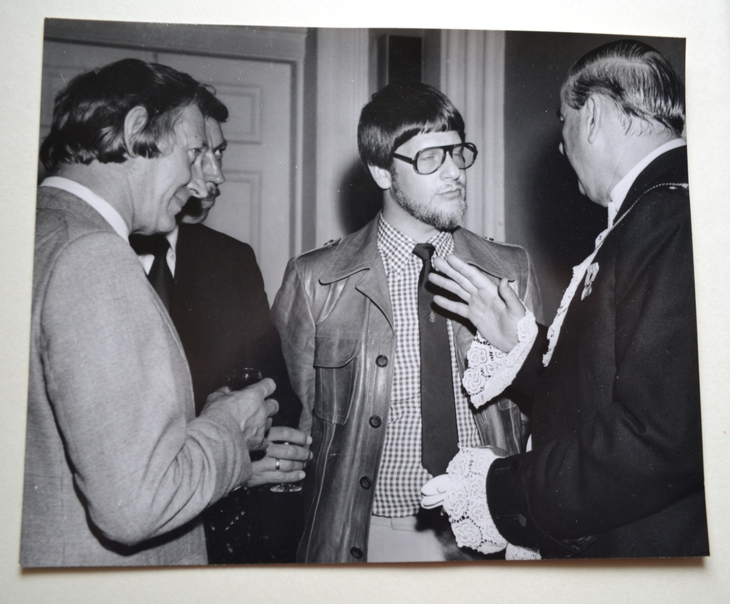
How did it all start?
This is Niels H. Elberling

Slide 5
The ‘70s
ECYC & DAYC
1976
ECYC was born
First attempts to reach CoE structures

Slide 6
ECYC’s first international projects
The ‘80s
1989
Moving East
Close contact with MOs

Slide 7
The ‘90s
Changes in funding
Professional youth work

Slide 8
2001
EU White
Paper
2014
First ECYC
policy paper
Brussels office
The 2000s

Slide 9
The present

Slide 10
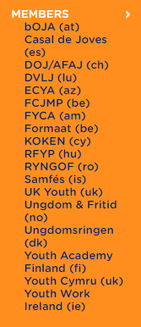
Who’s in ECYC?
19 national or regional youth work organisations
To be a member of ECYC, you must:
- support and work with youth clubs, promote open youth work, and/or organise non-formal education activities with young people;
- work on a national or regional level as umbrella or platform organisations;
- be free of political or religious structures;
- have your seat in a Council of Europe state.

Slide 11
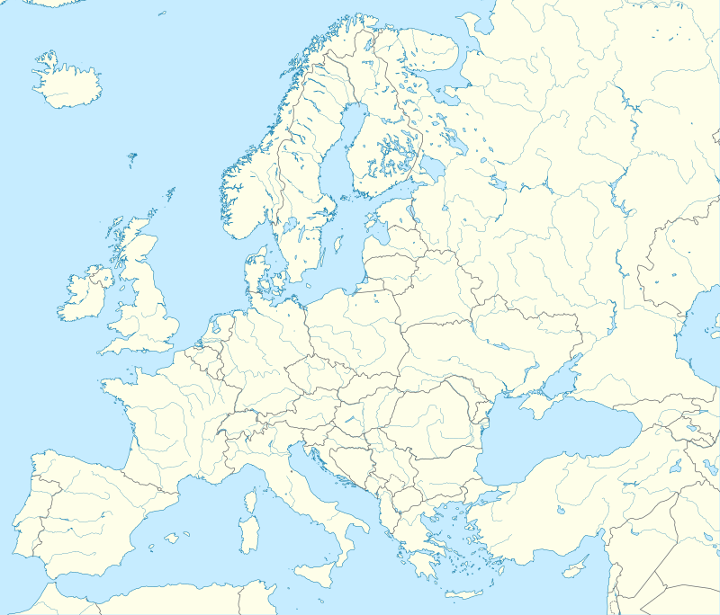

Slide 12
What’s ecyc mission?
To work cooperatively so that young people across Europe have access to quality open youth work opportunities.
Mission - to support youth clubs and other forms of youth work in Europe by:
facilitating networking and promoting the exchange and sharing of practice, knowledge and information;
providing opportunities for the personal and professional development of youth workers, as well as for young people’s active engagement and non-formal learning;
defending the common points of view of the members by lobbying European institutions and organisations.

Slide 13
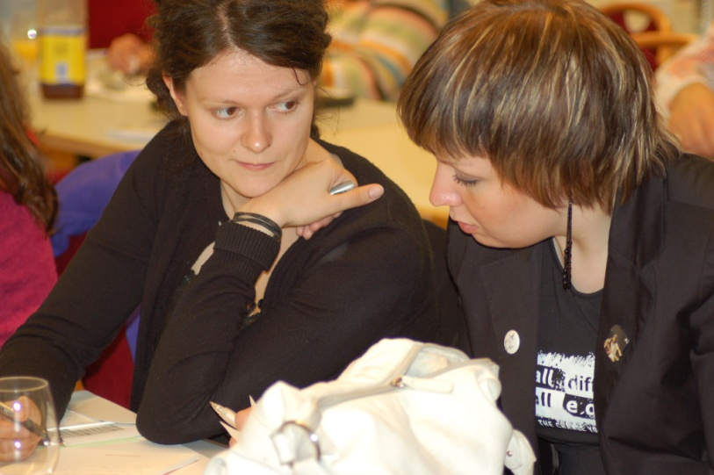
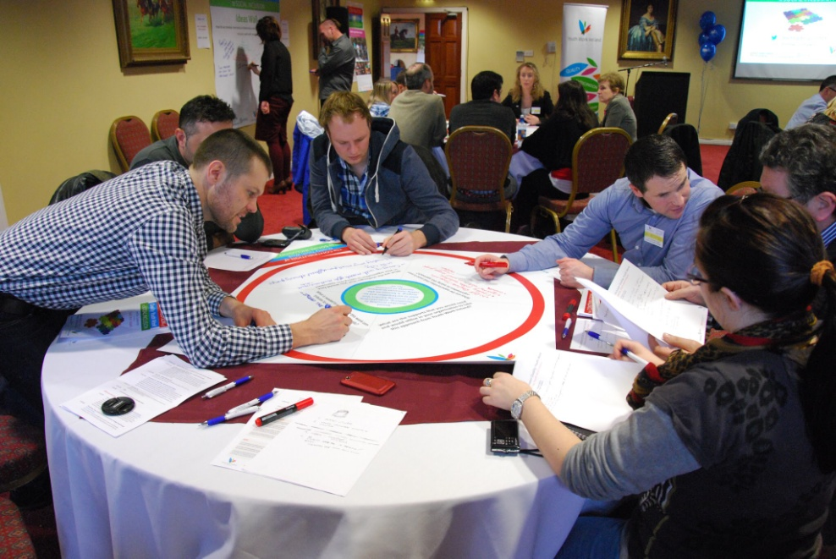
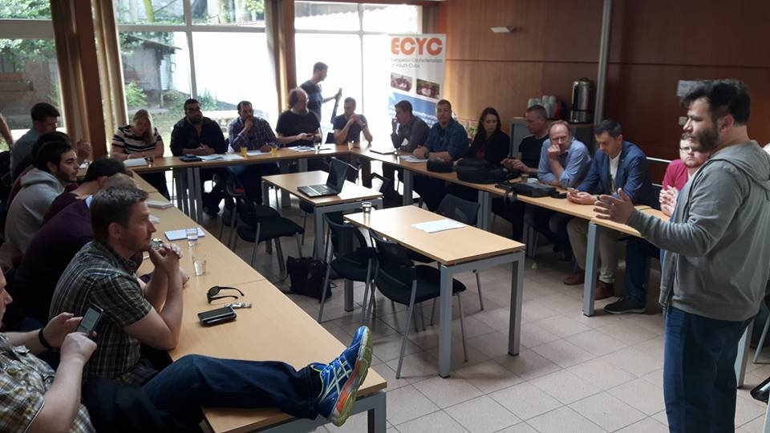
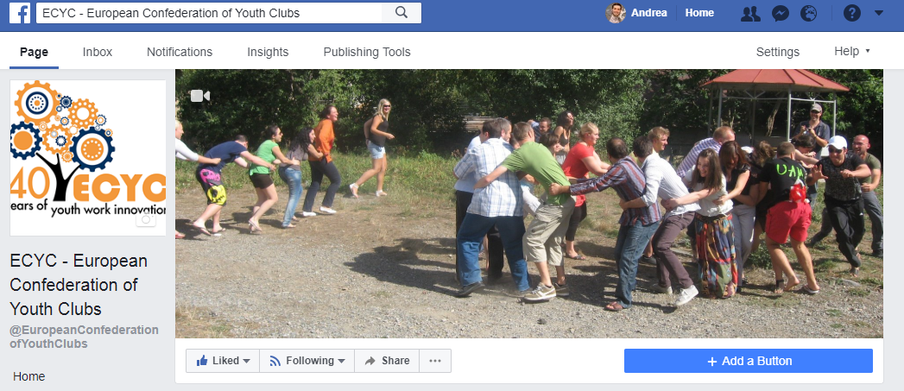
Networking & sharing

Slide 14
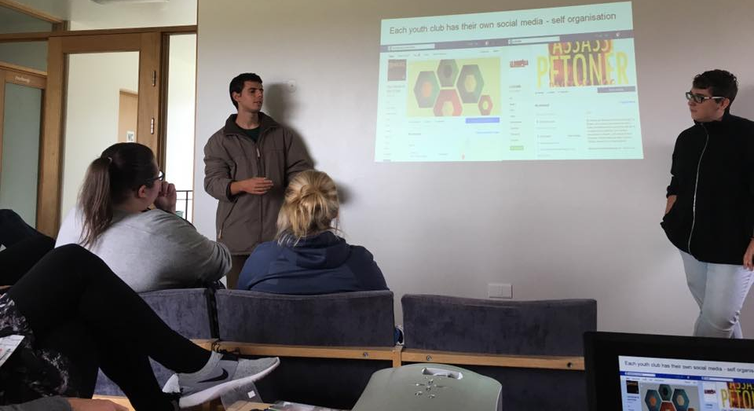
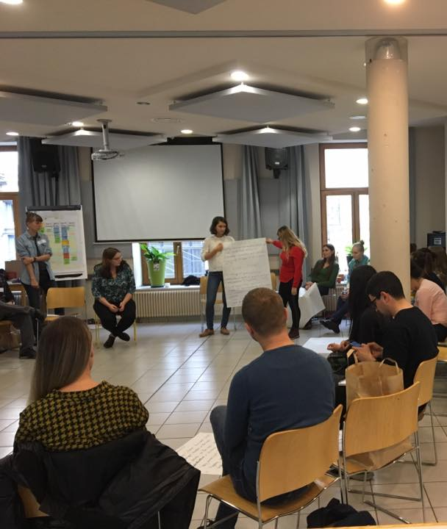
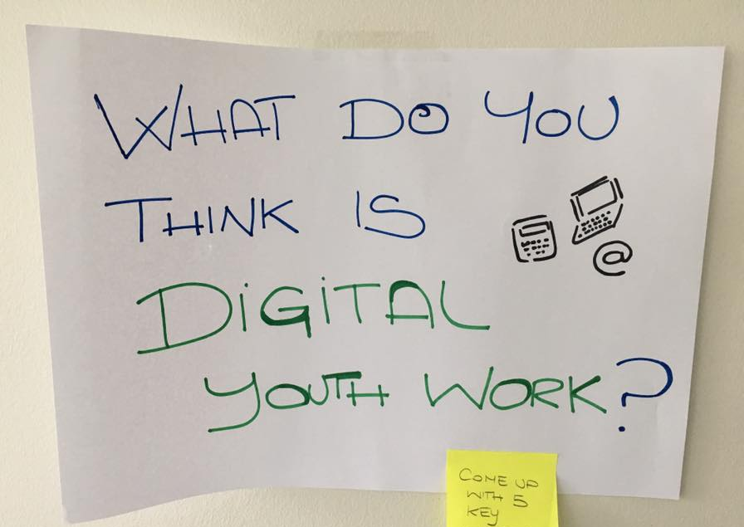
Capacity-building
International training courses, seminars, camps, study sessions & workshops!

Slide 15
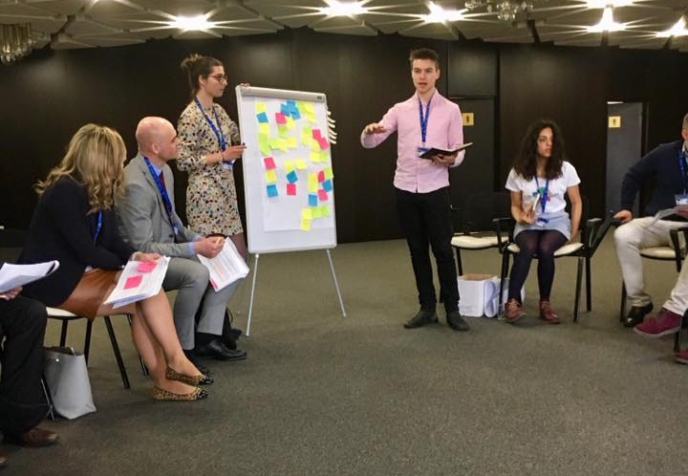
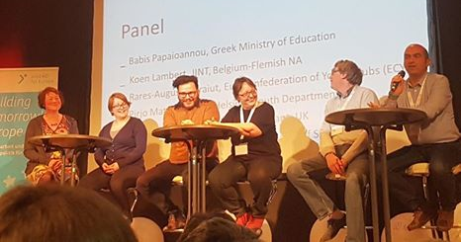
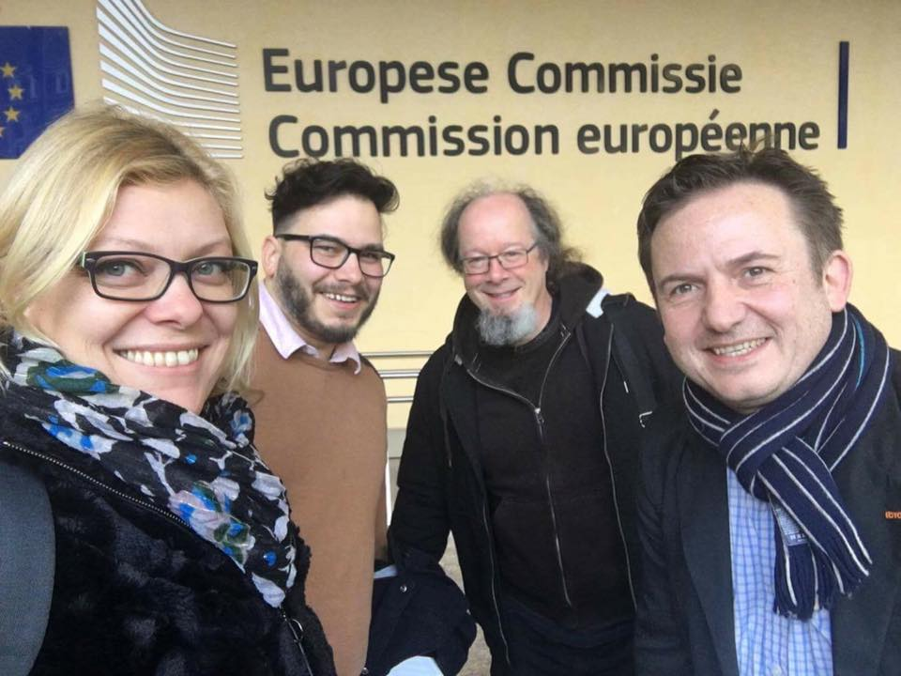
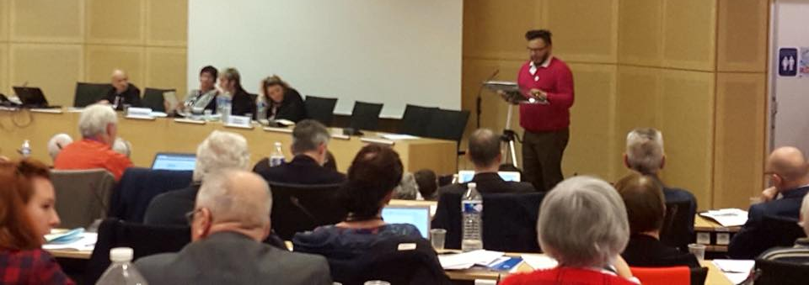
ADVOCACY

Slide 16
Our definition of youth work
ECYC believes that the purpose of Youth Work is to offer young people, on the basis of their voluntary involvement, developmental and educational experiences which will equip them to play an active part in our democratic society as well as meet their own developmental needs.
Youth Work takes place in youth clubs, youth projects, youth centres, youth houses as well as on the street through detached youth work.
Youth Work offers, to those who participate important lifelong learning experiences within the transitional period between childhood and adulthood. The lifelong learning cycle then continues as young people attain leadership and volunteering roles within their organisations.

Slide 17
That’s it!

Slide 18
HOW TO CONTACT US?
First of all, you are always welcome to come see us at:
Rue des Tanneurs 186, 1000, Brussels (Belgium)
You will find further information on ECYC on our website:
www.ecyc.org
And you will also find us on :
https://www.facebook.com/EuropeanConfederationofYouthClubs

Slide 19
HOW TO CONTACT US?
You can always reach us by email and phone at:
0032 02 540 84 73
ecyc@fcjmp.be and 0032 479 63 35 77 if you want to reach
Rares Craiut (Secretary General)
ioana@ecyc.org if you want to reach Ioana Surubaru (me)

Slide 20
Questions?

