Slide 1
Workshop History VII Workshop ‘Learning from the History of International Youth Organisations and Their Impact on Youth Work Practice Today
October 2018
From American Field Service to AFS Intercultural Programs and the development of the European Federation of Intercultural Learning - EFIL

Slide 2
AGENDA
History
What we do
The future
Key moments and influences
Contribution to European youth work

Slide 3
HISTORY
1915: the American Ambulance Field Service, a volunteer ambulance corps created by A. Piatt Andrew, to treat wounded soldiers returning from the war front in France. The 2569 transported 600.000 wounded.
1920: the AFS Association was established to coordinate reunions among former ambulance drivers and to administer a university student exchange programme between US and France (45 in total).

Slide 4
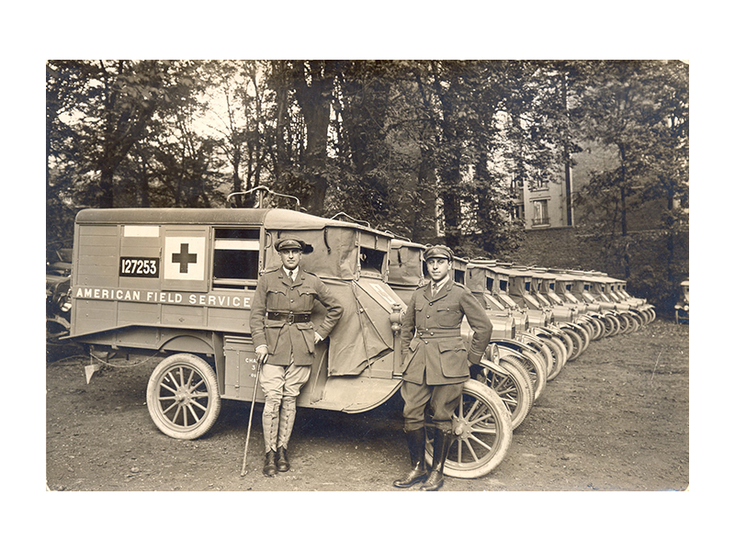

Slide 5
HISTORY
1941: AFS reactivated by Stephen Galatti. AFS officially aligned with the British military and Free French forces and the ambulance drivers served alongside the Allies troops all over the world. 2.196 ambulance drivers carried more than 700.000 wounded ‘no matter what uniforms they were wearing’.
1946: the university exchange programme is revived with students from all over the world (222 until 1953)
1947: the start of the secondary school programme – first in boarding schools, then in families. A life-changing experience, turning places into people.

Slide 6
HISTORY
1949-51: secondary school exchange programme of the American State Department with Germany to ‘live democracy’
1951: US youth goes abroad! 24 to France, and 54 in Germany (summer programme)
1950-1967: the boom
1964:
Stephen Galatti dies – new leadership of Arthur Howe
50th anniversary, informal meeting of European AFS organisations in Torino organised by Roberto Ruffino.
1967: AFS opens a office for European coordination in Brussels
1970: multilateral exchanges – a network of partners
1971: AFS Europe was born (EFIL as from 1975)

Slide 7
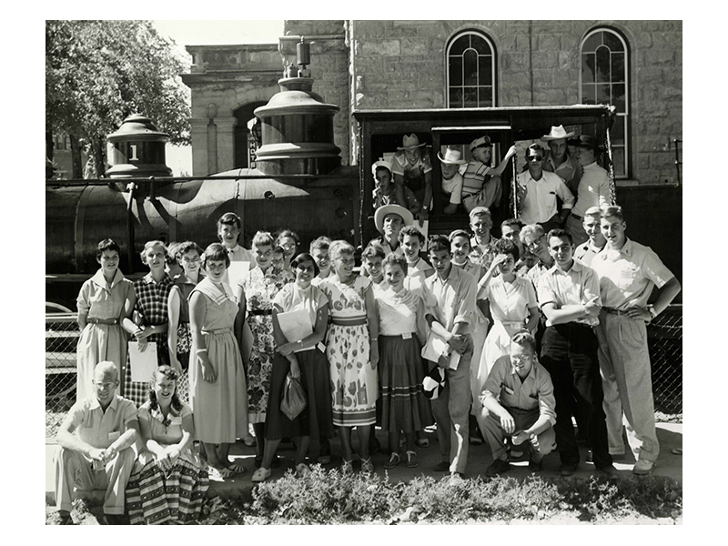

Slide 8
WHAT DO WE DO
AFS Mission
Empower people of all ages and all backgrounds with the intercultural knowledge, skills and understanding required to take action and make a positive difference at home and around the world.
Immersive long-term (3-10 months) intercultural exchange 15-18 year old pupils, host-family and host-school based, supported by non formal education experiential activities before, during and after.
18+ programmes (SENTIO)
Teacher exchanges, short programmes...
Learning Journeys for participants, host families, volunteers, schools

Slide 9
WHAT DO WE DO
EFIL supports its 30 members in pursuing the AFS mission
Advocacy
Training
Innovative Programmes and Projects
Member Support

Slide 10
HISTORY
80s-90s: EU learning mobility programmes develop, the AFS network is restructured, AFS organisations in the former Eastern block open (Russia, Hungary, Slovakia, Czech Republic, Latvia)
1993-1994: EFIL in crisis new statutes
2000s: a stable secretariat
2008:
European Year of Intercultural Dialogue
EU funded Pilot project ‘Individual Pupil Mobility’
Berlin conference ‘Moving Beyond Mobility’ launches the annual Forum on Intercultural Learning and Exchange
EFIL supports the opening of AFS branches in the Balkans
2014: Centennial and partnership with UNESCO and OECD
2017: Future AFS Strategy, launch of the European Education Area.

Slide 11
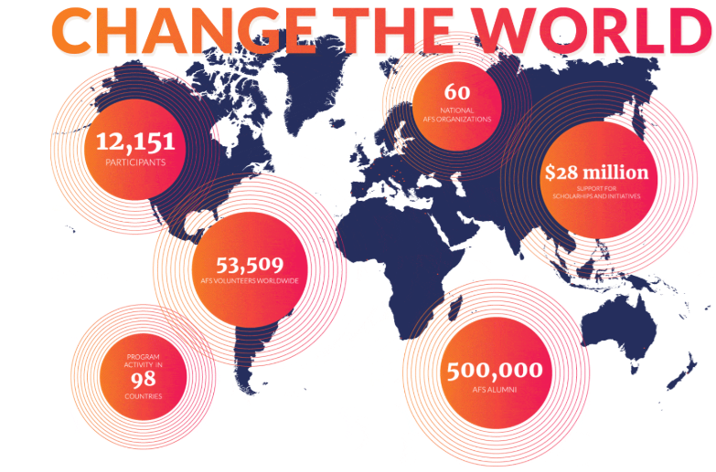
TODAY
400.000 families involved as from 1949

Slide 12
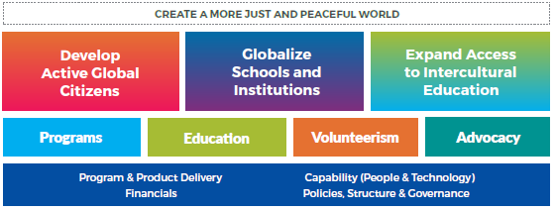
THE FUTURE
We have to take into account the characteristics of society nomaways ( liquid modernity) when shaping exchange programmes and education projects to offer to young people, families and schools. We must keep the eyes wide open to avoid any kind of rigidity in our educational mission, while aiming at improving the quality of the experience even more.

Slide 13
KEY MOMENTS & INFLUENCES
EXTERNAL | INTERNAL
WWI, the Great Depression, WWII | Returnees and fundraising
Reconstruction in Europe by USA - the ideal of American democracy 1948 – 1968 | The intuition of the potential of secondary school exchanges, families, volunteers, chapters
The financing by the US government of university exchange programmes (Fulbrigh programme) | The bus trip
Cold war: AFS had to close down in some countries | Change of leadership Galatti-Howe
Change of image of USA as from 1968 | tension/cooperation between EFIL and AFS Intercultural Programs
European construction | Frequent change of leadership within the network 80s-90s

Slide 14
CONTRIBUTION TO
EUROPEAN YOUTH WORK
several colloquia at the European Youth Centres
defining elements of quality of intercultural which influenced European policies and funding programmes.
joining the European Coordinating Bureau of IYNGOs (later European Youth Forum), and the INGO Conference of the Council of Europe
supporting the European Commission in developing the first exchange of young workers in 1977 and drafting the guidelines for the programme Leonardo, and the following programmes Erasmus and Petra.

Slide 15
CONTRIBUTION TO
EUROPEAN YOUTH WORK
projects funded by the European Youth Foundation and the EU programmes in the field of youth
Pool of trainers and Pool of representatives
Advocacy in the field of youth and education (youth and school exchange programme)
key actor in the field of learning mobility in Europe, contribution to the European Platform for Learning mobility
link between formal and non formal education

Slide 16
RESEARCH and IMPACT
Research: https://afs.org/education/education-research/
Assessment of Intercultural Competence
Intercultura Assessment Protocol
Fora on Intercultural Learning and Exchange
Assessing Intercultural Learning in Student and Pupil Exchanges: Exploring Evidence of Success
Intercultural learning for adolescents: indicators and measurement of competence acquired through non formal education and informal learning on educational exchanges
The school assessment of the intercultural learning of pupils during and after individual exchanges abroad
Definition of Intercultural competence:
AFS Intercultural Programs
EFIL (adapted for European environment)

Slide 17
Thank you!
elisa.briga@afs.org
Sources:
40 years of EFIL (2011)
Where the border stands, Chinzari and Ruffino (2014)
https://afs.org/archives/timeline/
More info:
www.efil.afs.org
www.afs.org

