Slide 1
Don Bosco Youth-Net
Developing a European youth work organisation through youth participation and historical research

Slide 2
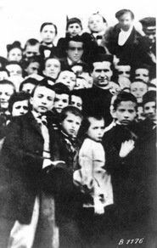
Man who started a movement
1815 – 1888
First oratory 1841
Preventive system
“Good christians and honest citizens”
Global Don Bosco Movement

Slide 3
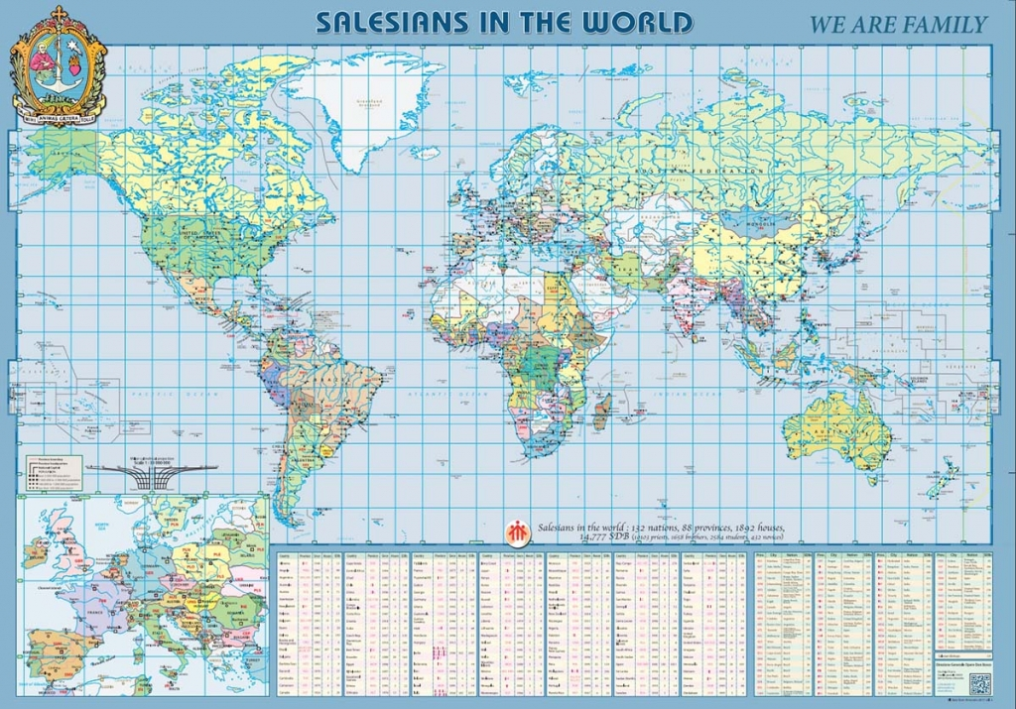
Don Bosco Movement today

Slide 4
Diversity within movement
Salesian family
  SDB
  FMA
  Cooperators
  …
International networks
  Don Bosco Network: international network of Development NGO’s.
  Don Bosco Youth-Net: international network for non-formal youth work.
  PGS International: international network for youth sports organisations
  Salesian Youth Movement Europe: international platform of youth ministry activities
  World congregation of Past-Pupils of Don Bosco: international confederation of past-pupils
Advocacy agencies
  Don Bosco International: international office representing the SDB congregation at the European institutions.
  Salesian Missions, Inc.: international office representing the SDB congregation at the UN’s ECOSOC in New York.
1 common denominator

Slide 5
Don Bosco Youth-Net ivzw
Building a European network from grassroots
Diversity of member organisations
Europe as impetus for youth work
  Reunification
  Enlargement
  Credit crisis
  Refugee effort
Educational methodology of Don Bosco as common denominator

Slide 6
Few words and a lot of action
Educational methodology of DBYN
  Salesian Educative and Pastoral Project
  Letter 21/02/1978 to F. Crispi
  Integration CoE’s youth department method on HRE
  Unity in diversity
Key components
  Themes
  Oratory criterion - Learning environment
  Educational flow
  Educator’s style - Assistance
Good christians and honest citizens
  Educator
  Advocate
  Social entrepreneur
  Salesian chaplain

Slide 7
Educators, not activists
Don Bosco’s theory of change
  Soft advocacy – “witnessing”
  Young people’s need central
  Engage all stakeholders
Dialogic development of advocacy stragegy
  2008 – credit crunch
  Catholic social teaching
  Impact on Cardinal Cardijn
  See – Judge – Act as method for DBYN

Slide 8
Continuing a legacy
Change society through its youth
  Youth Autonomy
    Education as motor
  Youth participation in local communities
    Citizenship is a competence people acquire through life itself
  “Bond with Don Bosco”
Educational methodology
  Originated from practice
  Long tradition of adaptation to new educational challenges
  Balanced approach towards core values freedom, responsibility, solidarity and sence of transcendence

