Slide 1
Youth Research in the Nordic Region
Ørjan BERGAN
National Correspondent EKCYP NORWAY

Slide 2
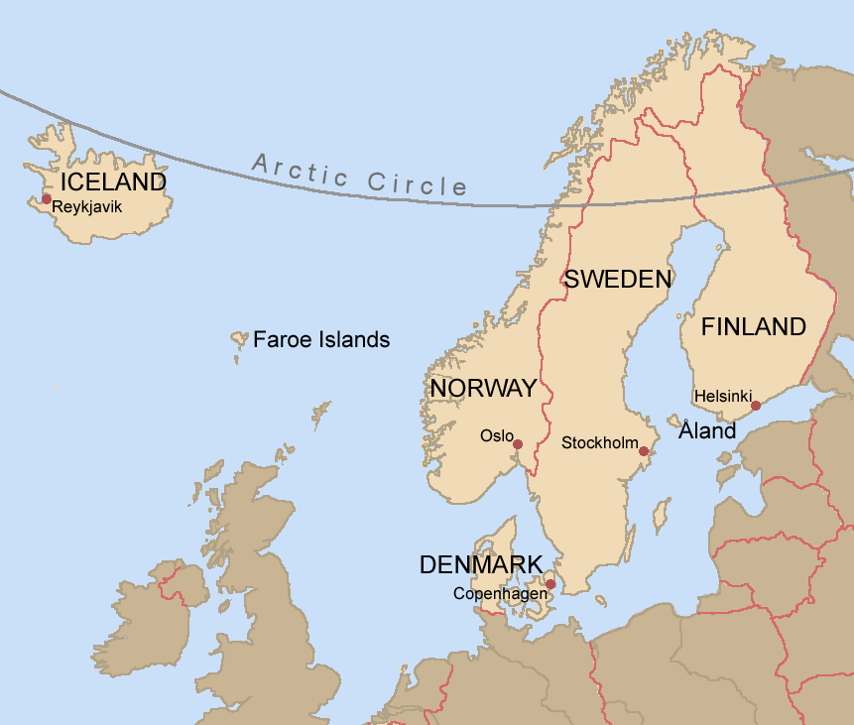
The Nordic Region
DENMARK
Population:
5 789 957
Political system:
Unitary parliamentary constitutional monarchy
ICELAND
Population:
350 710
Political system:
Unitary parliamentary republic
FINLAND
Population:
5 517 887
Political system:
Unitary parliamentary republic
NORWAY
Population:
5 312 343
Political system:
Unitary parliamentary constitutional monarchy
SWEDEN
Population:
10 182 291
Political system:
Unitary parliamentary constitutional monarchy

Slide 3
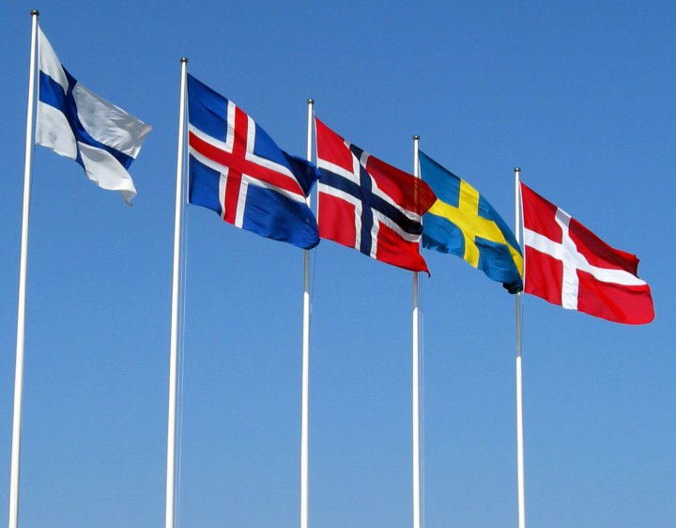
The Nordic Model
Refers to the economic and social policies common to the Nordic countries.
Also known as the social democratic model with a “universalist “ welfare state, facilitating economic security and opportunity within the framework of capitalism
Elaborate social safety net – free public services e.g. education, healthcare, pension plans
Low levels of corruption – high levels of trust
Elaborate regulation - free trade combined with collective risk sharing
Corporative management – high level of labor and employer organization involvement in policy making
High public expenditure and high tax burden
Centralized/unitarian state with high municipal autonomy in the implementation of policy.

Slide 4
Youth Research in the Nordic Region
Even if some of the Nordic countries have designated youth laws, policy making is mostly divided by sectors, not age groups
  Education
  Health
  Culture, sports and volunteering
  Employment and social welfare/services
Youth research is often found within sector divisons – which are supported by their respective ministries and benefactors
Corporate management – clusters and cooperation through formal and informal networks and platforms
All Nordic countries have youth specific research centres

Slide 5
Youth Research in the Nordic Region – cont.
DENMARK
  The Danish Centre for Youth Research – the University of Aalborg.
  https://www.cefu.dk/service/english.aspx
ICELAND
  No specific youth research division or institute?
FINLAND
  Finnish Youth Research Society and Youth Research Network. https://www.youthresearch.fi/
  Åbo Akademi University - https://www.abo.fi/en/study-subject/youth-research-minor-subject/
  Child and Youth Research Institute (Cyri) – University of Turku. https://www.utu.fi/en/sites/cyri/Pages/home.aspx
  Juventa (part of XAMK in Mikkeli ) https://www.xamk.fi/tutkimus-ja-kehitystoiminta/juvenia-nuorisoalan-tutkimus-kehittamiskeskus/
NORWAY
  Oslo Met – and NOVA: Centre for Welfare and Labour Research and Norwegian Social Research Division of Youth Research. NOVA also organizes a Network of Youth Researchers. Research on youth, youth culture and school.
  https://www.hioa.no/eng/About-HiOA/Centre-for-Welfare-and-Labour-Research/NOVA/Youth
SWEDEN
  The Department of Child and Youth Studies – Stockholm University. https://www.buv.su.se/english/
  The Department of Child and Youth Studies– University of Gothenburg. https://uf.gu.se/english/education+/thirdcycle-studies/research_programmes/child-and-youth-studies

Slide 6
Example: Norway
  Oslo Met – and NOVA: Centre for Welfare and Labour Research and Norwegian Social Research Division of Youth Research.
  Research on youth, youth culture and school.
  Funding through:
    Applied science and research contracts from ministries/executive agencies with a prescribed form of research questions and reporting
    Government/ministries general funding + National Research Councils
    EU - Horizon 2020
    NOVA reports having a significant impact on policy making in Norway, especially within the policy sectors of health and education (+ culture).
    See also:
    http://www.ungdata.no/English (survey lower and upper secondary school students)
    https://journals.hioa.no/index.php/ungdomsforskning/ (as of 2019 with a Nordic scope – will also be available in English)

Slide 7
Oerjan BERGAN – National Correspondant for EKCYP and Youth Wiki NORWAY
0047 466 15 958
orjan.bergan@bufdir.no & youthwiki@bufdir.no
https://bufdir.no/en/English_start_page/

