Slide 1
Youth research in SEE
Marko Kovacic,
Institute for Social Research
EKYP & Youth Wiki national correspondent

Slide 2
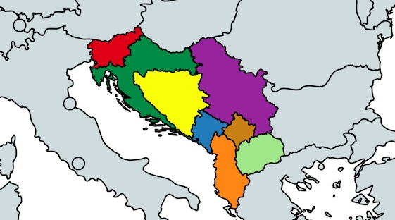
Southeast Europe (“the Region”)
Albania, Bosnia and Herzegovina, Croatia, Kosovo, Macedonia, Montenegro, Serbia and Slovenia (Hahn)

Slide 3
Similarities
Differences
Former socialist countries
EU oriented
CoE countries
Ethnic tensions
Turbulent history
Strong state universities and research institutes
State driven R&D
EU membership; quality of democracy
Different democratization patterns
GDP per capita (Slovenia-34036 vs B&H 11404)
R&D investments

Slide 4
Scientometric overview of the SEE countries
Country | Documents | Citable documents | Citations | Self-citations | Citations per document | H index
Serbia | 7630 | 7047 | 3525 | 868 | 0,46 | 172
Croatia | 6678 | 6197 | 3222 | 777 | 0,48 | 236
Slovenia | 6102 | 5627 | 3396 | 710 | 0,56 | 255
Lithuania | 3571 | 3348 | 2103 | 453 | 0,59 | 179
Bosnia and Herzegovina | 1130 | 1052 | 462 | 62 | 0,41 | 79
Macedonia | 944 | 872 | 366 | 64 | 0,39 | 97
Montenegro | 493 | 446 | 190 | 65 | 0,39 | 45
Source: https://www.scimagojr.com/countryrank.php?year=2017&region=Eastern%20Europe

Slide 5
Youth research in SEE
More than 50 years of tradition (educational vs youth)
  Youth research centers in Zagreb and Belgrade, Student center in Zagreb (60’s)
  Caparisons possible; generational & across countries
Topics: youth values, behaviors, attitudes, recently policy oriented
Academic (mostly empirical) vs. civil society
Funding schemes:
  State funded (top-down vs. bottom-up)
  EU funding
  International donors
  Foundations

Slide 6
Youth research in SEE II
Evidence-based approach in youth policy formulation
(Good practice) examples:
  SERBIA – youth research platform, quality research by civil society;
  SLOVENIA – cooperation btw. the government and the academic community;
  B&H – youth as a national/federal/entitative priority, international donors, civil society/independent researchers based research;
  MONTENEGRO – civil society-international donors cooperation;
  MACEDONIA – evidence based approach, youth institute/unit in spe
  CROATIA – lots of empirical (quantitative) data, an academic institution oriented on youth research
Regional cooperation

Slide 7
Example 1: FES youth studies SEE 2012 & 2018
Germany’s Shell Youth Studies as a template
2012: Slovenia, Croatia, Bosnia and Herzegovina, Albania, Kosovo, Macedonia, Bulgaria and Romania
2018: Albania (N-1200), B&H (N-1000), Bulgaria (N-1016), Croatia (N-1500), Kosovo (N-1200), Macedonia (1038), Montenegro (711), Romania (N-1048), Serbia (N-1170), Slovenia (1015)
Topics: leisure time and lifestyle, family, mobility, education, employment, values, politics

Slide 8
Example II: evidence-based youth studies program
Croatia-Slovenia
LLP
Research on youth work in both countries:
(1) youth workers, (2) employers
  Quantitative + qualitative
Curricula development: master and LLP
Competence models in both countries
Guidelines for mentorship

Slide 9
Example III: You SEE platform
Promoting youth employment and social cohesion
Albania, B&H, Kosovo, Montenegro, Macedonia, Serbia, Turkey
Evidence-based; thematic national reports on youth (un)employment, cross-national report

