Slide 1
Background paper on youth research in Eastern Europe and Caucasus Countries.
Background paper on youth research
in Eastern Europe and Caucasus Countries.
By Anna Ostrikova & Yaryna Borenko

Slide 2
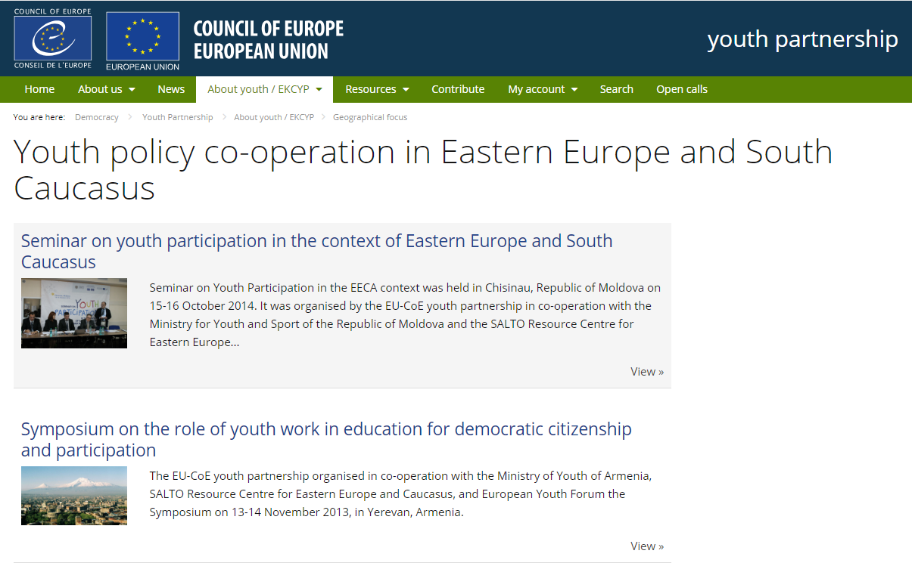
STRUCTURE
General information on youth research in region: features of the region.
Check list on system of data collection and processing on youth research in EaP countries.
Conclusion and next steps.

Slide 3
General information on youth research in region: features of the region.
The youth policy in the region is not as formalized as in the countries of the European Union.
Soviet Law on Youth «On the general principles of state youth policy of the USSR (1991)» introduced the main definitions and concepts, which are still present in the political discourse.
The governance system of new post-soviet countries was more or less defined by policy fields coming from the soviet system, but the discussions and conceptualization of youth policy on the level of governance had just started.

Slide 4
General information on youth research in region: features of the region.
The aim of Soviet state youth policy was defined as: creation of socio-economic, organizational, legal conditions and guarantees for the social formation and development of young citizens, their fullest self-realization in the interests of the whole society.
Main principles:
legal and social protection of young people,
independence and right for self-government in formal educational establishments,
right and guarantee for social services,
autonomy and support,
Structures:
The Law set up the creation of Youth Social Services, cooperation with non-state organizations in delivery of social services and cooperation with youth organizations;
The process of creating the law was the first experience of research;
The Soviet narratives and approaches are still relevant, since most of the countries has been oriented towards Russia.

Slide 5
Youth research models in the countries of the region
Armenia.
Armenia used to be the first country in the region in adaptation the CoE approaches. The country started with the National Youth Report in 2007 and following next in 2011 and 2012 and elaborated National Youth Strategies based on these reports. UNDP office in Armenia contributed to the creation of youth research institution within the Ministry.
Belarus
The youth issues in Belarus are under the Ministry of Education. There are several institutions conducting youth research in the country, mostly related to the universities and research groups. UNFPA and UNICEF participate in youth/children research.
Georgia
Georgia has most sustainable youth research and youth policy development with the strong impact from international cooperation project. The evidence-based policy and the youth research are mentioned in National Youth Policy Document.
Moldova
The Ministry of Youth and Sports is responsible for research, monitoring and evaluation of the youth strategy. It’s only one survey in the region, presenting the research on the youth centres and youth services.
Ukraine
The Ministry of Youth and Sports of Ukraine is responsible for the research, monitoring and evaluation. There is a research institution - State Institute of Family and Youth Policy. Annual Youth Surveys are organized and ordered by the Minstry since 2015 and provided by research companies.

Slide 6
Key role of international organizations
International organizations (mainly UN Agencies) working directly with the governments in the research issues related to National Youth Reports format:
the UN agencies have contributed to the “modernization” of youth research;
the results of the big projects are still not sustainable;
different UN agencies may compete, and their activities are not coordinated.

Slide 7
What is not the area of research
Youth policy in the region is most closely merged with sports. The sport clubs and sport organizations are usually not the topic for research;
The patriotic/national-patriotic education is not studied in the context of youth research, nevertheless and the impact of educational programmes has been not measured.
National surveys supported by donors like to confront with the issues of values, identity, migration, aspirations etc.

