Slide 1
Mapping educational and career paths
for youth workers
Brussels, 31 may & 1 June 2018

Slide 2
"The Mission of Scouting is to contribute to the education of young people, through a value system based on the Scout Promise and Law, to help build a better world where people are self-fulfilled as individuals and play a constructive role in society."
Mission

Slide 3
Volunteers:
People involved in different activities without monetary remuneration (although the reimbursement of expenses may be allowed). The benefit of this involvement is directed at supporting Scouting to achieve its Mission rather than at the volunteer (although the volunteer should also gain and develop from their involvement).
Professional staff:
People recruited to serve Scouting in a specific role or function in a paid, and often full time, capacity. They may or may not have taken the Scout Promise, but they are committed to the Mission and values of Scouting, and the priorities of the Scout organisation they work for.
Definitions
National Scout Organizations (NSOs)
Are responsible for managing, developing and supporting Scouting in the country. An NSO may have several member associations, known as National Scout Associations (NSAs).

Slide 4
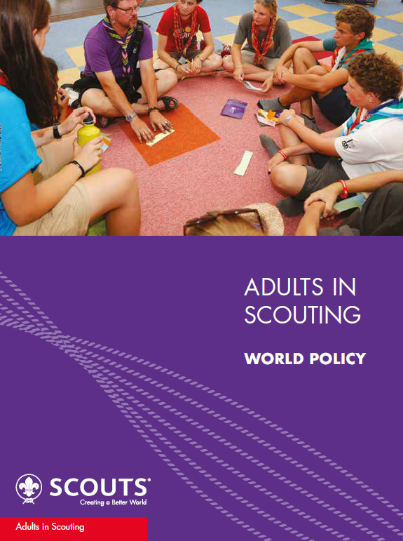

1 world policy position
Over 40 million members worldwide, all part of National Scout Organizations (NSOs).
There are currently 169 NSOs in the world.
6 regional approaches and support structures

Slide 5
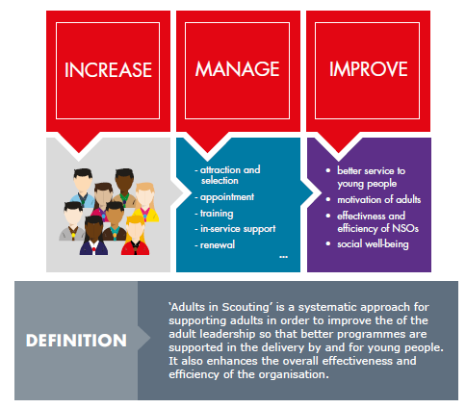
Why?
Because to fulfil our mission and our vision, we need:
More adults in scouting
Happy, committed, prepared, organized and with opportunity for self-development…
Being happy by providing high-quality non-formal education programmes for young people - The Scout way

Slide 6
The Adult Life Cycle (1)
The approach set out in the World Adults in Scouting Policy recognises the concept of a life cycle in every role or function undertaken by an adult in Scouting.
It is a holistic and systematic approach that gives careful consideration to all aspects of the management of adults in the Movement and includes attracting the adults we need and supporting them in their role or function, assisting them in their development and in their choices for their future.
One or multiple life cycles cover all stages and components in the lifespan of an adult in the Movement.

Slide 7
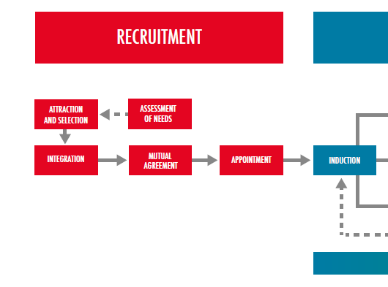
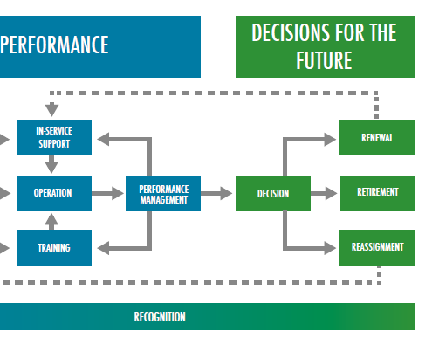
The Adult Life Cycle (2)

Slide 8
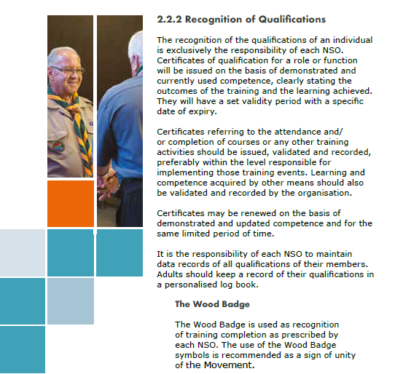
Recognition of qualifications:
NSO - responsability

Slide 9
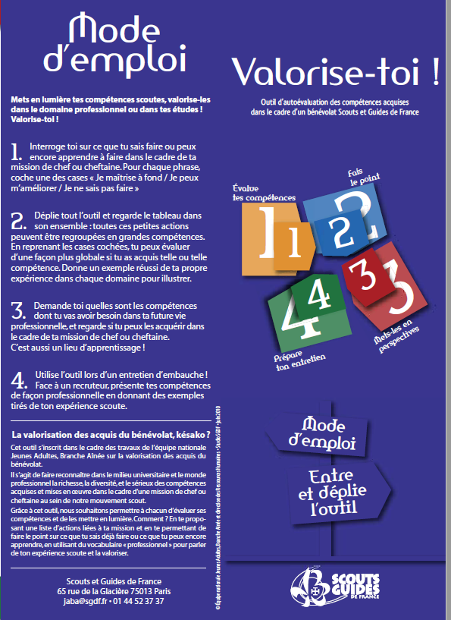
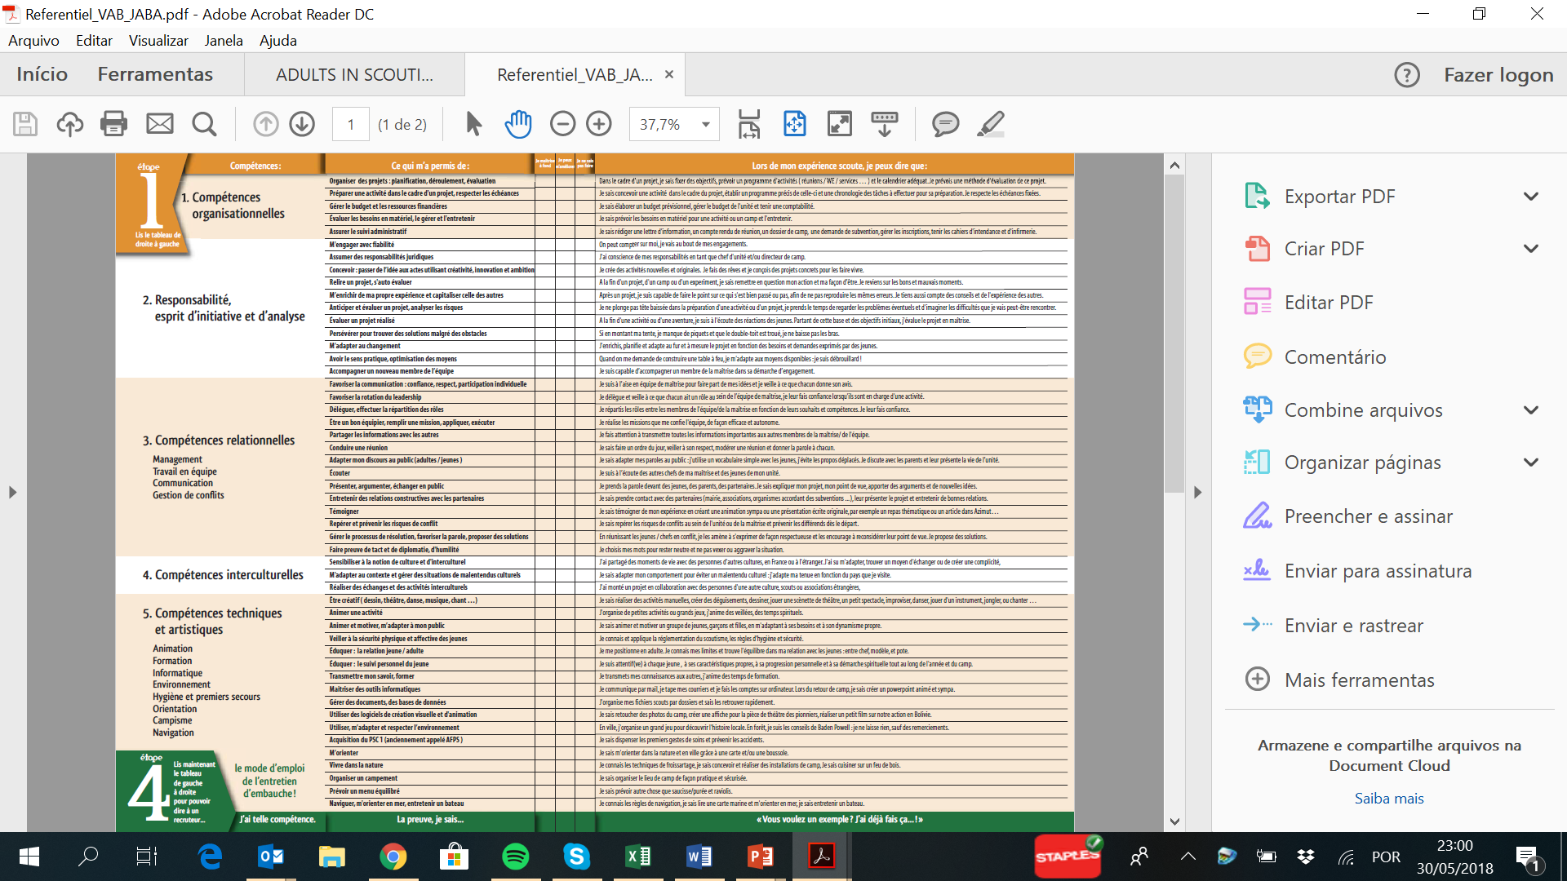
A good practice from France:
How to self assess your competencies and share it efficiently in your CV
https://www.sgdf.fr/images/stories/Espace_responsables-chefs/Actus/valorise-toi/Referentiel_VAB_JABA.pdf

Slide 10
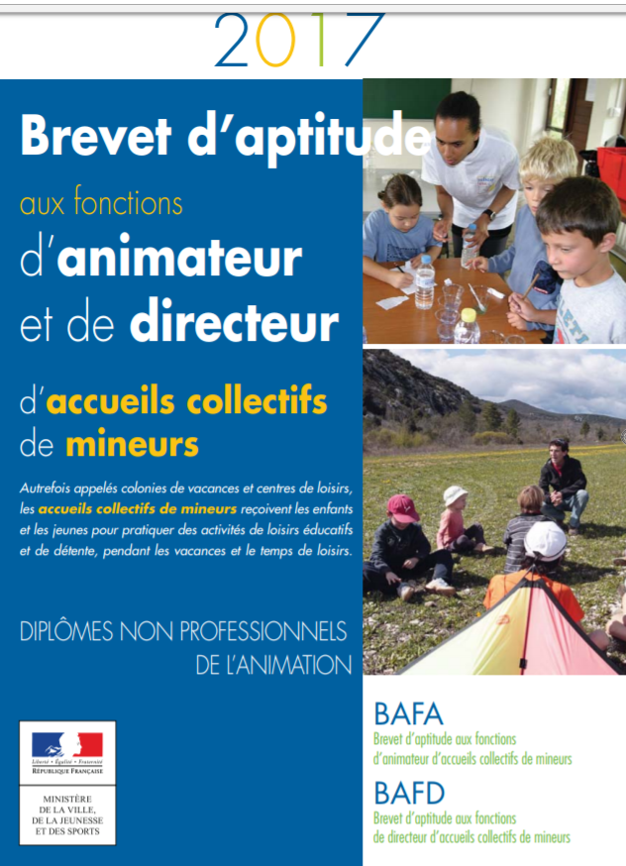
A good practice from France:
Recognition of training…
But also in Belgium and other countries

Slide 11
The recognition of soft skills (project management/group work...) instead of their only competences as youth workers is very important.

Slide 12
Some challenges ahead:
Recognition
Organizations
NGO’s
Validation
Volunteers
Formal VS Non-Formal
Certification
Professionals
Government

Slide 13
In conclusion:
We strongly support the need of formal recognition of knowledge, competencies and attitudes acquired within Scouting (for youth workers as for young people – both volunteers and professionals)
Recognition
We strongly believe youth workers must be able to be in a volunteer base as in a professional base, valuing the volunteers and offering opportunities to grow and play an important role in the organization
Roles
We strongly advocate the critical importance of volunteering based youth work. We also value the possibility of career paths for youth workers in Europe.
Career

Slide 14
THANK YOU
Joaquim Freitas
WOSM – European Scout Region
External Relations and Funding working group
j.castrodefreitas@gmail.com

