Slide 1
Theory-ladenness of comparative research (Tan 2015)
How does my world-picture (beliefs, values, assumptions, expectations etc.) impinge upon
1) my theoretical commitments for the research study;
2) my observations, perceptions and interpretations of data for the research study?
With respect to my research study how do I define ‘knowledge’, ‘evidence’, ‘truth’, ‘rationality’ etc?
How may my research data interact with, influence and challenge the theory I am using for my research study?

Slide 2
Some initial problems
The ontological (what is youth work), epistemological (how do we know about youth work), the conceptual (what concepts do we use to describe what youth work is about) and the practical (how can or cannot access the relevant information)
> How do you compare? What do you compare? What can’t you compare?

Slide 3
The theory of
practice architectures
(Kemmis & Grootenboer 2008)
study of prerequisites of social practices in terms of
the material-economic preconditions (‘doings’)
the cultural-discursive preconditions (‘sayings’)
the social-political preconditions (‘relatings’ )

Slide 4
The comparative perspective on youth work practice architectures
Sayings/cultural-discoursive dimension: how youth work is recognised, formulated, talked about and debated.
Doings/structural-occupational dimension: how youth work education is supported and how youth work can be a sustainable career.
Relatings/social-political dimension: how youth work is recognised, supported and organised so that it can relate to young people, general public and other professional cultures.

Slide 5
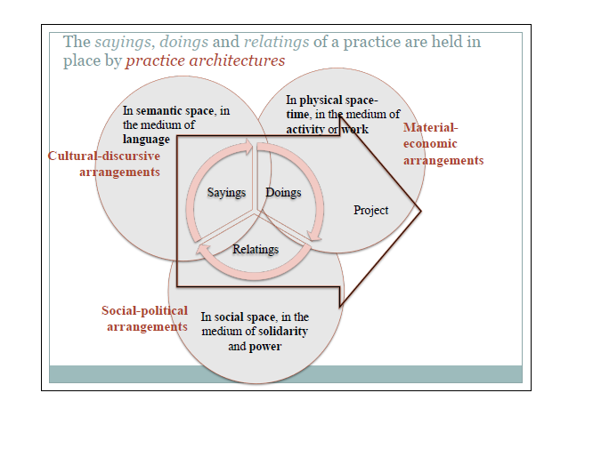
The way Kemmis himself visualises his theory

Slide 6
Group 1. Strong practice architectures
Legislative definitions
2. Competency description and/or
3. Quality assurance
o
strong Associations of youth workers
Belarus
Belgium (French)
Estonia
Finland
France
Germany
Ireland
Luxembourg
Slovakia
UK (England)
UK (Wales)
1. Vocational education on youth work
2. Tertiary education for youth work
3. Public support for non-formal learning
4. Identifiable and sustainable career paths
Formal learning,

Slide 7
Group 2. Strong practice architectures, room for development on certain level
Usually legislative definitions
2. Competency description and/or
3. Quality assurance work education
Associations of youth workers
Austria
Belgium (Flemish)
Belgium (German)
Czech Republic
Iceland
Liechtenstein
Malta
Portugal
Russian Federation
Serbia
Sweden
The Netherlands
1. Usually vocational education on youth work and/or
2. Tertiary education for youth work
3. Usually public support for non-formal learning
4. Usually identifiable and sustainable career paths
ng, economic Formal learning,

Slide 8
Group 3. Practice architectures where some parts have been developed
1. Usually legislative definitions
2. In some cases competency description and/or
3. Quality assurance
Armenia
Bulgaria
Latvia
Lithuania
Norway
Slovenia
The Former Yugoslav Republic of Macedonia
Turkey
In some cases
associations of youth workers
1. Usually vocational education on youth work and/or
2. Tertiary education for youth work
3. In some cases support for non-formal learning
4. Usually no identifiable and sustainable career paths
ng, economic Formal learning,

Slide 9
Group 4. Practice architectures in the need of development
Usually legislative definitions
Albania
Azerbaijan
Bosnia and Herzegovina
Croatia
Cyprus
Georgia
Greece
Italy
Moldova
Montenegro
Poland
Romania
Ukraine
In some cases
associations of youth workers
1. In some cases tertiary education for youth work
2. In some cases public support for non-formal learning

