Slide 1
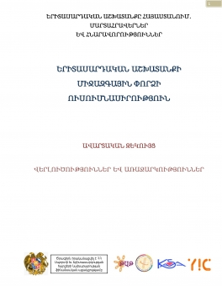
Youth Work Institute in Armenia
Development in State level started in 2015
Research stage

Slide 2
Youth Work Institute in Armenia
Research stage
Research of Youth Work and Youth Worker
non-married young people,
urban youth
young people who received or receiving vocational education,
young people whose age doesn’t exceed 25
more girls than boys
The research has found out a number of institutional barriers including the absence of statistics on youth work assessment tools and the participation of young people in youth work. The low level of cooperation between state and international structures in different fields related to youth has been emphasized.

Slide 3
Youth Work Institute in Armenia
Research stage
Youth work in the Republic of Armenia is implemented in the following formats:
1) Short-term and long-term trainings aimed at developing youth personal and professional knowledge and skills
2) Organizing meetings and events
3) Information management; dissemination of information leaflets, spreading information and materials on the web and mass media, advisory activities, which assist young people in solving their problems.
The experts propound the issue of recognition of youth work. It is particularly highlighted the need of formal institutional education.

Slide 4
Youth Work Institute in Armenia
Research stage
Study of International Experience of Youth Work
Belgian Flemish community
Finland
Denmark
Lithuania
Canada

Slide 5
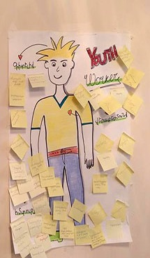
Youth Work Institute in Armenia
Challenges
1) to increase the number of information, guidelines and literature on Armenian language for youth work
2) professional (including specialized) trainings for youth workers
3) to publicize and increase the level of realization of terms “youth work” and “youth worker”
4) to clarify the types, functions, tools, ethical norms of youth work
5) to create, develop and spread knowledge and data for youth field
6) to create and develop platforms for local and international experience
7) to implement researches for youth work quality standards
8) to develop youth work standards.

Slide 6
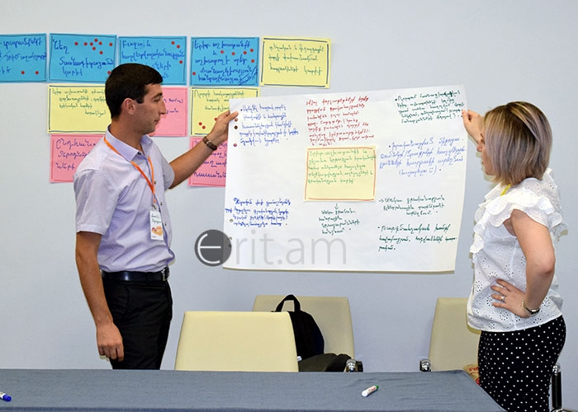
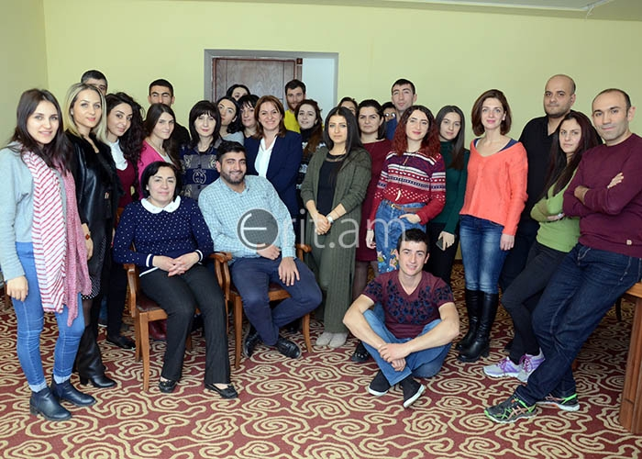
Youth Work Institute in Armenia
Steps
1) to publicize and increase the level of recognizability of terms “youth work” and “youth worker”
Youth work institute development program approved by the Government
Articles and interviews in media
2) professional (including specialized) trainings for youth workers
Long term trainings and certification or youth workers
3) to increase the number of information, guidelines and literature on Armenian language for youth work
Youth work tool fairs

Slide 7
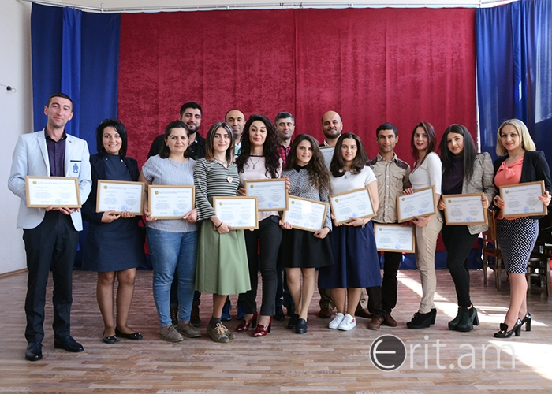
Youth Work Institute in Armenia
Steps
Long term trainings and certification or youth workers
Training of youth work professionals include a basic course which is organized in a long-term multidimensional training format. The program consists of a number of training sessions and during these periods the participants are able to work on their practical.
In addition to the basic course, thematic courses can be organized in different fields of youth work as well as in specific target groups (e.g. rural youth, people with disabilities, refugees) and community-based fields.

Slide 8
Youth Work Institute in Armenia
Next Steps
Organizing training for youth workers | 2018-2022
Publicizing successful articles on youth institute development through mass media | 2018-2022
Organizing informative events in cooperation with RA executive bodies, local self-government bodies and regional governorates | 2018-2022
Creating and replenishing platforms for literature on Armenian Language, materials, educational tools (methods, games, etc.) in youth field | 2018-2019
Preparing guidelines of international experience in the field of youth work with separate groups of young people and implementing educative study visits | 2019-2020
Developing legal Acts of mandatory youth employment in regional governorates (marzpetaran) | 2020
Developing and submitting educational program of “Youth work” to the Ministry of Education and Science of the Republic of Armenia | 2022

