Slide 1

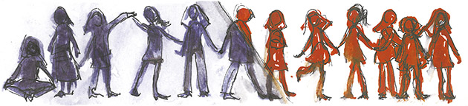
Building Knowledge Networks
South-Mediterranean youth co-operation:
Building Knowledge Networks for Evidence Based Youth Policy and Practice
Expert Meeting, Brussels 12-13 December 2016
Or 7 points on studying youth participation,
doing international research collaboration,
and contributing to evidence based youth policy
Sofia Laine, Finnish Youth Research Network, sofia.laine@youthresearch.fi

Slide 2
1. Importance of studying and understanding diversity of youth political engagement.
Way of reason (institutionalised) – way of subjectivity (everyday activism, social movements) (Pleyers 2010)
Young party members – NGO actors – Social movement activists
Inter- and intragenerational dialogue/misunderstanding
  Academy of Finland-funded consortium project called ‘Youth and Political Engagement in Contemporary Africa’ (YoPo) (2012–2016, n° 258235)
  EU-funded research project called ‘SAHWA: Researching Arab Mediterranean Youth: Towards a New Social Contract’ (2014-2017, n° 613174)
  Ministry of Culture, Spain, funded GENIND project ‘Indignant Generation. The youth movements of 2011 in the Mediterranean area: a transnational perspective’ (2013-2016, n° CSO2012-34415)
Recommendation: To develop mechanisms how the research knowledge would be in a deeper dialogue with a) youth policy and b) young people

Slide 3
2. Importance of co-research by scholars from the South and the North and real spaces of dialogue
Jabberi, Fatma & Laine, Sofia (2015) Spaces of dialogue? The case of the World Social Forum Tunis 2013 from the perspective of young, local volunteers. Global Studies of Childhood 5(2) 178–190.
Laine, Sofia & Suurpää Leena & Ltifi, Afifa (2017) Respectful resistance. Young musicians and the unfinished revolution in Tunisia. In Elina Oinas & Leena Suurpää & Henri Onodera (eds.) What Politics? Youth political engagement in contemporary Africa. Leiden: Brill.
Mai, Yên & Laine, Sofia (forthcoming) Blogging Activism of Young Educated and Global women in Tunisia and Vietnam: A Two-Case Study. PArticipation and Conflict Journal’s special issue 9(3) 2016: "Youth and the Reinvention of Politics. New Forms of Participation in the age of Individualizazion and Presentification".
Recommendation: Support tutoring / mentoring structures and co-research projects between global South and North

Slide 4
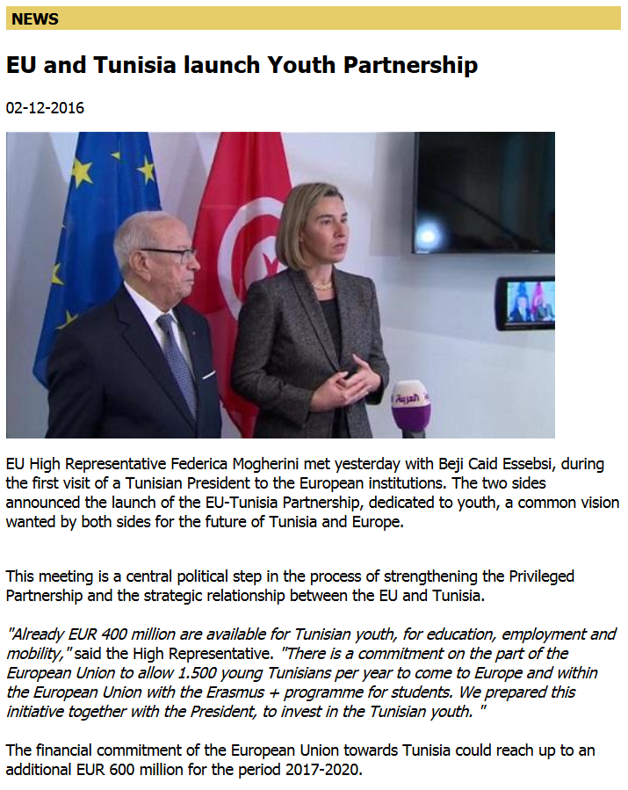
3. Importance of researching South-Med programmes – or young people’s experiences of the youth programmes
Tunisian School of Politics (TSoP) as a case study 2012-2016
Interviewing students in Tunisia and in Finland
Organising seminars together with Demo Finland (Finnish Funder)
Proposal: Organising extensive youth research project that studies EU and Tunisia Youth Partnership

Slide 5
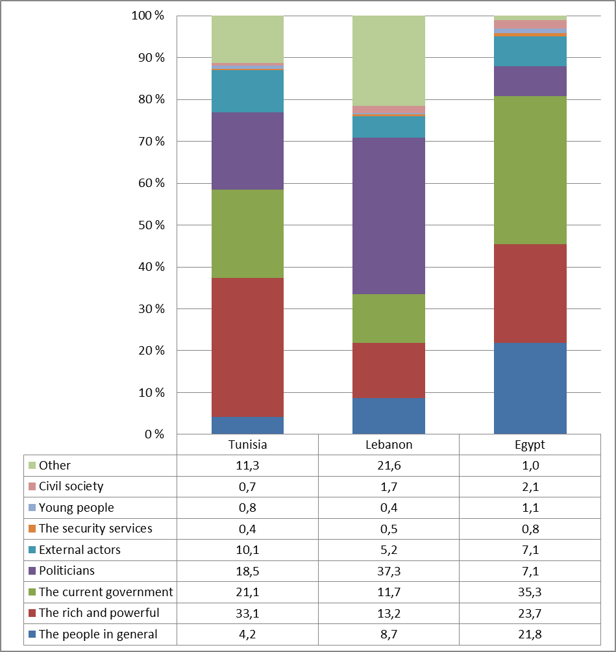
"Who benefits the most from the cooperation with EU” (%).
Source: SAHWA Youth Survey 2016

Slide 6
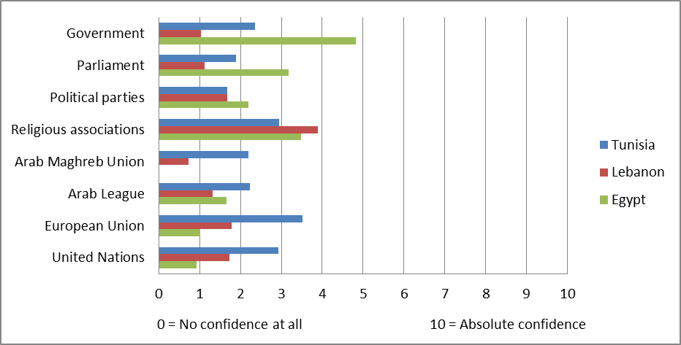
Figure: Confidence to political institutions (averages)
Source: SAHWA Youth Survey 2016

Slide 7
4. Importance of longitudinal research
Studying changes:
Institutional changes
Cultural changes
Individual chances / life trajectories
Recommendation: Better support to longitudinal research projects
5. Importance of North-South combined
a) research, b) Pool of Youth Research, c) Knowledge Centre for Youth Policy (ref. youthpolicy.org)

Slide 8
Sources: SAHWA Youth Survey 2016 & Finnish Youth Barometer 2013

Slide 9
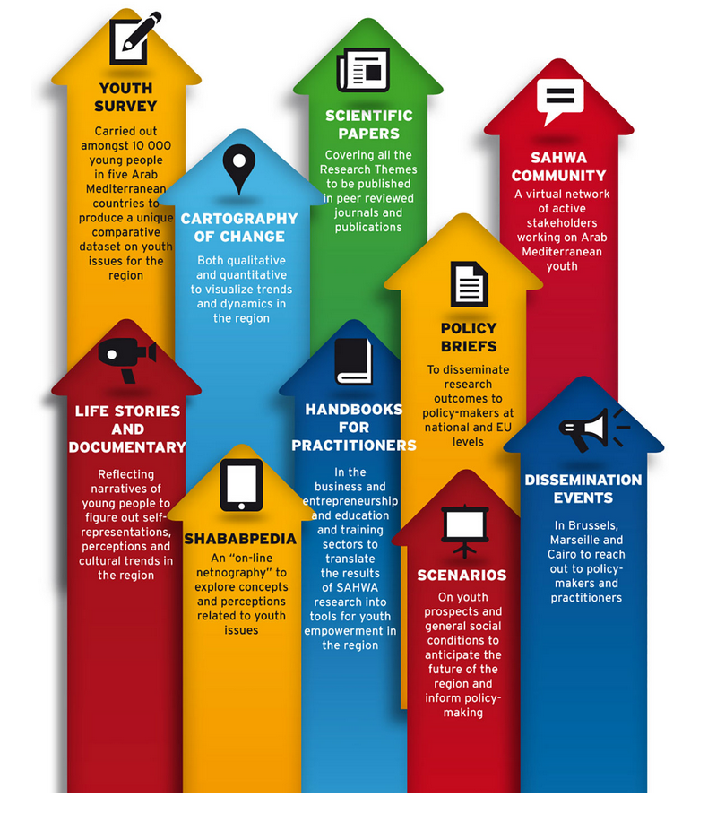
www.sahwa.eu
3,1 million euro project 2014-2017
15 research institutions involved on both shores of Mediterranean
15 locations of ethnographic fieldwork (3 / country)
10,000 youth survey (2,000 / country)
Informants 15-29 years
the FYRN team’s Policy Report 'Towards more inclusive youth political engagement in Arab-Mediterranean countries'
Notes:
Door to door –kysely, kokonaisuus kesken, viimeiset aineistot muutama viikko sitten SOFIA

Slide 10
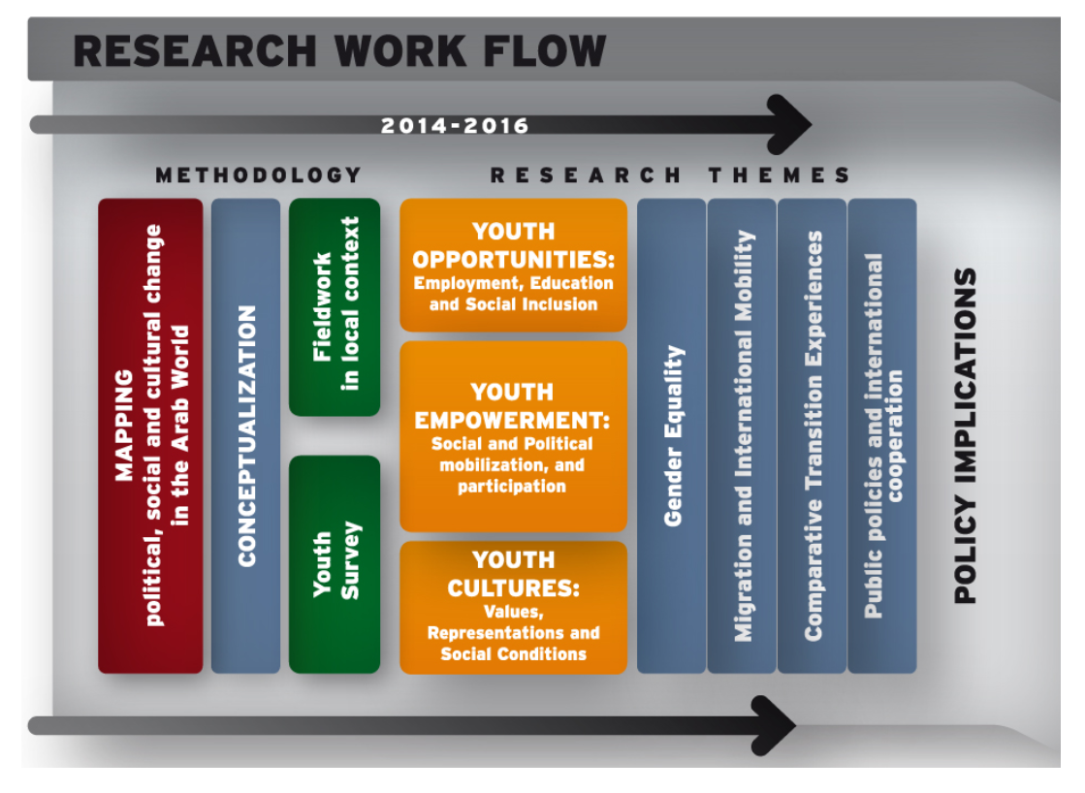
Triangulation + intersectionality + South-North co-research
Notes:
SOFIA

Slide 11
6. Importance to research and support the UN Security Council Resolution 2250 on ‘Youth, Peace and Security’
Recommendation: Collective research project on the topic
Necessity to develop new tools and practices to include young people better to the decision making in all levels.
High unemployment rates, social marginalisation and young people's increasing non-involvement in the societies decreases or even blocks the development worldwide.
Scott Atran (2015) ‘The Role of Youth in Countering Violent Extremism and Promoting Peace’: ”The key, as Margaret Mead taught me long ago, was to empathize with people, without always sympathizing: to participate in their lives to the extent you feel is morally possible. And then report.”
Young people look after meaningful life and dignity especially in the transition phase towards adulthood
2250 Resolution recognizes “that youth should actively be engaged in shaping lasting peace and contributing to justice and reconciliation, and that a large youth population presents a unique demographic dividend that can contribute to lasting peace and economic prosperity if inclusive policies are in place”.

Slide 12
Atran: ”three conditions that I believe young people need”
The first condition: offer youth something that makes them dream, of a life of significance through struggle and sacrifice in comradeship.
The second condition: offer youth a positive personal dream, with a concrete chance of realization.
A third condition: offer youth the chance to create their own local initiatives.
7. The CoE-EU Youth Partnership’s process on ‘’Young refugees and youth work”
Proposal: Collective research project on the topic, framing with 2250

Slide 13
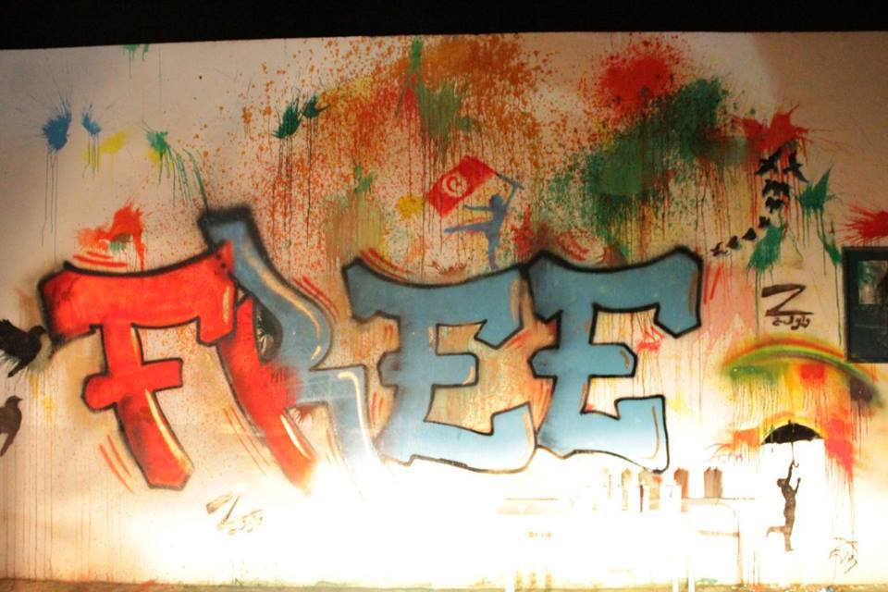
Thank You!
Copyright: Zwewla

