Slide 1
A few reflections on youth engagement in Arab-Mediterranean countries
Henri Onodera
Swedish School of Social Science Finnish Youth Research Network
University of Helsinki Helsinki
(henri.onodera@helsinki.fi)

Slide 2
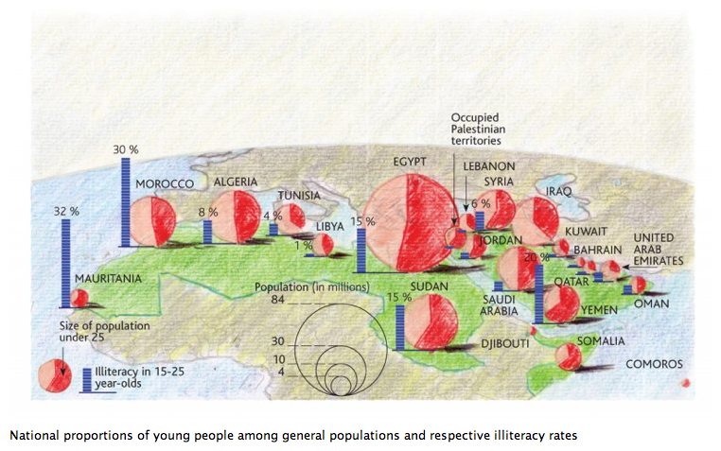
Matthew Machowski (May 2011) Le Monde Diplomatique

Slide 3
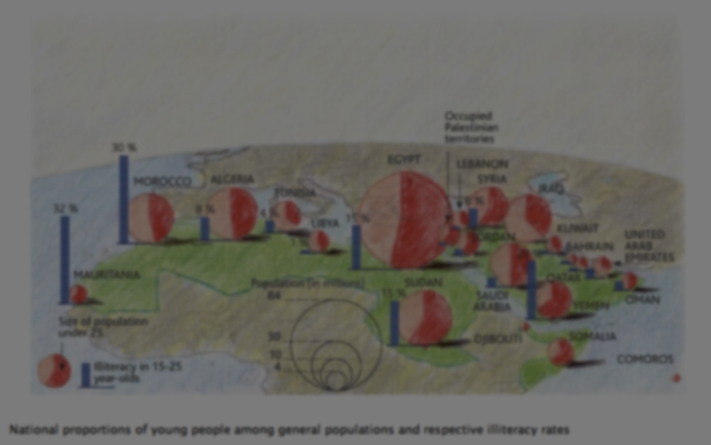
Everyone talks about integration or the involvement of young people in decision making, but how many young people are actually involved in these decisions? Isn’t this category of youth exploited in the production of certain policies? Regarding the forms of participation, we can observe some of them along the axis of Kenitra, Marrakech until Agadir. But there are other regions where young people are not involved at all and they choose non involvement. Is it a political choice? [---] They choose to stay at the coffee corner, smoking quietly, watching the sea, they have other concerns. (MOROCCO, Sahwa ethnographic material)

Slide 5
Figure 1. Participation in different political activities at least once during the last 12 months (%)
Source: SAHWA Youth Survey 2016

Slide 6
Figure 2. Experiences of the possibilities to play an active role and have a say (averages)
Source: SAHWA Youth Survey 2016

Slide 7
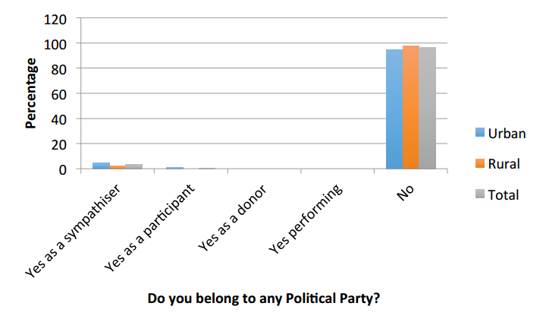
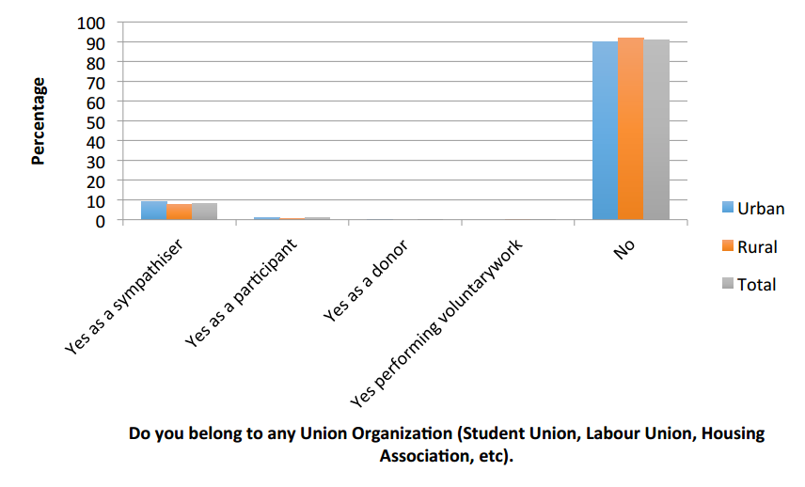
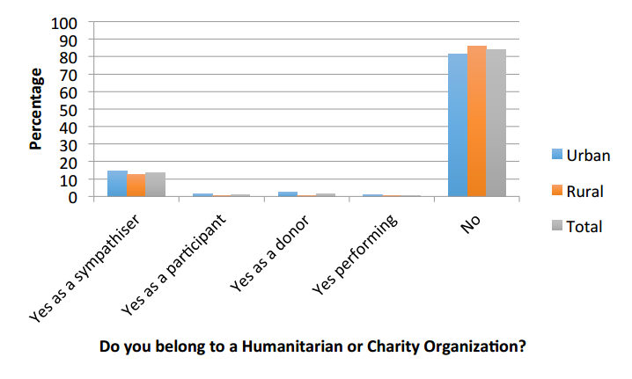
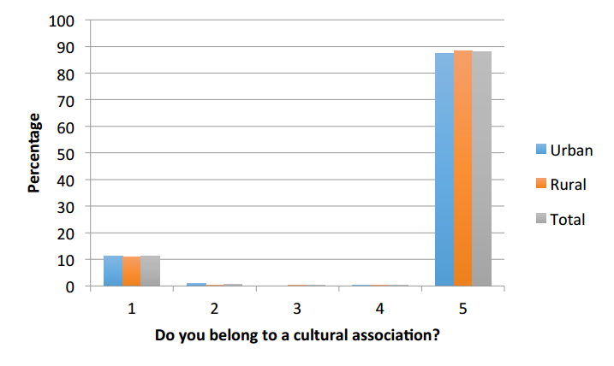
SAHWA National Case Study: Egypt

Slide 8
Figure 3. “The biggest problem in my country” reported by 15-29-years-olds, showing four most selected answers per country (%)
(Other includes also: The health system, Corruption, Morals in society, Housing, Criminality and drugs)
Source: SAHWA Youth Survey 2016 N = 1854-2036

Slide 9
Salwa
“Resala” was accessible for me during college when I used to live in “Beni – Suef” governorate. “Salwa” adds that “Resala” is also available in her hometown of Menya but it is far away from where she lives. Salwa adds that when she used to work in “Resala” she used to help a group of blind people. She dedicated herself once a week to sit down and read them a book while they sat down and thought it through. Other activities that “Resala” offered while Salwa helped there was the process of collecting old or used clothes and washing them and preparing them, then distributing them on the most needy. Salwa dictates that helping out in “Resala” created a sense of responsibility and self-worth for Salwa. After finishing college, Salwa wanted to actually work and stopped approaching charity organizations were she used to help out.“ (EGYPT, Sahwa ethnographic material)

Slide 10
Navtej Dhillon (2009): ”Waithood can be best understood by examining outcomes and linkages across five different sectors: education, employment, housing, credit, and marriage.”

Slide 11
Multiple forms of youth engagement
POLITICAL PARTICIPATION (manifest)
Formal political participation
”Activism” (legal, extraparliamentary & illegal)
CIVIL PARTICIPATION
Social involvement (attention)
Civic engagement (action)
”NON-PARTICIPATION”
Active forms (”antipolitical”)
Passive forms (”apolitical”)
Modified from Joakim Ekman & Erik Amnå (2012) Political participation and civic engagement: Towards a new typology. Human Affairs 22, 283-300

Slide 12
A few points in conclusion
Coexistence of multiple forms of youth engagement (manifest & latent)
Youth disengagement is not to be equalled with youth apathy
Waithood is becoming a norm
Qualititive research is needed alongside survey-based studies

