Slide 1
Refugees and European NGOs volunteering, learning and changing the world together

Slide 2
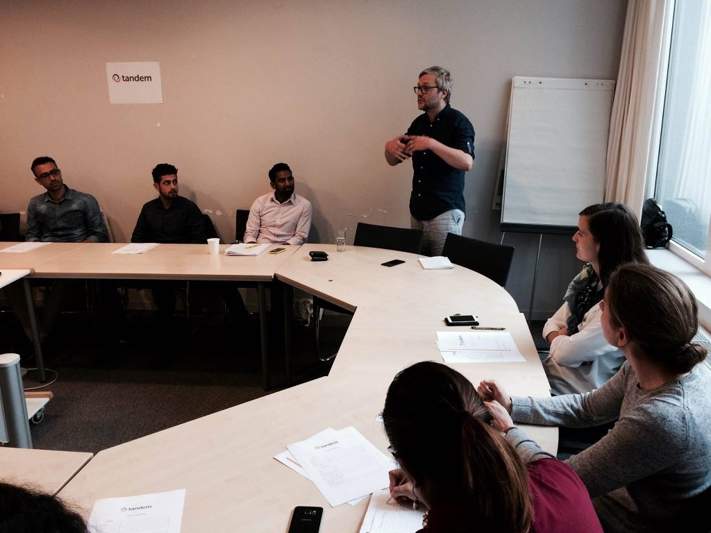
What is Tandem?
Tandem is an initiative co-led by refugees aimed at supporting their integration in Belgium.
We do this by creating opportunities for refugees to bring their experience and skills to European-level NGOs via short-term volunteer placements.

Slide 3
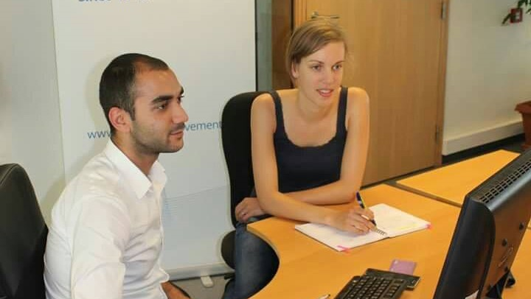
How it benefits refugees
Offering Opportunities and Autonomy
Alleviating Financial Uncertainty
“It was an opportunity to practice my English and to get to know more about policies and regulations of the EU. After I finished my two week internship, I learned about the EU’s history, policies and regulations, and I also had the chance to improve my English, as I had hoped.“
Yazan Azmi, 23-year old refugee from Syria
Supporting Change-makers

Slide 4
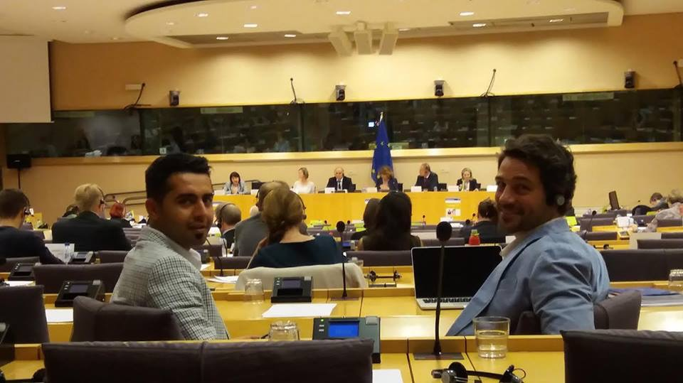
How it benefits organisations
Increase Capacity
Media work
Events
Research
Policy
Campaigns
IT
Bring New Perspectives
“Our experience with Yazan was very positive. We used his knowledge and experience with the Dublin system to write [about] Dublin and the EU-Turkey deal that combined both policy and his personal experiences, and that I will use in later work. We really valued having his inside perspective…We also really enjoyed having him in the office.”
Emma Klever, Head of Policy, European Movement International
Support Community Interaction

Slide 5
Practical considerations
All refugee/asylum seekers who work with us are legally allowed to volunteer. Unlike employees, any restrictions or requirements regarding social security, taxes etc. do not apply.
It is 100% legal
It won’t create extra admin
No special authorisation is needed from the government in most cases, and we work with Het Punt to take care of all legal/government requirements
Volunteer placements are for a two week period, remuneration is not allowed by law, but organisations are asked to pay a €25 daily allowance to cover food and travel
Format

Slide 6
Get involved
Organisation completes the Expression of Interest form
To take part you must:
Be non-commercial
Pay a €25 daily allowance to the volunteer
Provide workplace insurance for the volunteer (Tandem can help if this is not possible)
Tandem reviews the form to ensure the criteria is met and match the opportunity with a volunteer
The organisation and volunteer establish an agreement specifying tasks, responsibilities and hours with the volunteer (supported by Tandem)
The volunteer works a full-time, two week placement at the organisation. They learn, cooperate and enjoy!

Slide 7
Supporting organisations

Slide 8
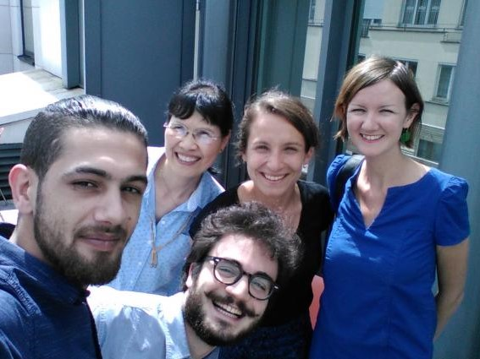
“It’s been the most beautiful time since arriving in Belgium because I felt alive again. This placement helped me to break the isolation that refugees in the asylum centres face. Meeting Europeans and feeling connected with them is so important.”
Monaf Alkalaani, 25, Syria
“ActionAid was eager to help Monaf tell his story and change the poisonous perception of refugees as a threat to our society instead of allies in a fight for a more just and peaceful world. Hosting him challenged us in our work and changed us profoundly for the better.”
Laura Sullivan, Europe and Americas Regional Director, ActionAid

Slide 9
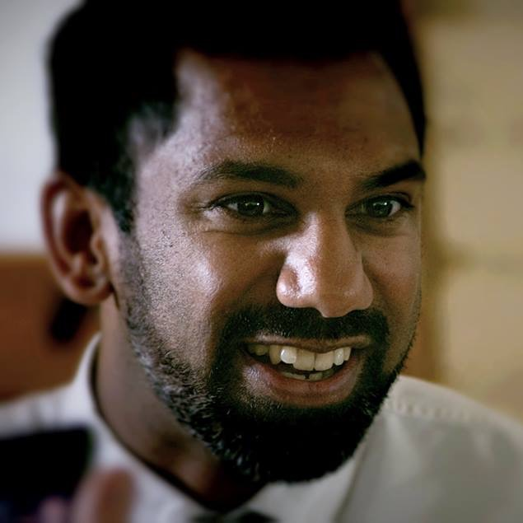
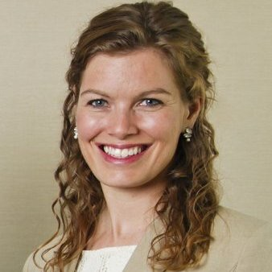
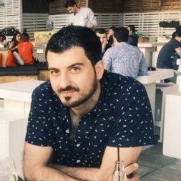
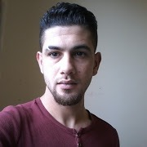
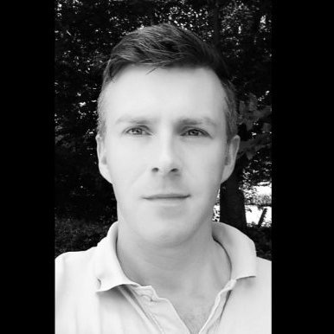
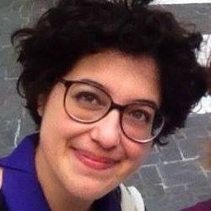
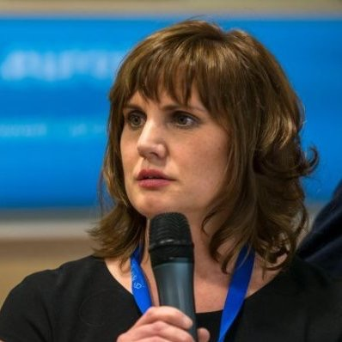
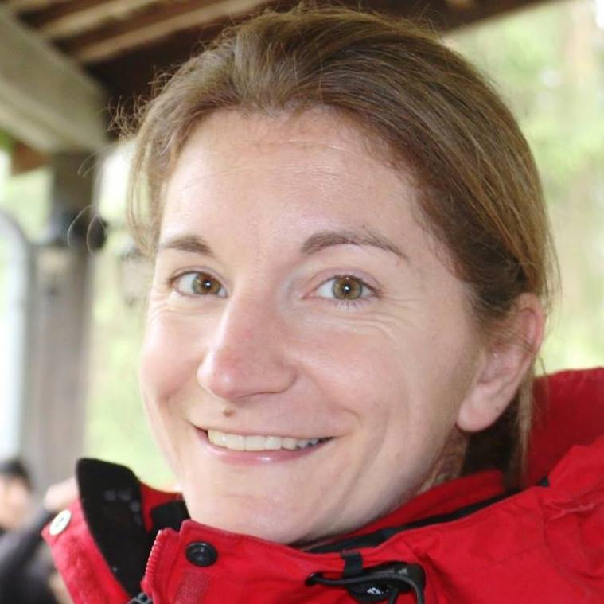
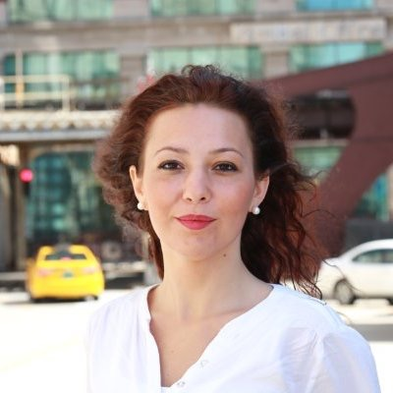
Get in touch with the team
Maarten Coertjens Partnerships
Advocacy Officer, CONCORD
Dutch Language Teacher
Mark Perera
Lead Coordinator
Alison Maassen
Promotion
Sabin Vaccine Institute Stanford Anthropology Department
Abdulmajid Abdulrahim Matching Coordinator
Student at Vrije Universiteit Brussel
Monaf Alkalaany
Refugee Outreach
facebook.com/Tandemvolunteering
tandemvolunteering.org
tandem@tandemvolunteering.org
Advisors

