Slide 1
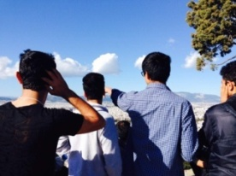
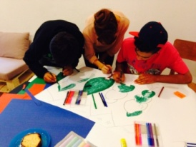
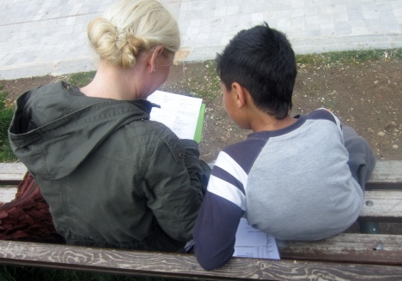
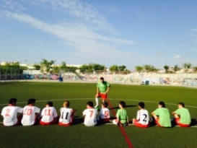
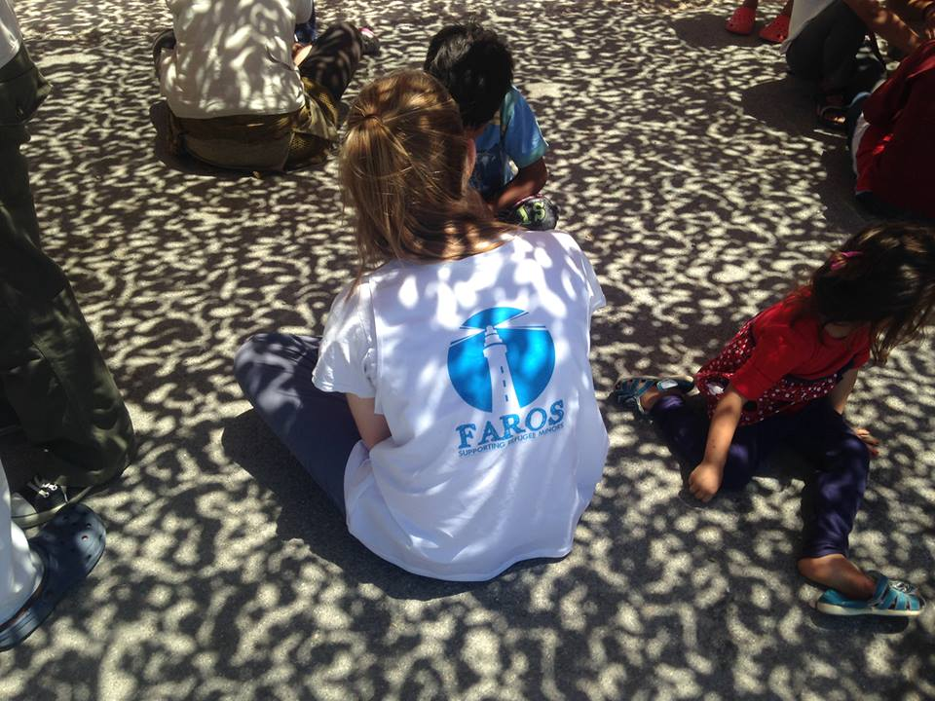
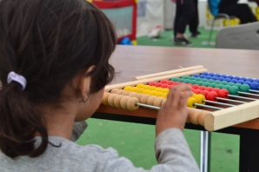
FAROS Supporting unaccompanied refugee adolescents in Athens, Greece

Slide 2
Context
From transit to host country: currently 57.000 refugees are ‘stuck’ in Greece
Over 3.500 unaccompanied refugee adolescents registered in Greece in 2016
Lack of housing facilities: currently the national agency for housing of refugees has over 1.500 unaccompanied refugee adolescents on the waiting list for a shelter space
Unaccompanied refugee adolescents are faced with various risks, including homelessness, violence, sexual exploitation and being detained by authorities

Slide 3
Faros work I
Local Greek NGO that since 2014 is supporting unaccompanied refugee adolescents in Athens
Drop-in center for unaccompanied refugee adolescents
Shelter for unaccompanied refugee adolescents

Slide 4
Faros work II
Social work support
Legal support
Mentorship program
Street-work
Non-formal educational classes in Greek, English, German, Business, Mathematics
Vocational training in carpentry and tailoring
Awareness classes on rights, health, hygiene
Sports academy in football, volleyball and taekwondo
Cultural exchange activities
Research and advocacy

Slide 5
Good practices to share
Sports programs, as increased participation can assist in reducing anti-social behavior, building social cohesion, and allows staff to get close to unaccompanied adolescents
Strengthening the feeling belonging: importance of being part and member of a group and community
Mentor ship program to support individual well-being of unaccompanied adolescents
Cultural exchange program with Greek adolescents to learn about each other

Slide 6
Life-skills program: boys on the move
Non-formal life skills support for unaccompanied adolescents in migration
MODULE 1: Know and Understand Self:
Session 1.1: Health/Hygiene/Self-care; Session 1.2: Emotions; Session 1.3: Coping with Stress
MODULE 2: Know and Understand Others: Session 2.1: Identity/Values; Session 2.2: Sex and Sexuality; Session 2.3: Interpersonal Relationships
MODULE 3: Know and Understand Society: Session 3.1: Communicating Respect/Social Engagement/Cultural Awareness; Session 3.2: Planning; Session 3.3: Wild Card, Adolescent Select
MODULE 4: The Big Picture/Making Connections

Slide 7
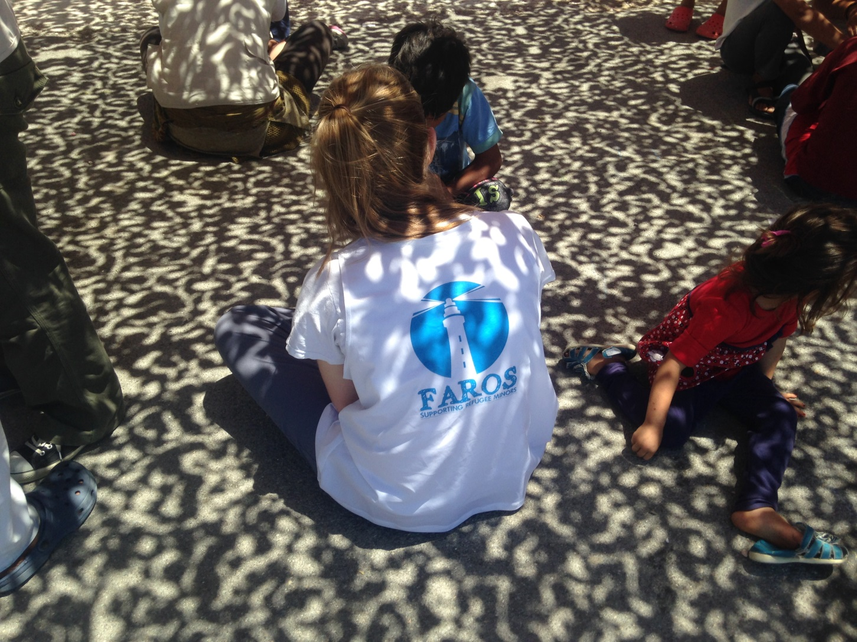
Thank you

