Slide 1
Future thinking scenarios – how will youth work and youth sector transform in the future
Journeys to a New Life
EU-CoE youth partnership Brussels, Nov. 23-24, 2016
Ulrich Golüke

Slide 2
Future thinking scenarios
“Stop saying young people are the future,
they are the present!”
(Young participant at the 2015 European Meeting of People Experiencing Poverty).
Young people themselves want to and should be at the center of future youth work.
My talk and the interactive session is how young people could occupy that central place.
goluke@blue-way.net

Slide 3
Future thinking scenarios
My suggestion:
The power of stories
and how to harness that power for future youth work
goluke@blue-way.net

Slide 4
Future thinking scenarios: The power of stories
Interactive exercise
goluke@blue-way.net

Slide 5
Future thinking scenarios: The power of stories
1 You cannot change the facts of your life, but you are free to arrange them to tell one story or a different one.
2 Some stories touch the heart, others the mind.
3 The stories you tell about the future determine what you do in the present.
goluke@blue-way.net

Slide 6
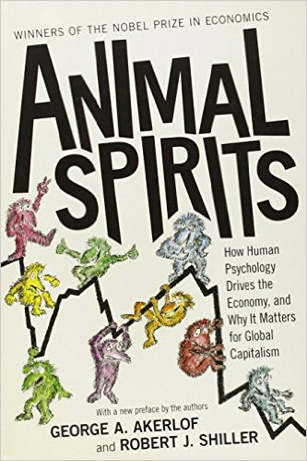
Future thinking scenarios: The power of stories
“The human mind is built to think in terms of narratives, of sequences of events with an internal logic and dynamic that appear as the unified whole. In turn, much of human motivation comes from living through a story of our lives, a story that we tell to ourselves and that creates a framework for motivation. Life could be just ‘one damn thing after another’, if it weren’t for such stories.”
Akerlof and Shiller: “Animal Spirits” pg 51
goluke@blue-way.net

Slide 7
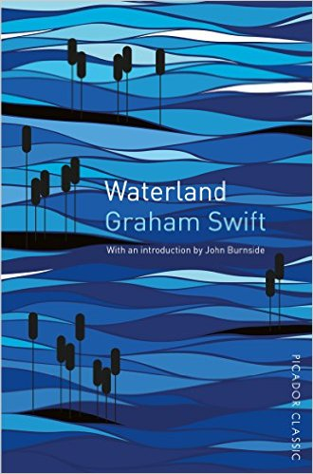
Future thinking scenarios: The power of stories
"Only nature knows neither memory nor history. But man and women are the story-telling animal. Wherever they go they want to leave behind not a chaotic wake, not an empty space, but the comforting marker-buoys and trail-signs of stories. They have to go on telling stories. As long as there’s a story, it’s alright."
goluke@blue-way.net

Slide 8
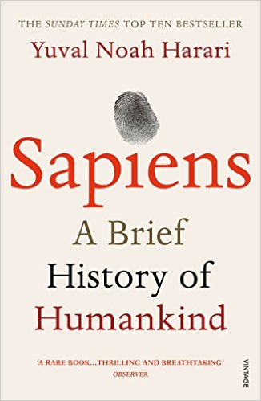
Future thinking scenarios: The power of stories
The dominance of human sapiens comes from our ability to talk about things that do not exist. Harari calls that the ‘cognitive revolution’
“Unlike lying, an imagined reality is something that everyone believes in, and as long as this communal belief persists, the imagined reality exerts force in the world.” Harari: “Sapiens” pg 35
goluke@blue-way.net

Slide 9
Future thinking scenarios: The power of stories
“Very young children love and demand stories, and can understand complex matters presented as stories, when their powers of comprehending general concepts, paradigms, are almost nonexistent.”
Oliver Sacks, The Man Who Mistook His Wife for a Hat and Other Clinical Tales
goluke@blue-way.net

Slide 10
Future thinking scenarios: The key to success
1 Stories must be created, told and spread by those ‘affected’.
2 They need to be authentic.
3 They are negotiated agreements about what could be.
goluke@blue-way.net

Slide 11
Future thinking scenarios:
… negotiated agreements about what could be
We’re no longer material constraint
transcendence
self actualization
aesthetic
cognitive
esteem
attachment
safety
biological
Grübler, A, Technology and Global Change, 1998, Cambridge University Press Lebergott, S, Consumer Expenditures, 1995, Princeton University Press
Maslow’s hierachy of needs
goluke@blue-way.net

Slide 12
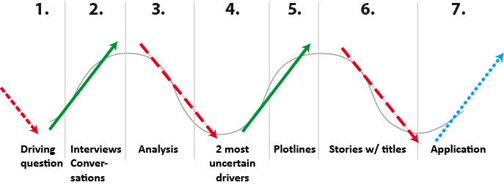
Future thinking scenarios: Method
Seven phases of scenarios
Awareness
Alignment
Engagement
Action
goluke@blue-way.net

Slide 13
Future thinking scenarios: Method
To Hell and Back
To Hell and Back
Unbearable
lightness
Unbearable lightness
The journey
to the bottom
of the night
The Journey to the bottom of the night
Justice
Justice
goluke@blue-way.net

Slide 14
Future thinking scenarios: Method
Application
Adapting to the future
Shaping the future
Transforming the future
goluke@blue-way.net

Slide 15
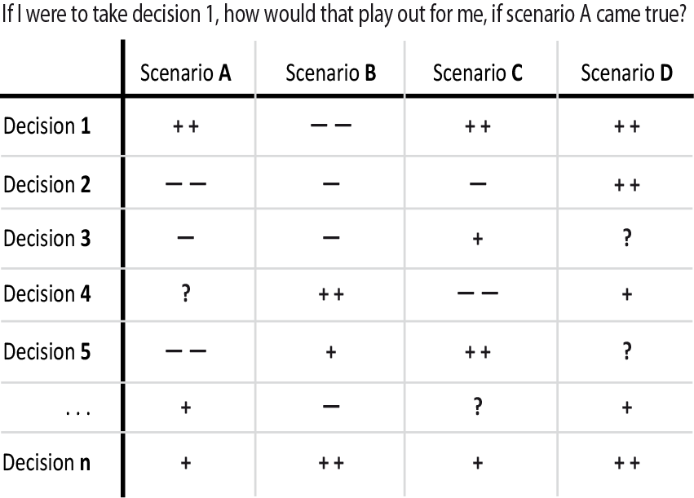
Future thinking scenarios: Method
Application Matrix: Adapt
goluke@blue-way.net

Slide 16
Future thinking scenarios: Method
Application Matrix: Shape
goluke@blue-way.net

Slide 17
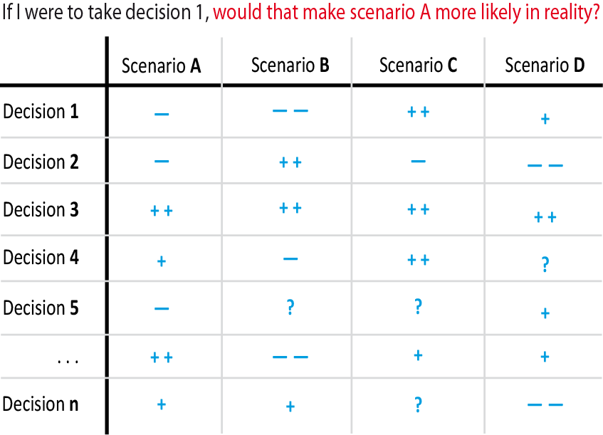
Future thinking scenarios: Method
Application Matrix: Transform
goluke@blue-way.net

Slide 18
Future thinking scenarios: Process
Scenario work
Learning vs. applying; self vs. others
Scalability, minimum effort and marginal benefit
Diversity; remarkable people and experts
(Residential) workshops; 24 ± 4 participants; core team: 2-7 people
Writing, communicating, visioning, doing
goluke@blue-way.net

Slide 19
Future thinking scenarios: Process
Scenario work
Isolated 3-4 day events
empower individuals
Effort to change European policy
Negotiating a common desirable future; creating counter narratives
goluke@blue-way.net

Slide 20
“Stop saying young people are the future,
they are the present!”
Thank you
goluke@blue-way.net

