Slide 1
Youth political participation
Annual joint PEYR/EKCYP meeting
Budapest, 7 September 2016
Tomaž Deželan
University of Ljubljana
@tomazdezelan
tomaz.dezelan@fdv.uni-lj.si
Notes:
THANK YOU FOR THE FLOUR. GOOD MORNING LADIES AND GENTLEMAN, THANK YOU FOR HAVING ME.
TODAY, I’M GOING TO SHARE SOME THOUGHTS ABOUT YUOTH POLITICAL PARTICIPATION. WE’RE BASICALLY GOING TO SCRATCH THE SURFACE AND THEN TALK A BIT MORE COMPREHENSIVELY IN THE WORKING GROUPS PHASE.
SO, WHAT IS THE MAIN QUESTION HERE AFTER 20 OR 25 YEARS OF COMPREHENSIVE RESEARCH?
IS THERE A YOUTH POLITICAL PARTICIPATION PROBLEM?
——- slide

Slide 2
Number of youth political participation articles in WoS journals?
Notes:
JUDGING FROM THE EXTENSIVENESS OF THE ACADEMIC LITERATURE IN THE PAST DECADE OR MORE, WE SHOULD SAY YES.
IN THE PAST 10 YEARS, THERE WERE MORE THAN 1.400 ARTICLES PUBLISHED ON THE TOPIC IN THE WEB OF SCIENCE JOURNALS. AND THE FREQUENCY IS GROWING EVERY YEAR.
I GUESS WE ALL KNOW THE MAIN PROBLEM IS PARTICIPATION IN INSTITUTIONAL POLITICS.
———- slide

Slide 3
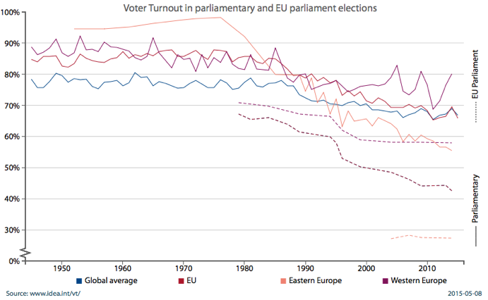
Voter turnout across time
Notes:
AND PARTICULARLY
DECLINE IN TRADITIONAL MODES OF POLITICAL PARTICIPATION (VOTING, STANDING FOR ELECTION, PARTY MEMBERSHIP)
WE’RE ALSO SEEING THAT YOUTH DOES NOT PARTICIPATE MORE IN UNCONVENTIONAL MODES OF PARTICIPATION MORE AND MORE OFTEN
WE SEE THAT THE GAP BETWEEN YOUTH AND OTHER AGE GROUPS IS GROWING
AND PARTICULARLY THAT AGE HAS BECOME ONE OF THE STRONGEST PREDICTORS OF PARTICIPATION

Slide 4
Two sets of reasons why youth participation record should be treated as a problem?
1. a set of general ones related to basic principles of democracy and relevant to all age groups or generations
2. a set of reasons particularly relevant to youth
Notes:
THERE ARE TWO SETS OF REASONS WHY YOUTH PARTICIPATION RECORD SHOULD BE TREATED AS A PROBLEM?
1. A SET OF GENERAL ONES RELATED TO BASIC PRINCIPLES OF DEMOCRACY AND RELEVANT TO ALL AGE GROUPS OR GENERATIONS
2. A SET OF REASONS PARTICULARLY RELEVANT TO YOUTH

Slide 5
A general set of arguments for robust political participation in democracy:
1. enhances the quality of democratic governance (GAP — How does this translate into policies?)
2. participation enhances the quality of citizens’ lives (GAP — In what way does it improve lives of citizens?)
3. legitimacy (GAP — How does this translate into representation? Beyond the national level and beyond descriptive representation)
Notes:
THE GENERAL SET OF ARGUMENTS FOR ROBUST POLITICAL PARTICIPATION IN DEMOCRACY:
participation enhances the quality of democratic governance by informing decision-makers about citizens’ preferences
and here I’ll also open up potential gaps in literature (GAP — How does this translate into policies when it comes to youth? Empirical evidence.)
participation enhances the quality of citizens’ lives as it involves the exercise of distinctive human capacities and is an intrinsically noble enterprise; higher levels of participation are connected with higher individual satisfaction with the quality of individual and community life
(GAP — In what way does it improve lives of citizens?)
legitimacy — a government is illegitimate when important groups of citizens are substantially less active and influential than others are (the conditions of collective self-rule are eradicated)
(GAP — How does this translate into representation? Beyond the national level and beyond the descriptive form.)

Slide 6
A set of arguments particularly relevant to youth:
the process of distancing of young individuals from institutional politics
the growing complexity of youth transitions
the changing political imaginary of youth (GAP: Absence of an international comparative literature)
the broadening of definition of politics (GAP: rare quantitative (survey) methodologies with a broad definition of political participation)
Notes:
THE SET OF ARGUMENTS PARTICULARLY RELEVANT TO YOUTH:
the process of distancing of young individuals from institutional politics (various reasons, well covered in the literature)
the growing complexity of youth transitions (longer and reversible transition periods infused by higher levels of uncertainty and vulnerability which affects repertoires of political engagement — lesser importance is placed on the key traditional factors that shape political socialisation, and greater importance is placed on peers and social media outlets)
the changing political imaginary of youth (politics does not entail a clear separation of traditional political institutions and everyday life anymore; the expansion of the political sphere means that political expressions is manifested through the daily lives such as choices of food, clothing, music, use of public spaces etc.)
(GAP: Absence of an international comparative literature)
the broadening of definition of politics (because the political imaginary of youth has changed and evolved, the agents, repertoires and targets of political action have also evolved; it is necessary to resist the narrow definition of political participation used in conventional survey methodology because this definition neglects political engagement of youth)
(GAP: rare quantitative (survey) methodologies with a broad definition of political participation)

Slide 7
How should the revision of the concept (diversification of the range, forms and targets of political expression) be translated into literature and in research?
new agencies—collective organisations that structure political activity (GAP: What do traditional actors (political parties) do? What are the innovations? How successful are they?)
diversification of the repertoires— reinvention of older forms of action or a consequence of technological innovation (GAP: What is the impact of new repetoires on participation and policy?)
the changing targets of political action—the change in political power and authority to transnational and supranational public and private agents (GAP: Which and how are private actors pressured and to what extent?)
Notes:
HOW SHOULD THE REVISION OF THE CONCEPT (diversification of the range, forms and targets of political expression) BE TRANSLATED INTO LITERATURE AND IN RESEARCH?
New agencies—collective organisations that structure political activity—started to emerge in the form of (new) social movements that differed from traditional forms of political organizations (e.g., political parties, unions and pressure groups) in terms of more fluid membership and contentious politics
(GAP: What do traditional actors (political parties) do? What are the innovations? How successful are they?)
Diversification of the repertoires—actions used for political expression—was caused by either a reinvention of older forms of action (e.g., economic boycotts) or a consequence of technological innovation (e.g., internet activism, social media and blogging)
(GAP: What is the impact of new repetoires on participation and policy?)
The changing targets of political action—which the political actors or participants try to influence—denote the change in political power and authority where the nation-state is losing its primacy to a variety of transnational and supranational public and private agents
(GAP: Which and how are private actors pressured and to what extent?)

Slide 8
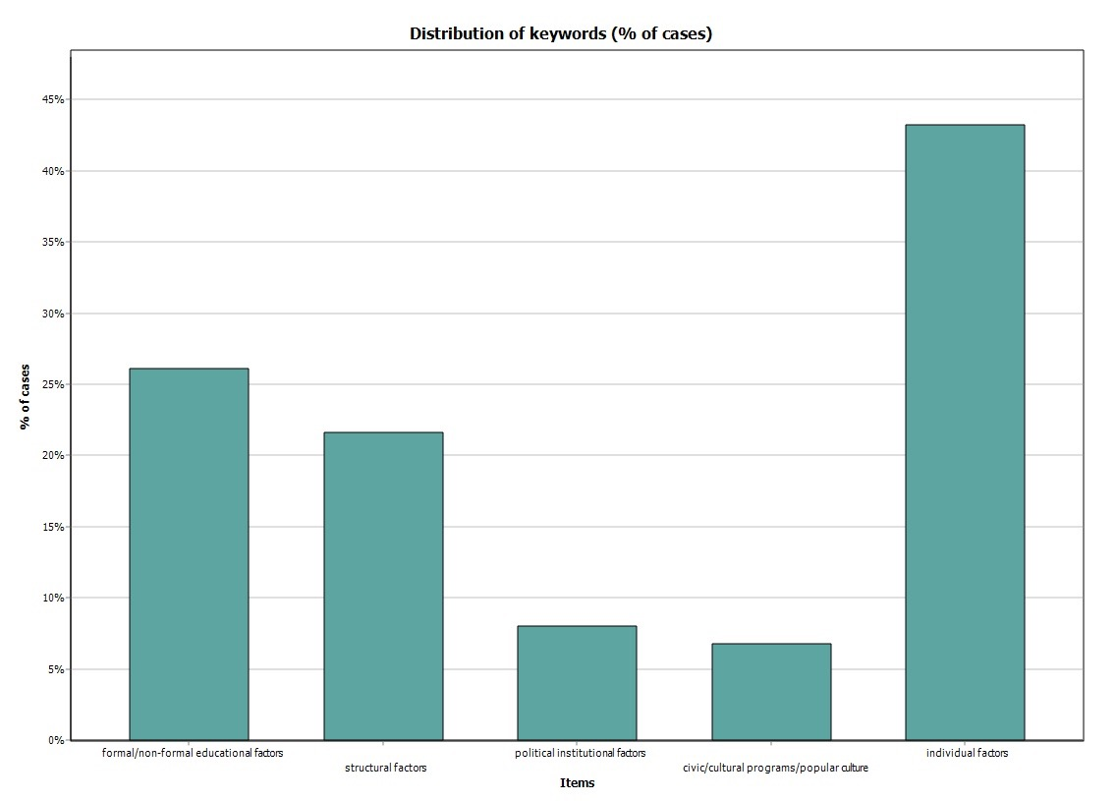
Youth political participation WoS journal articles for the last year — key factors exposed
Notes:
WHEN SCREENING THE WOS, WE WERE ABLE TO SEE THAT INDIVIDUAL (PERSONALITY) FACTORS ARE WELL COVERED AND CIVIC EDUCATION, LESS SOCIAL STRUCTURE, POLITICAL INSTITUTIONS AND OTHER CIVIL SOCIETY ACTIVITIES
ADDITIONAL GAPS TO BE FILLED:
The role of youth organizations in civic education
What are politicians and parties doing online to attract youth?
Impact of race and ethnicity online. Impact of ICT on disadvantaged groups
E-learning methods related to civic education and its influence on participation
What are the negative impacts of educational programs on participation (e.g. sports programs)
Intersectionality and differences between subgroups of youth
The effectiveness of mechanisms programmed to curb participation problem

Slide 9
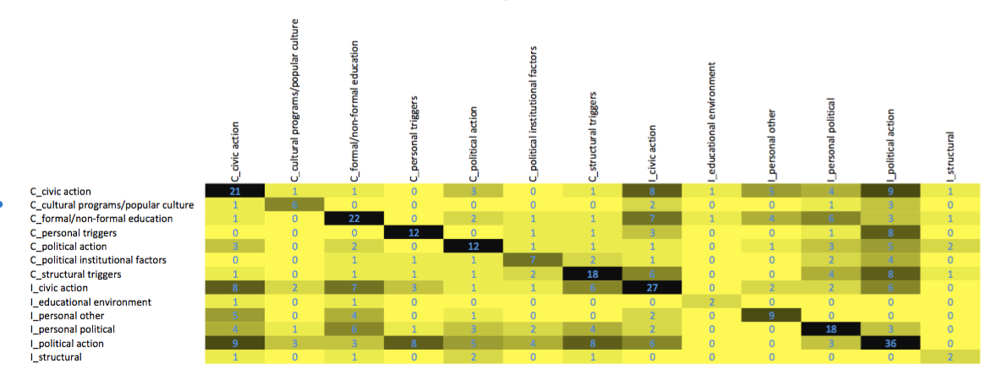
Youth political participation WoS journal articles for the last year — associations between concepts

Slide 10
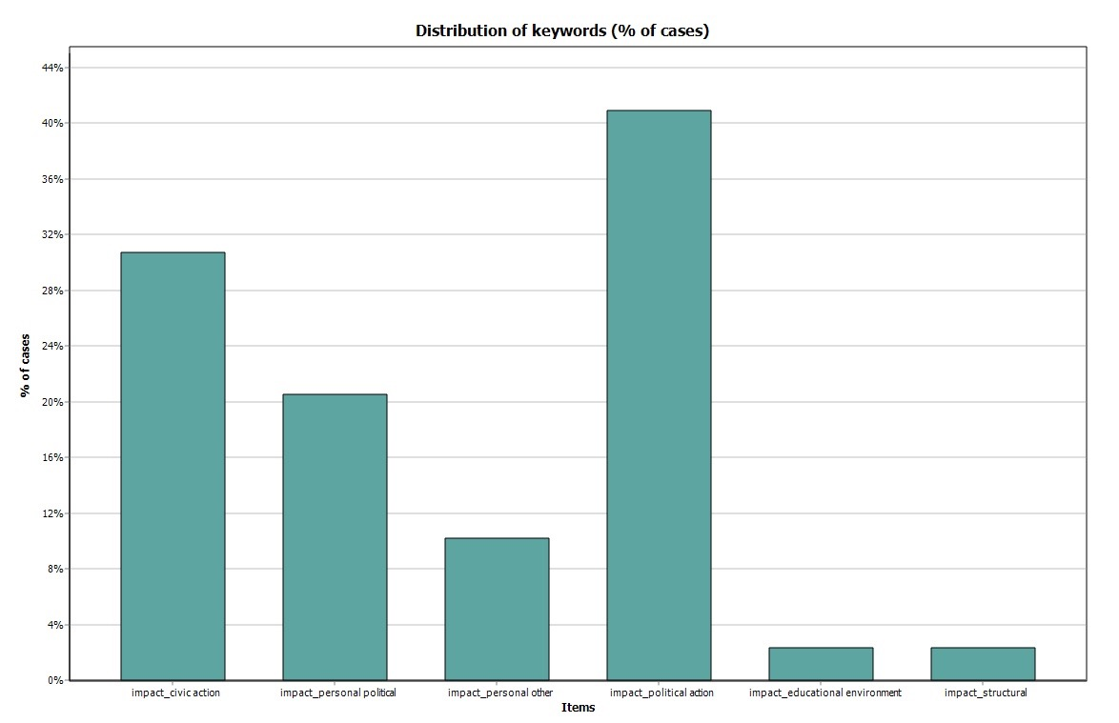
Youth political participation WoS journal articles for the last year — impact on

Slide 11
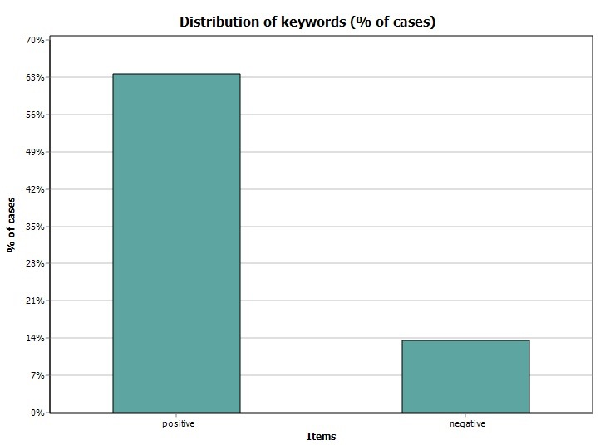
Youth political participation WoS journal articles for the last year — positive/negative impact of factors

Slide 12
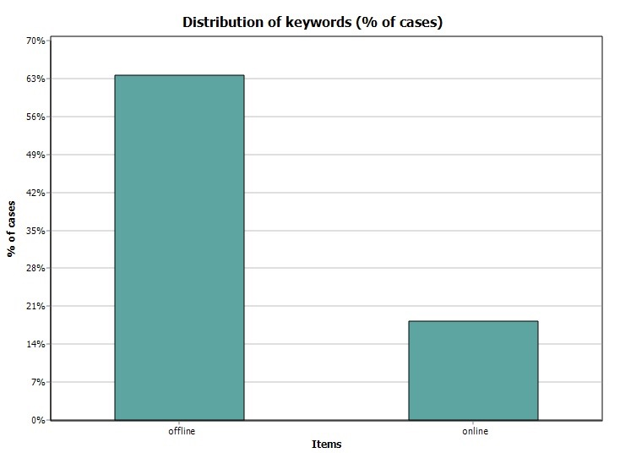
Youth political participation WoS journal articles for the last year — offline/online participation

Slide 13
Youth political participation WoS journal articles for the last year — offline/online vs. positive/negative (similarity matrix)

Slide 14
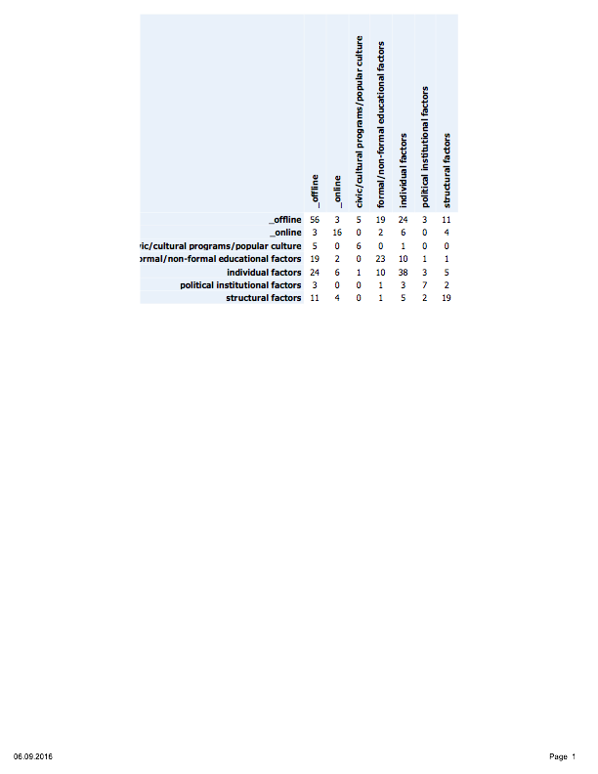
Youth political participation WoS journal articles for the last year — offline/online vs. most frequently exposed factors

Slide 15
Youth political participation WoS journal articles for the last year — positive/negative vs. most frequently exposed factors

