Slide 1
Youth work engaging with youth care, employment and education; what (might) work?
Pink Hilverdink,
The Netherlands Youth Institute
07 sept. 2016, Budapest

Slide 2
An example from the Netherlands
YouTube film T.O.M. Den Boschhttps://youtu.be/Ca0S_3c-41Y

Slide 3
Framework of the meeting
Focus of EU Youth Strategy
Role of youth work in cross-sectoral policies
Positive approaches to youth policy and practice
Reforms within the Netherlands
New decentralized responsibilities since 2015 with
Law on Child and Youth Help since 2015 & New Law on Social Support, mental health care, employment and income and ‘fitting’ education
Youth work in NL = youth social work / part of preventive youth policies (local dept led) for vulnerable youth (at risk)

Slide 4
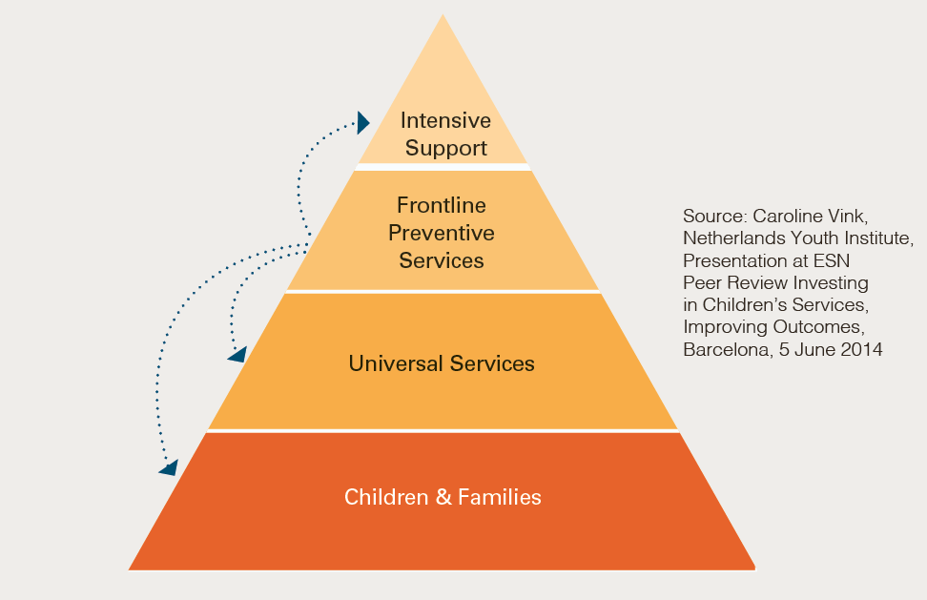
The new local reality

Slide 5
Key challenges in the Netherlands
Better focus on preventive support and care for children, young people and families
from service-led to needs-led support
Building stronger communities / civil society
Empowering all towards self-responsibility and developing informal co-support systems (networks)
Collaboration between all professionals in the direct environment of children, young people and families
Cheaper, more effective and higher quality of support and care – developing new monitoring systems
Stronger leadership of local municipalities

Slide 6
The international expert meeting
Learning from each other in policy and practice
in a local youth work setting
13 EU countries; + NL group
POYWE and Intercity Youth
Erasmus Plus Youth & Netherlands Youth Institute
Developing principles and conditions for successful cooperation between all

Slide 7
Main outcomes
No why or if, but what and how energy
Youth workers are change agents; need for reclaiming and reframing their profession
Youth work = more than leisure time activities -> future oriented & strength based
Youth work leads towards improving the city / village life
Evidence supports sustainable change

Slide 8
Ten steps towards strong(er) collaboration between all partners
Have young people to take part from the start
Build towards common views and a shared language (e.g. theoretical frameworks)
Take leadership as youth workers
Collect local data and build evidence from there (qualitative and quantitative)
Develop community-driven goals

Slide 9
10 steps (follow up)
Be open to differences and cross boundaries but recognize eachothers’ professions
Develop quality guidelines and make them sustainable (PDCA / monitoring)
Seek committment from politicians, management and other decision makers
Take continous care of risk management
Learn by doing and enjoy!!

Slide 10
”If you want to go fast,
go alone.
If you want to go far,
go together”
An African proverb

Slide 11
Following from here
What is research currently exploring/highlighting about collaboration / integrated working approaches?
To which extent is it known that youth policies and youth work are theory driven?
What quality or impact topics could be further explored?

