Slide 1
Participation and e-participation from a practical perspective
EU-CoE youth partnership
Pool of European Youth Researchers
Annual Meeting 2016
Kerstin Franzl nexus institute

Slide 2
nexus institute for cooperation management and interdisciplinary research
Participation: consultancy and facilitation
Public/political sphere
Research
Product development
Cooperation
Social science research

Slide 3
EU^{th} – Tools and Tipps for mobile and digital youth participation in and across Europe
Funded in H2020 programme, SC6 Europe in a changing world
March 2015-2018
Main goal:
Increase the trust of young people in Europe and its political institutions
digital solutions for youth participation: OPIN (www.opin.me)
empower initiators to set up youth e-part. projects
user-centered and tested outcomes
sustainable impact

Slide 4
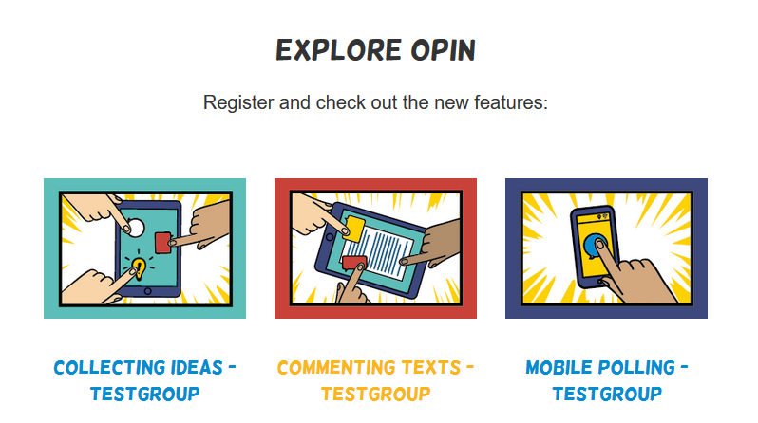
The software OPIN (www.opin.me)
Iterative development: full version in Sept 2017
Multi-client-platform
Participation features
Integration of online and offline
Guided admin interface with Decision-Support-Tool
Modularized guidelines
Smart community management

Slide 5
Modularized participation
Standardized participation -> Individualized participation
Mixed online and f2f participation
How to combine these elements in a way that they produce the best possible outcome?

Slide 6
EU^{th} research on process design of youth e-participation projects (ongoing)
Aim: Find generic, combinable online and f2f modules of participatory processes
processes analyzed according to:
topics and objectives
organizational structure: online & f2f participation

Slide 7
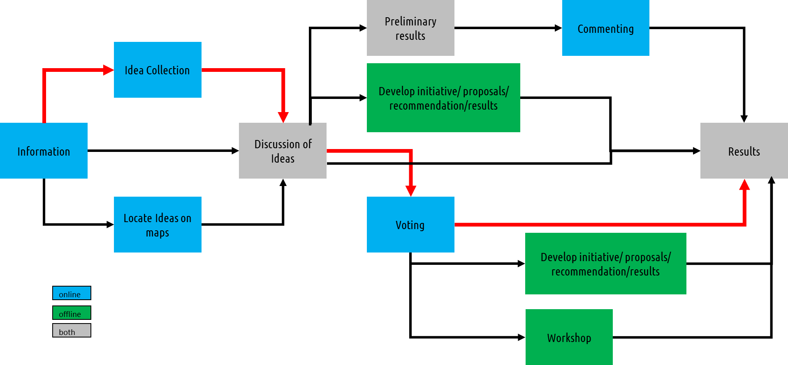
Example: Collection and discussion of ideas

Slide 8
What is f2f participation used for in combined processes?
Information and motivation
Structuring and condensation of data
Main participation event

Slide 9
A new concept: Digitalized Participation
Transparency over the whole process life cycle
including offline activities and
promotion of participation results

Slide 10
Limits of tools and methods for participation

Slide 11
Limits of tools and methods for participation
The most important success factor:
Impact of participation results

Slide 12
Limits of tools and methods for participation
The most important success factor:
Impact of participation results
Political will to include the public opinion

Slide 13
Thank you very much for your attention!

Slide 14
Part II

Slide 15
Technical Implementation of modularization
Idea Collection I
Phase: Participants post ideas on OPIN platform
Phase: Participants comment on these ideas and rate them on OPIN platform
Idea Collection II
Phase: Participants post ideas and comment on them on OPIN platform
Phase: Posted ideas are refined offline
Phase: Participants rate on refined ideas on OPIN platform
Topic Finding I
Phase: Participants post ideas and comment on them on OPIN platform
Phase: Participants use the OPIN App for polling/voting on the ideas (mobile polling)

Slide 16
More research is needed on age differences

Slide 17
More research is needed on age differences
Shyness to speak

Slide 18
More research is needed on age differences
Shyness to speak
High need for information

Slide 19
More research is needed on age differences
Shyness to speak
Need for information
Continuity: topical stability and attention span

Slide 20
Unsolved technical problems
Transfer of information from online to offline and vice versa
Multilinguality
Analytics of big amounts of qualitative data
Software compatibility

Slide 21
Discussion question
How could a political system for integrated public participation on a European level look like?
Citizens council
Fixed amount of seats in the parliament
Compulsory participation process for controversial questions with binding results (formal participation)
…

