Slide 1
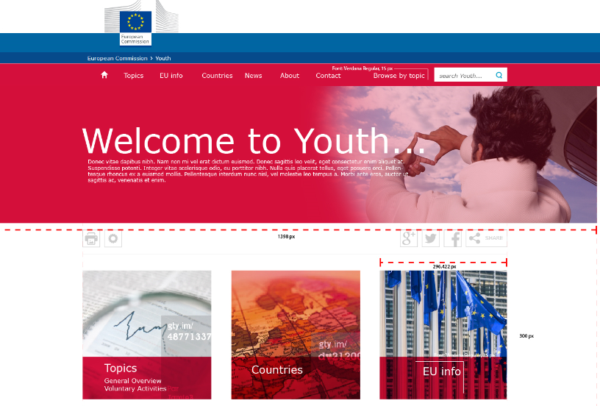
the
Youth
Wiki
8 September 2016
Giulia Paolini
EACEA A7
Education and Youth Policy Analysis
Giulia.paolini@ec.europa.eu

Slide 2
Contents of this presentation:
What is the Youth Wiki
Structure & Scope of the Wiki
Sources of information
Timeline
EACEA support
Future steps

Slide 3
Why? To promote European cooperation amongst national and European policy makers in the field of youth and to support evidence-based decision making, by documenting the implementation of commitments made by EU MS. What? A comprehensive database of national structures, policies and actions, presenting coherent, reliable and comparable information, in a user-friendly and continuously updated way Who? The information is provided and regularly updated by designated national correspondents. Currently, 27 European countries take part in the Youth Wiki project
What is the Youth Wiki

Slide 4
Structure & Scope
Culture and Creativity
Youth Policy Governance
Voluntary Activities
Youth and the World
9 CHAPTERS
Employment and Entrepreneurship
Education and Training
Social Inclusion
Health and Well-being
Participation

Slide 5
Sources of information
National policies
and official documents
laws, decrees, directives, regulations, framework guidelines, steering documents and similar public acts detailing the content of top-level policies and strategies in the field of youth
Studies and analyses
studies, surveys, analyses or assessments/evaluations conducted directly by public authorities or commissioned to research centres, experts, think-tanks
National statistics
Only marginally referred to as they are often collected
through country-specific methodologies which hamper
comparability

Slide 6
General Timing
2016
First 5 chapters
2017
4 remaining chapters
Youth Wiki is completed
2018 onwards
Chapters are annually updated

Slide 7
EACEA's support
Grants
Annual Restricted Call to designated beneficiaries and grant management
Content
Guidelines to NCs for the type, scope and organisation of information (Guide to Content)
Website
Technical web development, editing helpdesk & trainings (e.g. writing for the web)
Quality Assurance
External evaluation of content by independent experts

Slide 8
Future steps – 2018 and beyond
All chapters will be updated every year with all new information becoming available
In the future, new themes could be added to the current 9 to adjust to new political priorities
Participation is open to and encouraged from all Erasmus+ countries!

