Slide 1

A historical perspective on connections, disconnections, and new opportunities
for a youth work role in the youth justice system in UK?
Mick Conroy
Lecturer in Youth & Community Work
or
‘Plus ça change, plus c’est la même chose’
(The more things change, the more they stay the same)
Alphonse Karr, Les Guepes, 1849
© University of South Wales
Notes:
M.Conroy – Wales (UK)
Title slide 1
A historical perspective on connections, disconnections and new opportunities
for a youth work role in the youth justice system in UK?
or in short...
‘Plus ça change, plus c’est la même chose’
(The more things change, the more they stay the same)
Alphonse Karr, Les Guepes, 1849
Opening - Discuss entry point based on Seminar Themes – Connection to Disconnection to Reconnection. – The presentation aims to highlight key moments in history where youth work has had opportunities to connect with youth justice work and explores how each time that opportunity has arisen there has been a retreat from those involved in the strategic delivery of youth services to forge a clear role for youth workers in contributing to work with young people in the criminal justice system. Presentation concludes with thoughts around the seeemingly never changing importance of the ‘relationship’ in work with young people. Despite periods of immense social change within the time scale presented it is how the voluntary relationship principle is interpreted by youth workers that is one of the pivotal factors to the welfare v punishment debate in youth justice work. i.e Plus ça change, plus c’est la même chose’
The summary therefore presents a perhaps familiar and uncontraversial conclusion that a youth work role in the youth justice system becomes dependent not only on political priorities of the day but also on to what extent youth workers are willing to embrace the apparent oppositional philosophy of youth justice work and abandon current definitions of the ‘voluntary engagement’ principle and the ‘universal / open-access’ agenda. This entails having to as Howard’s often used analogy suggests in his claim that youth workers must ‘distinguish between its cherished values (to be defended) and its sacred cows (to be slain)’. In short, doing such things as Jon Ord (2009) describes as ‘Thinking the unthinkable’ e.g perhaps a re-imagining of what we mean by the voluntary engagement principle. It has never been an easy debate and there are no ‘silver bullet’ answers. The sharp end of youth justice does not want wishy washy youth work; the hard end of youth work, with adherence to its precious values, wants nothing to do with youth justice. I will attempt one or two potential solutions emerging from my own perspective as a practitioner and researcher.

Slide 2
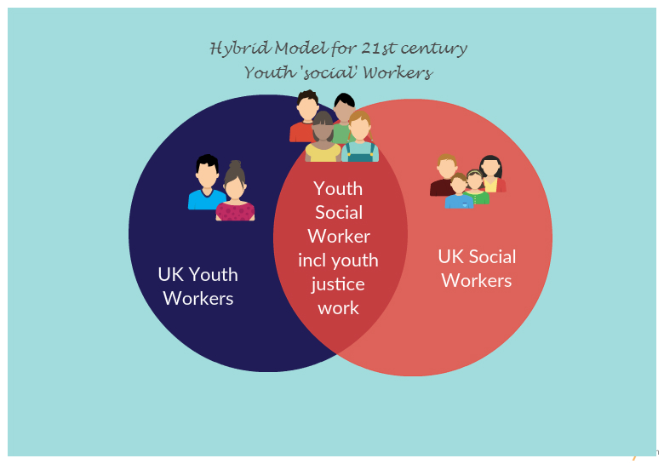
Young people in care
Young people with disabilities
Youth Work (Universal ideology)
+
Youth Justice Work (Targeted ideology)
=
Youth Social Work – (from a UK perspective)
Open access
Young offenders
Family support
Voluntary
Targeted
Non-formal & Informal Learning
formal
Statutory interventions
© University of South Wales
Notes:
Slide 2 – The Hybrid Model – youth work/youth justice formula (YOSO for the YOYO Generation!>>>
Youth Work (Universal ideology) & Youth Justice Work (Targeted ideology)
= Youth Social Work – (from a UK perspective)
I believe the last History Seminar came up with the concept of the ‘Youth Social Worker’ a sort of hybrid term which fits nicely as a descriptor for those youth workers in the UK who get more involved in statutory social work (something of course very different from the concept of ‘social work’ for many of you here today).
A central feature of social work with young people in UK is delivered in the realm of youth justice with youth work being seen as a distinct and separate profession. Social Workers have been involved in reformatories, treatment, help, re-engagement..... - Though not only with this target group. Other young people facing exclusion (kids in care but not troublesome, young people with disabilities ie. groups other than young offenders.) However, MY focus will be on 'youth justice', 'youth social work' and 'youth work' – I do also acknowledge that there are other forms of youth/social work going on with the other groups (which incidentally may be part of the reason why YW doesn’t exclusively lay claim to any single target group and therefore finds it difficult to articulate it’s specific professional identity)
So to reaffirm - I will talk about connections and reconnections between youth work and this specific area of social work, i.e youth justice work and those youth workers that support young people that come into contact with the youth justice system...
So, in linking to the theme of the seminar, I focus on key moments not only of connection and commonality of purpose that occurred between youth work and youth justice work, but also on times when there was collision and distinctive differences and therefore some moments of disconnect will be identified. I hope to do this by highlighting the recurring tensions as well as complimenting visions that have influenced the connections between youth work and youth justice over the past century and a half. I suppose these days we might refer to these things as times of ‘integrated practice’ and of ‘disintegrated practice’
In mentioning ‘disconnections’ the first point here is around the policy disconnect between the 4 countries of the UK. What might be referred to as The Disunited Kingdom (especially after the Brexit vote!)
So a ‘health warning’ therefore is that my dialogue today is primarily based along the developments in England and Wales. Similar and parallel journeys have been taken by Scotland but much of the legislation talked about had various interpretations amongst the devolved administrations of Scotland and Northern Ireland. (Howard & Howard are far more qualified to expand on the ideologies of those 2 countries than I am)
And so... to begin at the beginning.....

Slide 3
‘Plus ça change, plus c’est la même chose’
"Love must be the ruling sentiment of all who attempt to influence and guide these children”
(Mary Carpenter, Social Reformer- Writing in 1871: Reformatory Schools for the Children of the Perishing and Dangerous Classes, and for Juvenile Offenders.)
--------------------------------------------------------------
“One positive and sustained relationship with a youth worker can make all the difference in helping young people leave crime behind”
(Dame Glenys Stacey, HM Chief Inspector of Probation – Writing in 2016: Report on the effectiveness of practice in Youth Offending Teams)
© University of South Wales
Notes:
Slide 4 (shows both statements – to appear separately and dated as introduced)
"Love must be the ruling sentiment of all who attempt to influence and guide these children”
(Mary Carpenter, Social Reformer- Writing in 1871: Reformatory Schools for the Children of the Perishing and Dangerous Classes, and for Juvenile Offenders.)
---------------------------------------------------------------------------------------------------------------
“One positive and sustained relationship with a youth worker can make all the difference in helping young people leave crime behind”
(Dame Glenys Stacey, HM Chief Inspector of Probation – Writing in 2016: Report on the effectiveness of practice in Youth Offending Teams)
For youth work, the journey between the issuing of the two statements above is one that can be characterised by periods of connection and of disconnection with youth justice work. The connections or disconnections have come about as a result of youth work responding to what Gilchrist et al (2003, p9) refer to as the ‘insecurities, inequalities and instability’ faced by young people as a result of social changes throughout history. – SHOW TIMELINE SLIDE BRIEFLY – WAVES

Slide 4
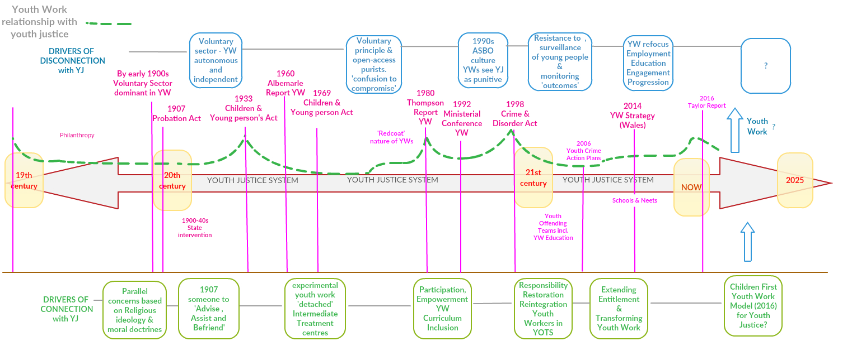
Notes:
1933 ‘welfare principle’ –
1980s – Association and Autonomy (parallels with Daniele’s ‘Centres for Youth Aggregation’ in Italy – YW as diversionary role
2006 – Youth Crime Action plans £100 million for diversionary activities – Accusations of YW agents of social control ……………..but the money was good

Slide 5
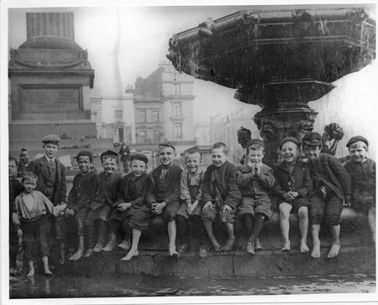
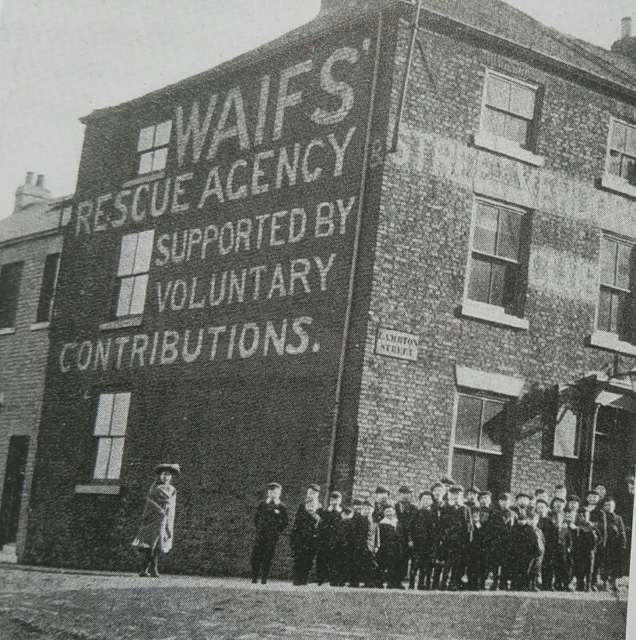
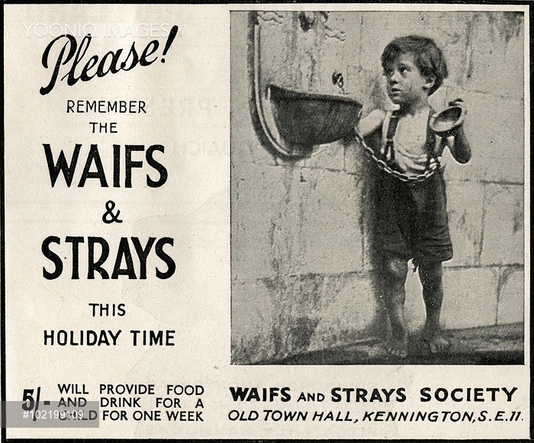
Devils or Angels?
Depraved or Deprived?
Delinquents or Deserving?
Deserving & Undeserving poor
Connection with YW/YJ via religious ideologies and moral doctrines
Liverpool 1890
Sunderland 1902
Waif‘s Rescue Agency
1881 -An appeal for funds by the Waifs and Strays Society.
Philanthropy to Welfare (19th century to early 20th century)
© University of South Wales
Notes:
My Home Town! – i am second from left!
Slide 4 – Pic of Waifs institute – Children & Young people –
Devils or Angels?
Depraved or Deprived?
Delinquent or Deserving?
Early to mid 19th century - = A period of connection between youth work / youth justice
Philanthropy alongside parishes – Each parish determined its own approach.
1800s – devils & angels
Rescue & Protection needed or Criminalisation and Punishment - the debate begins! Youth Work connects with youth justice in a way that sets out a welfare agenda (albeit a ‘tough love’ welfare) which was very much about prevention, protection and an evangelical moral duty to turn young people away from sin/crime.
Links between education and training – 19th century/21st century
Then – 1842 - In discussing the children of the ‘dangerous classes’ following the chartist riots Lord Ashleigh stated that in order to work effectively with any young delinquent then ‘he has to be turned again into a child’ (May, 1973, p7) here for the first time was an unambiguous recognition that a hierarchical age relationship needed to be considered by the courts.
Now – 2016 - A review of the youth justice system in England and Wales was completed by Charlie Taylor (2016), an educational expert whose report made explicit two ‘key principles’ that have informed the approach taken so far. The first is that ‘children who break the law [should be] treated differently to adults’; the second principle, in keeping with the report author’s background, is that ‘education must be central to an effective youth justice system’
Connection between Age/Education offered opportunity for those working in youth organisations such as YMCA and Lads Institutes to engage with youth justice authorities – however the voluntary orgs preferred their independence from any organised state intervention at this time and were suspicious of takeover at local levels and loss of their autonomy.
Plus ça change, plus c’est la même chose’
Juvenile courts punishment focussed and about containment / social order – JUSTICE V WELFARE debate begins in YJ
‘Spare the rod and you spoil the child’ versus ‘Love draws with human cords far stronger than chains of iron’. These were early signs of incompatibiltiy between 2 dominant philosophies that would shape work with young people involved in crime.
Period saw early example of a ‘Widening of the net’ to clamp down on delinquency and restore social order – criminal offences extended to crack down on the delinquent behaviour such as being jailed for stealing apples from orchards, selling in the street or telling fibs. Led to a surge of organisations campaigning for an approach with care and protection embedded as well as retribution for whatever offence.
(not using pics these but may use quote describing workers as ‘some people not depraved, willing to teach them’!!
Relationship and voluntary engagement key (again links to Taylor report 2016)
The emergent voluntary youth organisations could thus be seen as pioneering an important new expression of the true philanthropic spirit. “By self-consciously requiring their ‘workers’ to engage directly and personally with young people, they set out to bind giver and receiver very closely together”. (Davies, 1999, p11)
BARRIERS TO CONNECTION with Youth Work at this time – Adultism / Patriarchal approach – Evangelistic on both sides / patriarchy dominant
Lack of unification of orgs or state intervention. Children lives were seen as being made by adults not by their self-realisation. The doctrines of religion holding both sides together but early signs of the debate between the state/public wanting justice to restore social order (Justice) and those that believed there should also be an understanding of the age and other causation factors of criminal behaviour (Welfare)

Slide 6
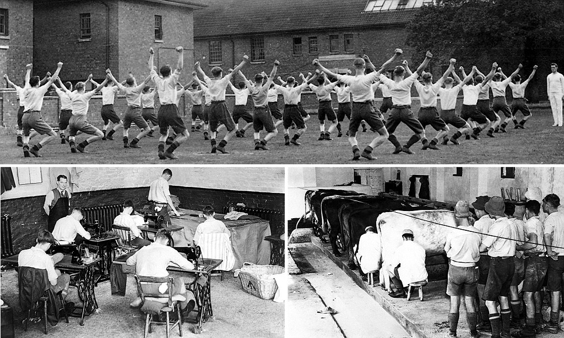
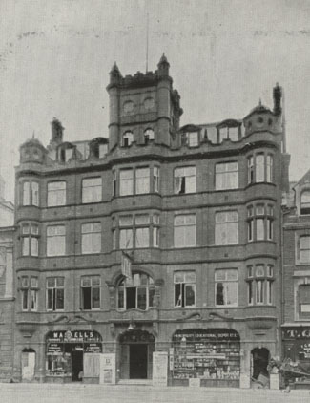
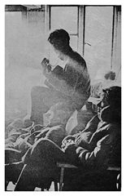
Pre and Post-War UK – 1900s to 1970s
The times they are a changin’….. State intervention
Time of the ‘well-meaning amateur’ over….
Connection in education and training
Borstal 1908 (Custodial centres with education and discipline)
YMCA Cardiff 1900
‘Albemarle’ Youth Clubs 1968
© University of South Wales
Notes:
Slide 6 – Very much a chance of connection as state intervention increases - Chance for connection - Age based legislation / separate from adult system
Beginning of 20th century
Borstals – 1908 (1st is placed in Borstal in Kent) – education and punishment attempt to come together. Despite their reputation, Borstals were more about training, correction and developing employability, and less about punishment. Regimes of hard exercise, hard work and strict education were implemented as a deterrent to re-offending on release.
Connection in having parallel ideologies but perhaps not ‘joined-up’ in practice- with YW / YJ 1900s – 1950s – Welfarists on the offensive –
Probation Act 1907 – made it possible for courts to discharge juvenile offenders to the supervision of a probation officer who would ‘advise, assist and befriend’ (relationship!) which was an approach being taken up by organisations such as YMCA and the lads institutes of the day with education and moral influence as being at the heart of working with young people facing disadvantage, deemed as vulnerable, and at risk of becoming involved with crime.
Pre-world war and war period 1900-1945 YW dominated still by voluntary sector and remained as something ‘separate from state’ - Post-world war 1945 onwards saw more and more state intervention which brought youth work into contact with other state services such as youth justice.
’Times they were a’ changin’ –(chance for YW in YJ)
Post WWII - Desire amongst young people to shape their own lives not be ‘made into images of their parents’
Dylan line – ‘come mothers and fathers throughout the land – don’t criticise what you don’t understand – your sons and your daughters are beyond your command’
’Times they were a’ changin’ – moral panics – riots, teddy boys, mods and rockers
A Chance for connection with youth justice – The 1968 ‘Children in Trouble’ White paper leads to 1969 Children & YP Act – At last a chance of a formal role for Youth Work? – (community-based work with offenders) Saw Convergence with youth work on a level not reached before (or perhaps since).
The National Youth Bureau in Leicester had an Intermediate Treatment Unit during the 1970s and innovative methods of work such as ‘detached youth work’ were put forward by researchers as exemplars of ‘youth service schemes to reduce delinquency’ (Davies, 1999, p91) – These were attempts to work with the ‘unattached’ classed by the National association of Youth Clubs (1965) as ‘those who do not belong to a youth organisation and are unhappy and /or delinquent’.
Furthering the progress of convergence between youth work and youth justice at this time, Wales also formed its own Intermediate Treatment Forum which was launched in 1976 by a youth worker from Cardiff who may be known to some of you here! – This grew into a practitioner-led group called Cynydd (actually translates as ‘progress’) which collaborated with youth services on such schemes as the Duke of Edinburgh Award Scheme being delivered to young offenders on probation. This group was supported financially by the Wales Youth Agency via the National Voluntary Youth Organisation grant scheme. Clear support for YJ work from YW on a national level. Howard’s vision not taken up by many though…
What are the barriers to Convergence & Connection then that seem to reappear with regular frequency?
Philosophising about role - Association or Individualism for YW?
1960s – Post-Albemarle - priority for Clubs & Association – The ‘Redcoat’/ recreational/ leisure nature of youth work perhaps meant it was ill-equipped for when Intermediate Treatment came along 1968/9 so a big chance for connection/ IT treatment and intervention lost due to lack of specialist knowledge of factors related to juvenile delinquency (e.g. legal, psycho-sociological theory, clinical counselling)
Widespread resistance to providing ‘intermediate treatment’ as it ‘labelled’ young people and was therefore seen as undermining the core values of, universalsim and non-stigmatisong facilities in the form of ‘open-access’ youth centres.
Still large influence from voluntary sector – even more purist in their resistance to state intervention (again) and so for statutory youth work at least an opportunity is missed as we go into the 1980s, a period when intensive intervention was abandoned and less-interventionist stratgey emerged in the juvenile justice debate (which in theory should have opened the door even wider for YW to be more involved).
However, more pressure on state sponsored work than voluntary sector to tackle the ‘problem of youth’ – youth work - debate - are we agents of social control or social change? .... Containment (social activities/ ‘off the streets’) or / Liberation (social action and social education) – ‘Catch all’ nature of youth work leaves identity crisis
1960s/70s/80s For YW the ‘Cherished values are defended and retained – no-one in YW wanted to ‘think the unthinkable’ – re-imagine voluntary principle.
Disconnect & chance to connect lost – 1970s onwards –retreat of the welfarists– ‘Short Sharp Shock’ (but soon abandoned)
Again – self defeating in-fighting by YW – navel gaze –
Milsom/Fairbairn report 1970 YW in School or Community? – ended up comprimising and never quite becoming either completely targeted or completely ‘open’.
He who pays the piper calls the tune – Conservative policies needed to be contributed to or no funding - Civil servant (Baker) from Thatcher administration states ‘Funding bodies (including govt) may not be prepared to provide resources for objectives which are not of THEIR choosing and for objectives which they may not altogether understand...’
Even the voluntary sector was being warned that they should evidence their funding bids in relation to what they would contribute to the political ideologies of the day. –
..Then along came a certain Margaret Hilda...........

Slide 7
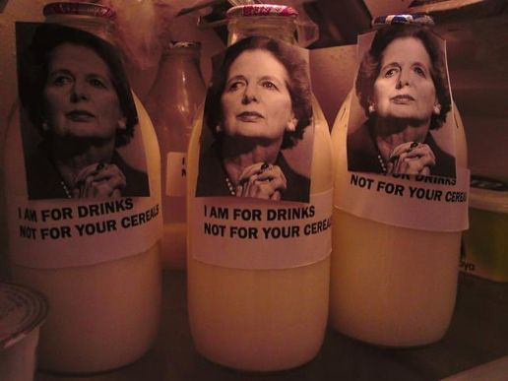
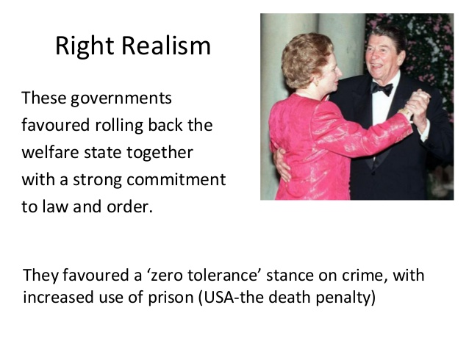

1980s – Thatcherism and ‘Rolling back the state’
‘Street-Level Bureaucrats’ (Lipsky)
YW/YJ Piecemeal YW connections and chances lost for re-connection
Reduction in spending on public services indirectly led to less-interventionist approach and a time when practitioners were given discretion over ‘alternatives’ to custodial sentences which were cheaper. (Unintended consequences? – Connection for YW?)
1980 8,000
1989 2,000
© University of South Wales
Number of Juveniles in Custody
Notes:
Slide 6 - 1980s – Thatcherism and ‘Rolling back the state’
- ......Progressive minimalism’ (Tony Pitts, 2015)
1980s - Disconnect between Rhetoric/Reality
As Conservatives came to power in 1979 with the hard line Law & Order manifesto – the possibility of a systematic and formal YW role vanishes and we are sidelined ..... We were in effect homeless!! …. (and therefore at risk)…YW hadn’t quite turned to crime so it turned to drugs! and other issue based work – universalist – tackling the ..isms)
Conservative government seemingly being tough on crime, - ‘no more excuses’ - but the reality in practice was a hidden connect with youth work practitioners (via Lipsky - Street level bureaucracy – frontline workers resistance/innovation) practitioners / academic research showing the ‘short, sharp shock’ didn’t work – Haines/Drakeford mention this as Golden Age for YJ – Pitts (2005) referred to it as ‘progressive minimalism’
1980s – alternative philosophy based on the belief that formal state intervention such as care orders which took young people from their homes often did more harm than good. So we see development of cautioning and community-based sentences arrive as alternatives to custody. Custodial sentences for juveniles declined from around 8,000 per year in 1980 to under 2000 per year by the end of the decade (Haines & Drakeford, 1998, p34) - ironically perhaps a better climate to attract work with YW than the 60s/70s was
Youth Work in 1970/80s – Jack of all trades / master of none – like this quote
‘Remember GHK’ (speak to Howard about who is this from his ppt at seminar) – ‘I was there for the most troubled and troublesome, dealing unsensationally and often invisibly with issues to do with drugs, crime, sexual health and homelessness.”
YW chance to contribute but becoming a dwindling influence in terms of professional identity amongst other arenas especially within integrated teams. 1992 ministerial conference when the under-secretary of the governemnt youth work ministry, Nigel Foreman had had enough of youth work’s internal dithering around open-access work and the universal service debate demanding a ‘concentrated fusillade’ and not a ‘scatter gun’ approach. Foreman went on to say that ‘if youth work could not demonstrate its value in preventing youth crime, then its future might well be called into question’ - a clear invitation for YW to contribute and prove it’s worth to the youth justice system
Instead however, an Education/ Curriculum frenzy begins amongst youth services across England & Wales in order to articulate exactly what youth work does – despite Foreman’s warnings, youth work remains generalist in practice using broad open-ended themes such as delivering activities that are ‘Empowering’, ‘Educative’ and ‘Participative’ bulit on principles of equality and inclusion. – Rhetoric which was admirable but clearly unachievable including such grand visions as youth work - ‘redressing all forms of inequality’ and the NYA 1992 statement of purpose for the role of youth work was described by Simon Bradford in 2008 as being ‘Utopian’. (p61)
However, youth workers went in search of this ‘utopia’ with the ‘Participation’ agenda from 80s for YW / Open Access and the vol principle to still be enshrined and embedded in practice delivery.
Disconnection -1990s – YW – further shift to curriculum, education and unemployment and some resistance to working with young offenders which, ironically (given the direction state-sponsored youth work was travelling in) was seen as a restrictive and deficit model for youth work.
A Disconnect catalyst – Bulger case 1993
‘Tough on crime – Tough on causes of crime’ – Again, societal moral panic as to how young people behave. Young people need discipline and to be held accountable.
Further Disconnect - The ASBO era - 1990s – In 1994 a phobia was even created –Ephebiphobia. (fear of adolescents and teenagers) - any move towards welfare floundered with Bulger case – ASBO – badge of honour for young people – gave them status amongst friends – Intended for all ages but became synonymous with young people.
IDYW stance - youth work prostituting itself – agent of state control argument emerges again?.

Slide 8


Into the Millenium...New Labour 1990s-2000s
New Labour - Education, Education and Education
YW /YJ Disconnection.
State in partnership with private sector & voluntary sector
What Works is priority not who delivers it
Backs tough Law & Order policies such as the introduction of ASBO
YW divergence from community punishments – seen as criminalisation of young people’s behaviour
© University of South Wales
Notes:
Slide 7 – New Labour - Education, Education and Education
If time – youtube clip - https://www.youtube.com/watch?v=2kAhChC_qxU (90seconds) Initially no place seen for youth work in the New Labour youth justice approach – seen as the ‘can’t do won’t do service’ – ‘Reformers versus Wreckers’
1990s also saw growing concern for levels of youth unemployment which was accompanied by (statutory) YW shift to focus on employment and education – Blair’s 3 priorities mantra - Education Education, Education
Copying their colleagues in education youth workers also decided on their own form of a national ‘curriculum’ aligning themselves firmly still in the arena of schools and ‘education for all’
Youth Work - Divergence from tough law and order agenda – ASBO - http://www.policeoracle.com/news/Teenagers-See-Asbos-As-Badge-Of-Honour_11784.html
Potential for YW role in youth justice begins to dissapear (along with the betamax video player version of YW/YJ from IT days at the same time!) and the VHS ‘universal’ version of Youth Work survives with an increased emphasis on youth sector contributing to the education services related to NEETS – Monitoring & Surveillance of young people became the order of the day. (IDYW campaign against targeted ‘state’ work)

Slide 9

2000 - onwards – Possibilities for youth work to contribute to youth justice arena?
Connection and Disconnection at same time – Localism in decision making leads to a patchwork provision of links with YJ
Youth Offending Teams
Integrated Practice Models are King (YW involvement piecemeal)
Professional or Interprofessional identity?
Bring on the Voluntary Sector (Austerity drive / Big Society)
Children First Youth Work (CFYW) model for YJ?
Children First Youth Work (CFYW) model offers an alternative to the adult-centric, system-centric and compliance-focused elements of youth justice and youth work that can limit children's capacity to contribution to and participate in voluntary and meaningful supportive interventions.
(Case & Harris, 2016, p1)
Taylor Report 2016 - we need to find the ‘right balance between protecting the public and employers from risk (justice) and promoting the reintegration and rehabilitation’ of children who break the law’(welfare)
Welfare v Justice Debate ongoing…. Plus ça change, plus c’est la même chose!’
© University of South Wales
Notes:
Slide 8…..2000s onwards what of the future possibilities for youth work to contribute to youth justice arena?
Youth Offending Teams consisting of practitioners from education, youth work and health services are set up although the developments across the regions are piecemeal in terms of levels of involvement by youth services.
As we enter the millenium in 2000s the government offers roles to independent projects and voluntary sector who can produce results and evdence the impact of their work, e.g Dalston Youth project which set up young people’s mentoring scheemes and Cities in Schools which focussed on young pupils with challenging behaviour in schools.
Policies such as Transforming Youth Work (England) and Extending Entitlement (Wales) offer hope for youth services to contribute a role for wider policy areas including reduction of crime and unemployment, although the Welsh policy saw a much more prominent role for youth services than did the reductionist view of youth services in England which Transforming Youth Work offered.
Again – for good (or bad) reasons we see a lack of any permanent and strategic role for youth work in youth justice arena and beyond 2014 in Wales the focus has shifted to youth services predominantly contributing in diversionary terms only via work with NEETS (Youth Engagement & Progression Framework, 2012) and Schools (National Youth Work Strategy, 2014)
Pre-90s ------- Post 90s
(not for use but articulation during presentation)
(THOUGHT - Perhaps youth workers have always felt more comfortable and at ease in dealing people from the class room and the games room rather than those that find themselves in the court room.)
Wales - Principles and Purposes - 2013 (Cherished values still rhetoric) v. a National Strategy for Youth Services 2014 (targeted / behavioral / formal education role) – Curriculum is king?
"Youth work values need to be articulated through a curriculum, otherwise youth work is beholden to the mere whim of the individual practitioner". (Ordd, 2008, p51.)
England has seen the relegation of youth policy to local level and in many regions (Positive for Youth) requires outcome measurements and social impact bonds from any funded provision. Many local authorities have ‘outsourced’ their services for young people through commissioning and competitive tendering.
For England – IDYW argument is that the failure to recognise youth work as an informal educational engagement with young people, which does not start from seeing them as immediate or future social problems, gives far too much ground to the targeted and behavioural agenda. The youth justice contribution from youth work has now shifted from a treatment and intervention approach to prevention by economic means – i.e. getting NEETS a job or formal accredited training opportunities.
For Wales – still hope for universalsim – entitlement – UNCRC – However, Howard’s vision to vacuum paper (2007?) injects some realism – Now – perhaps Wales blindly following what happens across the bridge in England – now playing the ‘engagement & progression’ game (Wales Government, 2013) – more of an incidental diversionary role than a direct interventionist role in youth justice work – Disconnect.
Finally, we should in this debate also of course ask what might social work/youth justice systems and models of delivery adopt from youth work principles and purposes. New research and models emerging from the work of youth justice academics are promoting and campaigning for what is being proposed as a new model of delivering youth justice known as 'Children First Youth Work' for Youth Offending teams to adopt (Case & Morris, 2016). But what would this model look like? Is there room for a participatory/ advocacy and rights based version of youth work which might fill the gaps in youth justice provision at the moment? This will again open up possibilities for a renewed commitment to helping those most in need and at risk of exclusion from society. Case & Morris claim that the Children First Youth Work (CFYW) model offers an alternative to the adult-centric, system-centric and compliance-focused elements of both youth justice and youth work that can limit children's capacity to contribution to and participate in voluntary and meaningful supportive interventions. (ironic perhaps that even youth justice academics/researchers believe youth work has become too ‘adult-centric’ and ‘compliance focused’!)
But how will youth workers respond to the inclusion of the term ‘youth work’ in the title of a proposed delivery model for a seemingly oppositional professional practice. As we have seen, the history of youth justice legislation and policy tells us that a merger of the two has up until now been impossible on both political and professional levels – what will become of this new opportunity for youth work to contribute?.

Slide 10
Summary (survival strategy?) – Time for reimagining youth work and moving forward without preserving the sanctity of the voluntary principle and open access
Statutory / paid YW is Youth Social Work and anything else is Youth Work?
Notes:
Slide 10 possibly to kick off any discussion – VISUAL PROMPT
Summary (a ‘Timeline’ showing waves of connect opportunity and disconnection with an extended (empty/gap) timeline up to 2025 – question to audience – someone please help me finish the timeline with thoughts for next 10 years – type them in live onto PPt slide as contributions come in)
As we have seen, there have been many opportunities for youth work to help blend the justice and welfare debate into some symmetrical equilibrium, a space where the justice seekers and the welfare bringers meet and all concerns either side are vanquished. If this can be achieved then what emerges is the ‘perfect practice’ model that we all seek.
However, In seeking this ‘holy grail’ consecutive governmental administrations have at times legislated towards either side of the welfare v justice pendulum in attempts to generate a union between the two ideologies. When we combine this janus-faced approach with the piecemeal approach by the youth service in making any fixed and permanent contributions to the youth justice field then it is no surprise that it becomes impossible perhaps to fuse these two diverse elements and any attempts at a strategic partnership is doomed to failure.
Still an educational gap to fill – poss by YW
Secure colleges – the new Borstals – first will open in 2017 – Education is key to desistance from crime – NEW THINKING??? I think not
Then = 1933
“Every court in dealing with a child or young person who is brought before it, either as an offender or otherwise, shall in a proper case take steps for securing that proper provision is made for his education and training.”
Section 44:(1),1933 Children and Young Person's Act
Now = 2016
“We need a resolute focus on giving children in trouble with the law, the skills, qualifications and aptitudes to lead successful law abiding lives”
Charlie Taylor, (2016, p2) – Interim Report of emerging findings - Review of Youth Justice System 2016 (The Taylor Report)
For those in informal education and youth work - Plus ça change, plus c’est la même chose!!!!’
Food for thought - that there is an opportunity of connection with youth justice and social work which is based on a disconnection between the voluntary youth work sector in the UK and (what is left) of the statutory YW sector in UK – I argue it is time for a harmonious but complete divorce and separation instead of the somewhat unbalanced and acrimonious relationship that has existed since Victorian times and is continuing today.. Plus ça change, plus c’est la même chose’!. As usual in divorce the argument will be about who will get the children!.

Slide 11
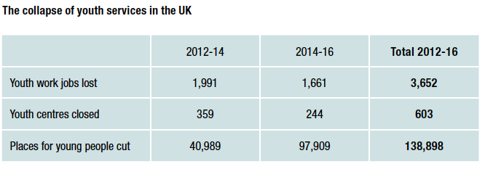
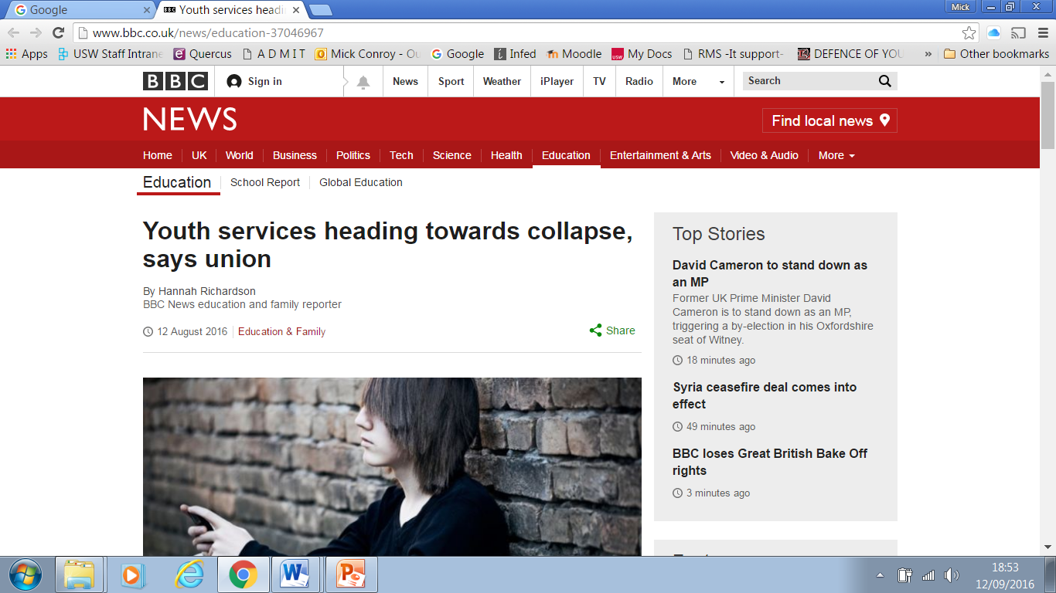
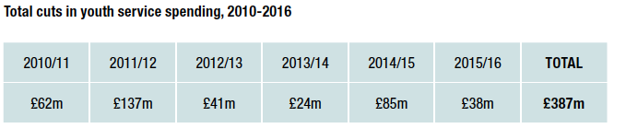
21st century youth workforce demolition and the (dis?) integration game.... discovery, dilution or disintegration of statutory youth work?
Commodification of youth work.. Some hope in mutuals….
© University of South Wales
Notes:
(Use only if time – if not skip to Slide 10
Slide 9 – 21st century youth workforce demolition and the (dis?)integration game)
UK decimation of youth work – The trade union UNISON in their document ‘A future at risk’ estimates £387m has been cut from youth service budgets since 2010, adding that there is "more of the same for youth services in the years to come. Already, they report that in the year 2016-17 and beyond, there is likely to be at least £26m more cuts in youth service spending, the loss of around 800 more jobs, more than 30 youth centres closed." (Unison, 2016)
New opportunity for role of YW in YJ – The advocacy/participation/and rights game.

