Slide 1
A brief history of youth work in Spain
Rafael Merino
Autonomous University of Barcelona, Spain
Malta, 21 September 2016

Slide 2
Summary
The concept of youth work
Three historical dimensions:
  Youth movements
  Youth policy
  Youth social work
Conclusions and issues for youth work today

Slide 3
The concept of youth work
No translation in Spanish
What is youth?
When we can talk about “youth”?

Slide 4
Youth movements
First third XX century:
  Ideological fighting
  Religious framing
  Educational youth work
Dictatorship (1939-75)
  New-fascist youth movement
  Youth against dictatorship
Democracy transition:
  Institucionalization: Youth Councils
  New forms of participation (Outraged, 2011)

Slide 5
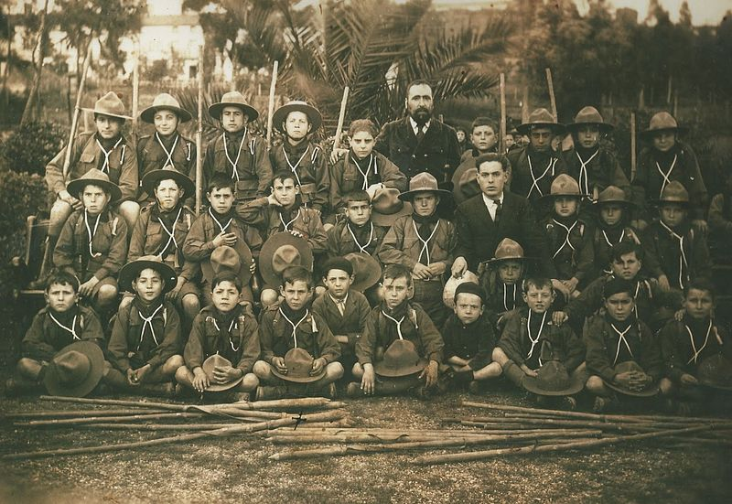

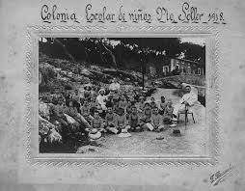

Slide 6

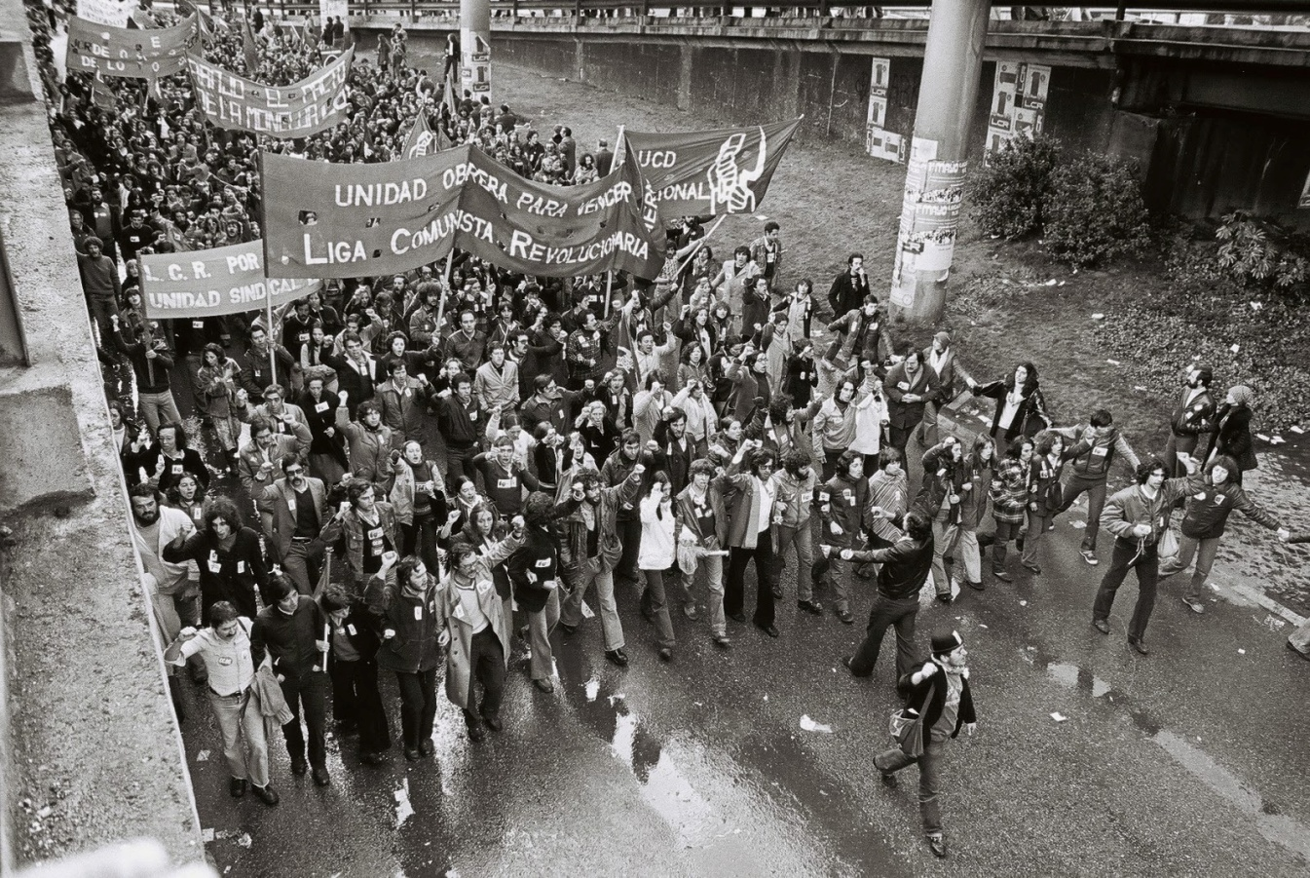

Slide 7

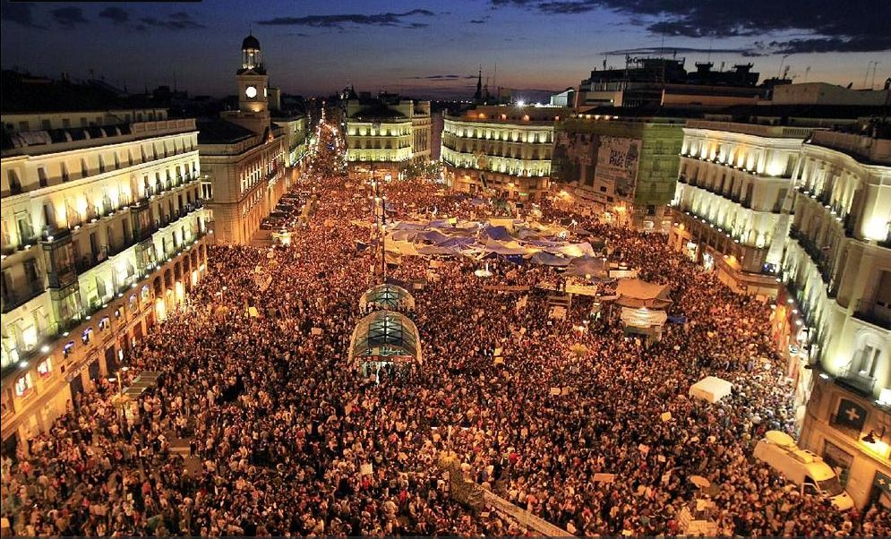

Slide 8
Youth policy
Dictatorship: youth policy as a “public” policy
Democracy:
  Multilevel public administration
  Role of municipalities: youth clubs, information agecies, youth workers
Dilemmas, conflicts and misunderstandings:
  Youth department or cross-sectional youth policy?
  Youth policy based on leisure and participation or based on transition to adulthood?
  Youth policy to “control” or to “empower” young people?

Slide 9

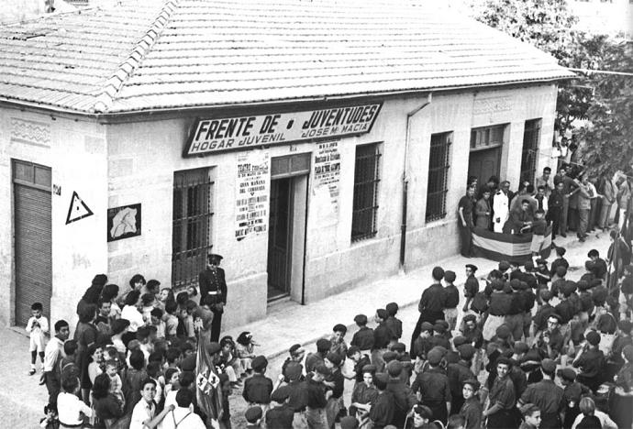

Slide 10
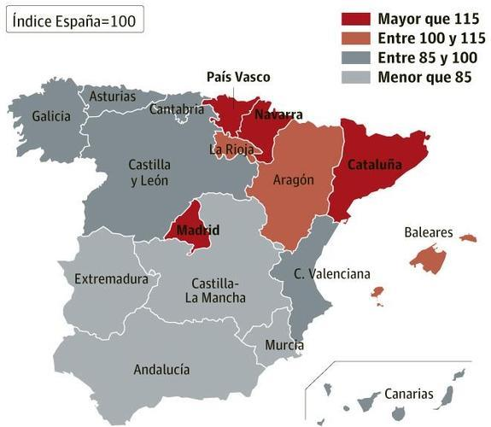

Slide 11




Slide 12
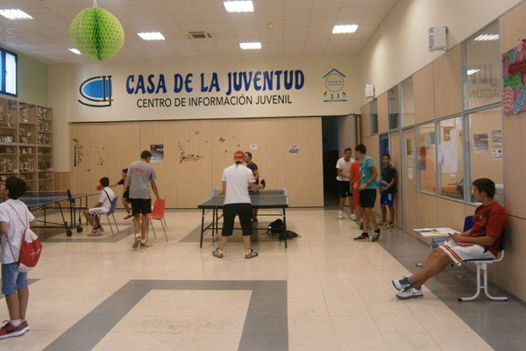
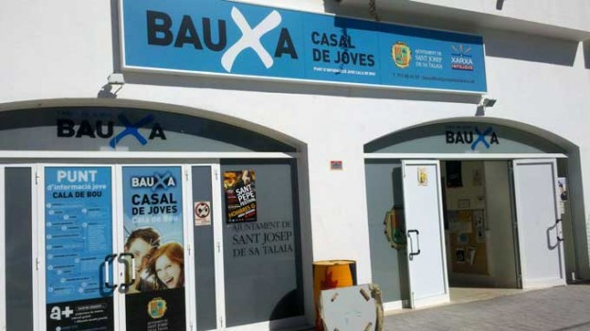

Slide 13
Youth social work
1960-70: the social emergence
  Suburban young people marginalised: unemployment, drugs, crime
  “Street educators”: voluntary work, religious organisations
1980-90: institutionalization
  Welfare regime (mediterranian) and social services
  Training: social education diploma (not social work)
  Professionalisation: social educators body

Slide 14
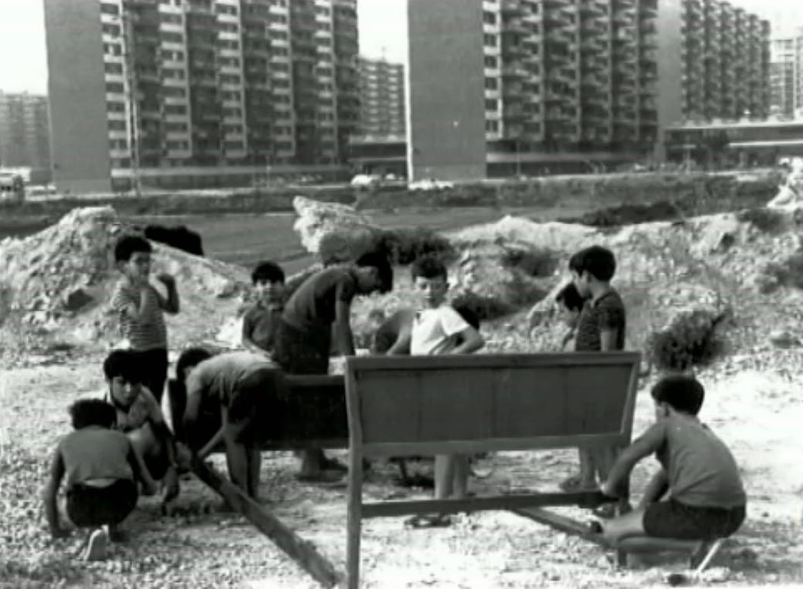


Slide 15

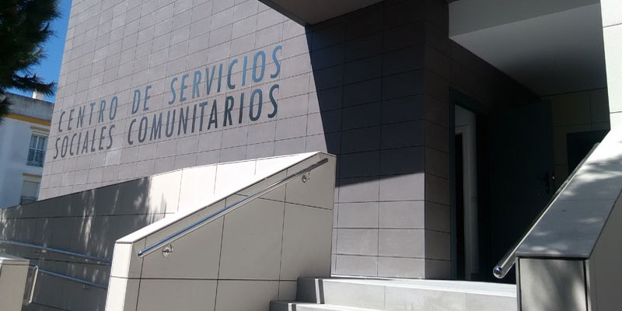
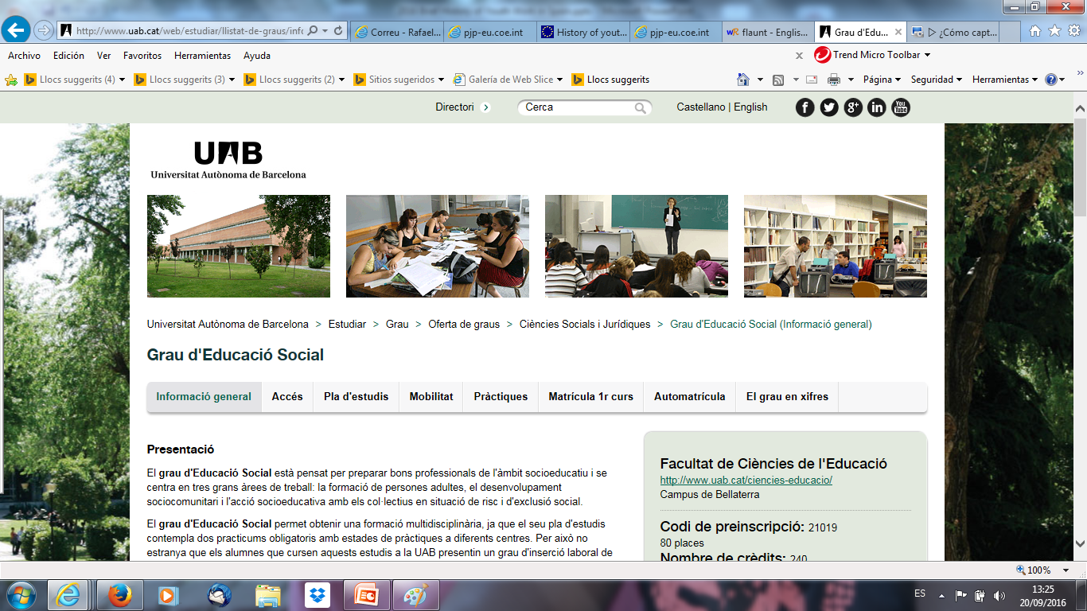

Slide 16
Conclusions
Youth work in a crossroads:
  Voluntary work, particularly in scouts and other similar movements
  Youth services and agencies: public and non-profit sector
  Networking with social work and others fields (schools, job facilities, health, justice)
Asking for the future:
  Where are the young people: “open youth work”?
  Who are “youth worker”?
  Youth work and youth studies: a research agenda?

Slide 17



Slide 18
Thank you!

