Slide 1
History and present of youth work and social work with youth in SlovakiA: connections and disconnections
Alžbeta Brozmanová Gregorová, Peter Lenčo, Jana Miháliková

Slide 2
Time periods
End of the 19. and beginning of 20. century
1918 – 1939
1939 – 1945
1945 – 1989
After 1989 and current situation

Slide 3
(Educational) Youth work – overview
In its broader sense it consists of:
  Out-of-school time education
  Afterschool education
  Non-formal and informal education
  Leisure time education
It is/was organised by:
  Schools and teachers
  Students/young people themselves
  Associations/organisations
  Churches and religious groups
  Local community / municipalities

Slide 4
Youth work
End of the 19. and beginning of 20. century
The movement of national revival and unification within the Austrian –an empire
Organisations and associations contribute to
  Increasing of education and literacy
  Developing and strengthening the culture
  Spreading and usage of Slovak language
  Civic engagement and nationalist education
  Realization of interest activities - including sport

Slide 5
Social work with youth
End of the 19. and beginning of 20. Century
End of 19. century – professionalization and development of social work general
Social care about children and youth – one of the key issues in social care
Tree groups of children:
  Abandoned and orphaned youth
  Youth on the street and delinquent youth
  Youth with different disabilities
Civic associations, volunteer organizations, churches
Since beginning of the 20. century
  social care started to be organized and professionalized and based on the individualization and prevention
  state as guarantee in social care and protection of youth

Slide 6
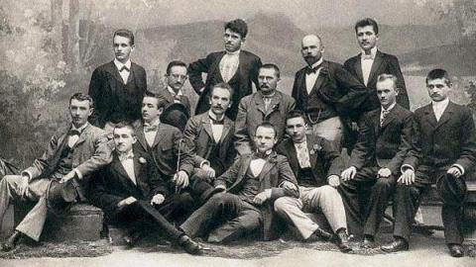
Youth work or social work?

Slide 7
1. Czechoslovak Republic
1918 - 1939
Age of associations
New innovative social policy
Democratisation

Slide 8
Youth work
1918 - 1939
Ministry of Education and National Edification, Department for Slovakia – responsibilities:
  Formal education
  National edification (including adult education)
  Social care aimed at children and young people
  Churches and religious organisation
  Civic associations and foundations
School = centre of education and community life
Central role of teachers as youth workers
Interventions by the ministry

Slide 9
Youth work
1918 - 1939
Educational and self-study groups
Cultural and leisure time activities
Sports, trips, excursions
Community activities
School and/or community libraries
YMCA, YWCA
Youth of Red Cross
Summer camps
(also abroad)
Playgrounds
Student organisations
Youth organisations of political parties
Youth and student organisations affiliated with religions and churches

Slide 10
Social work with youth
1918 - 1939
Ministry for Social Care
  responsible for social care and youth social work
Youth social care was guaranteed by state but in real practice it was provided by many nongovernmental organizations and also by municipalities

Slide 11
Social work with youth
1918 - 1939
Guaranteed by state:
  social protection of youth
  social + health + educational part
  state gave the responsibility for social protection in many areas to non-profit organization (public guardians, social protection of youth in social care…)
  example: specialized courts for youth
    close cooperation with social workers
    cooperation between public courts and non-governmental organizations
Non-guaranteed by state:
  social-health counselling
  hygienic and health care
  job counselling
  activities against alcoholism, prostitution…
  support of poor students

Slide 12

Example of connection between youth work and social work?

Slide 13
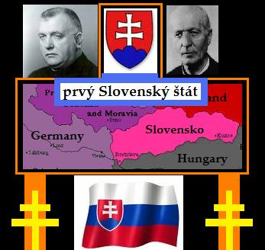
1. Slovak state
1939 - 1945
Fascis ideology
Clerical state

Slide 14
Educational youth work
1939 - 1945
Hlinka´s Slovak People Party
  Hlinka´s Guard, Hlinka´s Youth
Many democratic organisations and associations were cancelled or incorporated to Hlinka´s Youth
Christian organisations were allowed
Strong control of organisations with forced state officers
Young/New Czechoslovakia, The Central Union of Czechoslovak Students

Slide 15
Educational youth work
1939 - 1945
The importance of unstructured play and leisure time
Hiking (movement) and hostels/dormitories
J. G. Žatkuliak , 1943: triangle of education – family, school, leisure time ... specific forms and methods

Slide 16
Social work with youth
1939 - 1945
Provided by state and by non-gonvernmenal organisatios
Important 1941- Law about public youth protection
  Public guardian
    social protection of youth in foster care, youth from divorced families, youth under after-care
    youth workers and social workers
  After Care

Slide 17
How many residential institutions in social care for youth where in Slovakia in 1941?
13 provided by state
42 provided by volunteer organizations
55 and more all-together

Slide 18
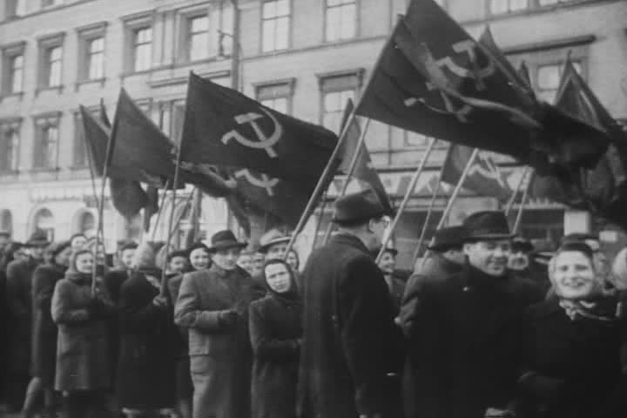
1945 - 1989

Slide 19
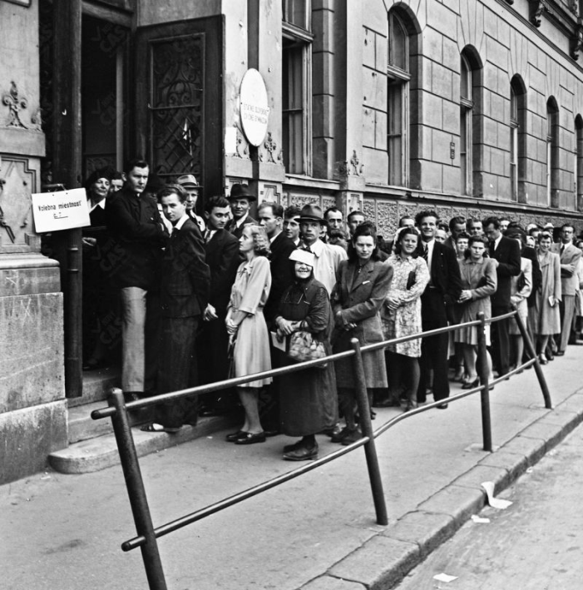
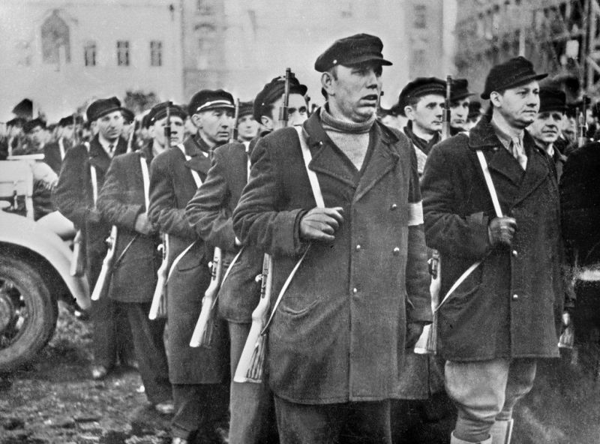
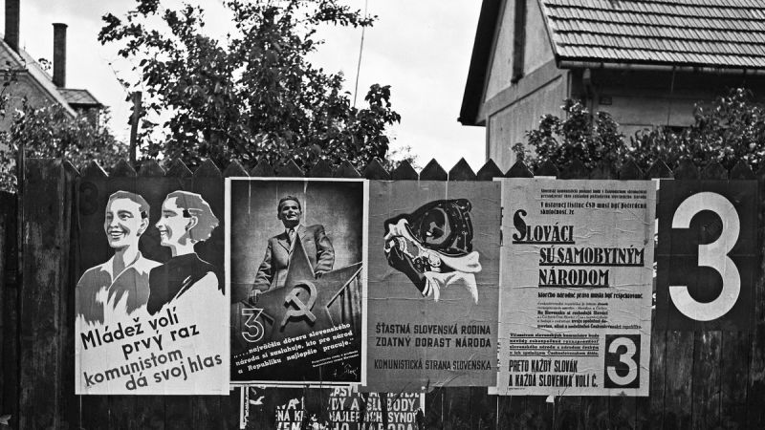
fight for leadership of the country

Slide 20
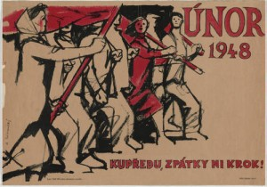
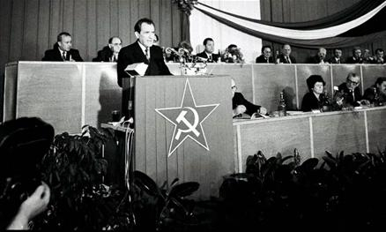
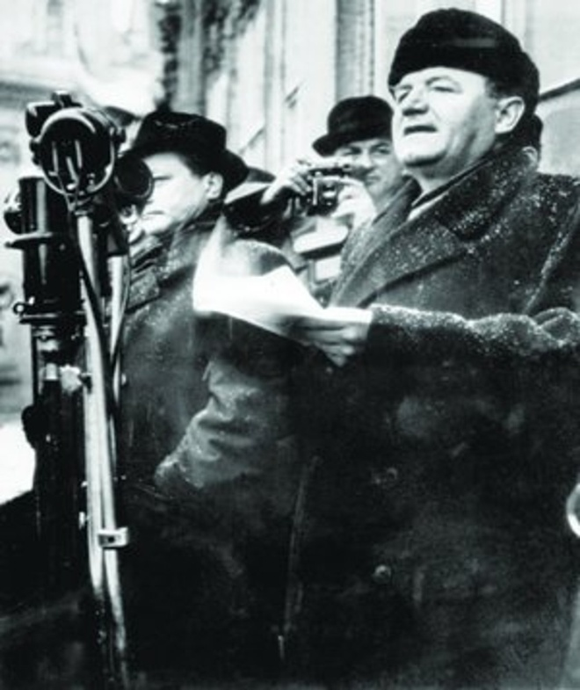
victory of communists (1948)

Slide 21
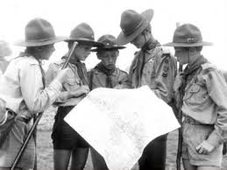
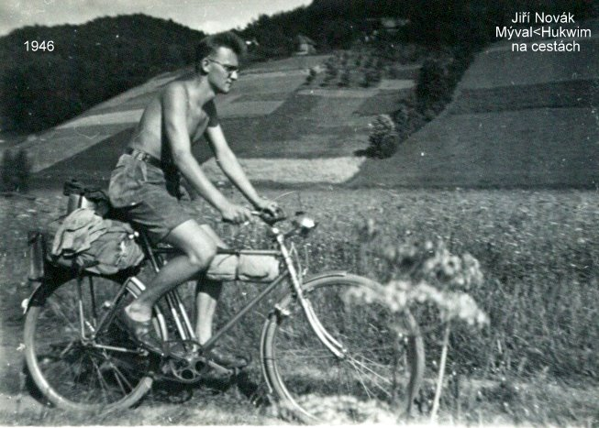
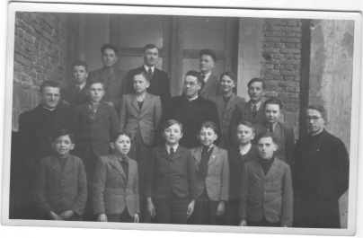
ban of traditional youth organisations (1950)

Slide 22
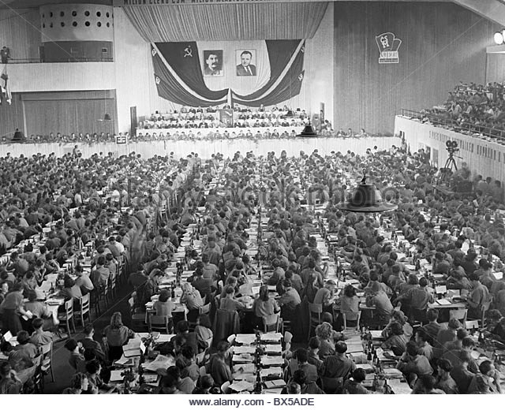
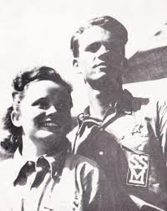
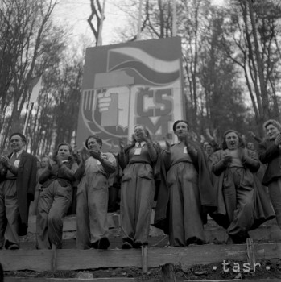

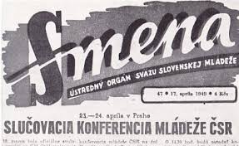
one unified youth organisation czechoslovak youth union (1949)

Slide 23
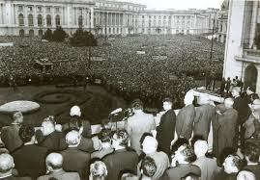
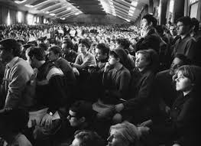
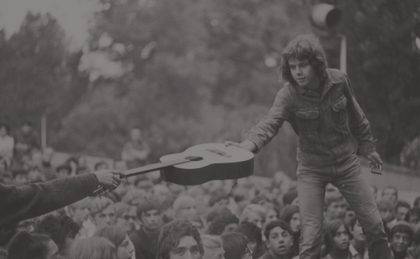
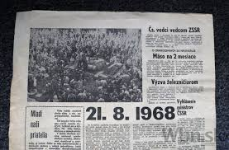
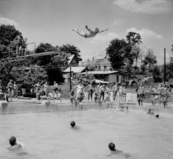
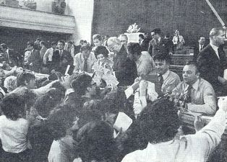
period of reforms
„short rebirth of youth organisations“ (1960´)

Slide 24
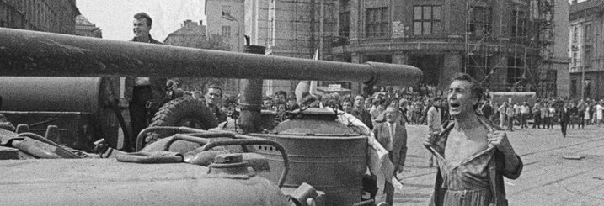
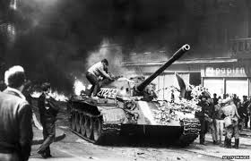
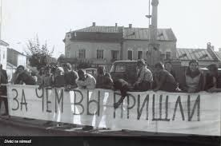
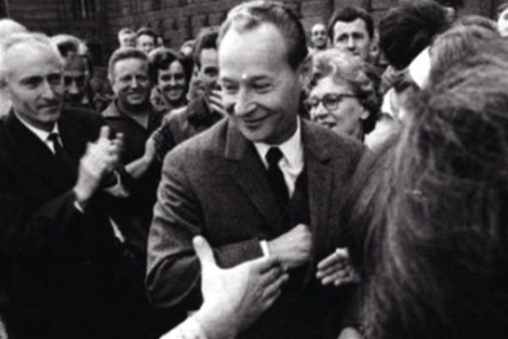
soviet invasion of czechoslovakia and „normalisation“ (1970´)

Slide 25
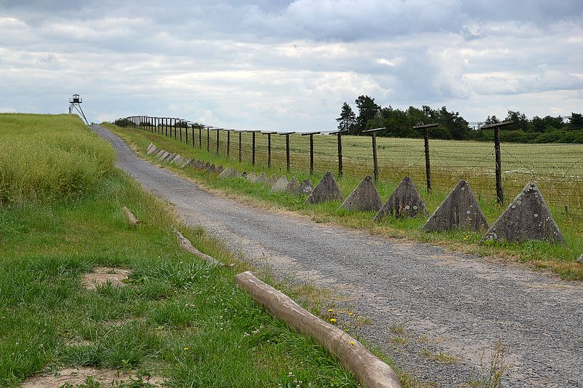
Iron Curtain – no way out

Slide 26
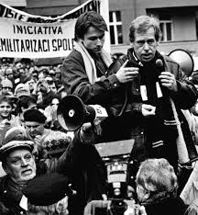
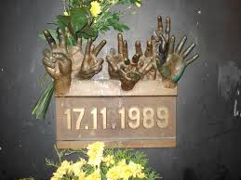
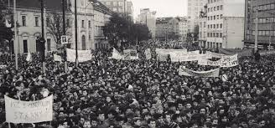
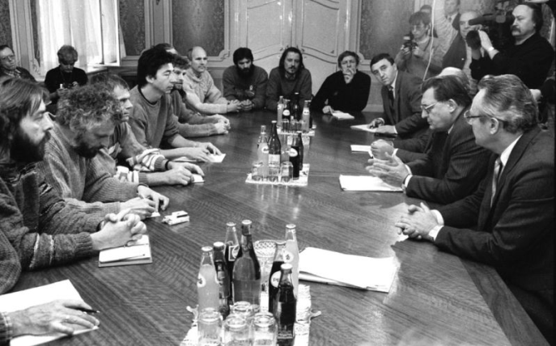
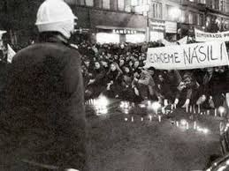
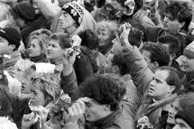
velvet revolution 1989

Slide 27
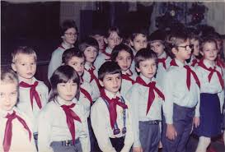
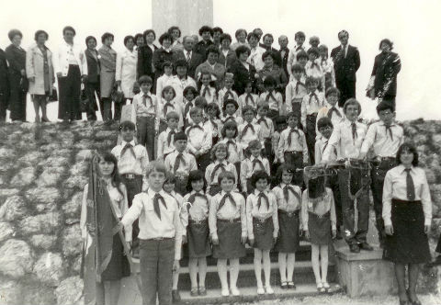
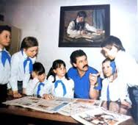
Youth Work 1949 – 1989
Pioneer – Member of Socialistic Youth Union – future Communist

Slide 28
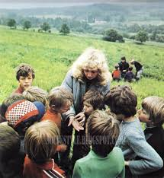
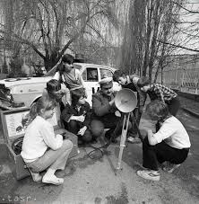
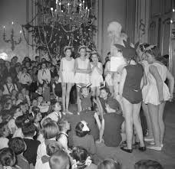
Infrastructure of Pioneer Organisation
Youth Workers Preparation

Slide 29
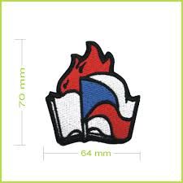
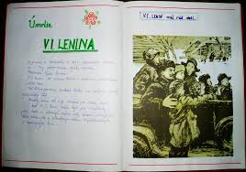
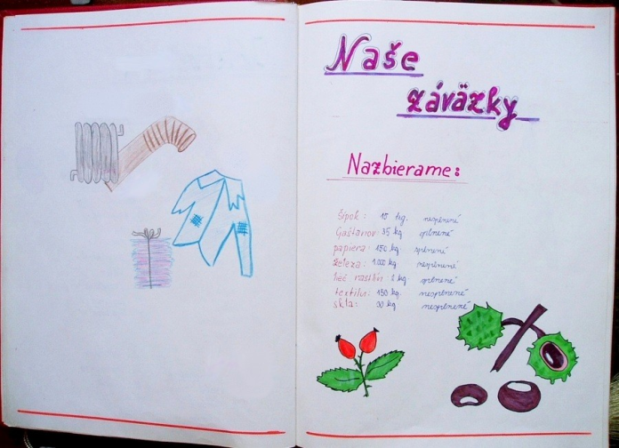
System of Education and Upbringing
Eternal values of Youth Work?

Slide 30
10 methods in common
Working in educational groups – teams
Support of the adults – friend/mentor/leader
The nature as educational tool
Learning by experience
Using traditions
Using games
Evaluation as the way of learning
Personal tasks and goals to reach
Positive role models
Making good deeds

Slide 31
PROS and CONS of Communist Youth Work
+
Proffesionals
Infrastructure vs. financing
Richness of methodical sources
Support form other organisations
-
Principle of voluntary participation???

Slide 32
Social work with youth
1945 - 1989
Social policy and social care were financed and organized by state
Social work was not needed (it was assumed that if there are no differences between people, there will be no social problems)
Social care for abandoned children, orphans, delinquent youth and youth with disabilities was provided in residential institutions based on collective education (big institutions in separate areas)
In 1952 foster care in families was cancelled
For youth social care were responsible different ministries (according to the age of children)

Slide 33
How many young people up to 15 were members of Pioneer Organization in 1978 (in %)
70 %

Slide 34
After 1989
decentralizations
deinstitutionalization
democratization
humanization

Slide 35
Youth Work from 1989
Boom of Youth Organisations
What happend to Pioneer Organisation
Youth Policy 1989 – 2000
  Principles of protection and support of children + funding
  Youth Policy 2001 – 2020
    Youth Conception (2001 – 2007, 2008 – 2013) + Funding
    Youth Strategy of Slovak Republic (2014 – 2020) + Funding
    2008 – Youth Work Suport Law
    2016 Conception/Strategy on Youth Work Development
    ESF projects, „youth worker“ as proffession

Slide 36
Youth work and social work with youth
Past
Moralistic
Normality
Problem oriented
Preset
Individuality
Empowernment
Guidance

Slide 37
 | Youth work | Social work
Ministry | Ministry of Education, Science, Research and Sport | Ministry of labor, family and social affairs
Legislation | Youth Work Support Act | Act on social-low protection of children Act on employment services Act on social services Act on social work
Organizations and institutions | Iuventa Schools, centers for free time activities (public and private) Nonprofit and profit organizations Nonformal groups (self-organized) | State offices of work, social affairs and family Regional municipality (responsible for social services) Local municipality (social services + social protection) Nonprofit organizations in all areas of social work
 | Low-threshold centers

Slide 38
 | Youth work | Social work
Target groups | children and youth (up to 30) | poor youth, abandoned youth, youth in foster care, youth on the street, delinquent youth, youth with disabilities, unemployed youth
Features | Education Prevention Helping Counseling Support Guidance Empowerment
 |  | Social protection Control

Slide 39
 | Youth work | Social work
Principles | Voluntary participation Partnership approach Mutual respect | Human dignity and human rights Respecting the right to self-determination Promoting the right to participation Treating each person as a whole Identifying and developing strengths Social justice Challenging negative discrimination Recognising diversity Distributing resources equitably Challenging unjust policies and practices Working in solidarity

Slide 40
 | Youth work | Social work
Environment | Open space and street Offices and organizations
 | School | Family Residential institutions
Forms and methods | Group work | Individual work
paid/ voluntary | Paid Voluntary | Paid
Education for workers | In NGO´s/University (pedagogy) | University level

Slide 41
When was the terms youth work and social work introduced in Slovak legislation?
Social work 1998
Youh work 2008

Slide 42
Thank you for your attention

