Slide 1
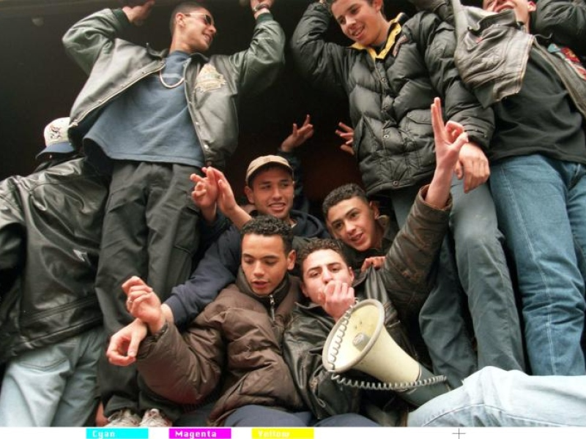
From ESCAPISM TO AGENCY
THE BECOMING OF YOUTH WORK PROFESSION
Connections, disconnections and reconnections. The social dimension of Youth work in history and today, 6th session in the series “ the history of youth work in Europe and its relevance for today’s youth work policy.
Malta, 21st – 23rd september 2016
Notes:
Thank you very much,
@Malta, host the session; possiblity to continue the conversation about youth work profession and that in such a nice surrounding and beautiful part of Europe.
@ organizers, starting the conversation quite a while ago and providing again such an inspiring programm and giving me the opportunity to share my thoughts about an issue that is close to my heart.
Title of my contribution may sound a bit provoking. And maybe it is. My main point is that we know much more about youth work as separate profession than we show. But for some reasons we hide, connect and create confusion about spaces and boundaries.
What i see is that governments, education, social work, youth policy, care, leisure activities, sports, health care, harm reduction and even the police all claim to do/be (some) youth work while it is quite clear that yes, there are similarities, but for sure also differences. What is it that all those parties do so much effort to claim youth work?
As fare as it concern youth work itself, it strikes me that youth work seems to be scared to take a position. Even on the local level within countries there are cirkling debates about youth work identity, all appearently aiming at excluding the other from being a real youth worker. Even in the paper written in preparation of this seminar is filled with statements like ‘not aim at purifying an essential youth work concept’ and ‘there might be “sacred cows” to be slain but there are definitely “cherished value”s to be defended. It might well be that identifying cows and values would be different depending on the perspective depending on the one who defines’. In international contexts we seem to get lost in translations. What is it that youth work seems afraid of defining it’s own identity?
As already said, I think that we are further than this. Also i think that both the claiming and escaping hinders/troubles the becoming of youth work profession and as a result of that harms the future of young people. This, because all of us, people from the governments, youth policy, youth care, sports, leisure activities and youth workers are not taking account of our own practices and our own responsabilities and are not really attempting to strengthen youth work.
What i will do in this key note is present a framework for the understanding of youth work profession in relation to her context: government policy, society (including institutions like school and police), and youth. Based on this framework i identify routes for the future, for both youth work and youth policy. For sure, we need to know our history to understand who we are and where we are going. Besides storytelling about our past we need to take time to handle and process our history and outline future strategy.
My work presented here is based on sociological theory of professions and research on the history of youth work. Because the limitation in time, i will not elaborate on the specific research findings. If you are interested in it, please contact me afterwards.

Slide 2
Position of Youth Work
Government policy
Youth
YOUTH WORK
Society
Notes:
How is youth work positioned within society?
This triangle shows that youth work has it’s own position, within the triangle of society, government policy and youth.
Kenmerkend van een beroep zijn, is dat professionals samen met hun organisaties, invulling geven aan de inhoud van het beroep. Het jongerenwerk doet dat niet voor zich zelf, maar voor de samenleving en voor jongeren. In Nederland heeft de overheid de rol voor het aansturen van publieke voorzieningen, namens de bevolking. Dat betekent dat het jongerenwerk zich ontwikkeld in verhouding tot jongeren, de doelgroep, de maatschappelijke ontwikkelingen en het overheidsbeleid.
This directly shows that youth work is separate from social work, because of the entwinement with society, youth and government. Social work is not only related with specific the youth question in relation to society and government.

Slide 3
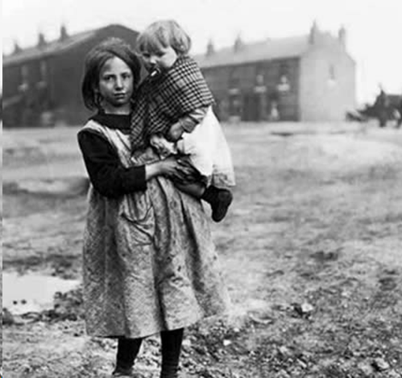
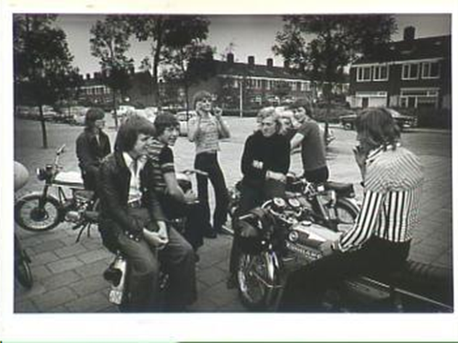
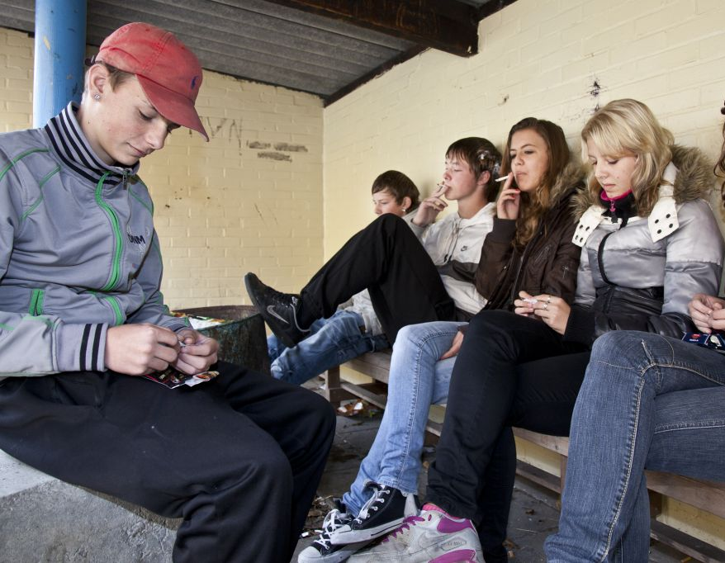
Legitimation of Youth Work
The support of young people in their process of
coming of age as part of society
Notes:
What learns the history about the legitimation of youth work?
It shows that every where and every time youth work is, youth work supports young people (not supervise!) in their process of becoming as part of society.
What is specific about youth work is that it is about the daily, completely normal process of growing up; which is hard enough; youth work is not about specific problems for example at school or with health.
It is not simply about reaching the age of 18, but about growing up as part of society – because that is the main issue of becoming: the change in position of being a child and dependent of adults and being an adult and being responsable for your self and others.
The cause for youth work, can be both from the side of youngers and the side from society. Also is youth work not only working with young people, but also with society. It depends on what is needed.
And finally it is about the support within this proces, not about supervision. By support i mean that youth workers are working to facilitate, ease and mediate the proces not just make it happen.
Youth Work is the only profession that focusses separately on the proces of becoming within society.

Slide 4
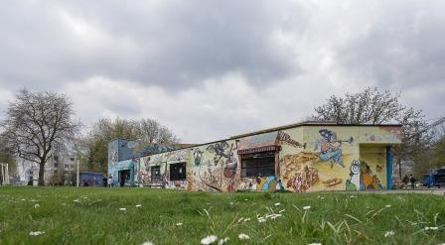
What is Youth Work?

Slide 5
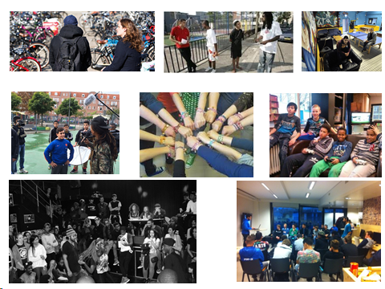

Slide 6
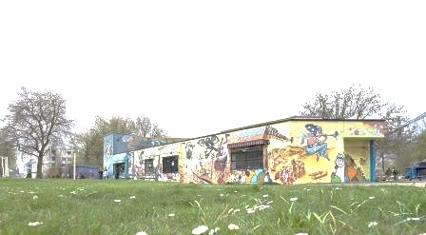
Youth Work is:
.. is an provision in the third domain
primary focussed on young people living in vulnarable circumstances
participation is voluntarily
aim is full participation in society
starting point is the life world of the young
specific activities and target groups differ and changes due to societal developments and trends within the needs and life styles of young people.
Notes:
How to define youth work?
Professional youth work within Northwest European welfare states has many appearances and consists of a diverse range of activities, topics and measures that take place in different spaces. On the streets, in malls and sport facilities, in community centres, online or in separate youth centres professional youth workers offer young people places to be and to meet, scope for exploration, activities in the area of urban culture and sport, the opportunity to learn or to organise activities themselves, information and advice, practical help and individual counselling. The diversity is the result of differences in traditions, in geography (country-specificities, urban vs rural, and regional specificities), in needs, dreams and living conditions of young people and in changes in society (Coussee, Verschelden, Walle, Medlinska, & Williamson 2010a; Metz 2011a; Dunne, Ulicna, Murphy & Golubeva, 2014). Within these differences there are five marks that identify professional youth work.
Professional Youth work:
is positioned in the third domain (Metz, 2011a), also known as the extracurricular area (Council of Europe, 2010) that compared to the home-situation (first environment) and school and work (second environment) offers a separate pedagogical regime with a strong sense of freedom, a great appeal of independence and personnel initiative and opportunities for experimentation (Bakker et al., 2010; Waal 2008).
starting point is the lifeworld of young people (Metz, 2011a; 2013), also described as “were young people are” (Smith 2013). Physically by working in spaces where young people remain (Dunne e.a. 2014). Symbolically by working from the perspectives, experiences, questions and aims from young people (Metz, 2011a; Smith 2013; 1st and 2nd Declaration European Youth Work Convention 2010; 2015). As a consequence, participation in youth work is voluntarily (1st Declaration European Youth Work Convention 2010; Smith 2013).
focuses primary on young people living in precarious circumstances (Metz 2011a; 2nd Declaration European Youth Work Convention). Beside the transition from childhood to adulthood (Metz 2011a; Dunne e.a. 2014), these youngsters face a form of marginalization as a result of deprivation or of a lack of skills, capabilities or possibilities. The age that demarcates youth as category varies between 10 years and 27 years, with the core at 15-24 years.
aim is the personal development of young people and the strengthening of their participation on all levels in society, nowadays as youngster and later as adult (Metz 2011a, 2013; Dunne e.a. 2014; 2nd Declaration European Youth Work Convention 2015);
is carried out by paid workers who demonstrably master relevant knowledge, skills and attitudes obtained through a combination of formal education, peer-learning and experience in working with young people. In most countries there is no homogenous training system for youth workers (Declaration of 1st European Youth Work Convention, 2010; Dunne e.a. 2014).
Further, within youth work there is still doubt about the need to make a division between professional youth work (delivered by paid workers) and volunteer youth work (delivered by volunteers) (see also 1st & 2nd Declaration European Youth Work Convention 2010, 2015). About the need to make a distinction between professional youth work and volunteer youth work: it cannot be denied that there is a difference. Because professional youth workers get paid for their job, professional youth work is more expensive and faces other expectations on for example quality and effectiveness. This does not mean that volunteers are not important for professional youth work. Historically and nowadays, separate youth work provisions were initiated by paid workers as well as by volunteers. Most initiatives that were started by volunteers become professional over time. Still, in most professional youth work settings, volunteers play an important role – besides the paid youth worker(s). There is a big variation in the amount of volunteers that take part in professional youth work. This depends on the availability of money for youth work provided by governments or charity. Also Identity-driven youth work organisations and youth work provisions in rural areas mostly count relatively more volunteers than youth work in urban areas.

Slide 7
Crosssectoral
YOUTH WORK:
Connect
Development capabilities
Participation
Agency
Perspective
Advocacy
COMMON
* Information and
advice
* Signal and
redirect
* Crosssectoral
collaboration
SCHOOL/ CARE/MUNICIPALITY/EMPLOYER/SPORT:
Formal education
Specialist care
Jobs
Leisure
SEPARATE SPACE for Youth Work is necessary

Slide 8
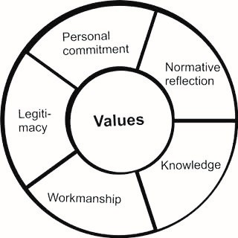
Professionalism
Notes:
As result of the circling debates about the boundaries, spaces and identity there is little attention to the specific professionalism of youth work while in my opinion it is important for both the future of youth and youth work. On the basic level I believe that the articulation and strengthening of the specific professionalism of professional youth work is the only route for survival of contemporary practice in which specific professional youth work appears one of the few actors that are able to bridge the extending gap between young people and society (of which radicalisation is an expression). A clear identity contributes to the acknowledgement of youth work as separate profession by governments, other social work provisions and schools. Also it functions as starting point for the further development of professional youth works specific body of knowledge and skills that fits to practice of working with young people in the third domain and forms an answer to the development to evidence based practice. The clarity of the specific professionalism makes it possible for professional youth work to take account for it’s own practice, which in my view is needed because youth work is of considerable influence on both the life of young people and society as a whole. The combination of the (more) clear identity, the stronger accountability and the growing acknowledgement together strengthens the position of youth work in society. This is needed to protect young people from the increase in the violation of their basic human rights by both increasing globalisation and changing regimes of Northwest European welfare states.
The central values form the core of professional practice and are both applicable to the youth workers individually as well as to youth work as a profession. This explicit normative positioning is important because youth work is of great influence on the lives of young people and groups of them and society as a whole. Because youth work is carried out in changing situations and contexts, for both its general employment as well as on an action level the consideration has to be continually made about what has to be done. The key values of youth work provide the direction for these considerations. At the same time they provide an anchor point for the dialogue with social forces and/or personal convictions. This is probably redundant: the key values which form the guiding principle for professional practice are not a matter of discussion in this dialogue. Before I elaborate on the key values of youth work, I will first deal with the five pre-conditions.
The five pre-conditions ensure that professional practice is good quality. The first pre-condition is the personal commitment to young people, because young people (and their life worlds) constitute the point of departure for the professional practice of youth work (also see part 1 of this lecture). Subsequently normative reflection is necessary. Normative reflection refers to the moral consciousness and evaluation capacity which is necessary for being able to make decisions about practicing the profession when in contact with young people and their environment in daily practice, in keeping with the key values. Afterwards workmanship and knowledge are needed for a qualitatively good implementation of the decision. Workmanship refers to being able to master the work in such a way that professionals in action are able to respond to the unexpected, and the sometimes unmanageable material with which they are confronted (Gradener, 2013; Sennet, 2008). Knowledge is the most important merit of objective rationality: the possibility of having better knowledge about what does and what does not work via scientific research. Youth workers are expected to be aware of the latest insights and are able to apply them in the implementation of their work. Finally, legitimacy refers to providing accountability about the application of youth work. This takes place on three levels: 1) in contact with young people, as counter weight to the professionals’ position of power in relation to clients (Dzur, 2004, 2008; Illich, 1977; Tonkens, Hoijtink, & Gulikers, 2013) and as part of the educational assignment to make young people part owner of the process of becoming an adult (J.W. Metz & Sonneveld, 2013); 2) in discussions with colleagues (as a form of monitoring the quality and jointly learning about how diverse methods work) and 3) with regard to financiers (transparency in spending public financial resources).
Allthough the model of professionalism can be transferred to other professions such as social work, it is the contend of the model that separates youth work as specific profession.

Slide 9
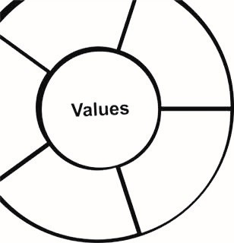
Youth Work Values
Notes:
Nu bij de kern, de waarden.
Weet iemand wat waarden zijn? Ideeen, uitgangspunten heel belangrijk voor je leven. Bijvoorbeeld ..
Waarden in de kern van het model betekent heel belangrijk voor het beroep. Uiteindelijk bepalen de waarden of je je werk goed hebt gedaan ..
Neem paar minuten de tijd, wat is volgens jou belangrijke waarde van het jongerenwerk als beroep?
What are the key values of professional youth work which form the heart of its professionalism and provide direction in daily professional practice? The international dialogue about the key values of professional youth work is slowly starting (Banks, 2004, 2012; Ewijk, 2009; Verschelden et al., 2009; Walker & Walker, 2012). In this article I underline the existence of an independent moral responsibility of professional youth work that is not negotiable. At the same time I provide a contribution to the beginning dialogue with the identification of three key values. From the perspective of the legitimacy of professional youth work I come to three key values: development-oriented, social justice and full participation.

Slide 10

Developmental oriented
The attention to the – broad, positive and long-term – development of young people. In my view this concerns the personal, social and societal development into becoming a fully-fledged human being, which consists of a combination of identity formation with emotional and moral development, the learning of life skills and participation (Metz, 2013, 18-19)
Notes:
Development-oriented is a key value in youth work because youth work is occupied with young people who are developing into adulthood (Metz, 2011a; Coussee et al., 2010). I define development-oriented as paying attention to the – broad, positive and long-term – development of young people. In my view this concerns the personal, social and societal development into becoming a fully-fledged human being, which consists of a combination of identity formation with emotional and moral development, the learning of life skills and social and civic participation (Bradford, 2012; Dieleman, 2012; Veugelers, Derriks, Kat, & Leenders, 2007; Waal, 2009). This can contribute to citizenship formation, prevention or cure, but that is not the primary focus. For citizenship formation, prevention and cure, the development has a specific objective established in advance. Development-oriented requires that young people themselves direct the process of becoming an adult. In the personal development to independence it currently concerns the acquisition of agency (Beck, 1992; Dieleman, 2012; Lash, 1999): from today’s adults it is expected that they are able to make choices independently, seize opportunities and take responsibility for themselves in relation to others and society as a whole.
Development-orientation has always been an important value in youth work. Along with the awareness that being young is a separate life phase comes the insight that young people should be given the opportunity to learn what they need to become a fully-fledged human being as adult (Metz, 2013c). The necessity for working with a development-orientation in professional youth work is still growing. Due to individualization and economisation of the welfare state, people become more and more on their own. To be able to face future expectations young people need the maximum opportunities to develop them selves. Youth work is the only welfare provision that supports young people on their own terms.
What does this mean in practice for professional youth work? Youth work always works with a development-orientation also when specific problems are the reason for the deployment of professional youth work. This involves that youth workers ensure that young people direct their own development processes, address every question, issue or dream as an opportunity for exploration, experiment and learning, and finally work on the enlargement of the possibilities for young people to explore, experiment and learn.

Slide 11

Social justice
striving for equality in outcomes as opposed to equality in opportunities;
striving for an honest division of social facilities, sources of help and power in a manner which is in accordance with what is needed;
the recognition of diversity and difference (in terms of gender, ethnicity, class, limitations and sexuality).
(Metz, 2013, p19-20)
Notes:
Social justice is the second key value in youth work because youth work is directed at those young people, individuals and groups, who are in need for support in becoming adults as part of society. Social justice as key value consists of three matters: (1) striving for equality in outcomes as opposed to equality in opportunities; (2) striving for an honest division of social facilities, sources of help and power in a manner which is in accordance with what is needed; (3) the recognition of diversity and difference (in terms of gender, ethnicity, class, limitations and sexuality) (Banks, 2011). The guiding principle of social justice consists of a combination of self-determination, social responsibility and human rights (Ewijk, 2009, 2010).
Social justice as value stems from the originating of professional youth work when at the end of the nineteenth century rising industrialization changed society and young people became estranged from their communities, hang around on the streets and undergo radicalization (Coussée et al 2009; Metz, 2011a). Ever since, the needs of young people in support of becoming as part of society has been the reason for initiating (professional) youth work provisions. The underlying cause can be a matter of generation (youth as category), of social issues (youth facing deprivation) or of diversity (the recognition of difference both within youth as well as within society). In the years to come, a growing appeal on social justice is to be expected. The reformation of Northwest European welfare states results in a clash between generations in which until now young people lose ground. Also in matters of climate change or environmental pollution it are the next generations who face the consequences. The widening gap within welfare states calls upon the social dimension of social justice. An increasing amount of young people grows up in precarious circumstances. Besides the need to overcome a form of deprivation, these youngsters also face social exclusion and a lack of resources and possibilities. When it comes to the recognition of difference, Northwest Europe faces a completely new situation in which big cities have become official minority-cities where no ethnic group can claim to be the dominant group while the smaller cities and rural regions stay mainly unchanged except for the arrival of refugees.
For professional youth work practice this has three consequences. The first is the choice of the target group. Although professional youth work is a facility for all young people, young people in need will require the primary and probably most attention. The second consequence is that professional youth work itself should be an inclusive practice where young people of different backgrounds meet and together develop democratic ways in how to deal with diversity. The third consequence is that youth work supports young people in (1) understanding how social structures produce oppression, inequality, social exclusion and the isms like racism, sexism, homophobia and Islamophobia; (2) find out how this all affects their life in person and as group, and (3) search for ways to overcome this both on the personal and on the structural level.

Slide 12

Full participation
“Full participation refers to the perspective on the way in which young people now and later as adult are part of democratic society. Full participation means to be able to take part in and give shape to society. This expects from young people to participate in society and from society to open up for the being, aims, dreams and needs from young people (participation as democratic process)” (Metz, forthcoming)
Notes:
Because professional youth work is directed at supervising young people in becoming adults within society, full participation is the third value. Full participation refers to the perspective on the way in which young people now and later as adult are part of democratic society. Full participation means to be able to take part in and give shape to society. This expects from young people to participate in society and from society to open up for the being, aims, dreams and needs from young people (participation as democratic process) (Du Bois - Reymond, Poel, & Ravesloot, 1998; Winter, 2000, 2007) (Lorenz, 2009); (Verschelden et al., 2009).
Like development-oriented and social justice, full participation has always been an important value in youth work. Full participation stems from the legitimacy of professional youth work and is well-understood self-interest in the continued existence of democratic society. Because young people are growing up in current times, they are better equipped than older generations for dealing with contemporary questions and manners and are therefore the bearers of social innovation. According to Dewey (1923) and underlined by contemporary political theorists and pedagogues like Dzur (2004; 2008) and De Winter (2000; 2012): democracy cannot be learned but has to be found out by each generation themselves. Finally in the face of the increase of terror and repression, it is important to remember that social stability is an important achievement of Northwest European welfare states that until now makes it possible that people living in Northwest European welfare states are safe and can live in peace and freedom.
In practice, full participation means that youth work has an assignment to both young people and society. Support young people in taking part and have influence in society bears both an aspect of self-development as well as one of adaption. Self-development concerns helping young people to discover their capabilities, develop them and find out how they want and are able to use them in within society. Adaption concerns giving young people the opportunity to become aware of social codes and norms of democratic practice and mastering the skills for being able to meet them. Support society in opening up for young people means support in becoming aware of the human rights, needs, dreams and aims of young people, support in the creation of separate spaces for the being of young people, support in opening up contemporary practices like neighbourhood councils, labour market or volunteering for the participation of young people and finally when needed support in the provision of specific services for young people like school mentoring projects, housing opportunities or youth dept counselling.

Slide 13
Development-oriented
Social justice
Between emancipation and discipline

Slide 14

(separate) Routes to the future

Slide 15
Youth Work | Youth Policy
Takes responsability for youth work practice, including choices about the future. | Acqknowledges own responsability of youth work
Provision of youth work in correspondence with the needs and dreams of young people and building bridges with society within the framework of government policy. | Focusses on specific responsabilities of the government: Money and space for youth work; Provision of opportunities for young people Connect youth work to social work, education, income provision, housing, leisure etc.
Take the lead in further professionalisation of youth work: Organizing youth work(ers); Debate on core values; Research for knowledge base; Develop education programms | Facilitate professionalisation of youth work Invest in (inter)national youth work association; Invest in youth work research; Invest in youth work education;

Slide 16
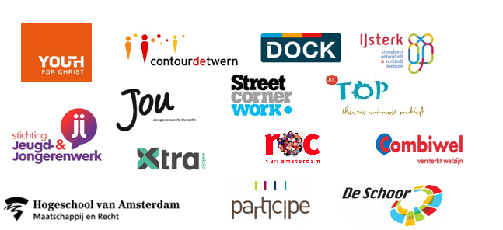

Lectoraat Youth Spot
www.hva.nl/akmi/gedeelde-content/lectoraten/lectoraat-youth-spot/youth_spot.html

