Slide 1
CONNECTIONS, DISCONNECTIONS RECONNECTIONS
The Maltese Story
Miriam Teuma
CEO
Agenzija Zghazagh

Slide 2
Malta
Geographical Location: 80 km south of Italy, 284 km east of Tunisia, and 333 km north of Libya.
Area: The country covers just over 316 km²
Population: 420,000 (despite an extensive emigration programme since the Second World War)
Capital: Valletta (0.8 km²⁾
Languages: Maltese and English

Slide 3
Malta's location has historically given it great strategic importance as a naval base, and a succession of powers, including the:
  Phoenicians,
  Carthaginians,
  Romans,
  Moors,
  Normans,
  Sicilians,
  Spanish,
  Knights of St. John,
  French and
  British

Slide 4
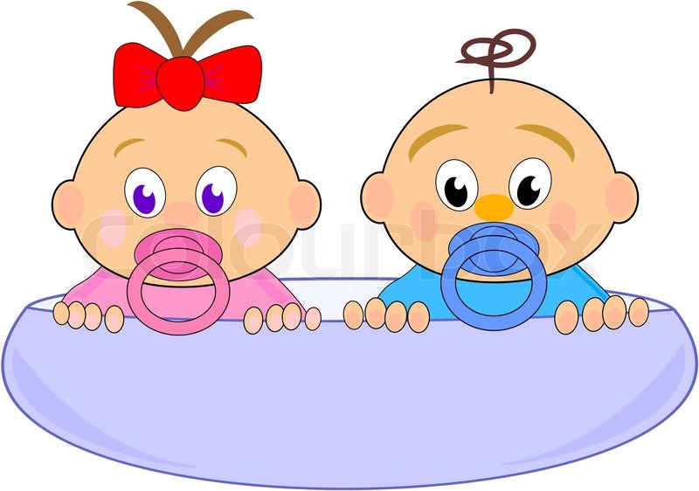
The Social Worker and the Youth Worker
The children of a common heritage - Christian charity, humanist philanthropy, industralisation, urbanisation, social action but not identical twins.
The children of a common heritage
Christian charity, humanist philanthropy, industrialisation, urbanisation, social action but not identical twins

Slide 5
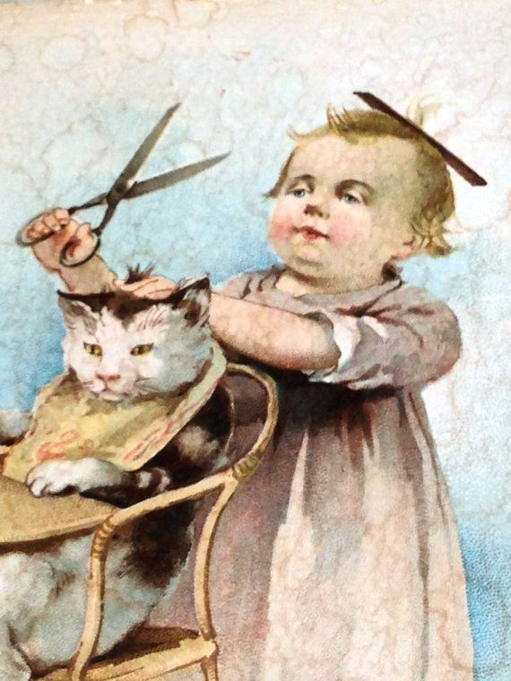

The Social Worker | The Youthworker
born confident, serious and favoured | Born carefree, jovial and overlooked.

Slide 6

As they grow older .........
The Youth Worker | The Social Worker
on the periphery and handed tasks to do mainly on voluntary basis | rises in the (welfare) state to a position of prominence, power and influence

Slide 7
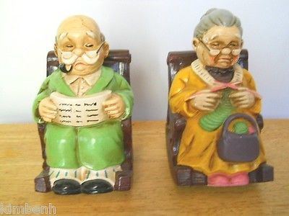
Today ......... afflicted with austerity, neoliberlaism and New Public Management theory
The Youth Worker | The Social Worker
seek solace and support from each other

Slide 8
Youth work Malta Time Line - 1
1908
The first Scout Troop in Malta is organised and is only the second overseas troop to be set up outside the UK
1908
The first Don Bosco Oratory was founded in Sliema
1923
The Malta Girl Guides is established
1931 Żgħażagħ Azzjoni Kattolika (Youth Catholic Action) is set up as a branch of Maltese Catholic
Action
1980
The Federation of Maltese Youth Organisations is set up
Connections
While youth work may be a "social" animal, there are many different animals. To what extent was youth work different from social work from the outset? What characterised these differences and have they persisted?

Slide 9
Youth work Malta Time Line - 2
1991
The National Youth Council (KNZ) is established following on the first National Youth Conference in Malta
1992
The University of Malta establishes an Institute of Youth Studies to train youth workers
1993
First national youth policy document is published by the new Ministry for Youth and Arts.
1998
The first youth work graduates of the University of Malta establish the Maltese Association of Youth Workers (MAY)
Disconnection
How have social work and youth work evolved over time? What have been their respective roles, impact and relative status across Europe? What has been their perception of each other? In particular, what has been the impact of the (welfare) state, professionalisation, youth culture, multiculturalism, humanistic psychology, feminism and the digital revolution on both social work and youth work and how have they shaped them?

Slide 10
Youth work Malta Time Line - 3
2014
Professional Youth Work Act is enacted
2015
The National Youth Policy Towards 2020 - A shared vision for the future of young people is launched
2010 Aġenzija Żgħażagħ (The Maltese Youth Agency) is established
2015
Youth Village and new administrative headquarters of Aġenzija Żgħażagħ are opened
Reconnection
Has the impact of globalisation, neoliberalism, and the recent financial and economic crisis, "narrowed the ground" for both social work and youth work and should they accordingly seek more "common ground“?

Slide 11
And let us start another story

