Slide 1
The theory and practice of the Hungarian youth work
Nagy Ádám habil. PhD - Oross Dániel, PhD
“CONNECTIONS, DISCONNECTIONS AND
RECONNECTIONS – THE SOCIAL DIMENSION OF YOUTH WORK, IN
HISTORY AND TODAY”
Malta 22 September 2016

Slide 2
Table of contents
I. Three traditions of Hungarian youth work (practice)
pedagogical practice
social work
cultural public work
II. The content of youth work in Hungary (theory)
The onion model
The system of youth policies in Hungary
III. Conclusion, questions to be discussed

Slide 3
Introduction
Aims of the presentation:
Instead of giving a historical perspective on Hungarian youth (Wootsch, 2010) present a more analytical approach
Instead of focusing on what the Hungarian government does (Nagy, 2010) and on policy changes (continuous discontinuity, Oross, 2015) explain where youth workers come from and how their tasks can be arranged into a complex model (connections).
challenging the ‚magic triangle’ model – heading towards a ‚magic pyramid’ (Zentner, 2016)? Putting young people and their communities into the middle.

Slide 4

II. Practice: Three traditions of Hungarian youth work
pedagogical practice
social work
cultural public work

Slide 5
Insufficient pedagogical practice
The Hungarian school system is criticized for the following characteristics (Mihály, 1999:95):
• the overcrowded curricula of the school and few other services provided by schools;
• the organization of knowledge: compulsory curriculum for all students that is impersonal and alienated;
• the conditions, the context where knowledge is being broadcasted;
• the effects of education on students personalities;
• the assumptions of the school related to the students;
• the internal atmosphere of the school;
• the relationship between teachers and students.

Slide 6
The tradition of social work
For social work horizontal relationship and co-operation has always been the way to address problems.
Today, youth work, that grew out of social work, has a very broad sense: exclusion, prevention, participation, empowerment - everything that is important from the aspect of young peoples’ social integration.
Poverty and exclusion has hit young Hungarians, in fact they were the losers of the new democratic political system (Andorka, 1996).
Covers not only crisis situations but aims to contribute to prevention. It aims to help the development of skills that enable sucessful integration into society.
Because of the proliferation of choices in life it is no longer possible to give young people universal biographical advices, a helping attitude (‘everyone's an expert in his own life’) is needed.

Slide 7
cultural public work
Independent school camps, youth clubs belonged to the natural context of community development in Hungary already before the regime change in 1989/90. These activities had French origin (animateurs). In search of a cure to depopulation their activities have been carried out during the eighties in Hungary coordinated by the Hungarian Institute for Culture.
The heritage of cultural public work on youth work lies today in animated communities beyond the walls of the school system. These communities give space to non-formal learning, independent activity and self-organization of young people.
The last quarter of a century has transformed these spheres also, especially due to the changing role of leisure space in socialization during the postmodern era (Nagy, 2013). Youth of the Hungarian youth camps of the socialist era became the youth of festivals during the Millennium and young Hungarians became screenagers during the 2010’s.

Slide 8
II. Theory: The content of youth work in Hungary

Slide 9

The onion model
The onion model enables us to arrange different elements (such as camps, youth offices, virtual youth work, youth research) of youth work into a coherent concept that is comparable to other European models.
The onion model combines the so-called vertical and horizontal approaches.
It is based on the immediate (specific) and the indirect (abstract) nature of the activities related to the individual and the community.
Within the center of the model there is the individual (or community) itself, with whom the activities take place

Slide 10
The structure of activities related to young people
young people and their communities
Indirect activites, services (organization, framework) are provided for young people on a higher level of abstraction. (youth professionals).
Horizontal activities, interdisciplinary linkages to other professions (youth and society).
Youth work

Slide 11
Youth work
Youth professionals
Interactions among young people and their communities.
All activities that have indirect contact with young people and their communities.
Horizontal activities
Horizontal youth activities include any activity related to youth age groups that has strong link to another discipline or profession (education, social work, culture, economy, etc.)
Inner circle: activities which are directly linked to the individual or to the community (youth work).
contains the horizontal approach where interdisciplinary linkages to other professions are located.
indirect services (organization, framework) is provided for young people on a higher level of abstraction.
These activities provide ‘background’ for youth work.

Slide 12
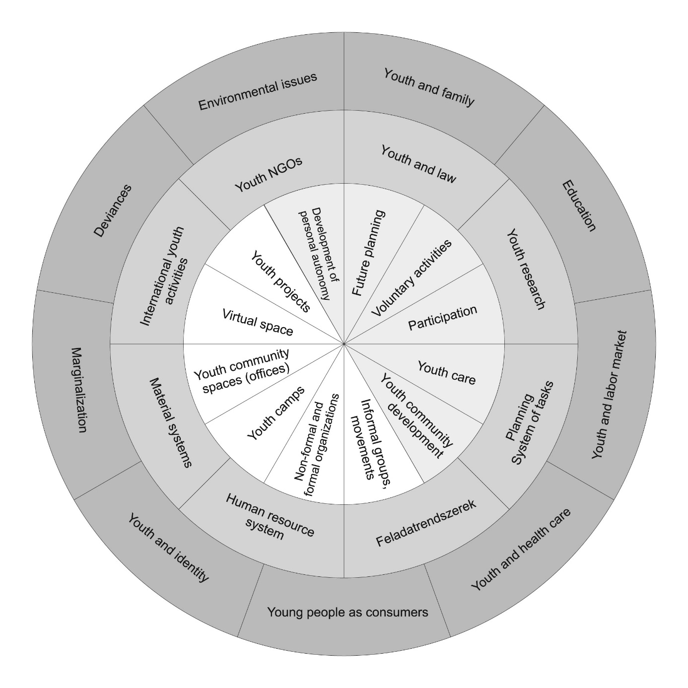
young people
and their communities
Youth work
Youth professionals
Youth and society

Slide 13
1. Areas of youth work
Development areas
Development of personal autonomy;
Future planning;
Voluntary activities;
Participation;
Youth care;
Youth community development.
Areas of youth work
Informal groups, movements;
Non-formal and formal organizations;
Youth camps;
Youth community
spaces (offices);
Virtual space;
Youth projects.

Slide 14
2. Disciplines related to youth work
Youth and law;
Youth research;
Planning;
System of tasks;
Human resource system;
Material systems;
International youth activities;
Youth NGOs.

Slide 15
3. Horizontal youth activities
Youth and family;
Education;
Youth and labor market;
Youth and health care;
Young people as consumers;
Youth and identity;
Marginalization;
Deviances;
Environmental issues.

Slide 16
IV. Conclusions
The onion model shows that different actors of youth work in Hungary have embraced the cross-sectoral and integrated approach of youth policy and have developed their own answers as to how it is possible to make this approach part of the Hungarian youth work practice.
But generally youth policy continued to be complementary, ancillary area in Hungary that has less prestige than related professions.

Slide 17
Selected literature
ANDORKA, R. (1996): Bevezetés a szociológiába, Osiris Kiadó, Budapest
MIHÁLY, O. (1999): A polgári nevelés radikális alternatívái, in: MIHALY, O. (szerk.): Az emberi minőség esélyei – pedagógiai tanulmányok, Okker Kiadó, Budapest
Nagy, Á. (2010.): Magyarország ifjúságpolitikája a lauritzeni modell tükrében. Nemzetközi Közlöny, 2010. I. szám, 3-14. oldal
NAGY, Á., TRENCSÉNYI, L. (2013): Amit az iskolában nem tanultam meg, Iskolakultúra 23/9
Oross, D. (2015): Ifjúsági részvétel a pártpolitikán túl, Doktori értekezés. http://phd.lib.uni-corvinus.hu/859/
Wootsch, P. (2010): Zigzagging in a labyrinth – Towards “good” Hungarian youth work. In: The history of youth work in Europe, Volume 2.
Zentner, M. (2016): Observations onthe so-called ‚magic triangle’ or where has all the magic gone?

Slide 18

Thank you for your attention!
Nagy Ádám habil. PhD
Bolyai fellow
docent of the Selye János University
research professor, Pallas Athene University
Oross Dániel, PhD
Hungarian Academy of Sciences,
Centre for Social Sciences, junior research fellow
adam@nagydr.hu
oross.daniel@tk.mta.hu

