Slide 1

Inclusive
National Youth Policy
2014 – 2020 (Czech Republic)
Zdenka Maskova
Ministry of Education, Youth and Sport
Tel.: +420 234 811 134
E-mail: zdenka.maskova@msmt.cz

Slide 2
Structure
Personal story: How I got involved
National Youth Policy – goals, measures
National Youth Policy – instruments for inclusive cross-sectorial strategy
Innovative elements

Slide 3
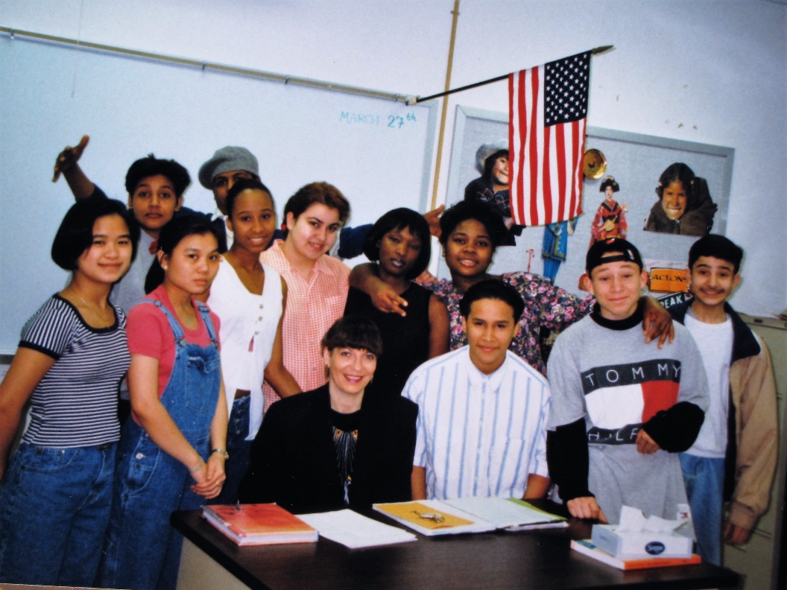
How I got involved
1997 U.S.A.
Fulbright High School Teacher Exchange Programme

Slide 4
National Youth Policy 2014 - 2020
Fundamental document for implementation of the state youth policy
This strategic document was approved by the Government of the Czech Republic on 12th May 2014
Strategic goals cover 13 different thematic fields: access to rights, access to information, leisure-based and non-formal education, leisure time, cross-border mobility, employment and employability, health and healthy lifestyle, participation, volunteering, young people with fewer opportunities, environment, media and culture

Slide 5
Target group of Youth Policy
The primary target group for National Youth Policy is youth between 13 and 30 years of age
Successful implementation of many of the strategic and operational goals of the youth policy also requires a systematic approach to working with children. This reality is taken into account in the wording of relevant objectives that focus on children younger than 13. Strategy 2020 thus covers a considerably wide social group with a specific position and role in society.

Slide 6
Strategic goals covering inequalities
SG 1: To facilitate equal access of children and youth to rights
SG 10: To facilitate inclusion of children and young people with fewer opportunities
Strategic goals are elaborated further into operational goals and measures:
Operational goals break down this vision in terms of the short, medium and long-term fulfilment of the strategic goals.
Measures define specific steps taken to achieve the desired operational goals.

Slide 7
SG: Facilitate the inclusion of children and young people with fewer opportunities
Two operational goals:
To improve access to services in education, employment, health and social care for children and youth with fewer opportunities
To encourage the development of skills for children and youth to promote tolerance across cultural and social groups

Slide 8
OG: To improve an access to services in education, employment, health and social care for children and youth with fewer opportunities
Three measures:
To promote the use of cultural, social and educational centres to provide opportunities for non-formal education
To support leisure-based and non-formal education projects focusing on the integration of children and young people with fewer opportunities
To promote further education and sharing of good work methodology with children and young people with fewer opportunities

Slide 9
Instruments
Thematic cross-sectorial working groups
YOUTH CHAMBER: a cross-sectorial advisory body of the minister responsible for youth
- expert group on linking youth work to social work
Grant schemes on supporting quality youth work
Grant scheme on supporting personal development of children and young people (enables to link formal and non-formal education through regional network of support services)
State Regulation on teaching pupils with learning difficulties and teaching talented pupils (will come into force in September 2016) – applies also to non-formal and leisure-based education settings financed through the state budget (network of Youth Centres)

Slide 10
USUAL THINGS
or
NOVELTY
in inclusive national
youth strategies?

Slide 11
two innovative elements
not often mentioned
when
youth policies are discussed

Slide 12


Slide 13
Fostering intergenerational dialogue
This strategic document is primarily focused on young people, but it fully respects the need for intergenerational solidarity and dialogue. It uses principles of intergenerational dialogue and emphasises the role of empathy and the ability to listen to one another in intergenerational relations across all the operational goals and measures.

Slide 14
Learning to accept and respect other cultures and religions as well as other people´s rights is based on learning how to respect different age categories
- within the own family
- in neighbourhoods / communities
- at schools
- in a workplace

Slide 15


Slide 16
Realistic needs and opportunities of young people – find a balance
Youth policy should respect real needs and opportunities of young people. Above all it is necessary to find a right balance in the areas and the extent to which young people should be supported.
Many young people urgently need support for their development in order to become as independent as possible and to contribute to society as fully participating members.
However
Support must not exceed a certain limit beyond which it is no longer an impetus for young people´s development but becomes an obstacle for growth.
Young people should be supported to take on activities and initiatives freely even though they may fail or be wrong, and should learn how to take responsibility for their failures, to learn from them and to see them as an impetus for positive change in the future.

Slide 17
Avoid having too much protective youth policies
Provide young people with opportuties when particular situations require from them to take on an activity and initiative independently, or at least partially independently, into their own hands despite their limited experience.
It is not easy to identify such a moment because it is very individual with each young person. That is why young pople’s life situation in all its complexity must be taken into account.

Slide 18
Thank you for your attention
Zdenka Mašková
Head of Youth Policy Unit
Ministry of Education, Youth and Sports
Karmelitská 7, 118 12 Prague 1 • tel.: +420 234 811 103
zdenka.maskova@msmt.cz • www.msmt.cz

