Slide 1
Tackling Youth Unemployment - Croatia
Dario Miloš
Ministry of Labour and Pension System

Slide 2
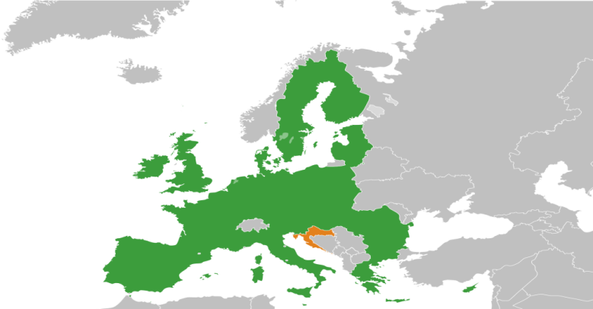
Republic of Croatia- brief summary
Population (2011.)-4.284.889
The number of employed persons (12/2015.)-1.413.637
The number of pensioners (12/2015.)- 1.228.020
The average number of unemployed persons (2015.)-285.906
Minimum wage (2015.)- HRK 3,029.55 (gross)- HRK 2,400.00 net (approx. EUR 320)
The average net salary (2015.)- HRK 5,693.00 (approx. EUR 759)

Slide 3

Youth unemployment in Croatia
EU – 5 milion unemployed young persons in EU (15-24)
Croatian Employment Eervice (2015.)
  Average number of unemployed young persons 84,724, (29,6 %)
  14,814 (17.4%) age 15-19;
  34,910 (41.2%) age 20-24
  35,000 (41.3%) age 25-29,
  Average number of unemployed young persons 102.484 (2014.)
The Youth Guarantee is a new approach to tackling youth unemployment which ensures that all young people find a job, start a apprenticeship, traineeship, or continue education.

Slide 4
ALMP Measures
The employment measures are designed for different groups of unemployed persons (young people up to 30 years, long-term unemployed, persons above 50 years…) and include:
• Training subsidies
• Job preservation subsidies
• Self-employment subsidies
• Education for unemployed
• Employment after Occupational training without commencing employment
• Public works
• Employment subsidies
• Occupational training without commencing employment

Slide 5
Total number of users of the Active labour market policy measures in 2015, by 31st December 2015
Measure | Young persons only 2015. | Active users at the beginning of 2015 | Included by 31st December 2015 | Total users during 2015. | Active users on the 31st December 2015.
TOTAL | 41.950 | 23.165 | 41.595 | 64.760 | 33.021
Employment and training subsidies | 7.361 | 4.697 | 7.120 | 11.817 | 6.747
Self-employment subsidies | 1.329 | 2.109 | 2.776 | 4.885 | 2.647
Education for unemployed | 679 | 54 | 1.552 | 1.606 | 1.095
Public works | 3.708 | 1.771 | 9.961 | 11.732 | 3.217
Occupational training without commencing employment | 28.222 | 13.897 | 18.597 | 32.494 | 18.307
Job preservation subsidies | 597 | 6 | 228 | 234 | 11
“Permanent Seasonal Worker” | 57 | 631 | 1.361 | 1.992 | 997

Slide 6
Labour Supply and Demand Mismatch
Despite the current number of 248,100 registered unemployed persons (latest CES data), employers in Croatia have difficulties finding suitable workforce
Employers’ Survey conducted by the CES show that a significant number (29.1%) of employers had difficulties finding suitable workers
Two most frequent problems were: lack of candidates with appropriate level of education (49,5% of employers) and lack of candidates with sufficient working experience (43,5% of employers)
Also, eployers also emphasize lack of generic skills

Slide 7
Alignment of education and labour market
Comprehensive approach to tackle this issue is needed
Application of Croatian Qualification Framework (CROQF) started in 2013, with the adoption of relevant legislation and it is a mechanism to determine actual needs on the labour market, and to bridge the gap between the economy and education
Process begins with an occupational standard, which is responsibility of the Ministry of Labour and Pension System and and continues with qualifications standard which is the responsibility of the Ministry of Science and Education.
Occupational standard is a document which clearly presents competences necessary to successfully perform a specific occupation
Also, in recent years lifelong guidance become important part alignment of education and labour market.

Slide 8
Plans for future
Some key points of National plan of reforms, related to education for the labor market:
    • implementation of curriculum reforms;
    • adoption and implementation of the Program of development of vocational education and training;
    • Development of the system of non-formal and informal learning, and;
    • increase the representation of professional practice in higher education.

Slide 9

Thank you for your attention!
dario.milos@mrms.hr

