Slide 1
Social justice for illegalized young bodies?
Some critical reflections on the ‘right to rights’, and implications for the youth sector
‘(Un)Equal Europe? Responses from the youth sector’
30 May – 2 June 2016, Budapest
Maria Pisani

Slide 2
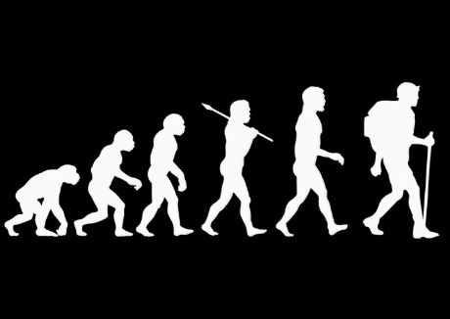
homo migratus

Slide 3
It’s time for Europeans to abandon the delusion that we can isolate ourselves from this crisis. Our region is living through the greatest humanitarian disaster since World War II, but our response is lagging far behind. It’s time to shift gears (Guterres, 2015)

Slide 4
Sovereignty, citizenship ‘right to rights’, CRC
HR abuses, conflict, persecution
Globalization,
transnational networks,
social media
The multifaceted
young person
Neoliberalism,
global inequality
Nationalism,
borders and identity
Colonialism
& Racism

Slide 5
Refugee crisis?
86% worlds refugees hosted in the global south
protracted refugee contexts – warehoused in limbo
containment
Responsibility for refugees should not be dictated by proximity to the disaster

Slide 6
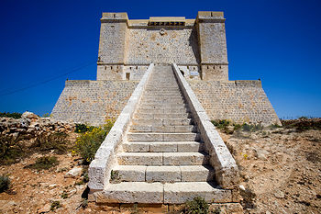
Fortress Europe

Slide 7
progressively restrictive migration and asylum policies
‘illegalization’ process: ‘the systematic process that renders people “illegal”’ (Bauder, 2013:4)
Western countries pride themselves on their humanitarian legacy, [and then]… find every possible way to prevent flows of refugees (Crepeau, 2003)
Defending external borders has had deadly repercussions

Slide 8
Construction of ‘illegal bodies’
discourses shape social experiences and political responses
sovereignty constructs the arrival of refugees – the illegalized bodies - as a security threat
exceptional circumstances that demand an exceptional ‘crisis’ response
calls for militarization and the use of force against the migrant (read Muslim/terrorist) ‘threat’

Slide 9
cooperation with third countries, ensuring the externalization of European border controls; (EU-Turkey deal)
detention
militarized anti-trafficking (smuggling) operations
razor wire fences
water canons
tear gas
repressive tools protecting the ‘nation’
the violation of human rights is normalized and justified

Slide 10
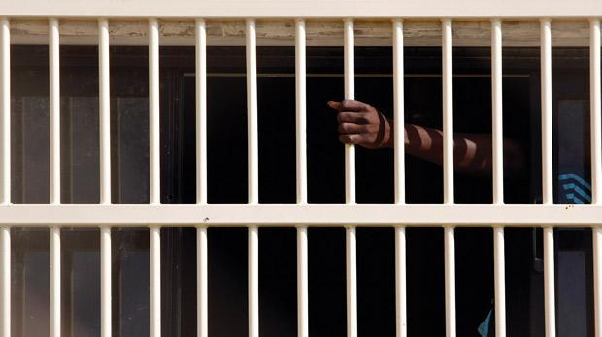
‘irreconcilable with the requirements of the European Convention on Human Rights and the case-law of the Strasbourg Court’.
National Security vs Human Security

Slide 11
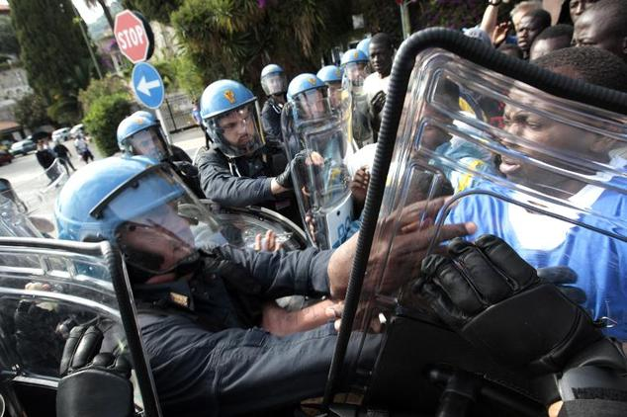
Implosion
MS agreed to relocate 160,000 (EC, 23 Sept, 2015)

Slide 12
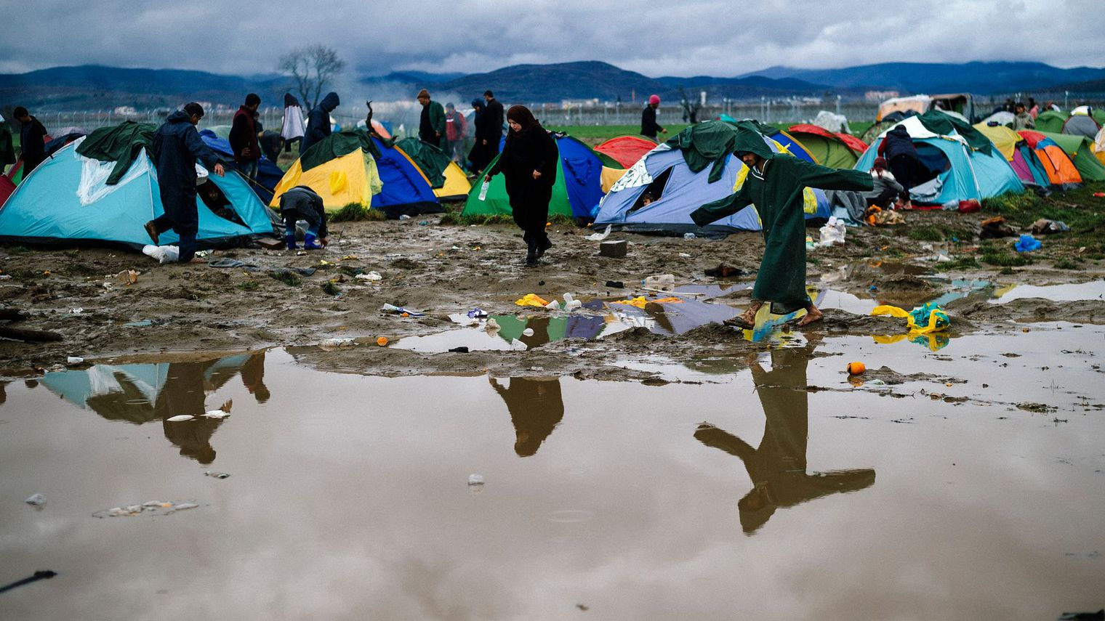
The Missing

Slide 13
100,000 registered unaccompanied minors 2015
10,000 registered refugee children missing - traffickers (Europol, 2016)
In Hungary, children disappear at an estimated rate of 90-95%; in Slovenia, about 80% of children went missing; and in Sweden about 7-10 children are reported missing each week. Greece recorded a decrease in the absconding rate of children. One hundred children went missing from one centre in Austria and 4700 unaccompanied children were recorded as missing in Germany as at 1.1.2016 (FRA, 2016)

Slide 14
It is likely that there are 400 unaccompanied children aged up to 17 years in Idomeni, maybe more, who are waiting to pass the border and continue their journey to northern countries of Europe. But, the exact number is not clear, no one knows how many unaccompanied children are in Idomeni due to the lack of coordination, legislative gaps and closed borders (themanews.com, 2016)

Slide 15
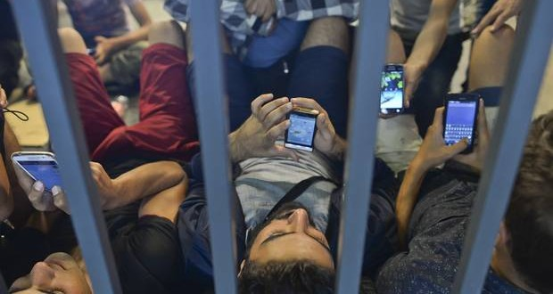
resistance and agency in a globalized world
Migration plan – survival strategies

Slide 16
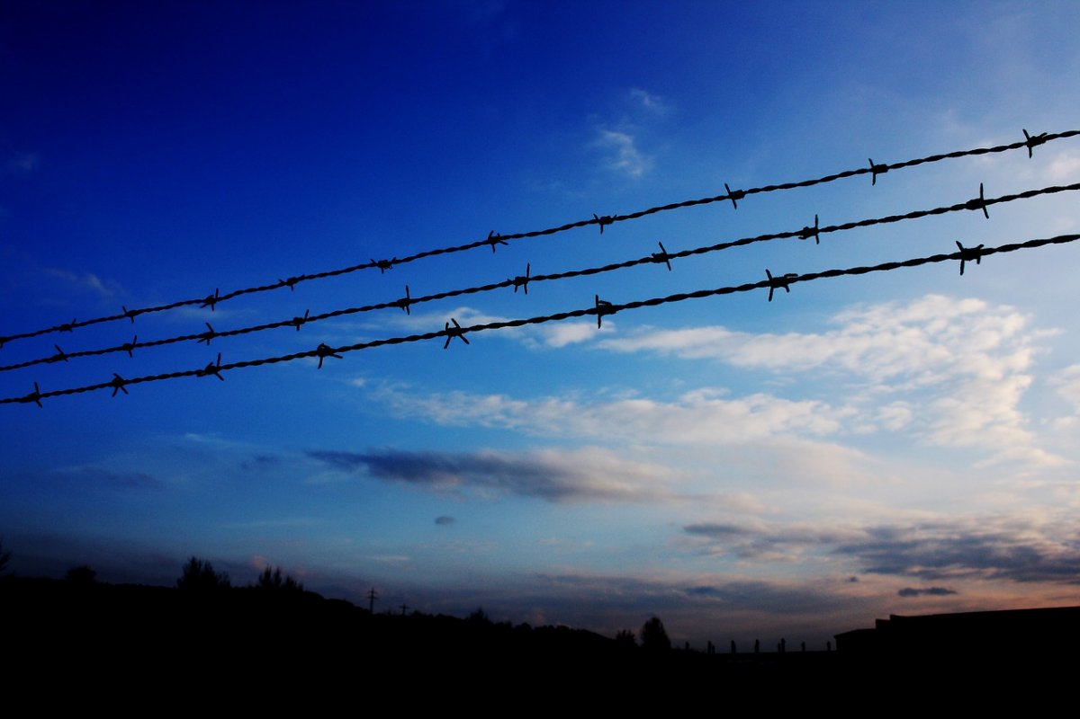
critical reflections

Slide 17
Rights based approach: State obligations, victimisation?
Unaccompanied minors/separated children – CRC
the protection needs of thousands of unaccompanied asylum seekers living within the EU simply are not being met (housing, employment, education, health)
‘political’ crisis: minimum standards can be compromised
Narrow focus on materialist concerns misses the point - the right to rights cannot be assumed
Socially excluded, racialized, politically marginalized and denied access to rights

Slide 18
For the nation-state cannot exist once its principle of equality before the law has broken down. Without this legal equality, which originally was destined to replace the older laws and orders of the feudal society, the nation dissolves into an anarchic mass of over-and underprivileged individuals. Laws that are not equal for all revert to rights and privileges, something contradictory to the very nature of nation-states (Arendt, 1951: 290)

Slide 19
The Nation State defines who ‘belongs’ and who does not ‘belong’
Citizenship is a formal status granting a set of legal, exclusive rights
The ‘illegal body’ is excluded by the state, and this is sanctioned – or actively encouraged – by the ‘citizens’, who also form the majority, the voters
Celebration of Democracy? Citizenship?

Slide 20
‘young people are citizens, too – and now’ (Davies, 2015: 103) - citizenship assumption (Pisani, 2012)
the transition from minor to adult will not provide for the ‘right to rights’
Can the illegalized youth speak?
Advocacy role of youth worker?

Slide 21
Resilience and agency
Migration strategy/survival strategies
Autonomy
Dreams of utopia
Responsibilities – employment
Heterogeneity: eg. Somali/Syrian

Slide 22
Eurocentric constructions of childhood/adolescence/ youth
Interpretation of needs – service delivery
Infantilizing (victimisation) – set up to fail
Rethinking theoretical and institutional paradigms?
Can they be heard?

Slide 23
thank you
maria.pisani@um.edu.mt

