Slide 1
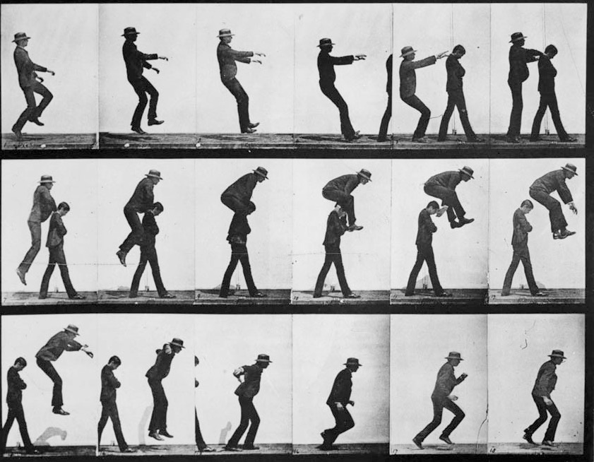
Understanding Youth Inequalities
‘(Un)Equal Europe? Responses from the youth sector - Symposium
European Youth Centre Budapest
30 May – 2 June 2016
layers, tensions and a zoom
Magda Nico
Researcher at the Centre for Research and Studies in Sociology, University Institute of Lisbon
Pool of European Youth Researchers, Youth Partnership

Slide 2
Outline
Tensions and intersections between:
the classist and the generational approach
the structural and the individualistic approaches
Implications for the youth sector
Layers, comparisons and accumulations of inequalities
Less opportunities compared to whom?
European map of youth inequalities’ inequalities
Implications for the youth sector
A zoom, or putting some flesh in theoretical bones
follow up project in Portugal
examples and results
Messages to take home

Slide 3
Tensions and intersections
The classist and the generational approaches or…
…. should policies be age or class-graded?
Classist approach
Principal: “youth is taken as a social group that is necessarily socially diversified, constituted by different youth cultures formed on behalf of class belongings, different economic backgrounds, different power resources, different interests, different occupational situations, etc. ” (Pais, [2003] 1993: 29).
Problems: wealth and income inequalities have become absolutely hegemonic in the study of inequalities in our contemporary society & subjective, longitudinal and individual approaches to inequalities, which would be necessary to a more comprehensive understanding of youth inequalities, are mostly left undone.

Slide 4
Tensions and intersections
The classist and the generational approaches or…
…. should policies be age or class-graded?
Generational approach
Principal: “youth is taken as a homogeneous group which main attribute is to be constituted by individuals on the same ‘life stage’” (Pais, [2003] 1993: 29).
Problems: to assume, even if just in the beginning of the process, argument or policy, that a group of people that share the same birth cohort, and that are “currently” young, have a sense of belonging to that group that exceeds significantly the sense of belonging to a specific social class or community, the preference for certain life styles, or a particular professional or educational identity

Slide 5
Tensions and intersections
Table 1: Implications of theoretical approaches to the design and targeting of youth policies
THEORY | POLICY
 | SOCIALLY-GRADED | AGE-GRADED
CLASSIST | Policy should primary be targeted at those who are most affected or at risk of poverty, social exclusion or without social rights. | Young People would only be particularly affected if they were also particularly affected or at risk of being affected by a poverty, social exclusion or without social rights.
GENERATIONAL | Although there are many policies that are intended for all young people, there is also a special concern with “young people with fewer opportunities” in the European official documents and agenda. | Policy should primary be age-graded. It is assumed that being young is a priori a condition of social vulnerability.

Slide 6
Tensions and intersections
Structuralism and individualism approaches or…
…. Do bottom-up and top-down policies meet or clash?
Underlying tension … or the elephant in the triangle
Researchers’ moto
incapable of denying “the (predominant) effect of social structure and social context on individual trajectories and (educational, professional, or general) “outcomes of life” - thus emphasizing the importance of social and public policies as a condition sine qua non (even of not sufficient or efficient at times) for the minimization and attenuation of unequal opportunities of life and of conditions of existence
Youth Work Moto
are more or exclusively concentrated on “activating” or “empowering” young people as directly as possible, independently of the measurability or significance/relevance of the effect”

Slide 7
Tensions and intersections
Table 2: Implications of theoretical approaches to the design and targeting of youth policies
APPROACH | CORNERS OF THE TRIANGLE
 | RESEARCH | YOUTH WORK
THEORETICAL STRUCTURALISM | Structural conditions and policy context should pre-exist the combating inequalities policy implementation by whomever. | The role of youth worker should in this context be of a mediator and an intermediate between the existing policy and young people (specially with fewer opportunities).
THEORETICAL INDIVIDUALISM | Individuals, both youth workers and young people, have seen their agency increase in the last decades (and therefore also their responsibility in resolving their own problems and unequal opportunities of life. | The role of youth worker is to be a “policy change maker” him or herself, and/or to empower or activate young people directly.

Slide 8
Layers, accumulation and comparisons
Layers (according to Therborn)
(That also vary according to their reversibility and to their systematic and recurrent interaction and accumulation across time)
VITAL or life chances of human organisms
that includes inequalities concerning life, death and health
EXISTENTIAL or capability of persons
that refers to the uneven acknowledgement of humans as people, where aspects such as liberty and human rights are at the core
RESOURCES or resources of social actors
Bases capitals (income, wealth, culture, education, power, etc.)
Access to opportunities of mobility and change

Slide 9
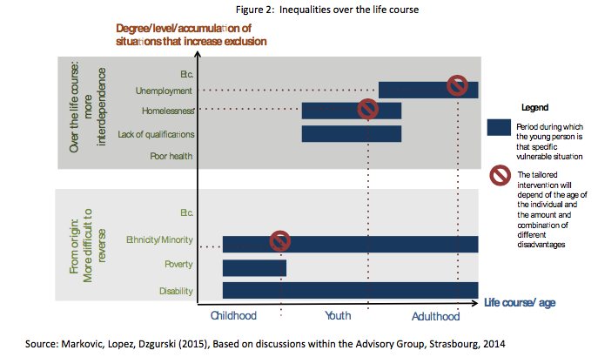
Layers, accumulation and comparisons
Figure 1: Inequalities over the life course

Slide 10
Layers, accumulation and comparisons
The notion of Accumulation reconciles the generational and the classist approaches
- Together they corroborate the need to perceive inequalities as as processes of reproduction or attenuation across time, instead of being analyzed with static social categories.
The understanding of this “meeting” between these two approaches is crucial both at an individual and a collective level to the identification:
of the degree to which one is “excluded” (from one or more dimensions),
the severity of the dimensions from which one is excluded,
the accumulation of and interactions between the dimensions from which one is excluded,
the type of intervention required and by which corner of the triangle.

Slide 11
Layers, accumulation and comparisons
Comparisons
Figure 2: Inequalities factors mentioned in Youth in Action
Source: Factors mentioned in Youth in Action

Slide 12
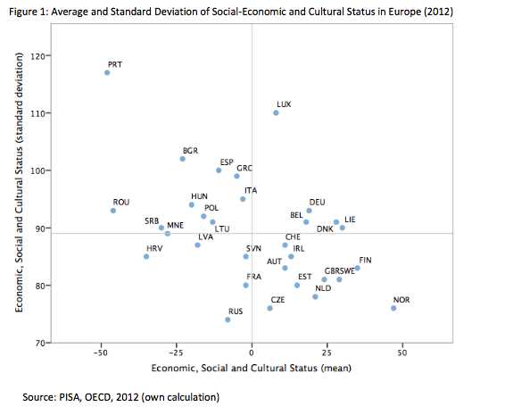
Layers, accumulation and comparisons
Figure 3: Average and Standard Deviation of Socio-Economic and Cultural Status (2012)
Assumptions:
- Young people with fewer opportunities are minorities in each countries (which is not so, unfortunately)
- Social structure is not a dichotomy: less opportunities vs. well-off youth.

Slide 13
Layers, accumulation and comparisons
Figure 3: Average and Standard Deviation of Socio-Economic and Cultural Status (2012)
“Disadvantage”
is an inherently comparative concept and being or not in disadvantage with others depends on the point of reference, depends on to whom one is being compared to, depends on the social context at play.

Slide 14
Layers, accumulation and comparisons
Implications for the identification and selection of “young people with less opportunities”

Slide 15
A zoom, a case study, or putting some flesh in theoretical bones
Follow up study with young adults in Portugal (2009-2016)
Wrong place at the wrong time
non-selective school system,
training systems with low average standards and coverage,
and a closed, segmented and informal employment regime.
High level of unequal social, cultural and economic status
Young people as minority in the country

Slide 16
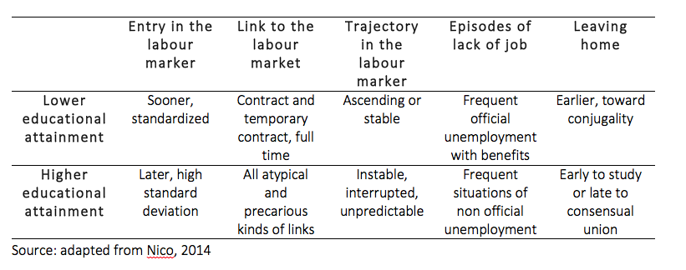
A zoom, a case study, or putting some flesh in theoretical bones
Table 4: Trajectories towards adulthood according to educational attainment (N=52)

Slide 17
A zoom, a case study, or putting some flesh in theoretical bones
Age
39
38
37
36
35
34
33
32
31
30
29
28
27
26
13
But ongoing
52
ESTUDO 2009
FOLLOW UP 2016

Slide 18
A zoom, a case study, or putting some flesh in theoretical bones
Changes over the life course: strategic adaptation to the crisis
Positive agentic reactions
Resistence to illegal, unsustainable or long-term precariousness
Resilience of consumption and savings ethics and values
Maintenance of the aversion to debt and credit cards
Big awareness of the effects of precarity
Negative uncontrollable effects
High level of unemployment episodes
Interrupted or canceled family projects
Impact of emigration of significant others

Slide 19
A zoom, a case study, or putting some flesh in theoretical bones
Changes over the life course: strategic adaptation to the crisis
Surprising empirical results
Crisis as opportunity, even if as rock bottom
Resilient optimism about life events (majority of which were considered positive)
Access to information on their rights as workers
Exaggerated assimilation of neo-liberal discourse “It’s up to you to succeed!”
Incapacity to interpret own life has embedded in the national history and context
Increased pressure to individually resolve collective and national problems
Enhanced intergenerational conflict in the public discourse
Increased incapacity to see in policies the solution for some of their real problems
Exacerbated aversion to discourses of “victimization”
Inequality as either an inevitability or something for the individual alone to handle.

Slide 20
Messages to take home
The research approach – classist or generational – end up deciding the target group
(therefore, show not be neglected or used automatically, for it is embedded in ideology and youth policy design)
Inequality is a process not a state, and no one is necessarily immune to it.
(therefore, interventions should be as continuous as life itself)
Dynamic, cumulative and holistic indicators of inequalities are need
(otherwise target and reach of policies towards inequality reduction are compromised)
Qualitative information on the processes of reproduction of inequalities are needed
(statistics need faces and stories, policy maker need to feed on this knowledge)

