Slide 1
Poverty, Democracy and Inequalities
Youth Partnership Symposium
(Un)Equal Europe?
Responses from the Youth Sector
Budapest 30 May 2016
Input: Fintan Farrell, Acting Director,
European Anti-Poverty Network (EAPN)

Slide 2
Overview of Presentation
Introducing EAPN and priority work areas
Poverty and Inequality in the EU a brief overview
Minimum Income Schemes in Europe – a case study
What can be done
The link with Democracy

Slide 3
Introducing EAPN
Independent Network of NGOs committed to fight against poverty and social exclusion, with and for people in poverty. Primarily working in the EU Member States
31 National Networks and 18 European NGOs as members
Participation of people with direct experience of poverty must be part of the solution.
Started in 1990 – key actor in poverty programmes and development of social OMC and Europe 2020 Strategy.
Receives financial support from the European Commission (EaSi Programme)
Coordinates the European Minimum Income Network (EMIN)

Slide 4
Introducing EAPN
4 Key Integrated Thematic areas:
Adequate Incomes throughout the life cycle
Accessible services of general interest
Inclusive, quality labour markets
Participation and civil dialogue
Cross cutting themes
Gender equality, non-discrimination, wealth and inequalities

Slide 5
Poverty and Inequality in the EU
In 2014, 122.3 million people, or 24.4 % (see Figure 1) of the population in the EU-28 were at risk of poverty or social exclusion (AROPE), An increase of over 7 million since 2009.
More than a third of the population was at risk of poverty or social exclusion in three EU Member States: Romania (40.2 %), Bulgaria (40.1 %) and Greece (36.0 %). The lowest shares of persons being at risk were recorded in Finland (17.3 %), Sweden (16.9 %), the Netherlands (16.5 %) and the Czech Republic (14.8 %).
More than 30 % of young people aged 18 to 24 and 27.8 % of children aged less than 18 were at risk in 2014
9.5 % of the working EU population was at risk of poverty in 2014

Slide 6
Poverty and Inequality in the EU
9.0 % of the population were severely materially deprived. 3.2 % in the Netherlands and Denmark, 2.8 % in Finland, 1.4 % in Luxembourg and 0.7 % in Sweden. On the other hand, the deprivation rate was more than 26.3 % in Romania and 33.1 % in Bulgaria
Inequality in Europe has risen quite substantially since the mid 1980s. While the EU enlargement process has contributed to this, it is not the only explanation since inequality has also increased within a "core" of 8 European countries. Large income gains among the 10% top earners appear to be a main driver behind this evolution (OECD Economics Department Working Papers, No. 952)
‘Of all the classes, the wealthy are the most noticed and the least studied’ John Kenneth Galbraith
Increasingly divided Europe – North - South and periphery:

Slide 7
Minimum Income Schemes
  Minimum Income schemes: “income support schemes which provide a safety net for those who cannot work or access a decent job and are not eligible for social security payments or whose entitlements have expired”
  Adequate Minimum Income: income that is indispensable to live a life in dignity and to fully participate in society

Slide 8
Minimum Income Schemes
Coverage
All 30 countries, except Italy and Greece have some sort of MIS established at national level, in line with definition of EMIN project
Most MIS have eligibility conditions related to residence, age, lack of resources, willingness to work.
Benefits vary according to household composition; uprating often not on regular basis; means-testing; mostly no time limits

Slide 9
Minimum Income Schemes
Adequacy
Big differences in generosity of benefits, ranging from 22 EUR in BG to1433 EUR in DK for a single person, and from 100 EUR in PL and 3808 EUR in DK for a couple with 2 children
In relation to median equivalised income:
1.High level (over 50%): only DK and IS
2.Medium-high (40-50%): AT,BE, IE, LU, LT, MK, NL
3.Medium-low (30-40%): CY, DE, ES, FI, FR, MT, NO, PT, UK
4.Low (20-30%): CZ, EE, HU, RO, SE
5.Very low (under 20%): BG, LV, PL, SK

Slide 10
Minimum Income Schemes
Coverage and Take UP of MIS
Several team find that their country uses thresholds to qualify for MI that are extremely low.
Problem of young people living with parents, who can’t receive MI. In some countries Minimum Income Schemes have age restrictions. Some countries have reduced minimum income rates for younger people.
Also(undocumented) migrants and homeless people are often cited as having difficulties to access MIS.
Non-take-up: serious problem! From 20% to as much as 75%: figures much higher than fraude, but less policy and media attention!

Slide 11
Adequate Minimum Income Schemes
What can be done!
A comprehensive approach is needed. You can’t have adequate Minimum Income Schemes unless you have decent work, comprehensive social protection systems and fair taxation.
You can’t move from very low quality schemes to perfect schemes but we can build coalitions to fight for the progressive realisation of adequate Minimum Income Schemes that facilitate participation in society and in work
The countries with the biggest challenge are also the countries with the least means. Cooperation at EU level will be needed if progress is to be made.

Slide 12
More Equal Societies – what’s needed
Maintain a debate about the society we want- what constitutes a good life for all, what's the role of governments, how to enhance democracy
Create knowledge about wealth and inequalities
Build a campaign for a global welfare and well being project
Reinvest in public services and social protection systems
Promote decent work and wages
Promote tax justice

Slide 13
Link to Democracy
EU-funded GINI project (DG Research project on inequality)
“A major conclusion was that as inequality increases, political participation tends to fall among those who are at the bottom in terms of earnings, while the very rich are able to have a bigger influence on policy. This is a danger to democracy and a major concern.”
The fight against Poverty must be seen as a fight for democracy” Sergio Aires, EAPN President

Slide 14
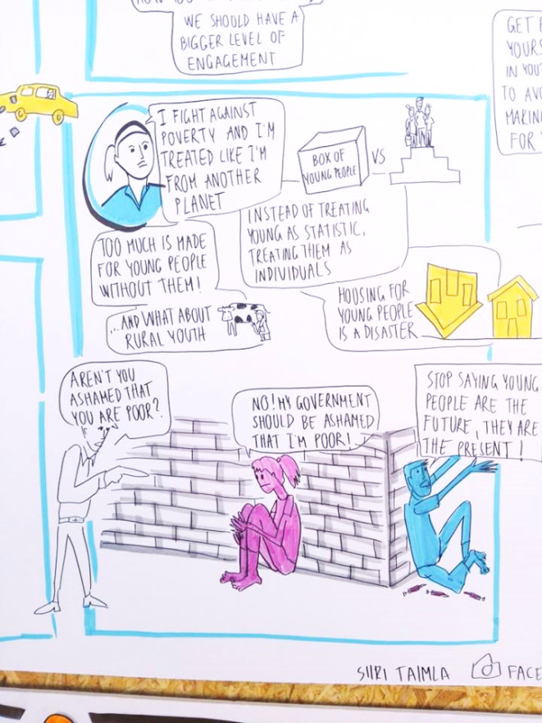
European Meetings of People Experiencing Poverty

