Slide 1
Proposals for tackling systemic barriers to social exclusion of young people in Europe
Clementine Moyart
European Youth Forum

Slide 2
Excluding Youth: A threat to our future
Youth unemployment rates are not enough to describe the situation of young people today ie. in Germany
Crisis created new forms of exclusion and insecurity for young people: cost-containments on education, social protection…
Gaps in European social protection systems!
Notes:
-Germany: highest employment rate of young people across Europe, but in 2014, it was estimated to one in five workers held a so-called ‘mini-jobs’, only partially covered by the compulsory public pension system and fully exempt from unemployment insurance
-Little is known about the actual adequacy of social protection for young people in Europe today

Slide 3
Working questions
Are Welfare states in Europe failing to protect young people? And why? Did the crisis exacerbated this?
What are the barriers in our European systems that prevent social inclusion of young people? And how to tackle them?
Notes:
-many principles of the welfare systems are taken for granted in Europe such as education or healthcare there still clear access barriers
-In principle young people can benefit from almost all types of social protection programmes but, in practice, due to numerous eligibility criteria and requirements young people are often denied access to benefits or services
-Are the specific needs of youth recognised? What are the new challenges and risks faced by young people?

Slide 4
Barriers in Accessing quality education and VET
Cuts in education Ie. In Greece in the past 6 years no new school or renovation
Difficult access to quality education for vulnerable groups:
Measures on apprenticeship and VET often fail to reach out to the most vulnerable youth :
Ie in France, enrolment has doubled over the past few decades but apprentices without prior qualifications fell from 60% to 35%
Notes:
-in 2011 and 2012 cuts in education budgets were made in 20OECD countries for which data was available

Slide 5
Proposals
Invest in life-long learning and non-formal education
Include second chance programmes available for harder to reach target groups
Enforcement of quality internships and apprenticeships and help for young people who fail to find an apprenticeship position
(ie. Supra-Company apprenticeship in Austria)
Notes:
-Non-formal education develops competences that are essential in building an inclusive society for all, particularly through its methods of cooperative and experimental learning

Slide 6
Barriers in Accessing quality jobs
Youth minimum wages (France, Belgium, Czech Republic, Ireland, The Netherlands….)
“Sub-minimum youth wages potentially conflict with the principle of equal pay for work of equal value” ILO
Precarious jobs and Contribution to pension systems
Development of new forms of work and income (self-employment, sharing economy….)
Notes:
-Definition of youth minimum wages: different, lower, level of minimum wage for those of a younger age group.
-the netherlands: 18 you would 45,5 % of the adult wage, 19 would be 52,5%... (up to 8 different rates !)
-Saving for their future?: through being engaged in non-standard forms of jobs young people are unable or less able to participate in contributory pension systems and precariousness of income also inhibits younger people to save in private pension plans.
-Collaborative economy: the rise of alternative forms of work and income generation, for instance through the collaborative econnmy brings new opportunity for young people but also challenges regarding access to social protection and worker’s rights.
-Work life balanced? Growing number of dual earners family with dual care needs both for small children and for ageing parents. Quality employment should also allow reconciliation of work and family life. Gender inequalities are still very important here!

Slide 7
Proposals
End age-based discrimination in access to minimum wages
Contributory pensions systems should be better adapted to the reality of people’s employment trajectories, ensure the possibility of banking enough working time to reach adequate income at retirement
Ensure that creative freedom of business is not detrimental to the protection of workers’ rights

Slide 8
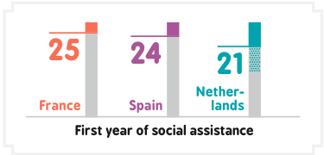
Barriers in accessing decent income
Unemployment Benefits tend to be inaccessible for young people: In most of European countries, 12 months of contributions via employment are needed
‘reduced unemployment benefits (Belgium, Greece, Luxembourg, the Uk, Denmark….) or Minimum income schemes. But….
Notes:
-Even when young people have succeeded in contributing in some ways, the prevalence of short term and precarious contracts makes it difficult for them to receive benefits that would ensure them a life out of poverty
-adequacy of these schemes: Of the approximate 13 million NEETS across OECD Countries living below the poverty line, 70% of them are in fact already recipients of some form of income support payments, which really questions the adequacy of this support

Slide 9
Proposals
Push for an ‘independence supporting approach’ !
and not a ‘stay at home’ policy:
-Limits of family benefits
-Neglect of individual circumstances

Slide 10
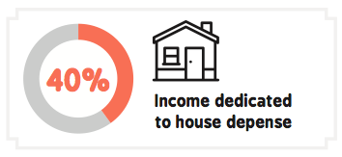
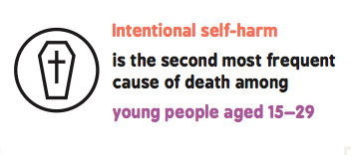
Barriers in accessing Health and Housing
Very high rental and purchase prices are main obstacles to youth independent living: ie. for 50% of young people experiencing poverty, the share of their income dedicated to housing represented more than 40%
Certain health services such as Mental health are particularly important for young people, due to specific challenges in the transition to adulthood

Slide 11
CONCLUSIONS
The distinct category of youth, with its specific needs, and new challenges not yet taken into account
Multiple discrimination against young people
Short-term decisions are prioritised vs long term and sustainable choices for Europe
Systemic changes are needed: need a forward thinking approach to ensure new safety nets and real systems that allow social INCLUSION of all young people:
➔ Need participation of young people in decision-making processes

Slide 12
THANK YOU FOR YOUR ATTENTION !
The full report is available online the website of the European Youth Forum:
http://www.youthforum.org/assets/2016/05/Excluding-youth-a-threat-to-our-future.pdf
If you want to receive an electronic version, contact me: Clementine.moyart@youthforum.org

