Slide 1

Hi there!

Slide 2




Slide 3
ENTER! (?)
Project initiated by the youth sector of the Council of Europe in 2009 aiming at the development of youth policy and youth work responses to situations of exclusion, discrimination and violence affecting young people, particularly in multicultural disadvantaged neighbourhoods.
The project promoted young people's access to social rights as a means for their inclusion and participation in society.

Slide 4
The main concerns that the project responds to are the multi-dimensional social and economic imbalances which hinder young people in accessing social human rights.
The project includes support measures for youth work practices that enhance young people's participation and for youth policies that reflect the promotion of access to social rights.

Slide 5
What happened in enter ?

Slide 6

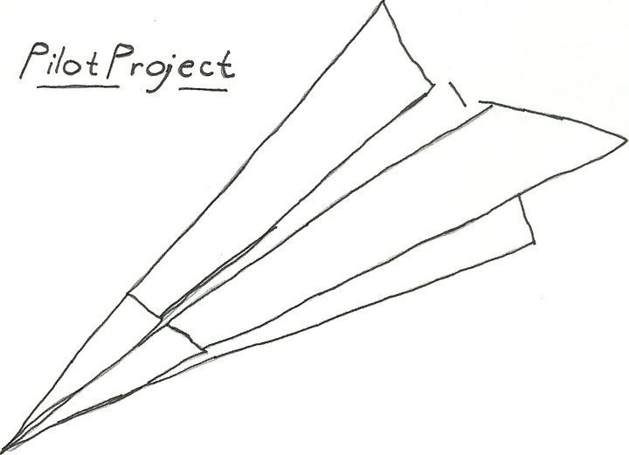
LTTC for youth workers
Developing the competences of youth workers/youth leaders to contribute to combating the social exclusion of young people in disadvantaged neighbourhoods through the development of concrete projects.

Slide 7


…
Policy recommendations
Educational tool

Slide 8


Meetings, thematic seminars, study sessions international youth activities …
Research - youth work and youth policy aspects related to access to social rights for young people.

Slide 9
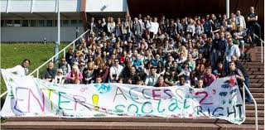
Enter youth meetings

Slide 10
What was I reminded of during ENTER ….
"All animals are equal but some animals are more equal than others".
Many young people in today’s Europe live in situations where they experience exclusion, discrimination and violence.
In the transition to adulthood, young people experience situations of socio-economic vulnerability and of fragility in their place in society.

Slide 11
What I became aware of …
The value of youth work
The importance of adequate youth policy responses to challenges faced by young people
The need for thorough research
The value of non-formal education
The power of cross-sectorial cooperation

Slide 12
…. What came out of ENTER …
Competences
Participation
Youth Social Rights Network

Slide 13
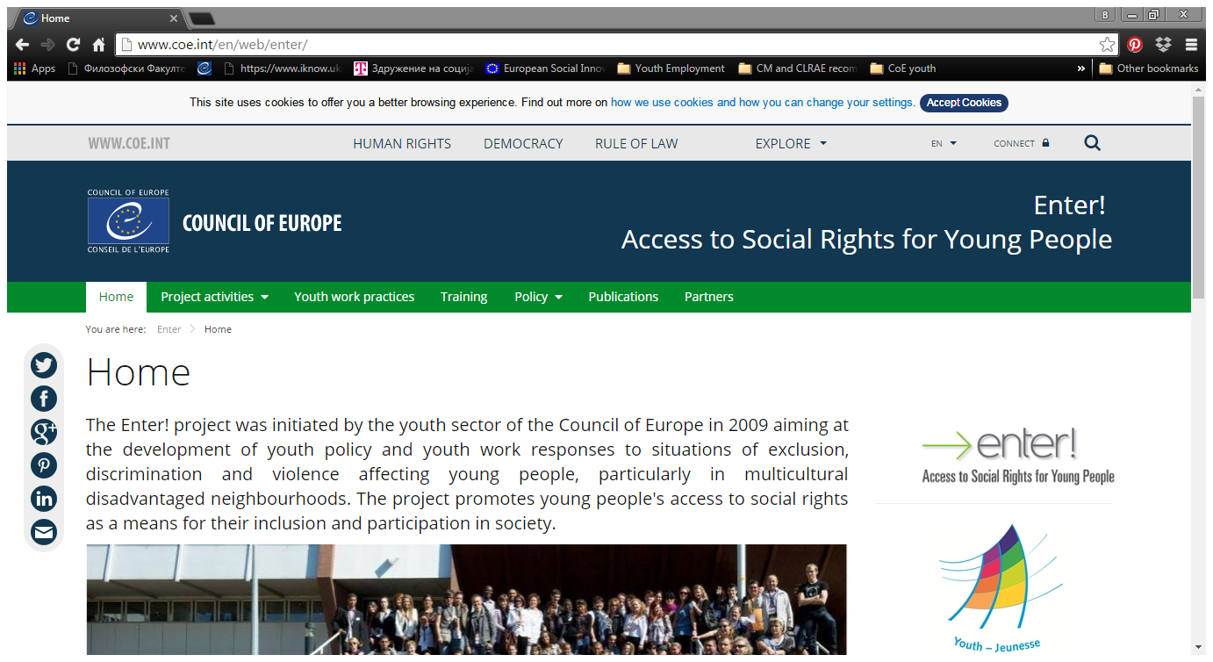
More details on ENTER! http://www.coe.int/en/web/enter/

Slide 14
Thank you
ENTER
http://www.coe.int/en/web/enter/home
Biljana Vasileska Trajkoska
Youth Social Rights Network
ysrnetwork@gmail.com
http://ysrnetwork.weebly.com/

