Slide 1
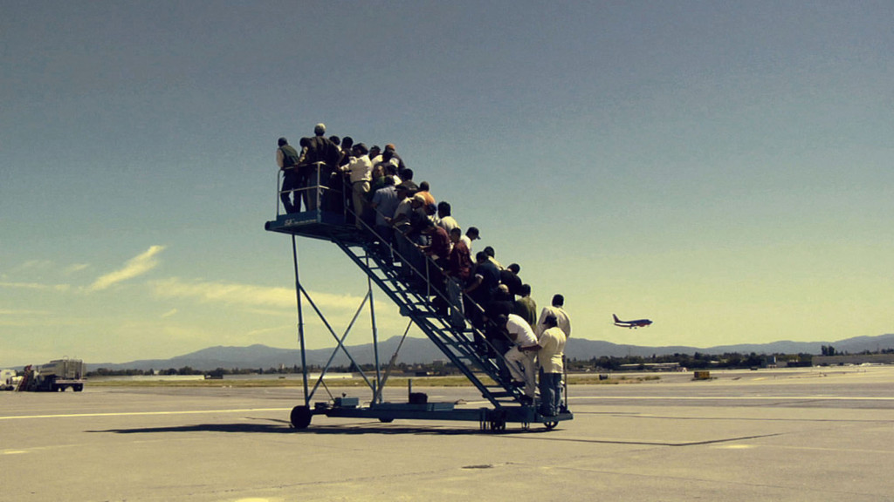
Youth perspectives on young refugees
30 May – 2 June 2016, Budapest
Barbara Giovanna Bello
The photo by Adrian Paci is retrieved from the web

Slide 2
From ‘numbers’ to ‘human beings’
In 2015, the number of people who fled their (own) homelands reached the highest peak since the second World War.
The number of first-time asylum applications within the EU-28 in 2015 was 1.26 million (from 563,000 in 2014).
“Refugees are not numbers, they are people who have faces, names, stories, and need to be treated as such”
Pope Francis

Slide 3
A «youth» issue
In 2014, young refugees constituted some 79% of all refugees, almost 4 in every 5 asylum seekers in the EU-28 being under 35 years of age
More than 23,000 unaccompanied minors (i.e. under the age of 18 and traveling alone) requested asylum in one of the EU-28 countries (Eurostat, 2015).

Slide 4
Refugee «emergency» and «crisis»
Agreement EU-Turkey entered into force on 20 March 2016 and is harshly criticized by many NGOs, which are developing advocacy strategies (hyperlink: http://www.cear.es/wp-content/uploads/2016/05/DENUNCIA-COMISION-.pdf)
Human rights violations as well as breaches of refugee law
Overcome “European exceptionalism”

Slide 5
POLICIES AT EUROPEAN LEVEL
EU Work Plan for Youth for 2016-2018
Erasmus+
Inclusion and Diversity Strategy: is designed to make it most accessible to disadvantaged young people: the integration of migrants and refugees is a priority specifically set for 2016.

Slide 6
Young people’s attitude towards refugees in Europe
Refugees and asylum seekers are considered by young European respondents among the groups at highest risk of discrimination in all areas of their life (EYF, 2014. Explorative Survey on multiple discrimination) Hyperlink http://www.youthforum.org/assets/2015/10/Multiple-discrimination-and-young-people-in-Europe.pdf

Slide 7
Young people’s attitude towards refugees in Europe
Generally speaking, available studies show that young people are sympathetic towards refugees coming to Europe and many are actively engaged in initiatives supporting newcomers.
Young people are engaged both in youth-lead initiatives and in activities run with adults

Slide 8
The last presidential election in Austria showed that the country is split in two. Analysts say that young people, together with women, urban voters in Vienna and the well-educated, were crucial to Mr Van der Bellen’s victory.

Slide 9
Places in which young people are more engaged
NGOS
UNIVERSITIES (various projects, Legal Clinics at Law schools)
Social media

Slide 10
How are young people engaged?
Awareness-raising activities: to create a critical mass to support refugees; mobilize public opinion; to tackle anti-refugees and racist resentment in societies: through docu-videos; cineforum; living libraries; campaigns
Activities directly targeting refugees: to offer different kinds of services to refugees and their children
Crowdfunding and bottom-up initiatives for refugees

Slide 11
Some snapshots on pro-refugees initiatives
“They have walked enough” (3296 members on 29 May 2016) are popular on Facebook and are taking stand in this debate (hyperlink https://www.facebook.com/kavelleettarpeeksi/?fref=ts)
“On the bride’s side” (hyperlink: http://www.iostoconlasposa.com/en/)
HilfsKonvoi (Eng: Aid Convoy): it included 140 cars being driven by activists in order to take as many asylum seekers as possible from Hungary to Austria
Online campaign “Mehr als nur flüchtig” Hyperlink: https://www.bjv.at/activities/publikation-mehr-als-nur-fluechtig/

Slide 12
More info on projects will be soon available in the «Analytical paper on refugees and asylum seekers in Europe»
Thank you very much,
Barbara

