Slide 1

http://youth-partnership-eu.coe.int
The programme
Block 1: Setting the youth policy landscape in South East Europe
Block 2: Understanding the impact: analysing the policy framework
Block 3: Looking forward: elements of successful social inclusion policies and good practice sharing
Block 4: Future Thinking: guidelines for inclusive national youth policies

Slide 2
http://youth-partnership-eu.coe.int
Social media outreach of the seminar
Facebook event page and the youth partnership page
https://www.facebook.com/events/431379943735113/?ref=2&ref_dashboard_filter=upcoming&action_history=null
Twitter hashtag: #‎Youthinclusion15‬

Slide 3
http://youth-partnership-eu.coe.int
Mapping of barriers to social inclusion for young people in vulnerable situations
From Malta to Mostar

Slide 4
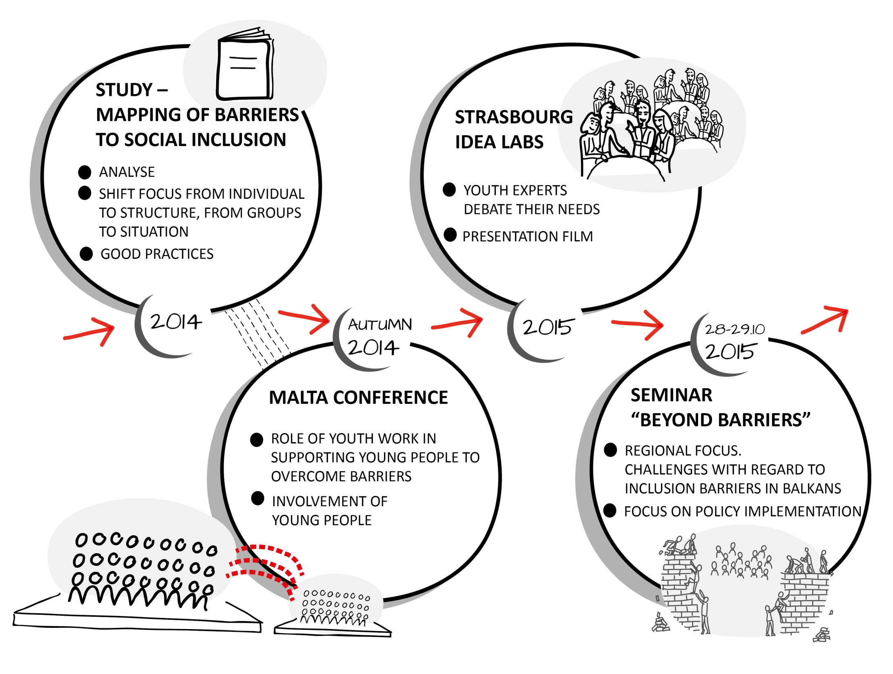
http://youth-partnership-eu.coe.int

Slide 5
http://youth-partnership-eu.coe.int
Mapping of Barriers
The purpose of a mapping of `barriers to social inclusion of young people in vulnerable situations´ is
to understand better (mechanisms, structures)
To support initiatives and programmes to strengthen rights of young people in vulnerable situations
To provide them with opportunities to equally engage in society.

Slide 6
http://youth-partnership-eu.coe.int

Slide 7


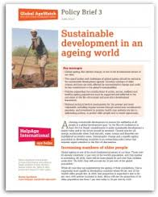
http://youth-partnership-eu.coe.int
Expected outcomes
Analytical report covering the areas of the mapping
Recommendations to youth work and youth policy
Policy brief for presenting and disseminating the final results
Notes:
Before EKCYP, few words about the Partnership on Yout

Slide 8
http://youth-partnership-eu.coe.int
What ???
From a youth perspective, social inclusion is the process of individual’s self-realisation within a society, acceptance and recognition of one’s potential by institutions and integration in the web of social relations in a community.
Study, work, culture, health, participation, well-being in general where you live.
Notes:
Before EKCYP, few words about the Partnership on Yout

Slide 9


http://youth-partnership-eu.coe.int
Who???
Groups or Individuals
Or better: situations!!!
Notes:
Before EKCYP, few words about the Partnership on Yout

Slide 10
http://youth-partnership-eu.coe.int
Barriers: where and how?
Education
Participation and belonging
Housing
Health
Employment
Structural and contextual factors
Personal factors
Notes:
Before EKCYP, few words about the Partnership on Yout

Slide 11

http://youth-partnership-eu.coe.int
Example: Employment
Structural and contextual:
Getting a job ( age, qualifications)
Working conditions (salary, temporary contracts)
Loosing a job (long term unemployment, disengagement)
Discrimination (gender, identity)
Personal
Lone parenthood and teenage pregnancy
Health problems
Family situation(education & support)
Notes:
Before EKCYP, few words about the Partnership on Yout

Slide 12
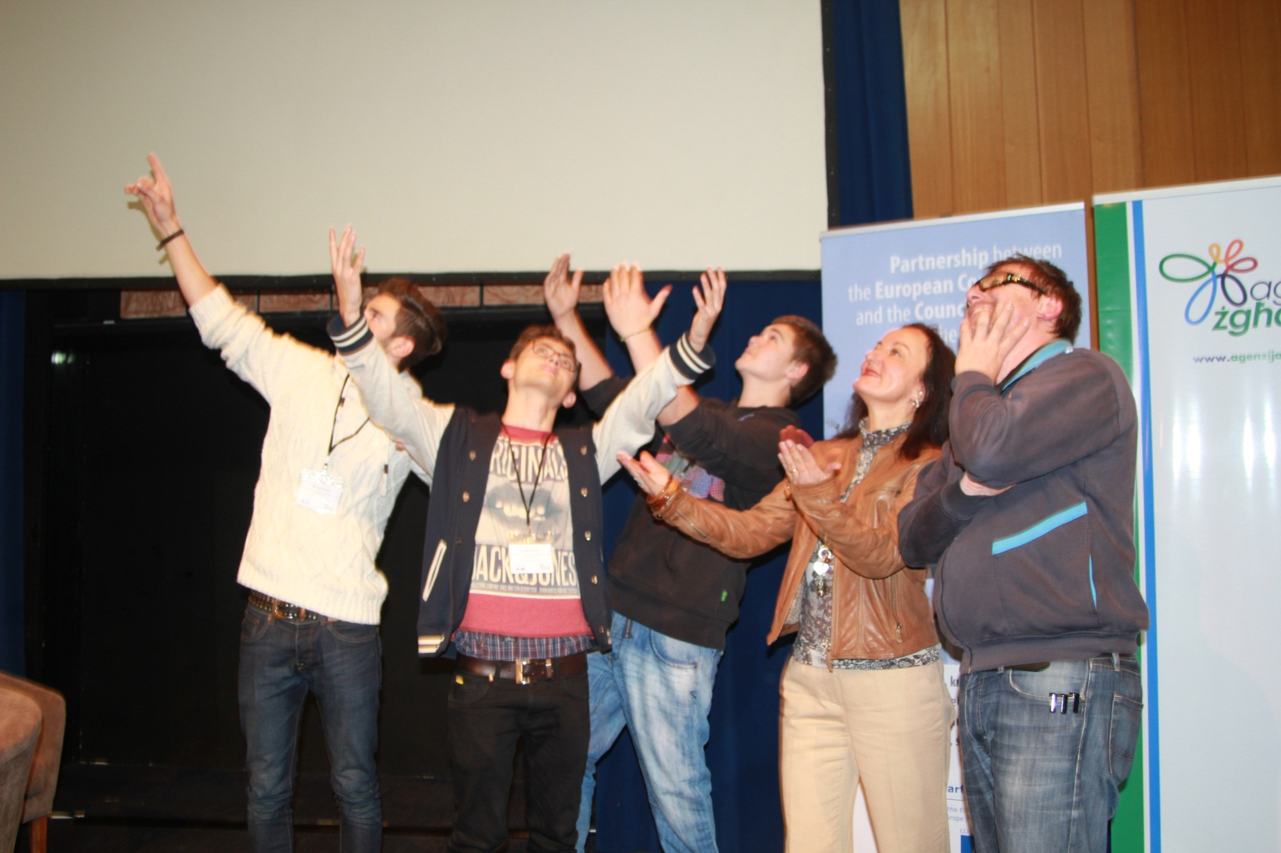
http://youth-partnership-eu.coe.int
From Malta to Strasbourg

Slide 13
http://youth-partnership-eu.coe.int
Malta conference on youth work supporting young people in vulnerable situations
Researchers, policy makers, youth workers exchange
Study presented
Malta youth experts enter the stage!

Slide 14
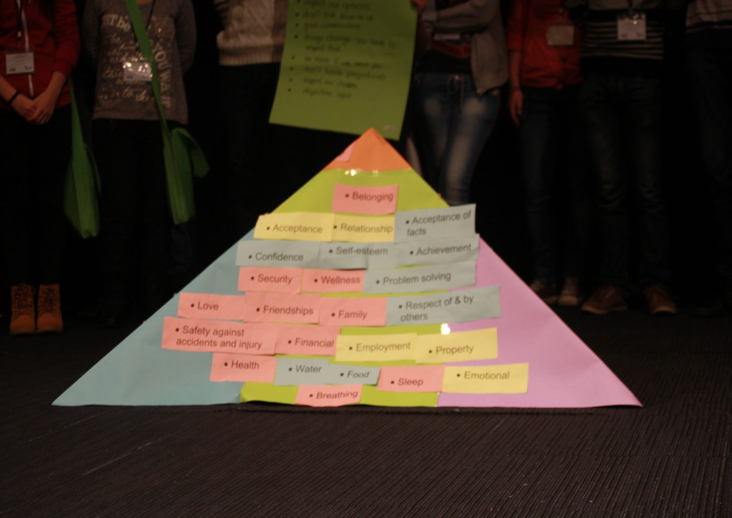
http://youth-partnership-eu.coe.int
Pyramid of needs II
Purpose

Slide 15
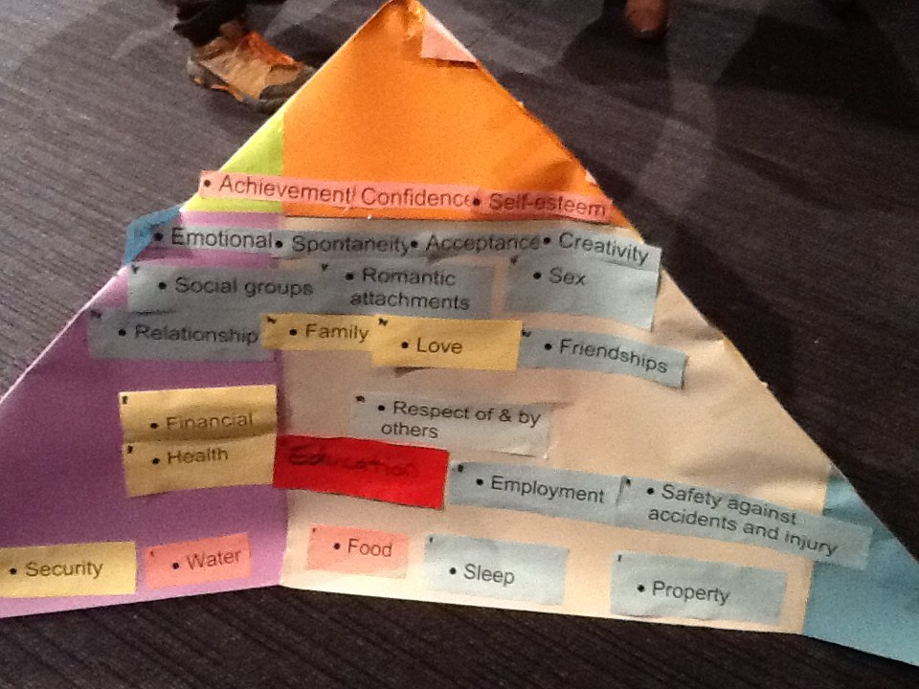
http://youth-partnership-eu.coe.int
Pyramid of needs

Slide 16
http://youth-partnership-eu.coe.int
Malta youth experts – some messages
“TAKE US SERIOUSLY - RESPECT OUR OPINIONS - DON’T LOOK DOWN ON US”
“GOOD COMMUNICATION: DON’T TALK TO YOURSELF ASK US WHAT WE WANT”
“MONEY IS IMPORTANT, BUT PEOPLE ARE MORE IMPORTANT”
“THINGS CHANGE: YOU HAVE TO ACCEPT IT!”
“BE THERE FOR US (IN CASE WE NEED YOU)”
“SUPPORT OUR CHOICES” –“LIFE TIPS BUT NO JUDGEMENTS”
GIVE US OBJECTIVE INPUTS”
“WE NEED TO COME TOGETHER AND TO TALK TO EACH OTHER”

