Slide 1
Transfer of an integrated approach for the improvement of employment prospects among Roma youth
Transfer of a project from IQ Roma Service (Brno, the Czech Republic) to HESED (Sofia, Bulgaria)

Slide 2
Actors
Health and Social Development Foundation (Sofia)
IQ Roma Service (Brno)
Notes:
In essence, the project transfers and adapts a successful and established practice developed by the IQRS in Brno to the context and needs of Roma youth in Sofia.
IQ Roma service is independent, steady, transparent and professional organization, IQRS was established as civil association in 1997.
Services are organized in two centers:
C. for prevention and personal growth
C. for education and professional career
HESED - The Health and Social Development Foundation (HESED), founded in 1998.
We provide our services in Health and Social Center for Community Development, a innovative type of social infrastructure, providing a range of social services within the Roma neighborhoods. Life skills development of adolescents;
Early child development programs:Social services targeted at pregnant women and parents of children 0-3 years;Alternative service for early childhood development for children 4-6 years who do not attend kindergartens and their parents.

Slide 3
Time line
 | February | March | April | May
Visit from Sofia to Brno
Visit from Brno to Sofia
Selection of participants
Individual employment counselling with Roma youth
Creation of a database for young Roma job seekers
Search for suitable employers and jobs for Roma youth
Notes:
The pilot started with a two-day study visit of experts from HESED, Sofia to IQ Roma Service (IQRS) in Brno. The HESED team had an opportunity to look at and learn from the original project. Experts from Brno presented their socially innovative practices and trained HESED experts to work with clients on issues like job skills training and counselling. HESED experts had a chance to observe the 13 activities taking place in the IQRS headquarters (Centre for Counselling and Employment, Ethnic Friendly Employer Concept, media campaigns and cooperation with employers, database with clients Gendalos programme). The visit helped the HESED team to plan and set up a pilot in Sofia.

Slide 4
Main activities
The pilot’s main goal: to improve the prospects of young Roma for successful employment.
employment counselling with Roma youth Health and Social Development Foundation (Sofia);
creation of a database of young Roma job seekers, employers and relevant job ads;
setting up of a network of employers interested in hiring the project participants;
Notes:
The central activity of the pilot is a cycle of individual consultation sessions. The first 1-2 sessions serve as orientation. Consultants and participants get to know each other and consultants assess participants’ skills, motivation, abilities, education and work preferences, and personal situation.
A digital database for young Roma in need of support for future employment was created through specialised software. The database includes the relevant information (educational and employment background; relevant skills; preferred employment; areas for improvement; help received during counselling sessions; jobs already applied for; contact information) of 60 Roma youths from the Fakulteta neighbourhood, who are either participants in the pilot counselling sessions, participants in other programmes run by HESED or visitors at the Health and Social Centre.
The search for suitable employers for Roma youth and the dissemination of information among potential employers started simultaneously with the consultation sessions. Contacts have been established through different channels: personal contacts, online job search platforms, career websites, company websites, industrial and business associations, branch chambers and job fairs. Special attention was given to companies with a strong corporate-social responsibility programme and which are socially active. The contacted companies are from varied industries, which are both typical and not typical for Roma workers: facility management, garbage recycling, tourism, food and beverages, education, IT and call centres. The contacted and potential employers were recorded in a database.
the individual employment counselling with Roma youth and creation of a database of young Roma job seekers, employers and relevant job ads. The main area these activities address is employment, but the project also has a long-term potential to increase social capital and contribute to the social trust, especially between the network of employers and young Roma job seekers.

Slide 5
Transfer adaptations
IQRS | HESED
participants come on their own with clear purpose and goal; | Recruitment of the participants- dissemination and advertisement
no need to devote time and energy to additionally motivate the clients to participate | Lack of punctuality and wavering motivation of participants.
do not have a specific number of sessions to attend | The clients to complete a cycle of 8-10 sessions
Notes:
In the original project in Brno, the high level of dedication and motivation are a necessary condition for participation in the training programme. The programme participants come to the Centre on their own with clear purpose and goal and there is no need for the personnel to devote time and energy to additionally motivate the clients to participate.
This approach could not work in Sofia, where the service was offered for the first time and people in the neighbourhood were still unfamiliar with it. Due to tight schedule, a planned group of 10 participants had to be assembled rather quickly. For this reason, dissemination and advertisement became a crucial addition to the original work plan at the start of the pilot.
The planned selection criteria had to be altered. Even after the consultations started, the personnel had to deal with problems of lack of punctuality and wavering motivation of participants.

Slide 6
Participants in the counselling programme
Attended between 1 and 20 counselling sessions | 13
Expressed interest, but did not attend any sessions | 5
Education:
University Finished secondary school Attended secondary school, but have not finished Finished primary school Attended primary school, but have not finished Not gone to school at all | 0 3 1 2 6 1
Work experience:
Considerable Some None | 2 9 2
Skills/qualifications:
None Vocational skills Musical skills Foreign language MS Office | 9 2 2 2 1

Slide 7
Counselling programme
13 participants started consultations
1-3 sessions: 5 participants
5 sessions: 1 participant
7 sessions: 2 participants
10 sessions: 3 participants
12 sessions: 1 participant
20 sessions: 1 participant
3 started to work within the project
Notes:
13 participants started consultations. however, five participants stopped visiting the consultation sessions soon after the first few appointments.
Those participants who have found work through the project have shared their need to receive support and advice on how to adapt to the work environment and establish relationship with co-workers. The issues of work discipline, discrimination, conflict resolution, changes of attitudes and stereotypes also came up. They continued to visit their consultant.
Another interesting fact is that in some cases, consultants also visited participants in their homes. Both women who started work through the project are mothers and it was essential for the consultants to meet with the families and discuss with them what help and support they were able to provide (for example, looking after the children while the women are at work).
Another cultural-specific aspect of employment among Roma, which came out of the counselling sessions, was the influence of the man in the family on the woman’s decisions whether to work or not. The Roma community in Bulgaria is still rather patriarchal and having a job may not be culturally acceptable for a woman. For example, women who work may be considered promiscuous. Several female clients reported this issue with their partners and were counselled on how to approach it.

Slide 8
Employers
26 contacted companies:
Two offered employment to pilot participants and hired three of them.
One of these two employers later recommended HESED as a reliable organization.
14 agreed to be contacted again in the future and to inform HESED in case they have appropriate vacancies.
3 have rejected any cooperation and declared that they do not hire people with Roma origin.
Notes:
The target of 20 employers was exceeded and 26 companies were contacted. Contacts have been established through different channels: personal contacts, online job search platforms, career websites, company websites, industrial and business associations, branch chambers and job fairs. Special attention was given to companies with a strong corporate-social responsibility programme and which are socially active. The companies were from different sectors: facility management, waste processing and recycling, tourism, food and beverages production, education, IT and call centres. The contacted and potential employers were recorded in a database.

Slide 9
Digital database
Relevant information for 60 Roma youths
educational and employment background;
relevant skills; preferred employment;
areas for improvement;
help received during counselling sessions;
jobs already applied for;
contact information
Notes:
A digital database for young Roma in need of support for future employment was created through specialised software. The database includes the relevant information (educational and employment background; relevant skills; preferred employment; areas for improvement; help received during counselling sessions; jobs already applied for; contact information) of 60 Roma youths from the Fakulteta neighbourhood, who are either participants in the pilot counselling sessions, participants in other programmes run by HESED or visitors at the Health and Social Centre.

Slide 10
Conclusions
Learning form established practice saved time, as strategies, content and tools were “copied” and adapted to the local circumstances rather than created anew.
Such kind of programme has the potential to increase social capital and social trust empowering young Roma to by providing them with a chance to fully participate in the society by increasing their abilities.
We see this program as a complimentary activity to the programs we already developed based on our experience working with Roma, a further step we are about to make together with them.
Notes:
Learning form established practice saved time, as strategies, content and tools were “copied” and adapted to the local circumstances rather than created anew.
Such kind of programme has the potential to increase social capital and social trust empowering young Roma to by providing them with a chance to fully participate in the society by increasing their abilities.
But our experience also proved that a lots of efforts need to be invested in preparing the young Roma, to make them ready to be willing to be involved. We see this program as a complimentary activity to the programs we already developed based on our expirinece working with Roma, a further step we are about to make together with them.

Slide 11
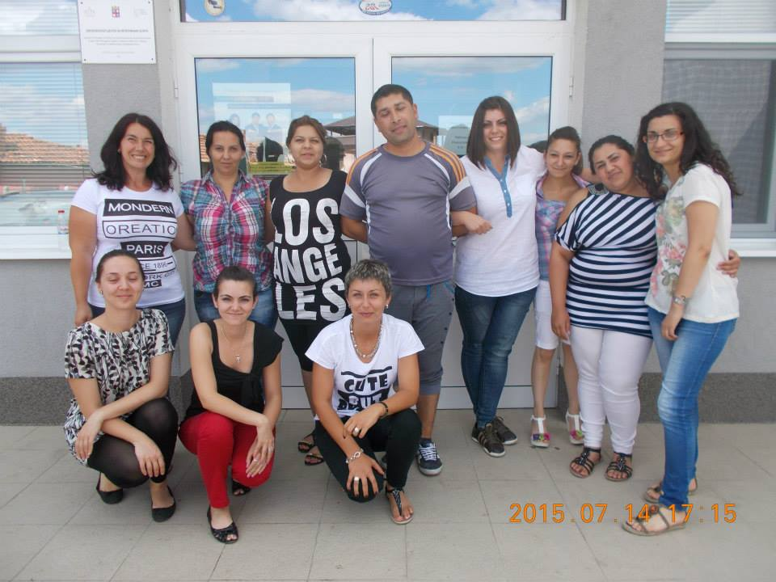
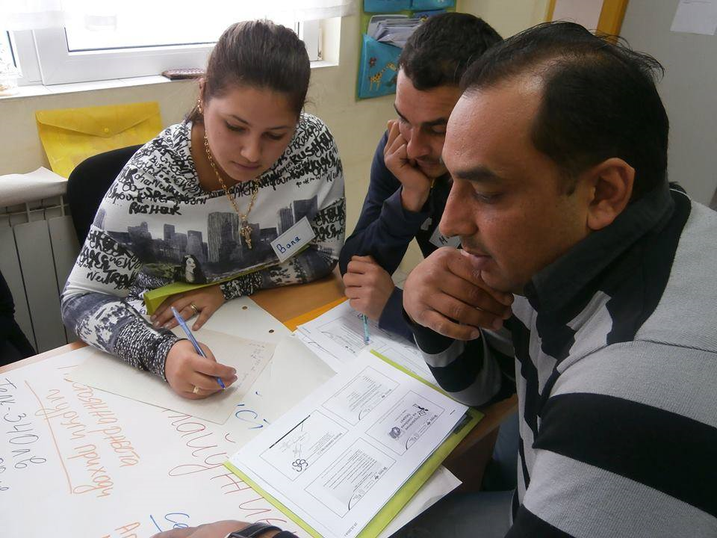
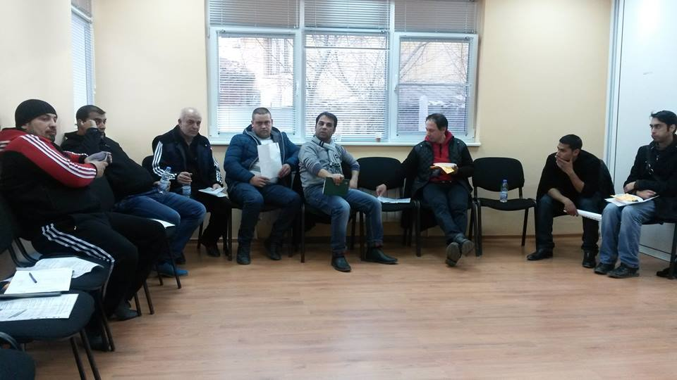

Slide 12
www.hesed.bg
www.iqrs.cz

